Slide 1
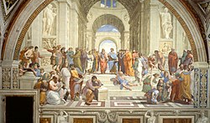
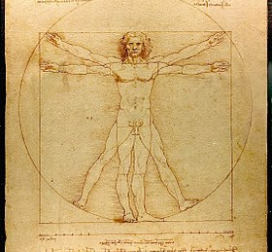
HUMANISM AND RENAISSANCE
MARÍA SANZ
IES SAN JUAN BAUTISTA

Slide 2
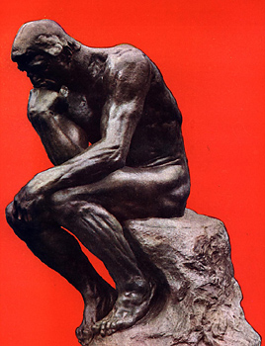
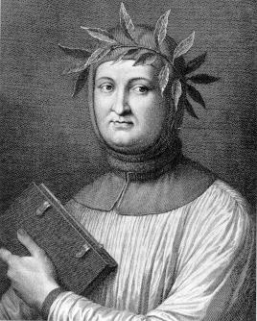
An intellectual movement that focused on INDIVIDUALS instead of religious issues.
MAIN CHARARACTERISTICS WERE:
- ANTHROPOCENTRIC POINT OF VIEW OPOSSED TO A RELIGIOUS CONCEPTION OF LIFE.
- REASON AND EXPERIMENTATION ARE THE BASE OF SCIENCE.
- THEY WERE INSIPIRED IN GREK AND ROMAN MODELS.
- BOOKS BEGAN TO BE WRITEN IN MODERN LANGUAGES.
HUMANISM

Slide 3
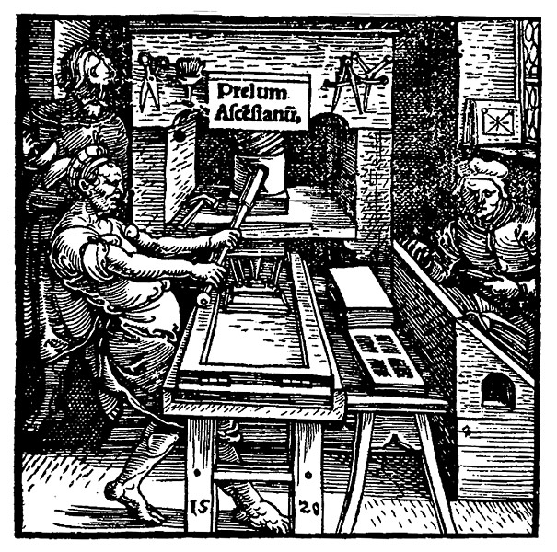
SPREAD OF HUMANISM
GUTENBERG INVENTED THE PRINTING PRESS IN 1440 SO BOOKS COULD BE PRODUCED IN LESS TIME AND WERE CHEAPER. THEN, IDEAS EXPANDED QUICKLY.
CLASSICAL CULTURE WAS STUDIED IN ACADEMIES AND UNIVERSITIES LIKE VIENNA, BOLOGNA OR ALCALÁ DE HENARES.
HUMANISTS EXCHANGED IDEAS BY TRAVELLING AND SHARING WRITTEN CORRESPONDENCE.

Slide 4
PETRARCH
PETRARCH WAS AN ITALIAN WRITER
WHO CHOSE TO WRITE IN ITALIAN RATHER
THAN LATIN.
HIS POEMS WERE ABOUT BEAUTY,
LOVE AND LIFE, NEVER ABOUT DEATH.
MAN SHOULD CARE ABOUT LIFE ON
EARTH AND NOT ABOUT HEAVEN AND HELL

Slide 5
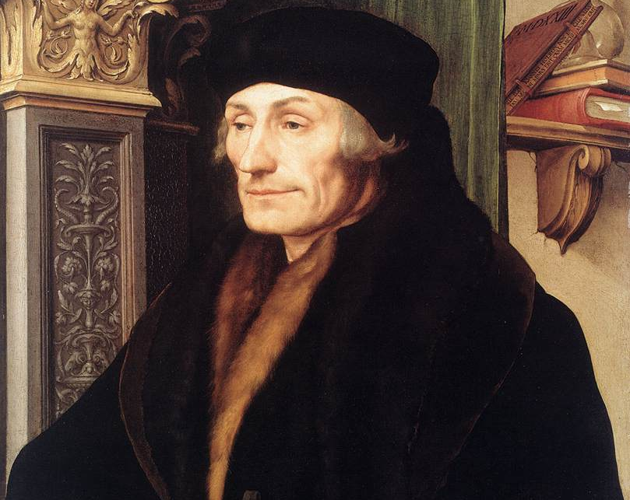
ERASMUS OF ROTTERDAM
HE WAS A DUTCH HUMANIST AND
LIVED IN HOLLAND IN THE 16TH CENTURY.
HE WROTE THE BOOK CALLED
“IN PRIASE OF FOLLY” AGAIST THE CHURCH
AND SUPERTITIONS PEOPLE BELIEVE IN.
HE ALSO SUPPORTED THE IDEA OF
TRANSLATING THE BIBLE INTO COMMON
LANGUAGES

Slide 6
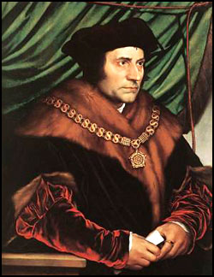
THOMAS MORE
He was an Englishman contemporary to
Erasmus.
His most famous book is titled Utopia, It
was about a country where people were not poor,
where everybody was free and without wars.
However this country does not exist, then I
Used this to analyze the society I lived in.

Slide 7
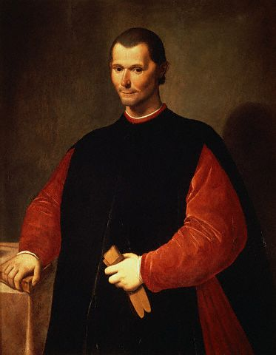
Political Ideas of the Renaissance
Niccolò Machiavelli
“The Prince”
Machiavelli observed city-state rulers of his day and produced guidelines for the acquisition and maintenance of power by absolute rule.
He felt that a ruler should be willing to do anything to maintain control without worrying about conscience.
Niccolò Machiavelli

Slide 8

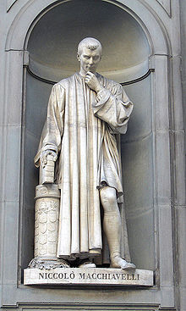
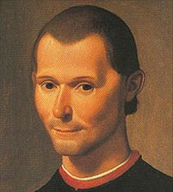
Machiavellian
Niccolò Machiavelli (1469 - 1527)
The Prince (1513)
Better for a ruler to be feared than to be loved
Ruler should be quick and decisive in decision making
Ruler keeps power by any means necessary
The end justifies the means
Be good when possible, and evil when necessary

Slide 9
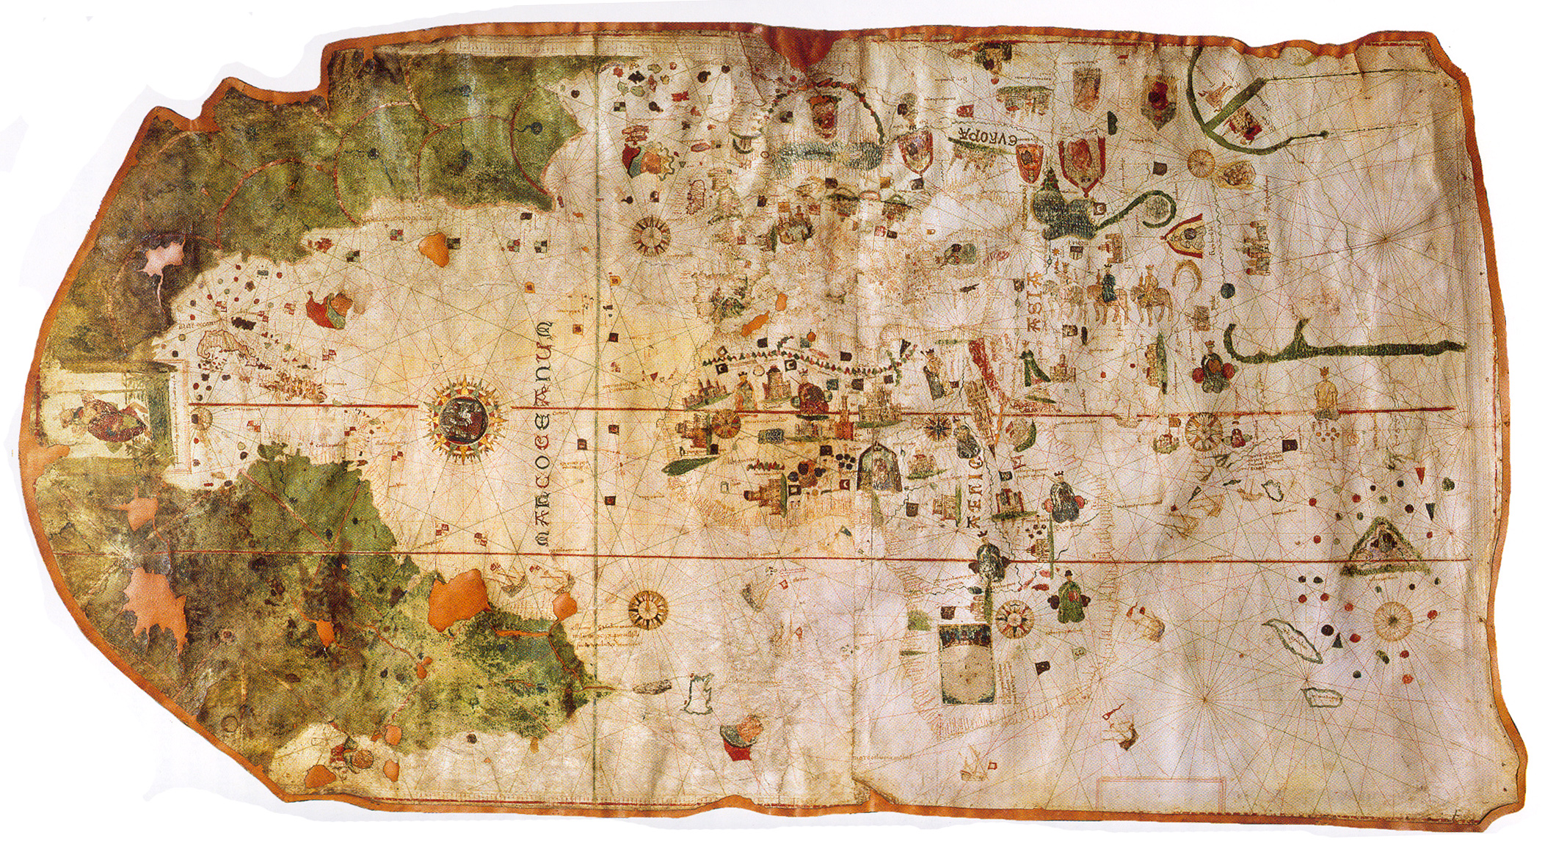
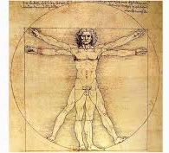
THE NEW SCIENCE
IN THE MIDDLE AGES CLASSICAL IDEAS WERE NOT QUESTIONED. HOWEVER, IN THE RENAISSANCE EVERYTHING WAS BASED ON EXPERIMENTS TO BE PROVEN.
SCIENCES DEVELOPED MAINLY ASTRONOMY, MEDICINE AND PHYSICS.
GEOGRAPHICAL DISCOVERIES IMPROVED CARTOGRAPHY AND BIOLOGY.

Slide 10
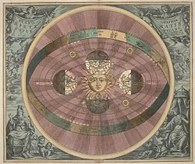
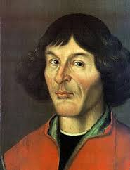
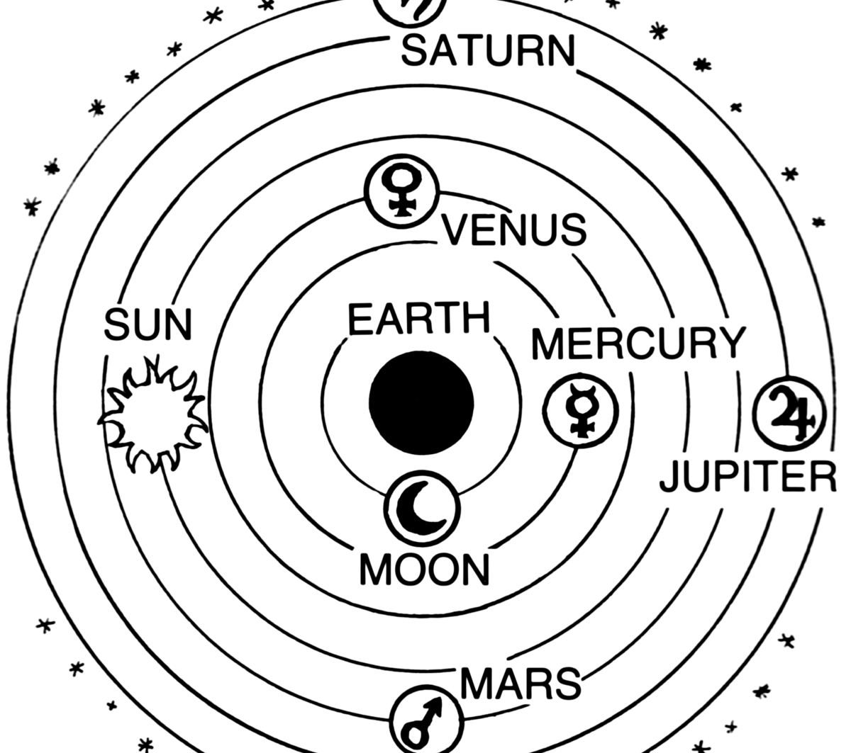
ADVANCES IN ASTRONOMY
Copernicus published the Revolution of the Revolutions of the Heavenly Spheres stating the heliocentric theory. Copernicus believed the Sun was the centre of the universe.
However, his theory was against of the geocentric theory promoted by the Catholic Church. Geocentric theory was based on the idea that the Earth was the centre of the universe

Slide 11
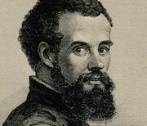
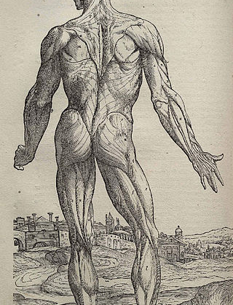
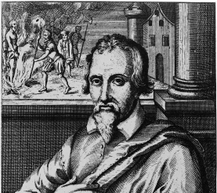
The new medicine
Andreas Vesalius was a Flemish anatomist .
Vesailus conducted public dissections and created detailed illustrations of anatomy for students in the form of six large woodcut posters.
Vesalius created human skeleton for scholars to study it.
Miguel Servet discovered the pulmonary circulation of blood.

Slide 12
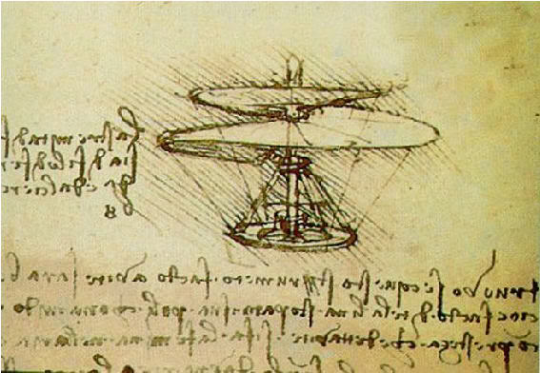
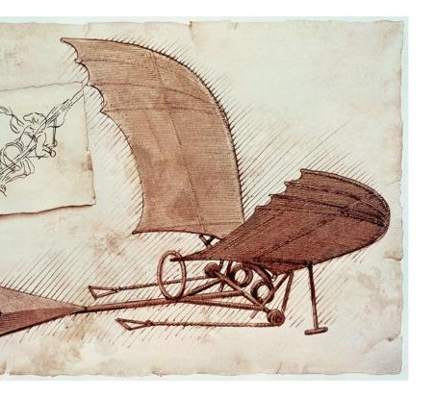
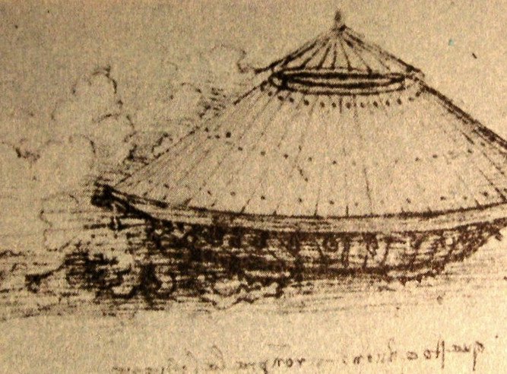
Discoveries in physics
The main advances were related to hydraulic and aerodymic and were made by Leonardo da Vinci.
Da Vinci created new inventions such windmills, the flying machine as well as tanks and warships.

Slide 13
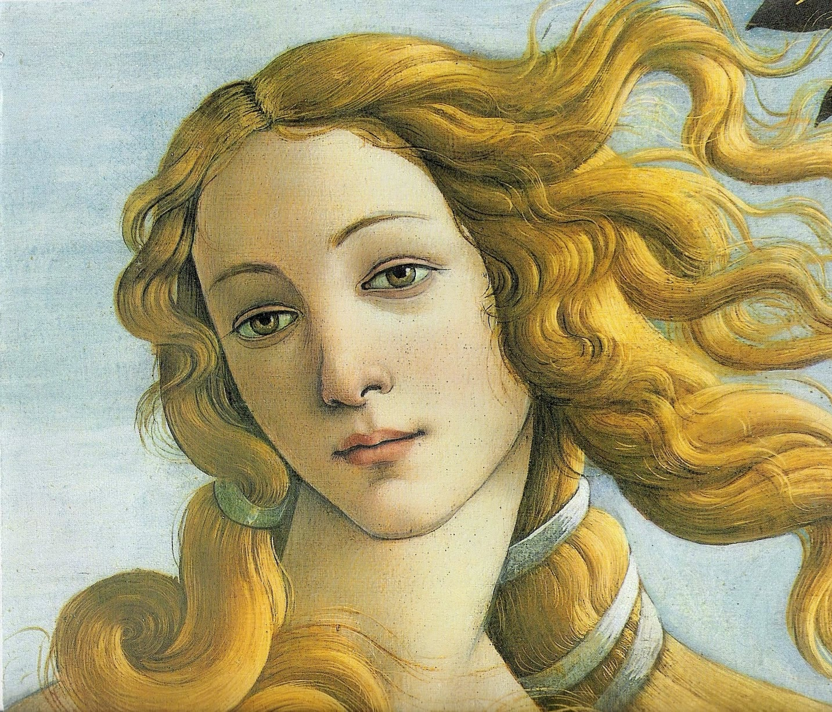
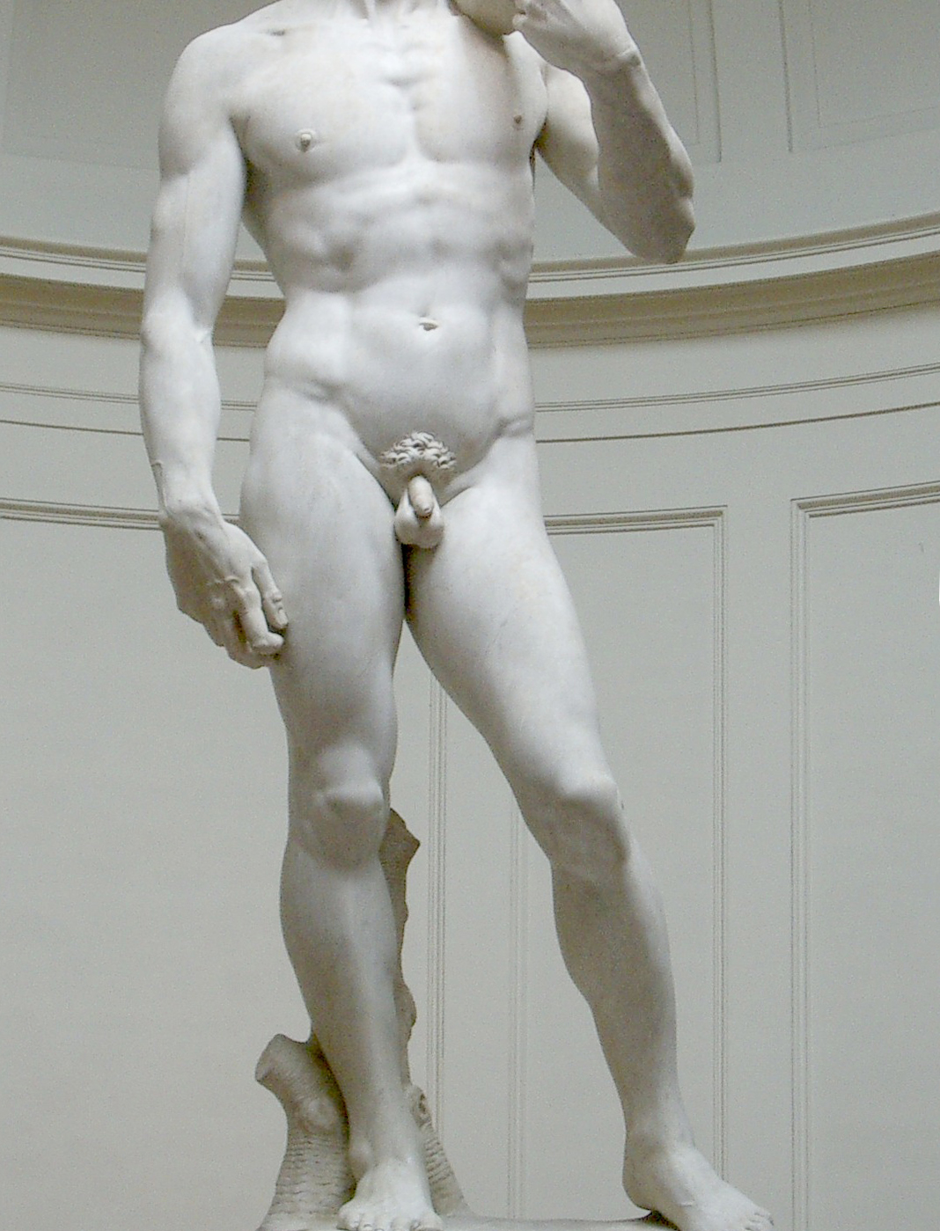
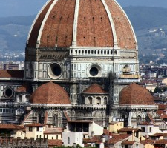
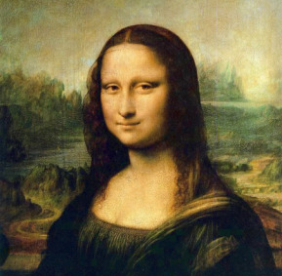
Renaissance
Renaissance art was completely opposed to the Medieval art based on religious scenes and topics. Renaissance artists were interested in secular themes and their main interest was human being.
Art was based on idealized beauty and was inspired in ancient Greek and Roman models.
Art was influence by ideas of proportion and harmony

Slide 14
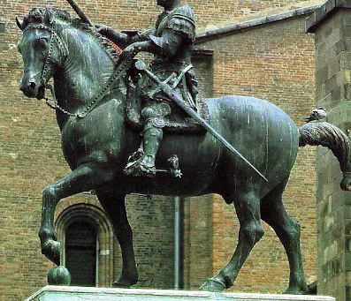
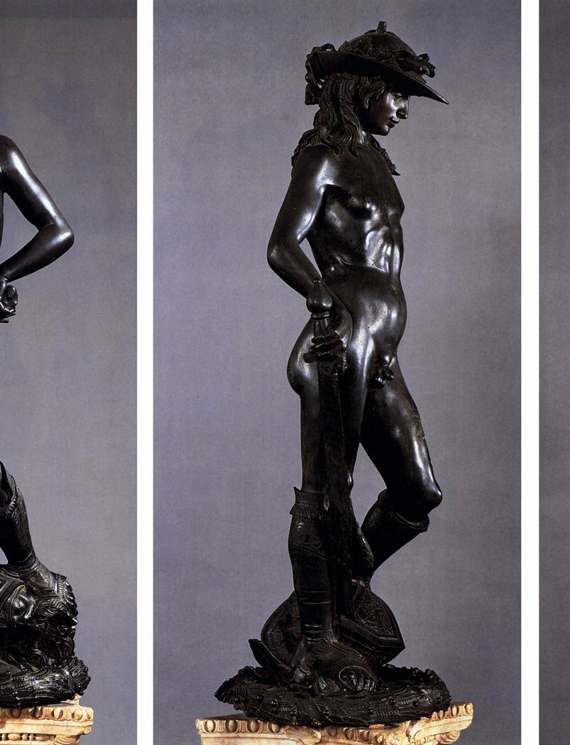
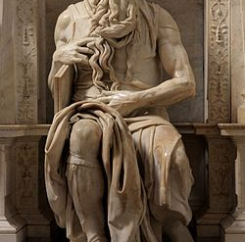
Chronology and periods
Renaissance began in Italy at the end of the 13th century.
Italian Renaissance was divided into two periods:
Quattrocento occupied the 15th century and the main artistic centre was Florence
Cinquecento or High Renaissance developed in the 16th century. Rome became the most important artistic centre.

Slide 15
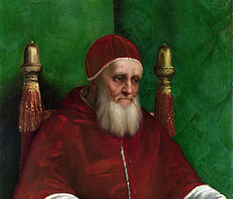
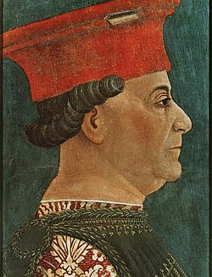
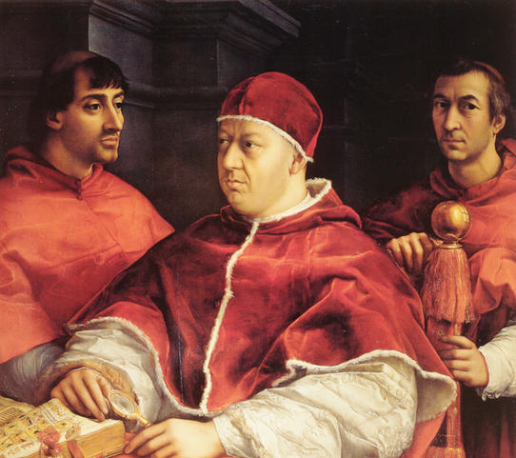
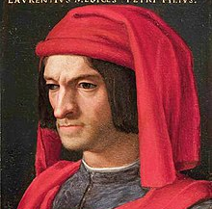
patrons
The wealthiest Italian families – nobles and burghers - appreciated art and education.
They were prosperous and rich so they sponsored artists and invested fortunes in their palaces and local churches.
In the Quattrocento families like the Medici in Florence, the Sforza in Milan and the Gonzaga in Mantua financed art and artist.
In the High Renaissance the main patrons were the Popes Julius II and Leo X.
Artists became popular and famous, something completely different from the Middle Ages when artists mainly were anonymous.

