Slide 1
The Protestant
Reformation (I) :
Lutheranism and Calvinism
María Sanz

Slide 2
What is the Protestant Reformation?
A movement in Europe in the 1500’s when reformers caused a break in church unity.
Caused by:
  Church became corrupt during the Renaissance
  The Pope’s luxurious lifestyle and political power
  Sale of indulgences – lessening of the time a soul had to spend in purgatory

Slide 3
What is the Protestant Reformation?
Recognition that the Catholic church needed change
Period of change in religious thinking
Protestant separation
  Creation of non-Catholic Christian churches

Slide 4
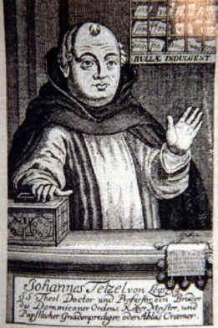
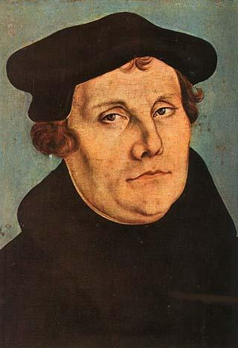
Martin Luther’s Protest
Johan Tetzel- (preacher) said indulgences gave entrance to heaven for buyers and their dead relatives.
Used money collected from sale of indulgences to build the Cathedral of St. Peter in Rome
Martin Luther – (German monk) protests the sale of indulgences
VS

Slide 5
What are some of the causes of the Protestant Reformation?
Church corruption
Church worldliness
Sale of indulgences

Slide 6
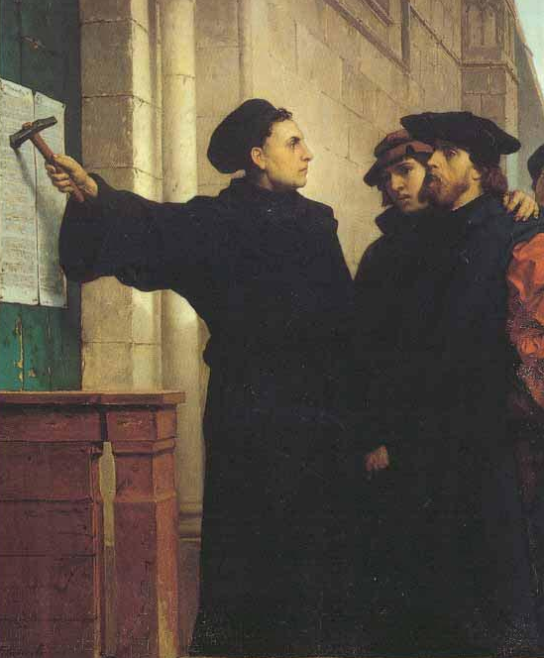
95 Theses
Luther writes 95 Theses and posts it on door of Church of Wittenberg

Slide 7
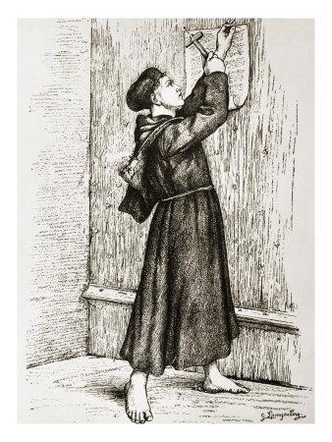
95 Theses (cont.)
Major Points
Indulgences have no place in Bible, salvation through faith alone
Bible is only source of religious truth
Everyone have equal access to God and Bible – translates into vernacular
Pope has no authority to release souls from purgatory

Slide 8
Luther v. The Church
1521 – Pope asks Luther to recant
Luther refuses, pope excommunicates him
HRE Charles V summons Luther to the Diet at Worms to explain his views
When Luther arrives, he is asked to recant, Luther refuses and is declared an outlaw

Slide 9
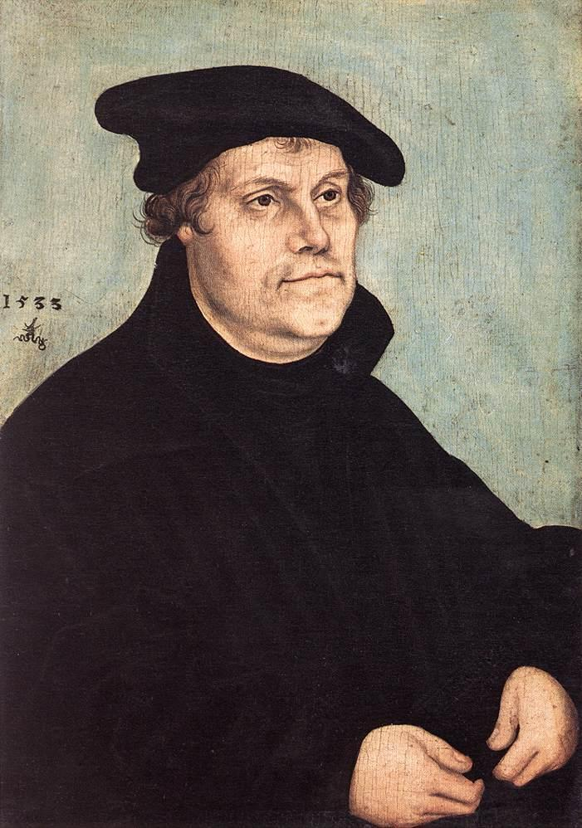
Martin Luther
Religious Implications
  Pope did not speak for God
  Church and priesthood not necessary for salvation
  God’s grace given to all who seek it
Political Consequences
  Peasant war
  Northern Europe became Protestant

Slide 10
Luther’s Ideas Spread
Lutherans become known as Protestants.
Peace of Augsburg: allowed each German prince to decide what religion would be followed in their land

Slide 11
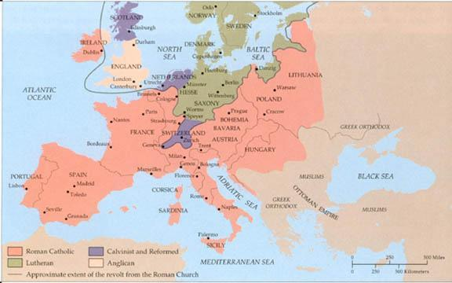
Europe after the Reformation

Slide 12
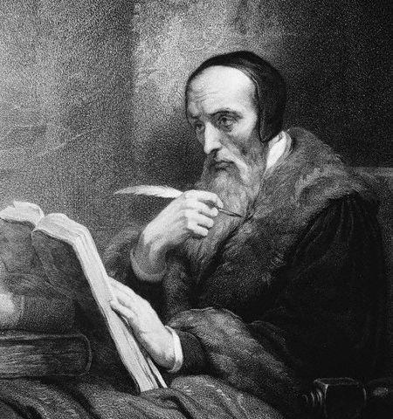
John Calvin
French lawyer and priest
Beliefs:
  Salvation is earned through faith alone
  Predestination: God has already determined who will achieve salvation
  World divided into two groups saints and sinners
    Believed that only those who were saved (saints) could live truly Christian lives
Set up theocracy in Geneva, Switzerland
Designed to be the ideal Protestant community
  Strict punishment for breaks in “morality” (laughing in church, dancing, fighting or swearing)

