Slide 1
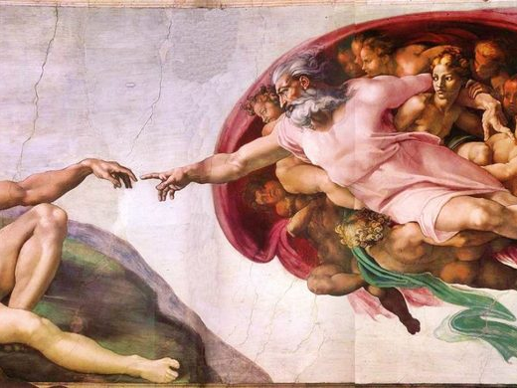
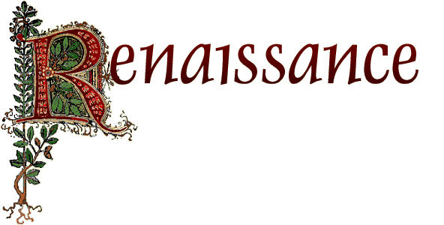
MARÍA SANZ
IES SAN JUAN BAUTISTA

Slide 2
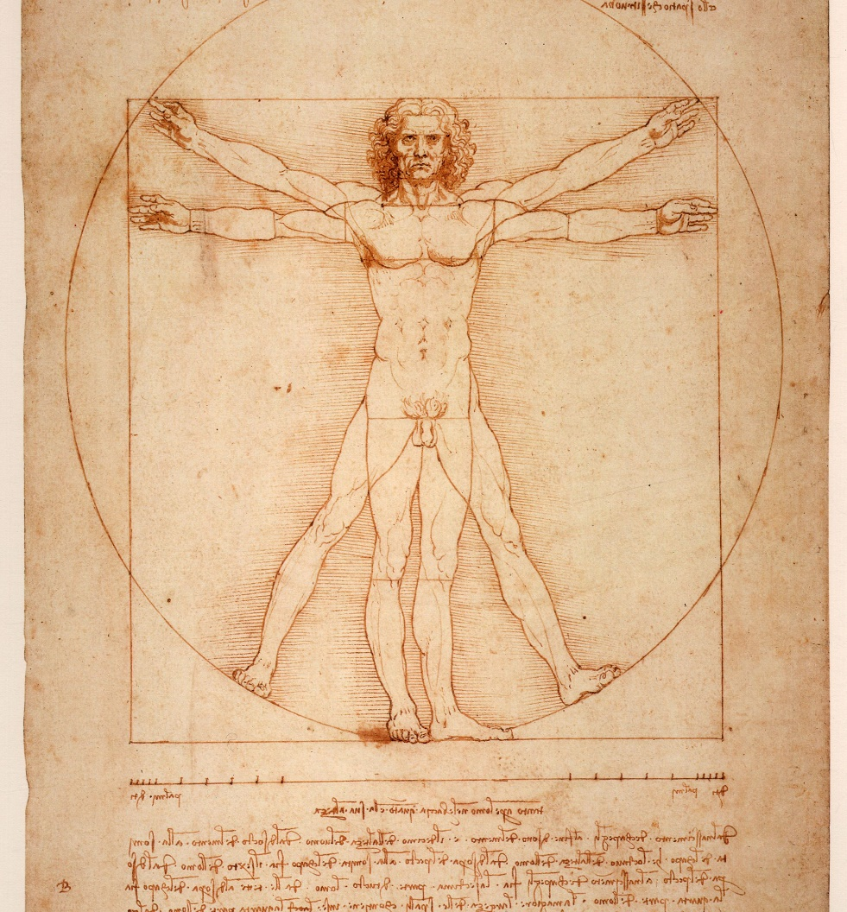
Renaissance
Means REBIRTH
Rebirth of art and learning
Began in northern Italy

Slide 3
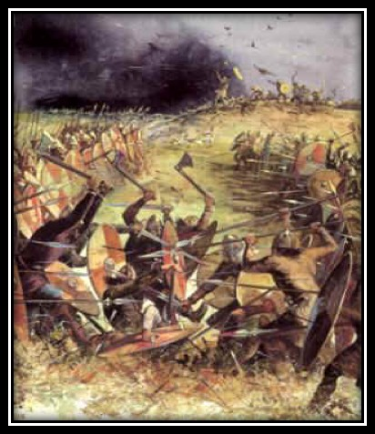
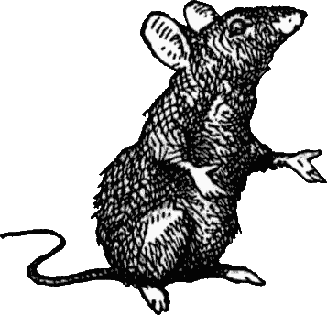
Contrast to grimness of the Middle Ages
Wars
Plagues
Spend life preparing for the afterlife
Decreased power of the church

Slide 4
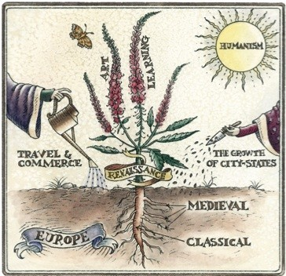
A Visual Metaphor of the Renaissance

Slide 5
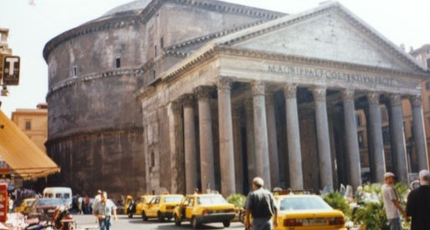
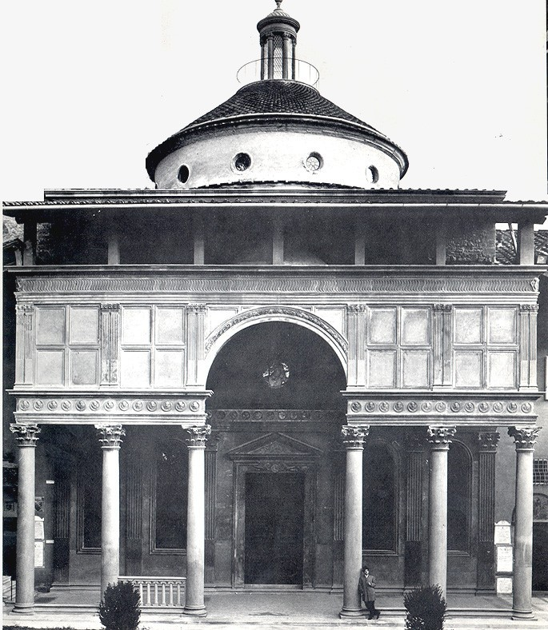
What was the Renaissance?
Period following the Middle Ages
“Rebirth” of classical Greece and Rome
1st period to name itself and say bad things about earlier times (Dark Ages)
NAMES FOR ARTISITS
Began in Italy
Moved to northern Europe and Spain

Slide 6
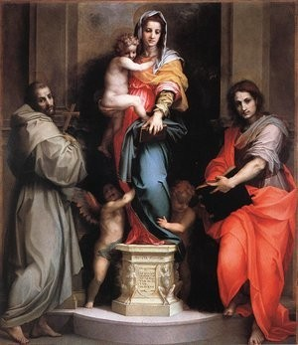
Economic Foundations
Increased demand for Middle Eastern products
Encouraged the use of credit and banking
Letters of credit expanded supply of money and sped up trade.
New accounting and bookkeeping practices used Arabic numerals

Slide 7
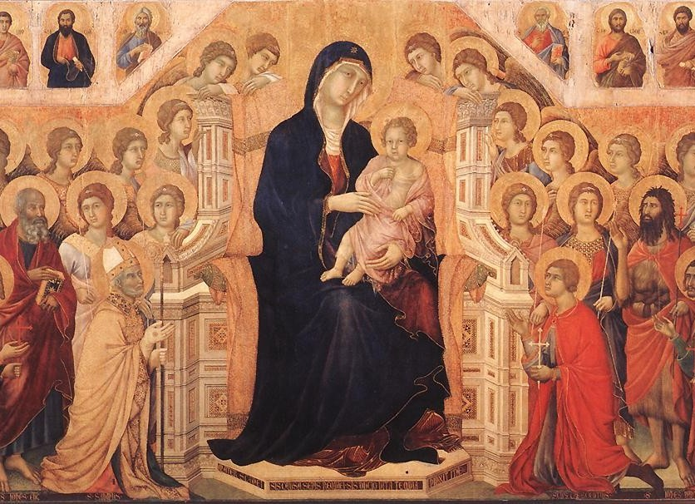
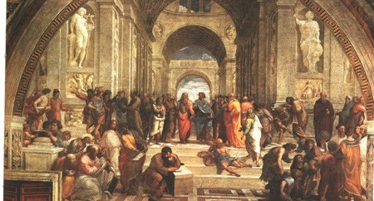
Main ideas
During the Middle Ages
Find God
Prove pre-conceived ideas
During the Renaissance
Man as the center of the universe
Promote learning and experimentation in science.

Slide 8
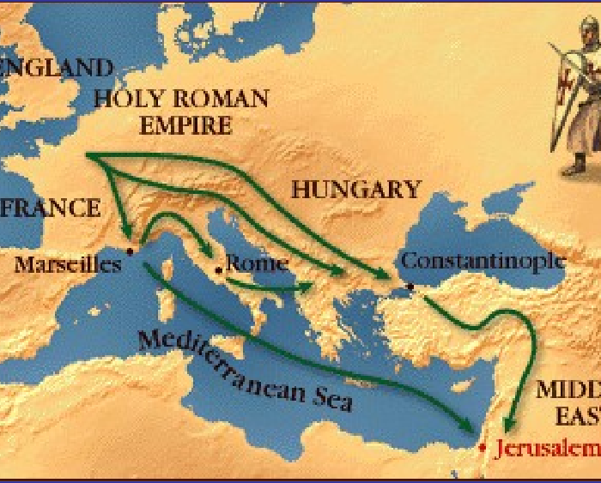
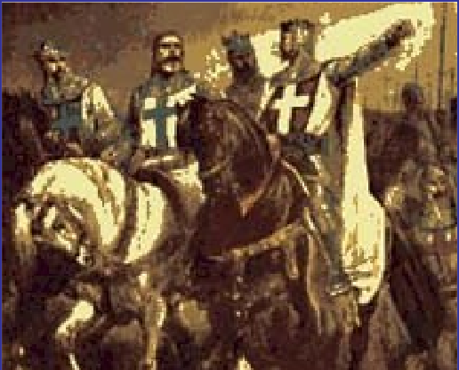
Causes of the Italian
Renaissance
Crusades
Control of Mediterranean Trade

Slide 9
Growth of the Trade and Commerce
Influence of City States
Trade = Wealth
Crusades connect with Muslims
Rich Families Support Arts
Muslims introduce new ideas
Cities and Merchants grow
Beginning of the Renaissance in Europe
Tried to improve on old things
“Humanities” in Education
Greece and Rome
Change ideas about government, religion, social class
The Growth of Humanism

Slide 10
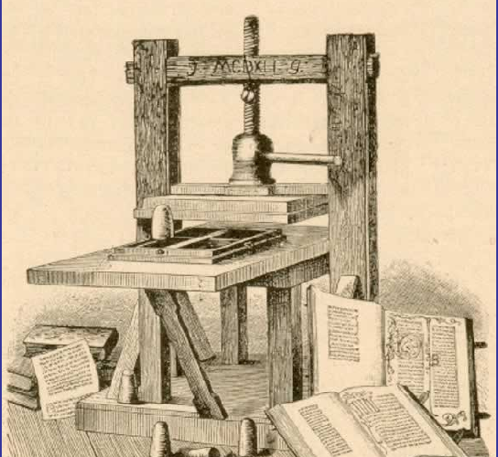
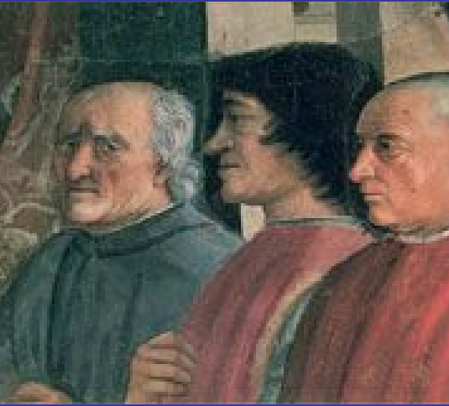
The printing press perfected by Gutenberg helped the spread of books, ideas and art Works. This “invention” contributed positively to the extension of Humanism

Slide 11
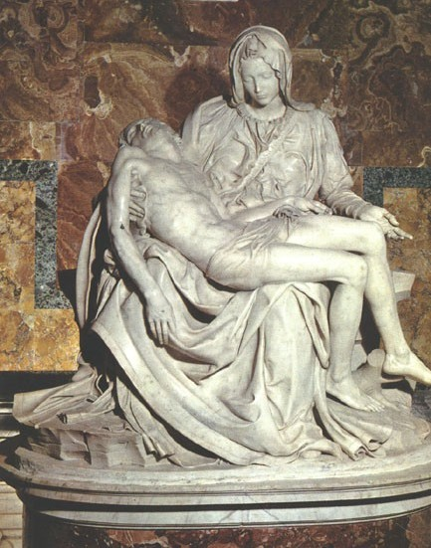
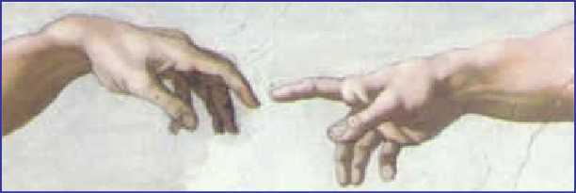
Renaissance Art
perspective
light & motion
study of human form
emotion & drama
new subject matter>secularism
science & mathematics
composition & balance
changing perspective of man & his role in the world
unique vision of each artist

Slide 12
Effects of the Renaissance
Advances in Science & Technology led to the European Exploration of the World
Secularism led to the Protestant Reformation
Humanism encouraged the growth of Democracy & the Fight for Human Rights
Role of Women in Society Improved
Renaissance Art led to the Age of Classical Music and Art in Europe

Slide 13
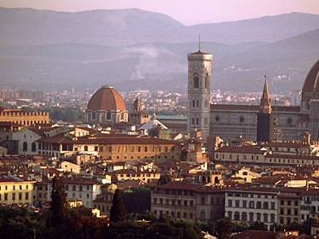

Slide 14

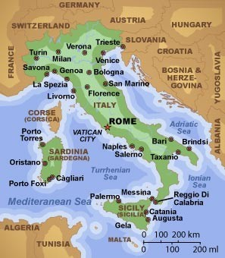
Italy
Italian city-states became rich from trade:
  Florence
  Venice
  Genoa
They were trading centers for the distribution of goods to northern Europe.
Independent city-states governed as republics by wealthy merchants.

Slide 15
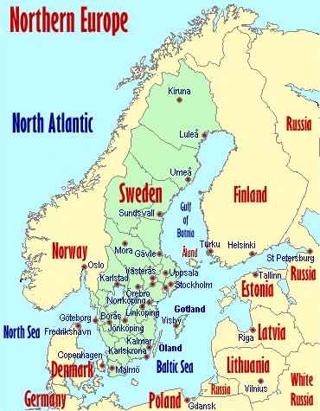
Renaissance
With the rise of trade, travel and literacy, the Italian Renaissance spread to northern Europe.
The art and literature changed as people of different cultures adopted Renaissance ideas.

Slide 16
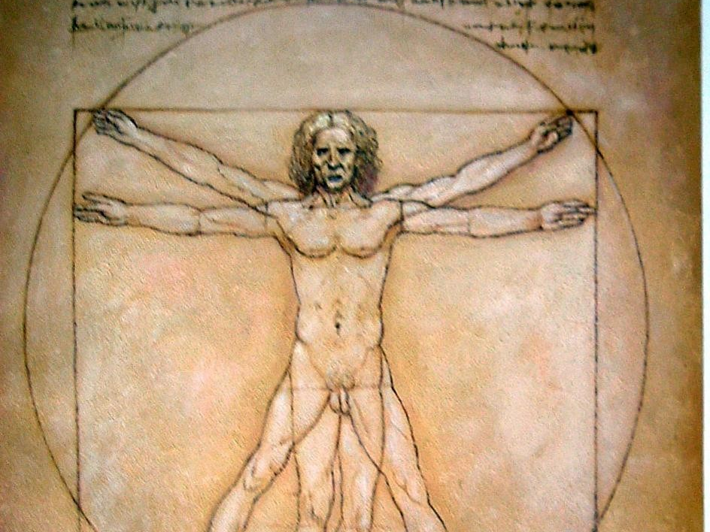
Humanism
Celebrated the individual
Stimulated the study of Greek and Roman literature and culture
Humanists were supported by PATRONS who were very wealthy
The Vitruvian Man

Slide 17
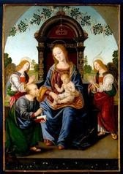
Art and Literature
Medieval art and literature focused on the Church and salvation.
Renaissance art and literature focused on individuals and worldly matters, along with Christianity.

Slide 18
Renaissance Artists embraced some of the ideals of Greece and Rome in their art
They wanted their subjects to be realistic and focused on humanity and emotion
New Techniques also emerged
Frescos: Painting done on wet plaster became popular because it gave depth to the paintings
Sculpture emphasized realism and the human form Architecture reached new heights of design

Slide 19

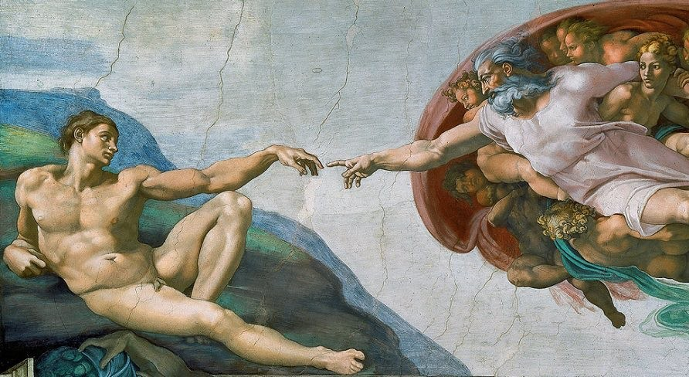


Slide 20
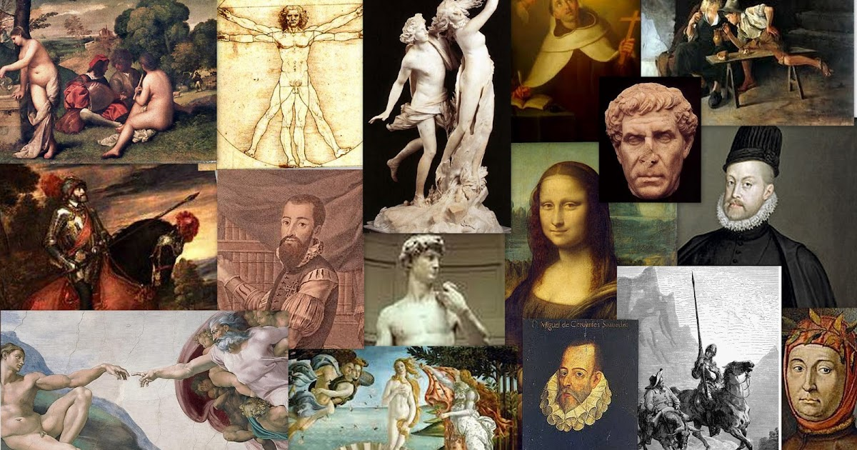
STAGES
The Renaissance has 3 stages:
EARLY RENAISSANCE OR TRECENTO
HIGH RENAISSANCE DIVIDED INTO TWO PERIODS:
A) Quattrocento or 15th century
B) Cinquecento or 16th century
Manierism -) From 1550 to 1600

Slide 21
TRECENTO
It developed in the 14th century and represented the end of the Gothic art. Gothic did not have a great influence in Italy so transition between both styles was easier. The first artist to show evidences of the Renaissance style was Giotto.

Slide 22
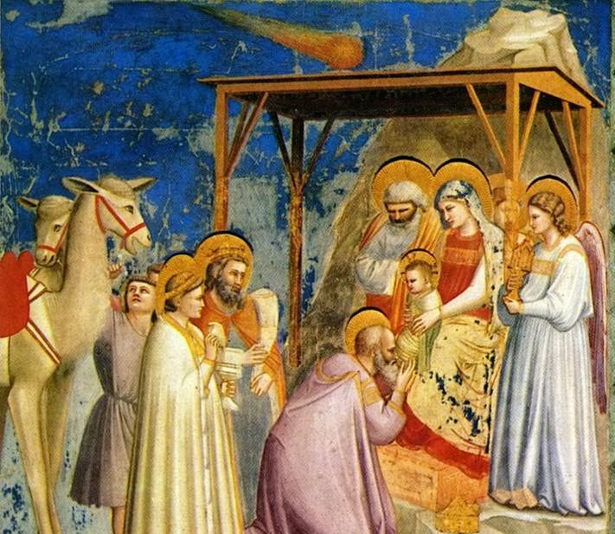
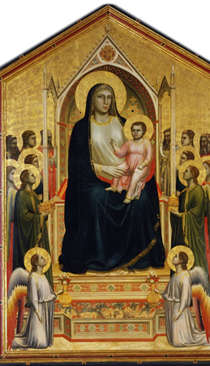
GIOTTO

Slide 23
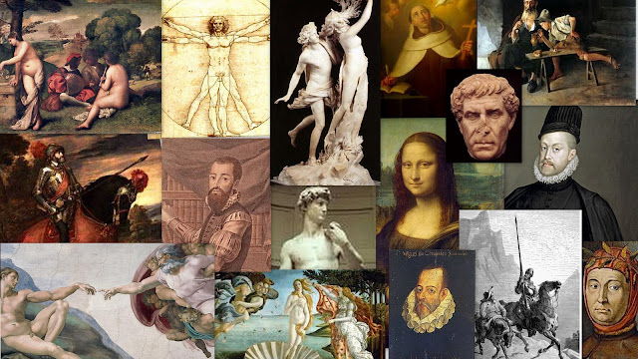
QUATTROCENTO
Developed in the 15th century in Florence. The new concepts and innovations were based on the ideas of harmony and proportion. Brunelleschi and Alberti renewed architecture; Ghiberti and Donatello gave classical proportions to their sculptures while Masaccio, and Botticelli were considered the most important painters.

Slide 24
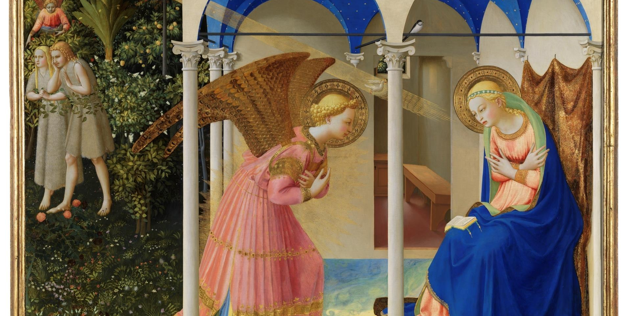
FRA ANGELICO

Slide 25
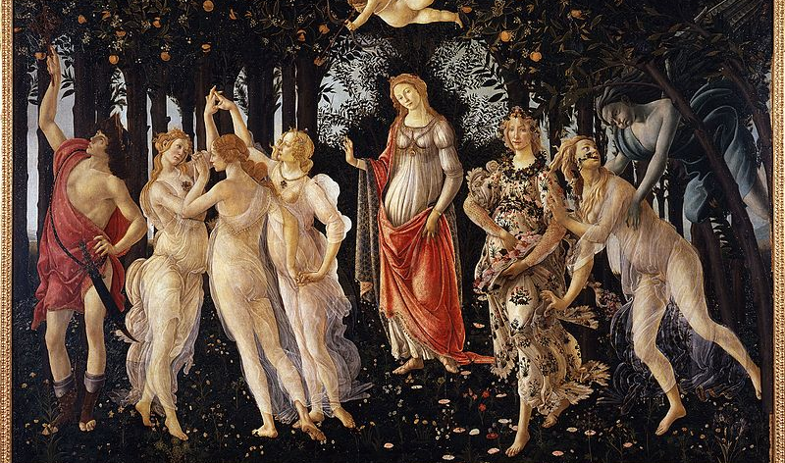
BOTTICELLI

Slide 26
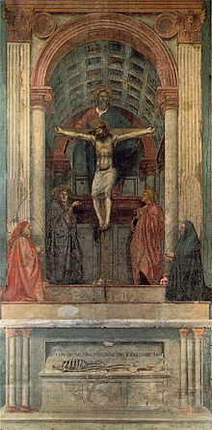
MASACCIO

Slide 27
CINQUECENTO
Took place in the 16th century. Rome became the most important artistic centre and Popes were the main patrons. Michelangelo, Leonardo da Vinci and Raphael Sanzio were the most relevant artists. However, a new school of painting (Venetian school) emerged in Venice and its most important painters were Giorgione and Titian.

Slide 28
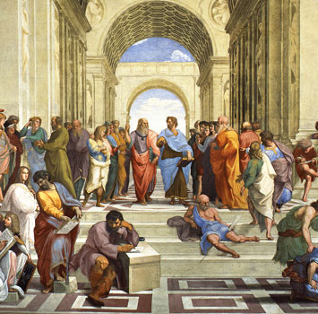
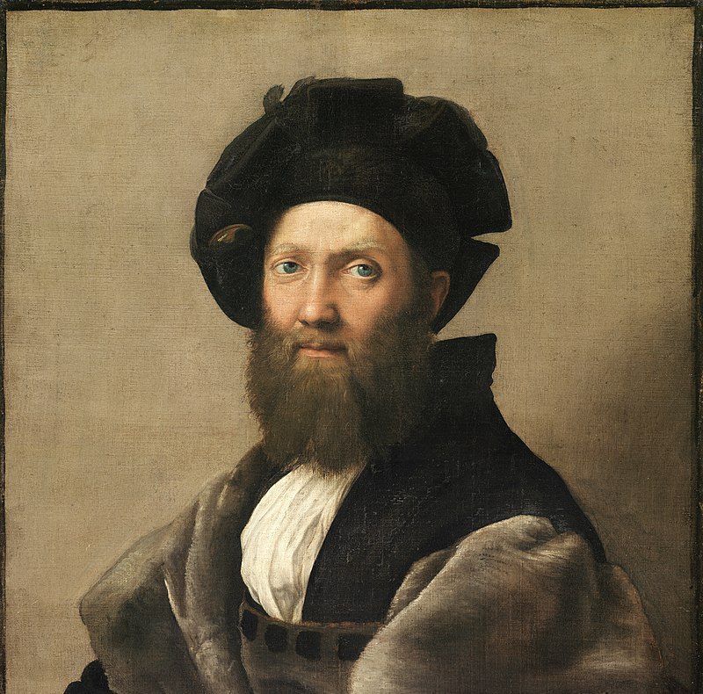
RAPHAEL SANZIO

Slide 29
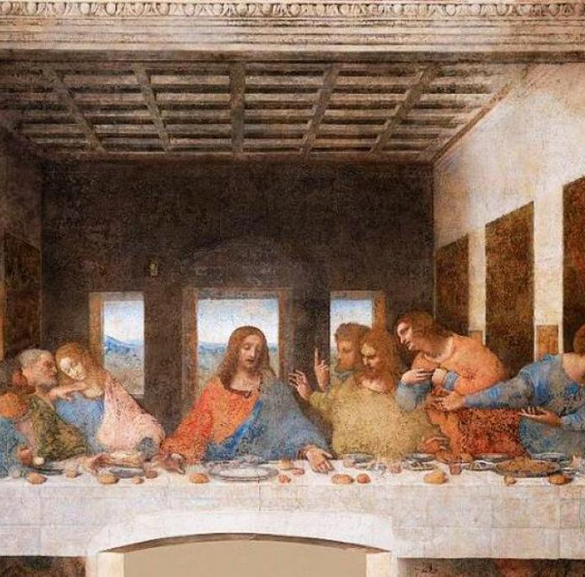
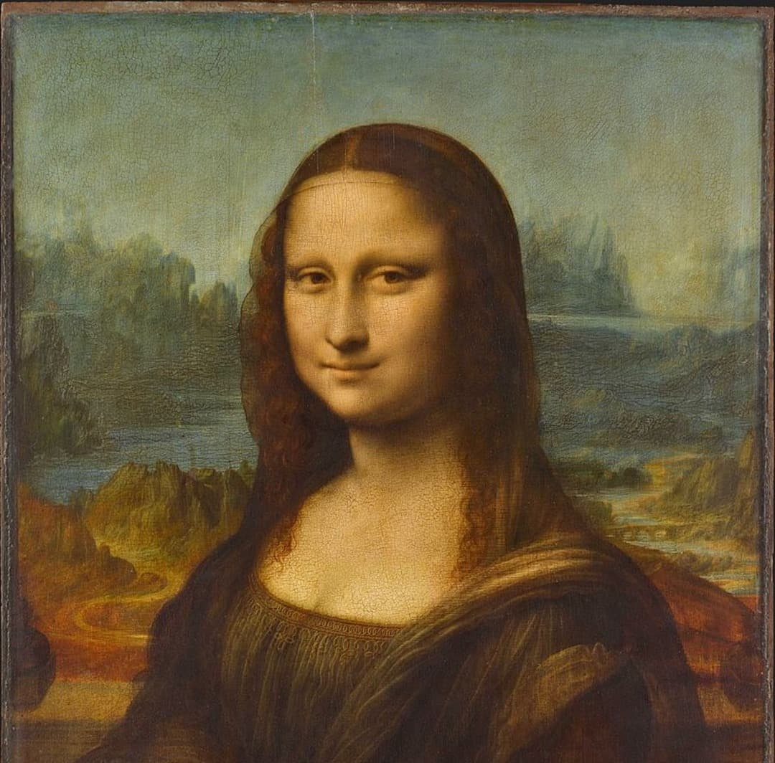
LEONARDO DA VINCI

Slide 30
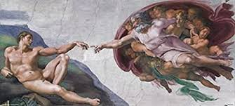
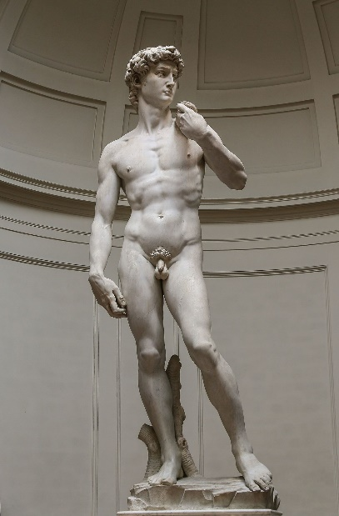
MICHELANGELO BUONARROTI

Slide 31
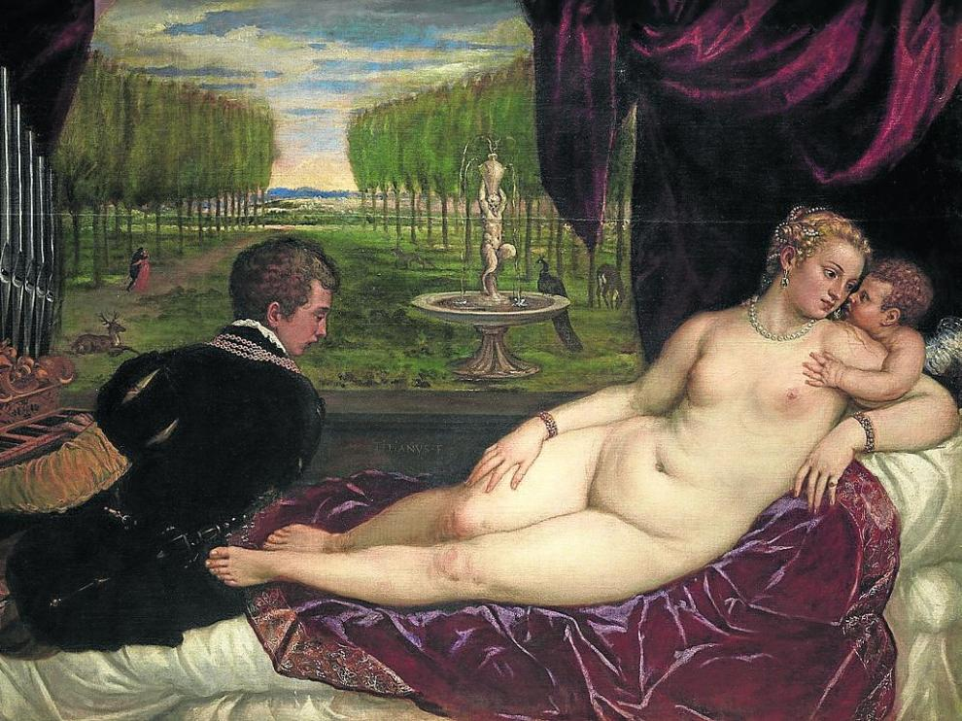
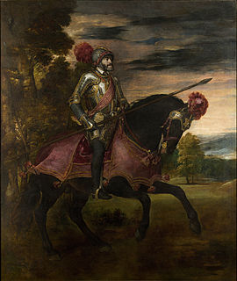
TITIAN

Slide 32

MANIERISM
It is the last stage of the Renaissance. It began in 1530 in Italy. Manierism is characterized by rejecting the ideas of harmony and proportion in favour of a more realistic approach to painting. This style developed in Florence. Bronzino stands out in Florence while Tintoretto and Veronese are the most important painters in Venice. Cellini and Giambologna were maniesrist sculptors.

Slide 33
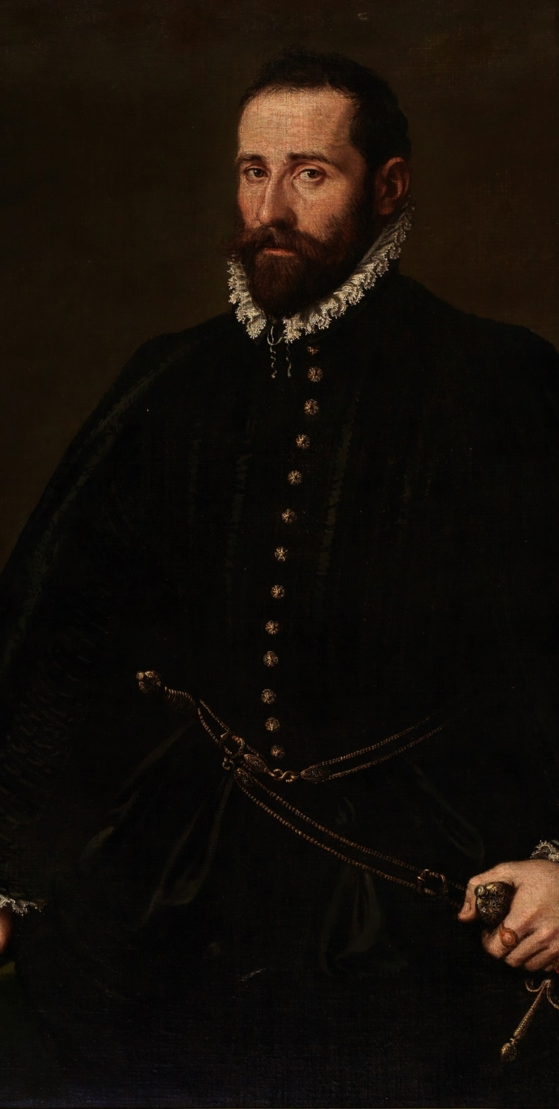
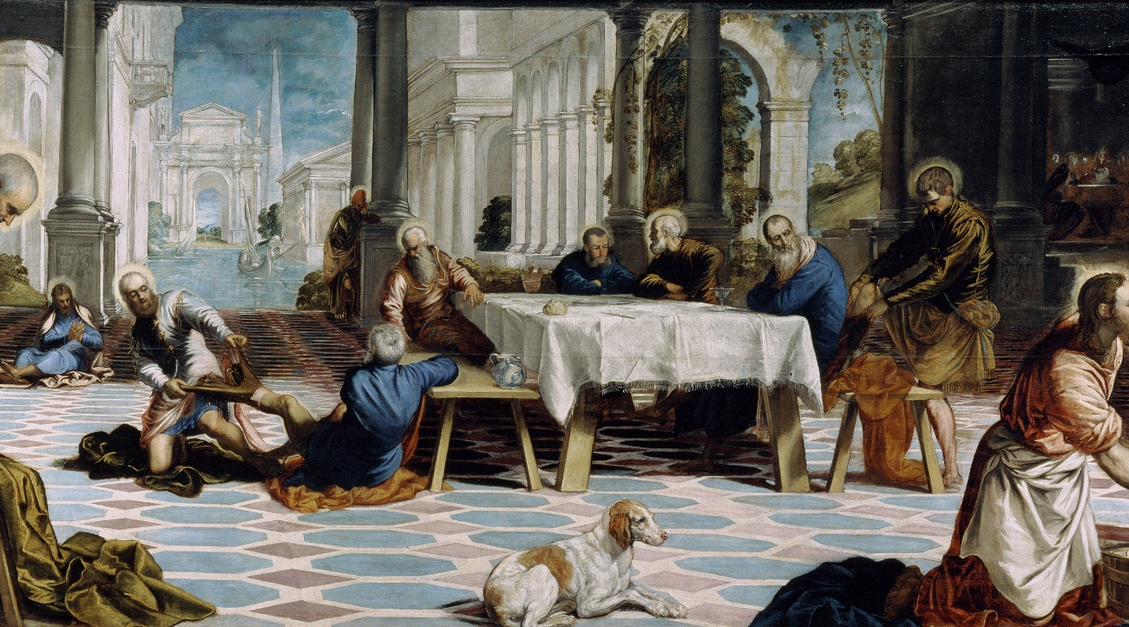
TINTORETTO

Slide 34
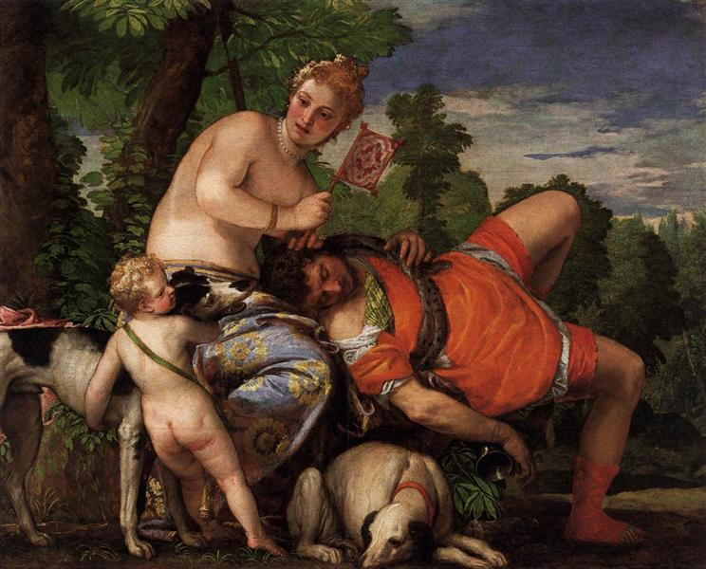
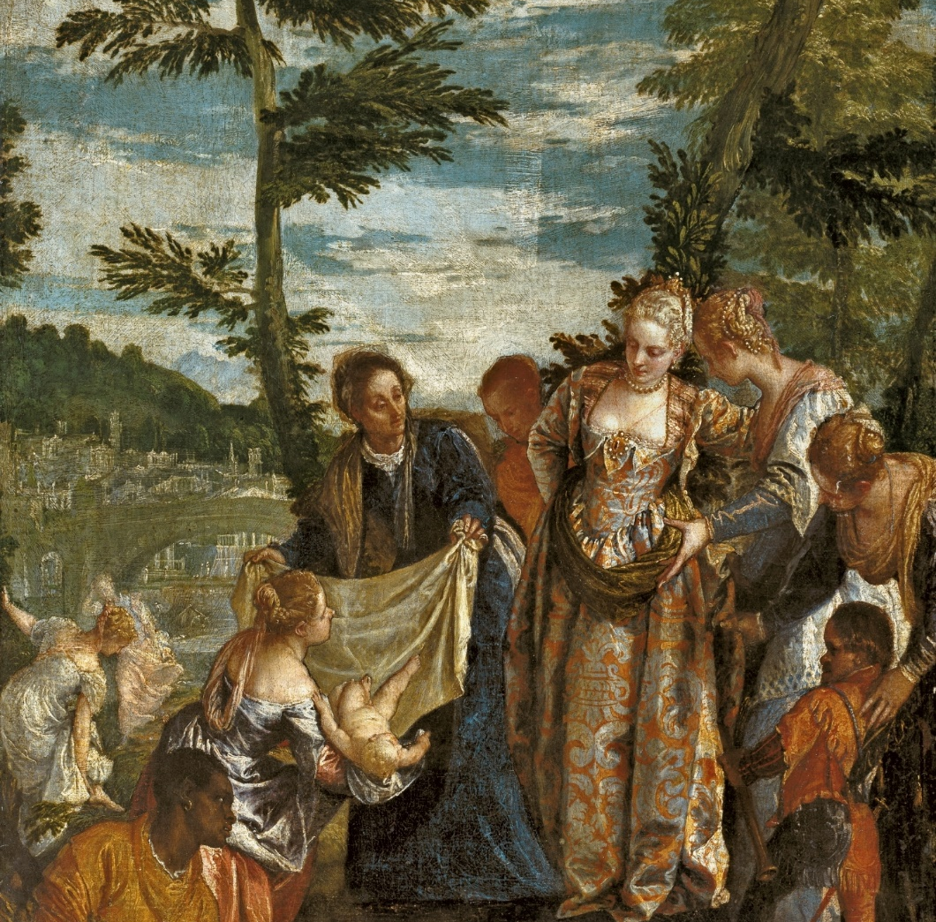
VERONESE

Slide 35
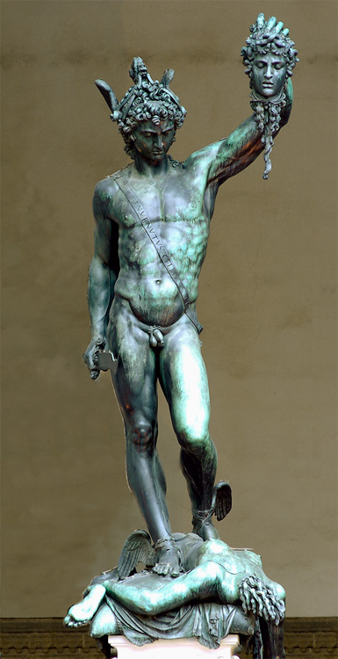
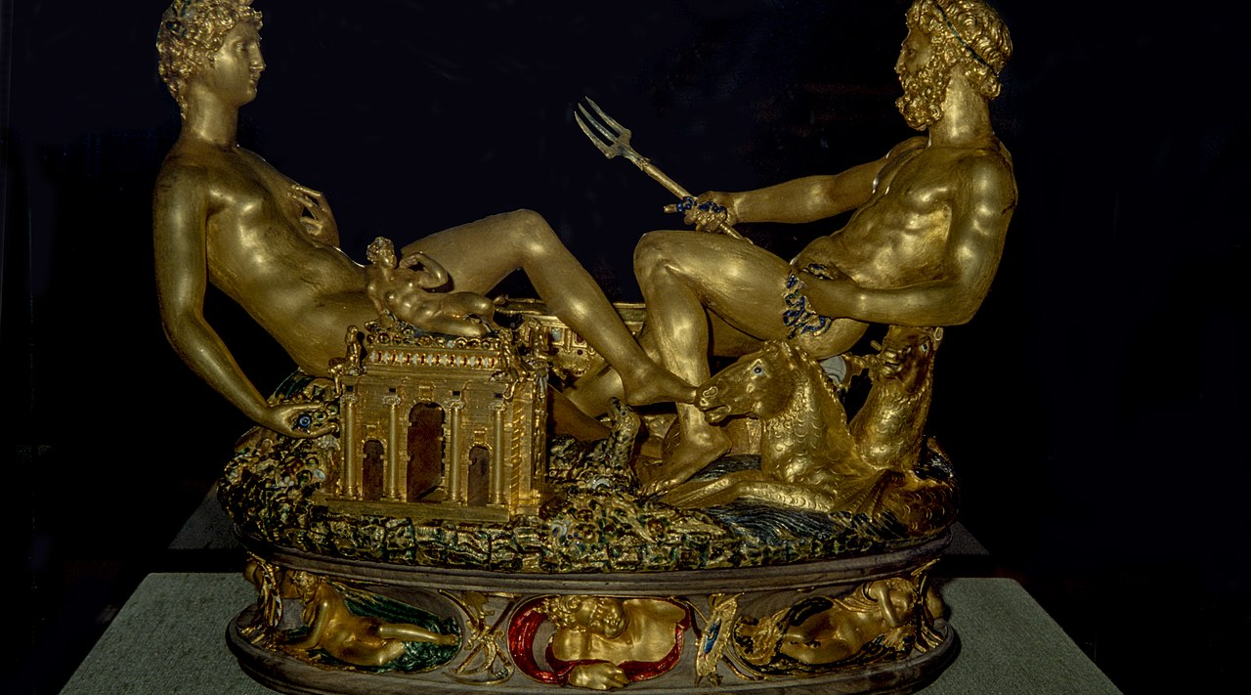
CELLINI

