Slide 1
Inventions in the Renaissance
María Sanz

Slide 2
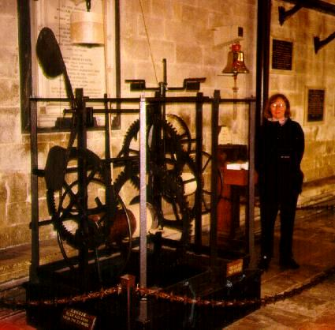
Clocks
The oldest smechanical clock was made in the 1300’s.
Galileo discovered the pendulum.
This made for better time keeping.

Slide 3
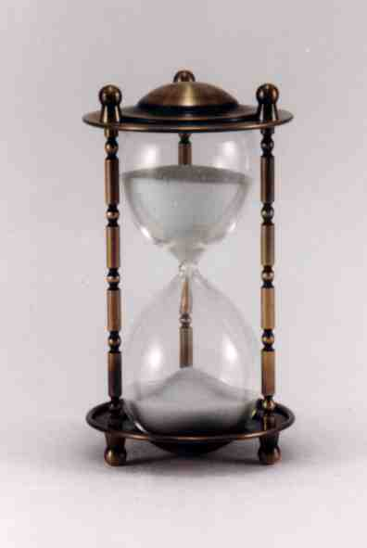
Water clocks and hourglasses
Water clocks and hourglasses were widespread in the 1500’s.

Slide 4
The Watch (portable timepiece)
The portable watch was invented by German Peter Henlein in 1505.
This watch was a pocket watch. The wrist watch didn’t come into widespread use until the 1800’s.

Slide 5
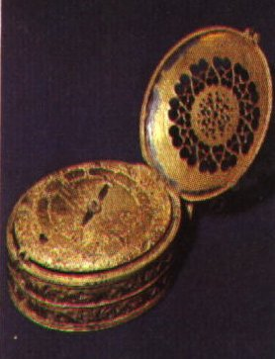
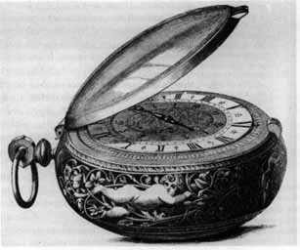

Slide 6
Printing
The Chinese were the first to invent printing in 868.
In the mid-1400’s, Johan Gutenberg of Germany invented a printing press using moveable type.
Now books could be printed with greater speed and less effort.

Slide 7
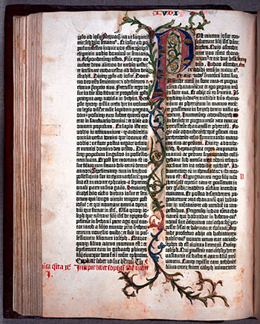
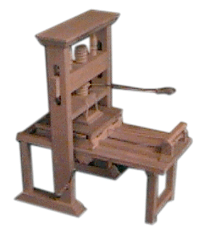

Slide 8
Eyeglasses
Eyeglasses were invented in the 1300’s.
With the invention of the printing press in the 1400’s, the demand for eyeglasses increased.
Far-sighted glasses (for reading) were developed first.
Later on near-sightedness was able to be corrected.

Slide 9
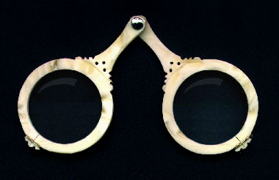
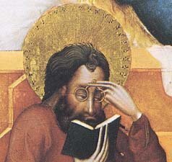

Slide 10
Lenses
Lenses were used for more than eyeglasses.
Galileo used lenses to make an astronomical telescope to look at the stars and planets in 1606.
Isaac Newton made the first reflecting telescope in 1668.

Slide 11
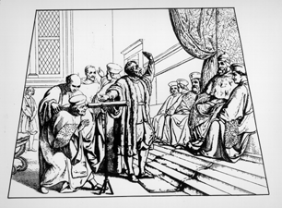
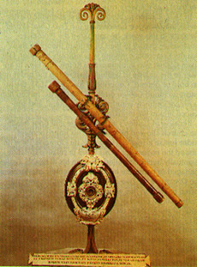

Slide 12
The Musket
The musket was the first usable rifle that soldiers could carry into battle.
It was developed in Spain in the 1500’s.
It could fire a metal ball that could kill or hurt someone.
The first muskets were very large weighing
They were very hard to use.

Slide 13
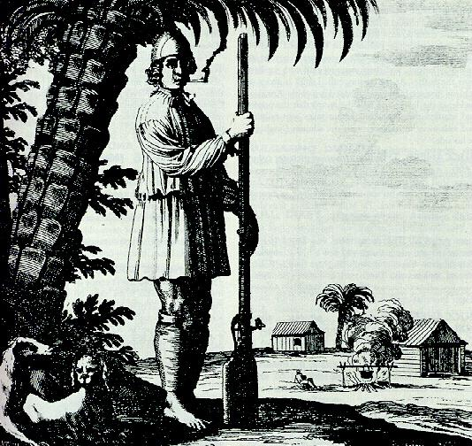

Slide 14
Adding Machine
The French scientist, Blaise Pascal has been credited with inventing the very first digital calculator. In 1642, the 18-year-old Pascal, the son of a French tax collector, invented his numerical wheel calculator called the Pascaline, to help his father count taxes.

Slide 15
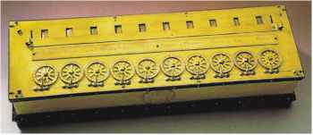
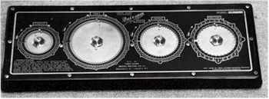

Slide 16
Thermometer
The Thermometer was invented by Galileo in 1593 which, for the first time, allowed temperature variations to be measured.
In 1714, Gabriel Fahrenheit invented the first mercury thermometer

Slide 17
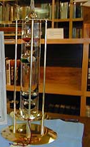

Slide 18
Submarine
The submarine was invented in 1624 by a man named Cornelius van Drebbel.
Leonardo da Vinci drew out the basic concept of a submarine over one hundred years before.
Drebbel, a Dutch inventor and engineer employed by the British navy constructed a leather- covered rowboat from which oars protruded through watertight seals.
Drubbel's ship could stay underwater for a few hours, but it only went about fifteen feet under the surface.

Slide 19
