Slide 1
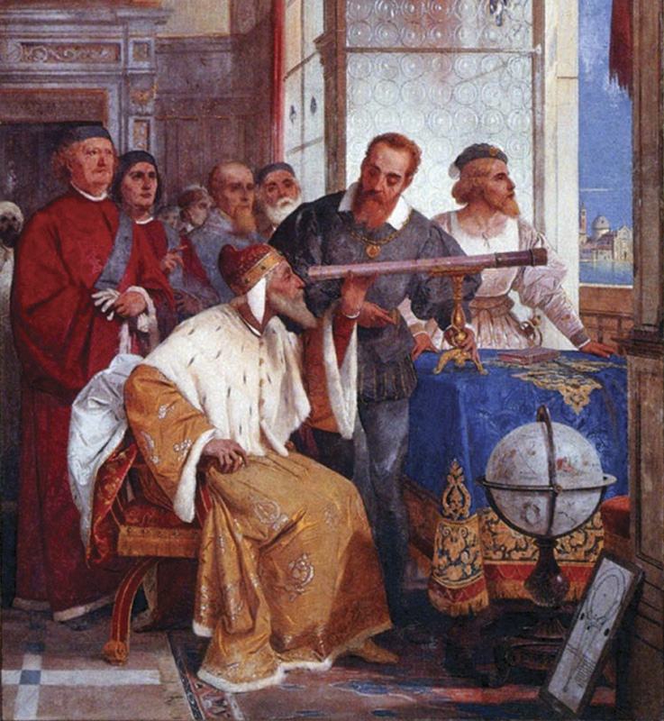
The Scientific Revolution
(1500s-1700s)

Slide 2
What was the Scientific Revolution?
Beginning of Modern Science
Scientific method: Depends upon logic, observation, and reason rather than faith
Created the technologies and techniques that built the modern world
Created paradigm of our solar system

Slide 3
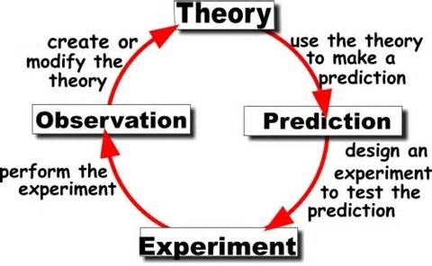

Slide 4
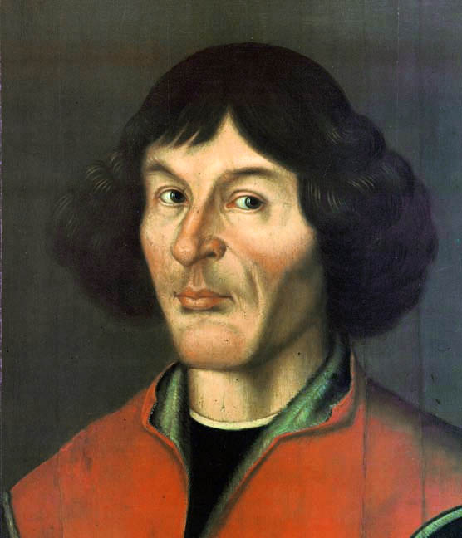
Nicolaus Copernicus (1473-1543)
Main achievements:
Earth revolves around the sun
Heliocentric theory:
  Sun is the center of the universe

Slide 5
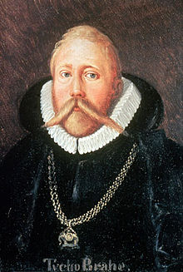
Tycho Brahe (1546-1601)
Danish royal astrologer
Follower of Ptolemaic system
Observed and mapped
over 700 stars in a 20-year period

Slide 6
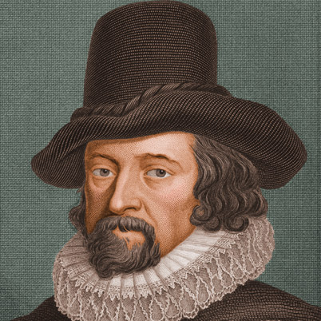
Francis Bacon
(1561-1626)
Preferred inductive reasoning
and facts over theory.
Invented the scientific method

Slide 7
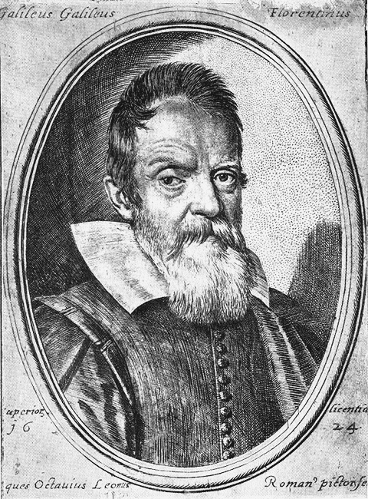
Galileo Galilei
(1564-1642)
“I recant”.
Invented the telescope, pendulum clock, thermometer, water pump, and sector.
Discovered speed of acceleration for gravity

Slide 8
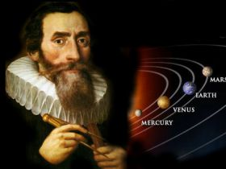
Johann Kepler
(1571-1630)
Brahe’s student for 20 years
Living during 30 years of war
Loved the planets and made
it his life’s work
to explain the motion of planets
Invented Three Laws of Planetary Motion

Slide 9

Rene Descartes
(1595-1650)
Deductive logic
Deduced the existence of God
Invented Cartesian geometry
(xy axis)
“I think therefore I am”

Slide 10
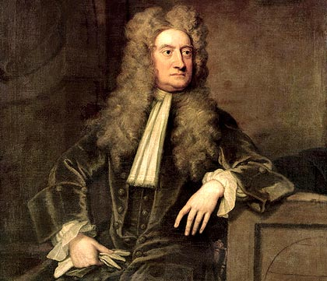
Isaac Newton
(1642-1727)
Tied up the loose ends
of Kepler and Galileo.
Three Laws of Motion.
Defined gravity and its laws.
Invented optics and calculus

Slide 11
Rise of the Scientific Community
Developed the modern scientific method.
Universe ordered according to natural laws.
Discovered that scientific laws can be discovered by human reason.
Took the role of god out of the study of the universe.
Mechanical views of the universe

Slide 12
Review Questions
What astronomer, author of On the Revolutions of the Heavenly Spheres, believed that the earth revolves around the sun?
Who is credited with inventing the scientific method?
Who came up with the Three Laws of Planetary Motion?
What famous Italian astronomer was convicted of heresy by the Inquisition?
What English scientist defined gravity?
Describe what is the Scientific Revolution

