Slide 1

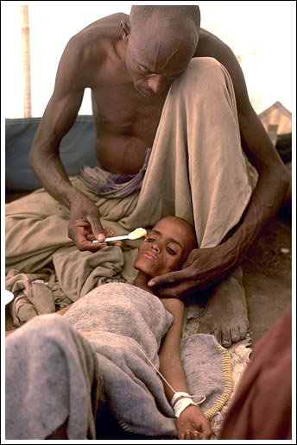
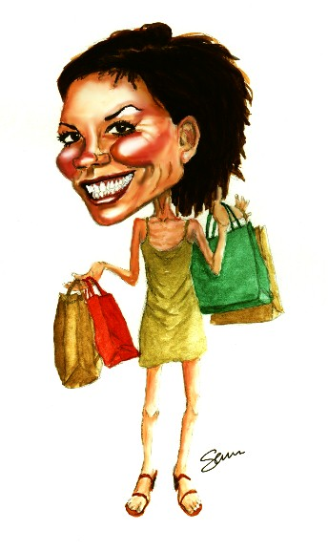
World Development

Slide 2
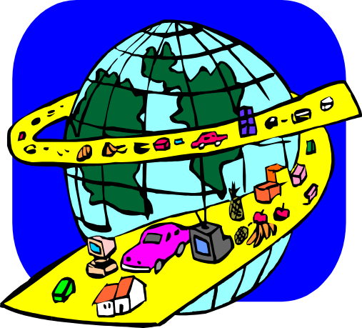
Developed
(Rich Country)
NIC – Newly
Industrialized
Country
M.E.D.C
(More Economically
Developed Country)
First World
(The north)
Third World
(Poor South)
L.E.D.C
(Less Economically
Developed Country)
Developing
(Poor Country)

Slide 3
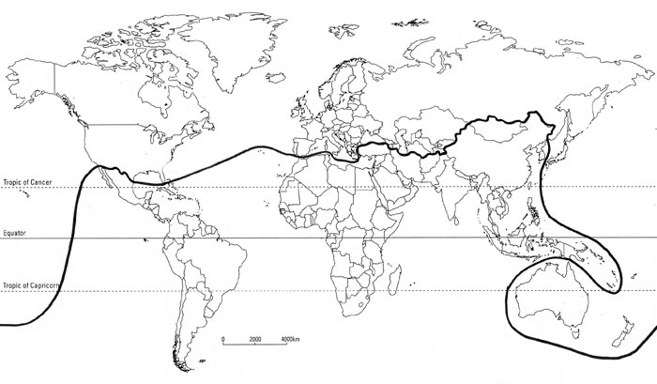
Rich North Poor South
The Rich North
The Poor South

Slide 4
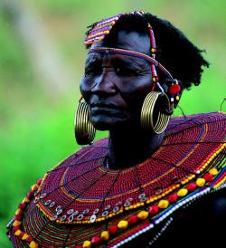
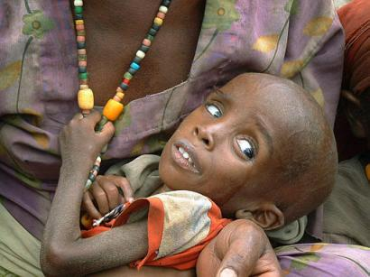
Life in LEDC’s

Slide 5
Jobs
“Most jobs in our country are low paid and unskilled. Most people work within the primary industry like farming and mining”

Slide 6

Trade – Buying & Selling
“We have to sell raw materials like coal and food at really low prices to MEDC’s. However, we have to buy our manufactured good (machines, clothes, electrical goods) from MEDC’s at high prices”.

Slide 7
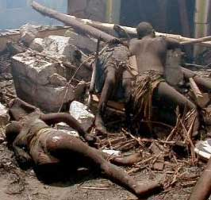
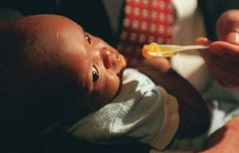
Population – Life & Death
“We have a very high birth rate because of a lack of sex education and contraception. We have a very high death rate because of a lack of medicine and doctors. Lots of children die and you are not expected to live past 50 years old. Life is difficult”
Death Rate = Number
of people that die per
1000 people per year
Birth Rate = Number
of people that are born
Per 1000 people per year

Slide 8
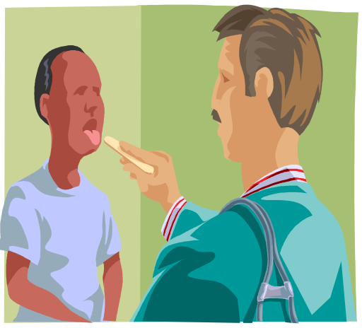

Health
“A developing country like ours has a lot less money to spend on training up doctors and nurses and providing medicines, hospitals and dentists to it’s people”.

Slide 9

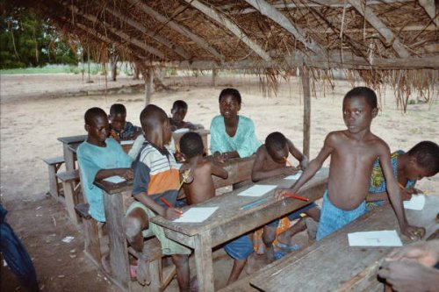
Education
“There are lots of children in our country (high birth rate) but there is no money to build good schools or to buy books and computers for the students. This means few people can read and write. As a result we have a low literacy rate”

Slide 10
How do we judge our wealth?
GDP – Gross Domestic Product (US$)
This is the total amount of money made by the country from selling it’s raw materials, manufactured goods and services.
This figure is then divided by the total number of people that live there to give the average amount of money available to each person living there.

Slide 11
Examples of GNP
Note:
€1 is worth $1.45
USA = $39,820
France = $35,854
Rwanda = $210
Ethiopia = $110
Which is MEDC?
Which is LEDC?

Slide 12
A personal view on QUALITY OF LIFE
“People walking along a street in a western city rarely seem to smile. They look harassed and under pressure. Perhaps it is the strain of work or trying to find a job, of paying the mortgage or finding a home. In contrast, people in the poorer countries which I have visited such as Kenya, Thailand and Malaysia seem to be very much more cheerful, laid back and relaxed, and always prepared to help the visitor. Socially and culturally they are in no way ‘less developed’”
Which society appears to have the preferable quality of life?

Slide 13
Is it as straightforward as Rich North / Poor South?
Using the CIA World Factbook and looking at GDP figures in $, can you find any countries that don’t fit the ‘rich north, poor south’ Brandt model?

