Slide 1
Economic development:
MEDCs versus
LEDCs

Slide 2

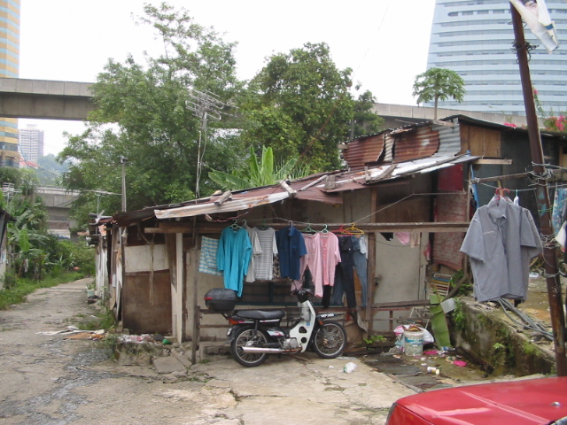

Slide 3
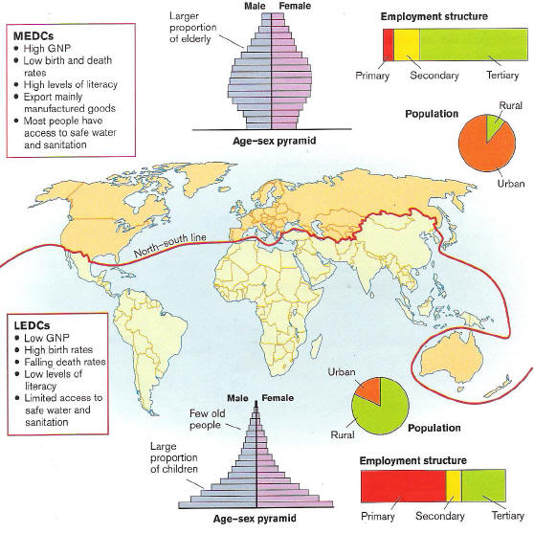
What does this map show?

Slide 5
Key questions
What are the characteristics of MEDC’s and LEDC’s?
How can countries be divided by the Brandt line?
How relevant is the Brandt line compared to economic and composite maps of development?

Slide 6
How relevant is the Brandt line in the 21st Century?

Slide 8
Key questions
What are the characteristics of MEDC’s and LEDC’s?
How can countries be divided by the Brandt line?
How relevant is the Brandt line compared to economic and composite maps of development?

