Slide 2



What is foreign aid?
Foreign aid is the term used to describe a country giving some of its resources to help or support another country.
The resources could be money, materials or services. Developed countries often provide aid to developing countries.
Click for
Audio

Slide 3


What are the issues?
There are many reasons why foreign aid is a necessary and positive thing. However, there are also many issues.
Task: Before we explore both the advantages
and disadvantages together, can you think
of any?
Click for
Audio

Slide 4

What are the advantages of
foreign aid?
Foreign aid is vital in emergency situations such as natural disasters or man-made disasters. This support during an emergency helps to save lives.
Task: Can you list some examples of natural and man made disasters?
Click for
Audio

Slide 5

What are the advantages of
foreign aid?
Foreign aid helps to reduce poverty. When wealthy countries give some of their wealth to poorer countries, it helps to lessen the effects of poverty in that region.
Click for
Audio

Slide 6
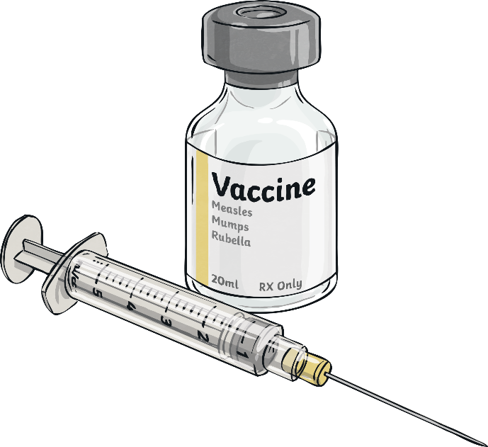

What are the advantages of
foreign aid?
Foreign aid helps to save lives by providing medication and healthcare services that the people in the region wouldn’t otherwise have access to. This saves lives and increases life expectancies.
Click for
Audio

Slide 7

What are the advantages of
foreign aid?
Foreign aid that supports farmers can help to increase food production which creates a greater supply of food and work for the local people.
Click for
Audio

Slide 8

What are the advantages of
foreign aid?
Foreign aid is often targeted at the most vulnerable and disadvantaged people in a society. These are the people who are most at risk and need
the greatest amount of support in order to survive or succeed.
Task: Discuss who you think could be considered the most vulnerable people
in a society.
Click for
Audio

Slide 9


What are the disadvantages of
foreign aid?
Foreign aid runs the risk of corruption. If the people in power are dishonest they may use the money for their own agenda rather than using it as it was intended. This means it may never get to the people who need it most.
Click for
Audio

Slide 10



What are the disadvantages of
foreign aid?
The country receiving aid may feel under political or economic pressure from the donor country.
Click for
Audio

Slide 11



What are the disadvantages of
foreign aid?
When a country is receiving aid from more than one source, the sources may have different ideas of how it should be used. This can cause problems such as education and health systems that are fragmented.
Click for
Audio

Slide 12

What are the disadvantages of
foreign aid?
It causes problems when a country becomes dependent on foreign aid as it is not sustainable in the long term.
Sometimes aid is given as a loan, not a gift. Countries can get into more debt when they cannot afford to repay such loans.
Click for
Audio

Slide 13
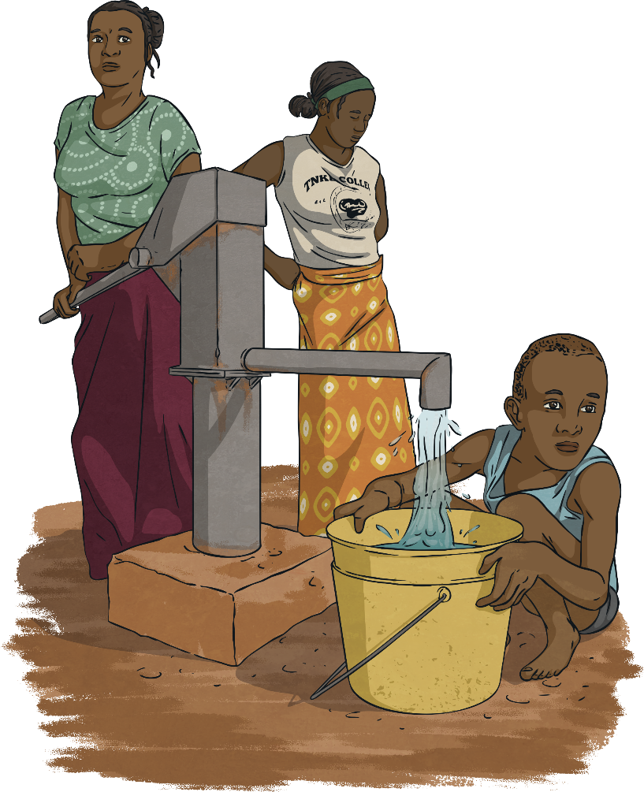
What are the disadvantages of
foreign aid?
Sometimes foreign aid is directed towards big projects and doesn’t benefit the smaller scale projects such as small farmers.
This means that the people who need help the most are overlooked.
Click for
Audio

