Slide 1
THE SPANISH HEGEMONY(I):
CHARLES V

Slide 2
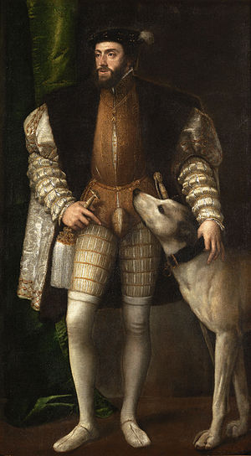
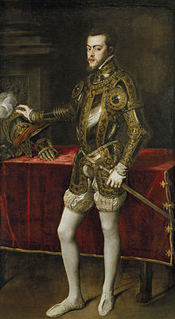
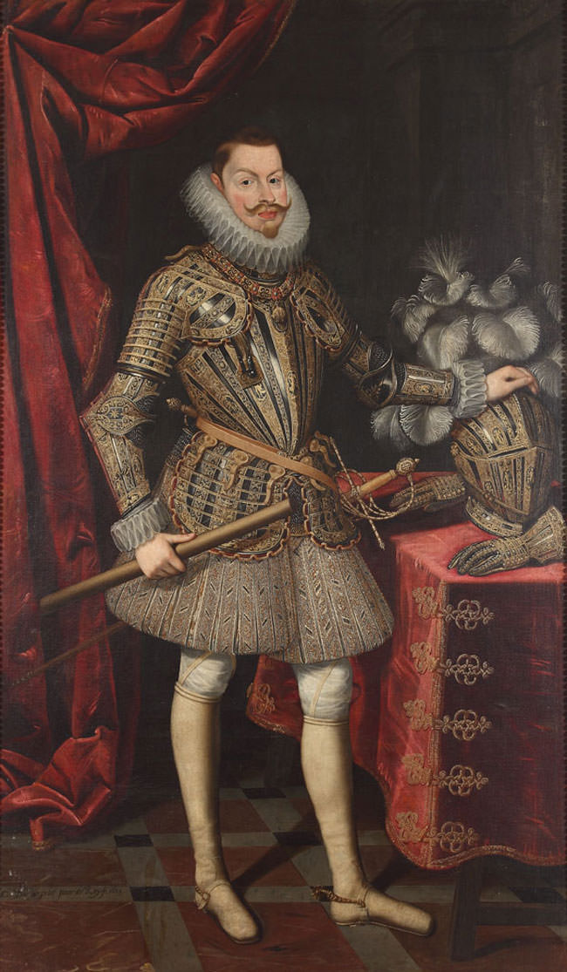
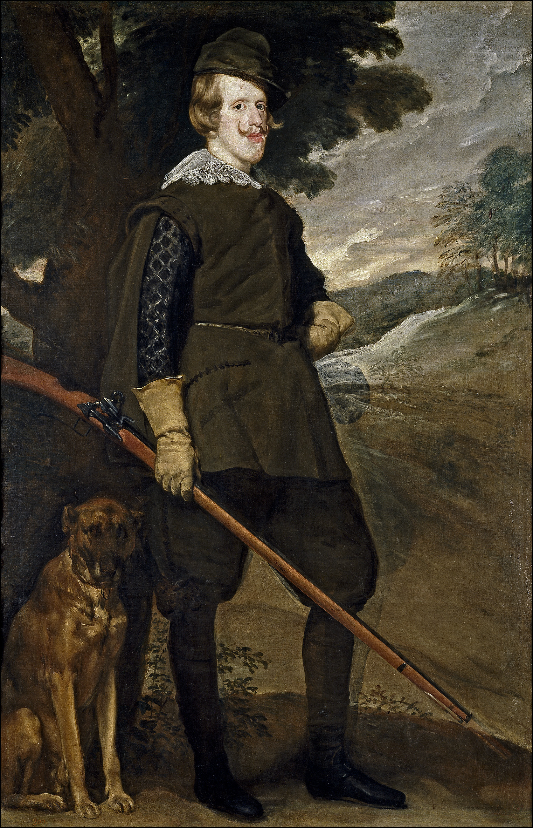
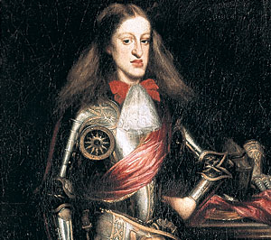
HABSBURG DINASTY
Charles’s grandfather (Maximilian) was from the Habsburg family. He was the Emperor of the Holy Roman Empire.
So Charles and his successors are known as the Habsburg dynasty of Spanish kings.

Slide 3
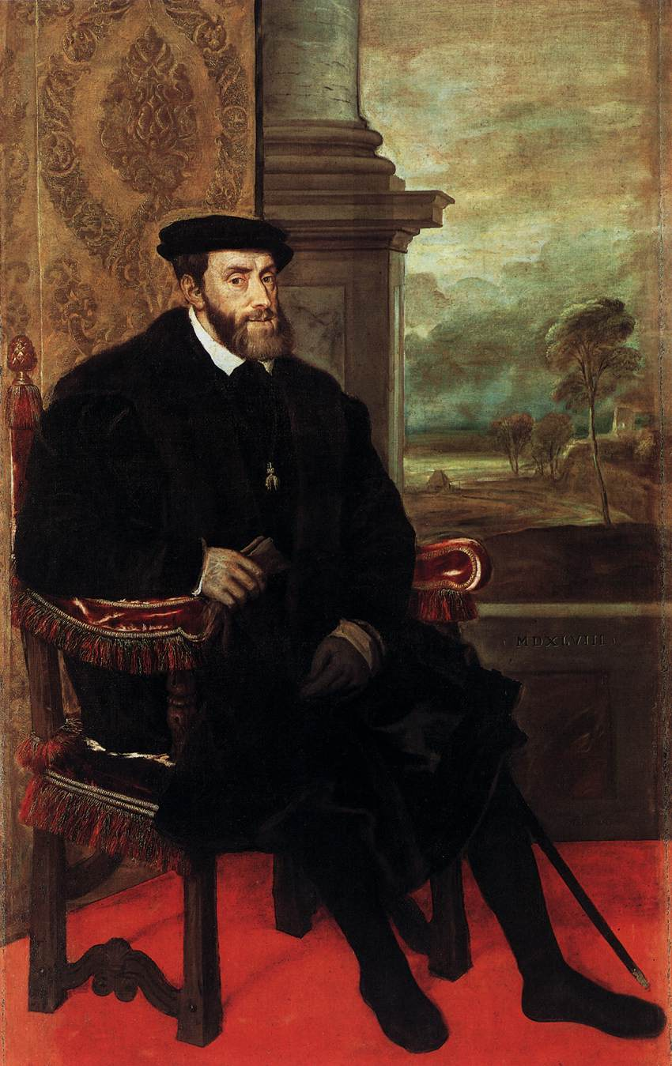
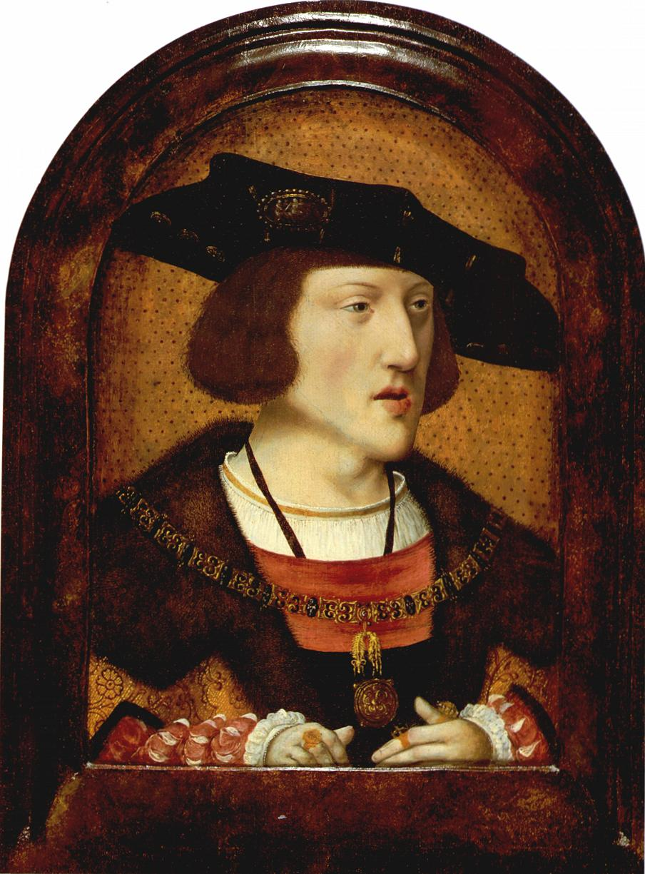
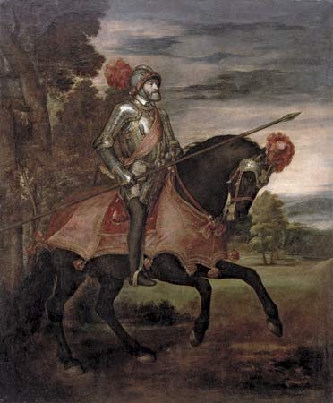
CHARLES V

Slide 4
Charles I of Spain and Charles V of Germany (1516-1556):
When Isabella died in 1504, Joanna becomes Queen of Castilla, however Ferdinand continues ruling. Philip died in 1506. Ferdinand the Catholic died in 1516. Charles I came to Spain in 1517.
Charles becomes King of Burgandy and the Low Countries Charles was elected Holy Roman Emperor in 1519 after the death of Maximilian I.

Slide 5
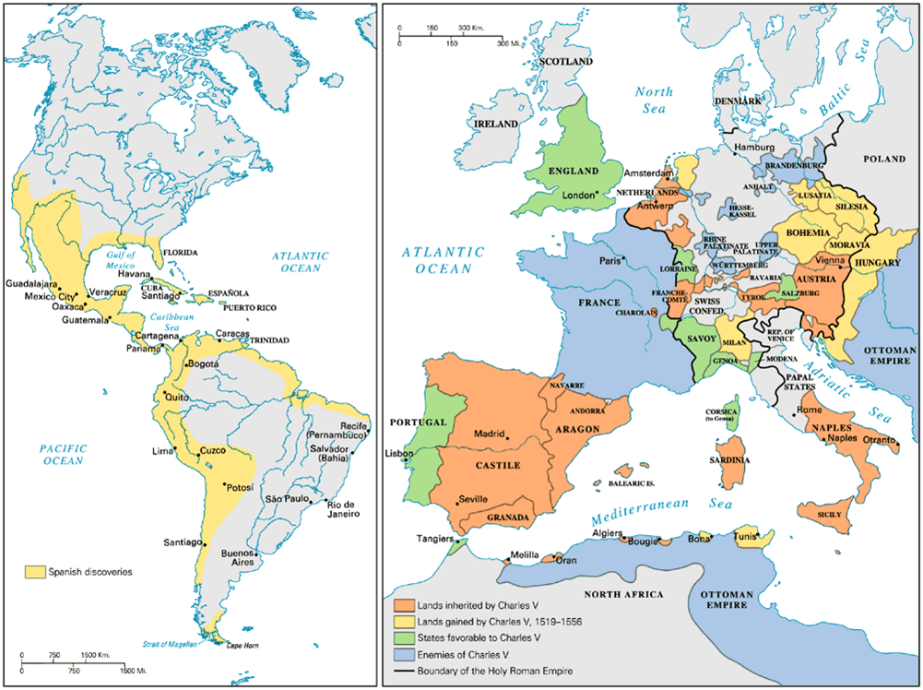

Slide 6
DOMESTIC POLICY
Charles was born and raised in the Low Countries. In Spain he was seen as a foreigner: He could not speak Spanish and selected Flemish people for high offices. Charles raised taxes to finance his election for emperor.
He also used much money to fight wars abroad. Then Spaniards revolved against him:
the revolt of the Comuneros (1520-1521):
  uprising against Carlos in many towns of Castilla.
  they had to pay high taxes.
  leaders were executed.
the revolt of the Brotherhoods (1519-1523):
  revolt of the artisan guilds against the monarchy in Valencia and Mallorca.

Slide 7
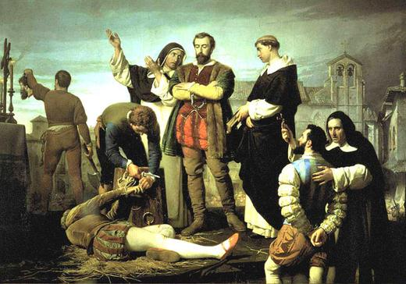
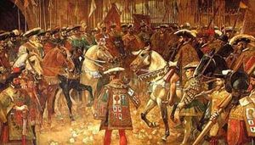

Slide 8
FOREIGN POLICY
A) RIVALRY WITH FRANCE
In 1522 pope Adrian VI tried to reconcile Francis I and the emperor but he failed
Three years later Charles’s army defeated Francis I at the Battle of Pavia, taking prisoner the king. The victory ensured Spanish supremacy in Italy. Held in the alcazar of Madrid, the royal captive feigned agreement with the conditions imposed by Charles. The Treaty of Madrid concluding hostilities between the two countries was signed in 1526.
As soon as he had regained his freedom, Francis rejected the treaty and refused to ratify it. The newly started war between the emperor and France finished when the mother of Francis I approached Margaret of Austria, the emperor’s aunt, through whose mediation the so-called “ladies’ peace,” the Treaty of Cambrai, was concluded in 1529. The status quo was preserved: Charles renounced his claim to Burgundy; Francis, his claims to Milan and Naples.
War resumed on and off until the death of both monarchs, Their successors signed the Treaty of Cateau-Cambrésis in 1559 which made peace between France and Spain stable for more than 50 years.

Slide 9
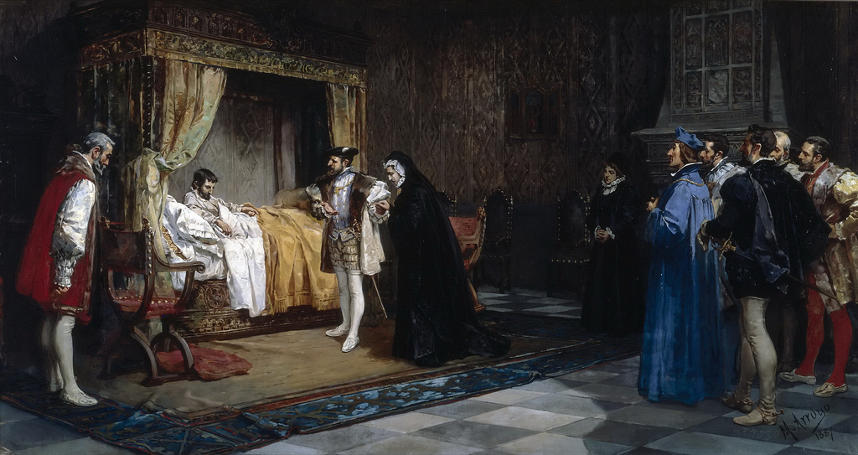
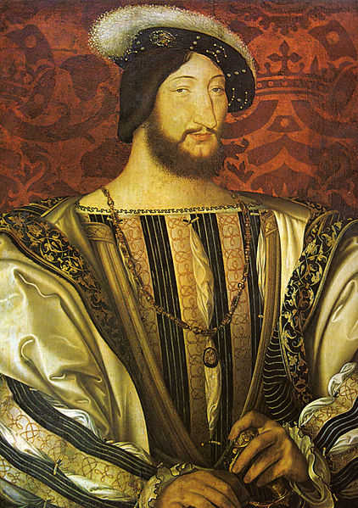
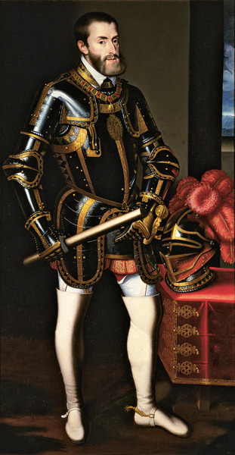
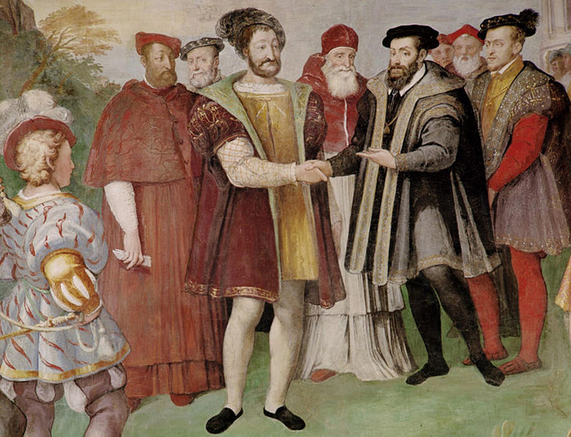

Slide 10
B) RELIGIOUS ISSUES IN THE HOLY GERMAN EMPIRE
As a devout Catholic, he fought to suppress Protestantism in the German states.
John Frederik, elector of Saxony, formed the Smalkaldic League to defend Lutheranism in Germany.
After years of religious conﬂict, Charles V defeated the Lutheran league at Mulhberg.
Charles was forced to allow the German princes to choose their own religión. The Peace of Augsburg was a treaty between Charles V and the forces of the Schmalkaldic League signed in 1555, which officially ended the religious struggle between the two groups and made the legal division of Christendom permanent within the Holy Roman Empire.

Slide 11
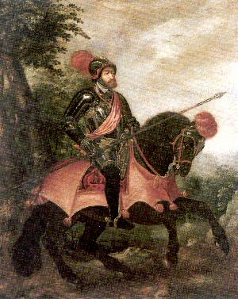
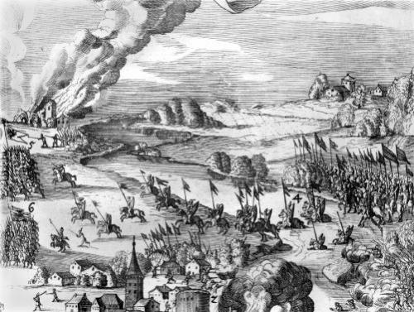
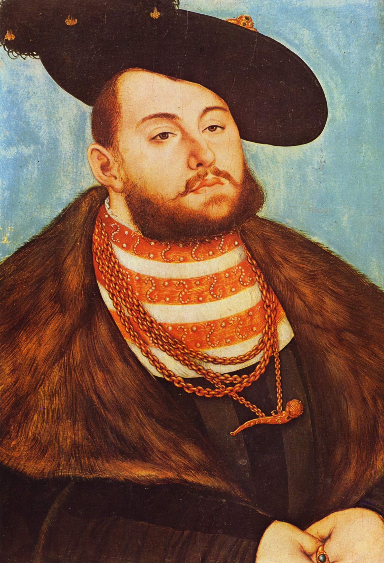
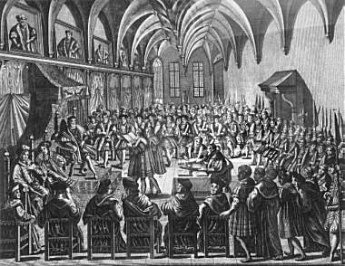

Slide 12
C) FIGHT WITH THE OTTOMAN EMPIRE
Charles also faced the Muslim Ottoman empire, which was based in Turkey but stretched across the Balkans.
Under Suleiman, Ottoman forces advanced across central Europe to the walls surrounding Vienna, Austria.
Although Austria held ﬁrm during the siege, the Ottomans occupied much of Hungary following their crushing victory at the Battle of Mohács.
Ottoman naval forces also continued to challenge Spanish power in the Mediterranean Althought they were defeated at the battle of Lepanto during Philip´s II reign.

Slide 13
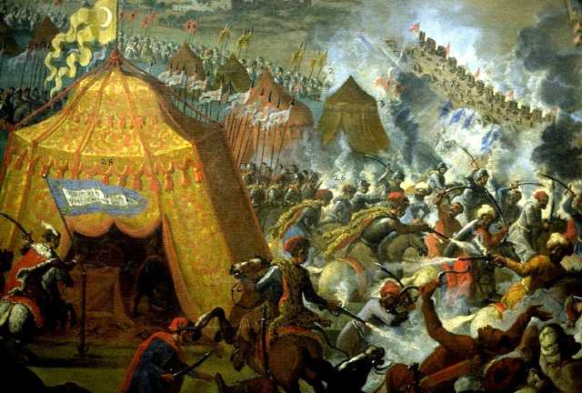
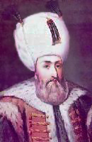
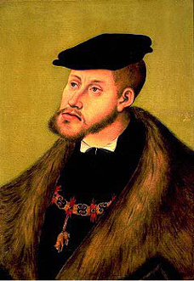
.
____

Slide 14
ABDICATIONS
Charles V abdicated in two different moments:
  1555: the imperial crown to his brother Ferdinand I.
  1556: the Spanish crown to his son Felipe II.
  He thought that the empire was too big for one person.
He retired to the Monastery of Yuste where he died (1558).

Slide 15
