Slide 1
NORTHERN RENAISSANCE
MARÍA SANZ

Slide 2
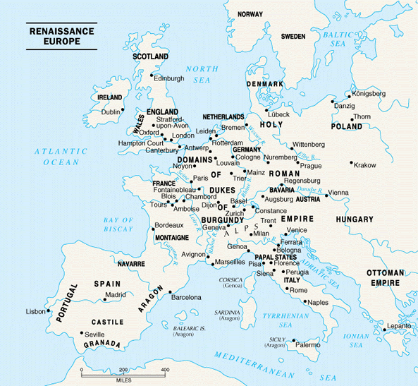
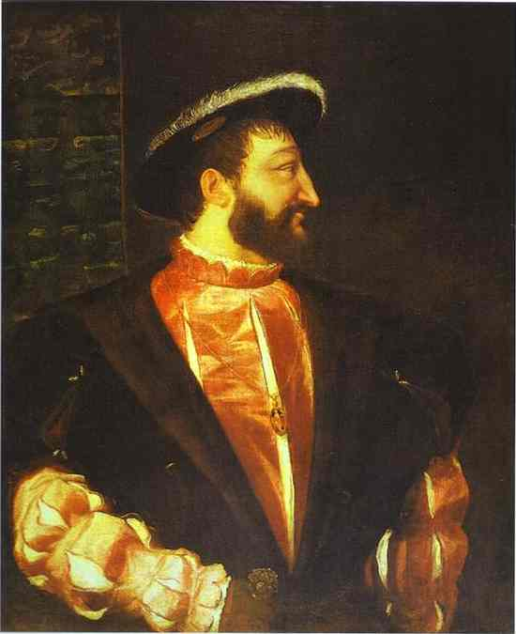
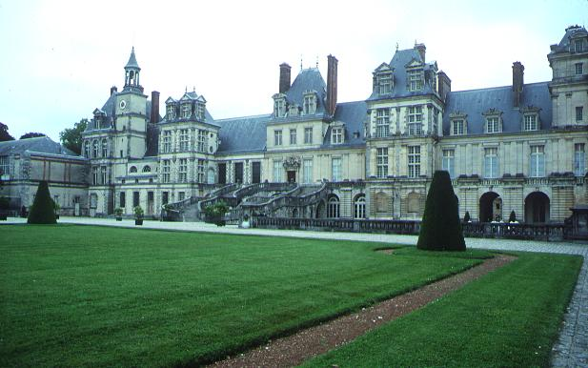
What factors led to the
beginning of the Renaissance
in northern Europe?
the northern population
began to recover from
the plague.
Hundred Years’ War
finally ended.
cities were growing
rapidly
city merchants were
becoming wealthy
enough to become
“patrons” as well as
educated in Humanist
pursuits.
Monarchs in England and in France (such as Francis I who hired Italian architects to build his palace at Fontainebleau) supported the arts and introduced Renaissance styles to northern Europe.
PP Design of T. Loessin; Akins High School

Slide 3
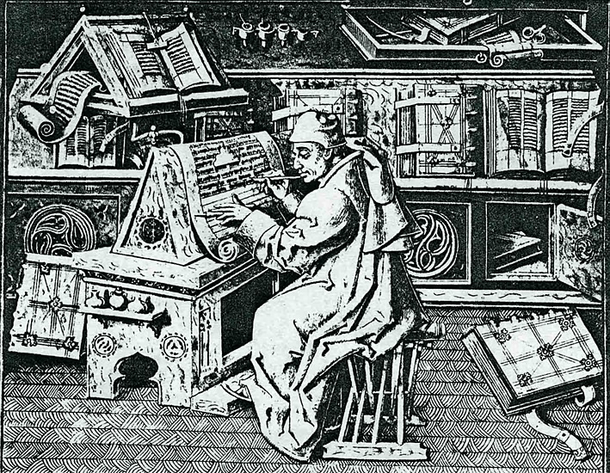

Slide 4
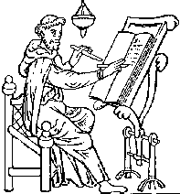
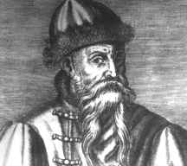
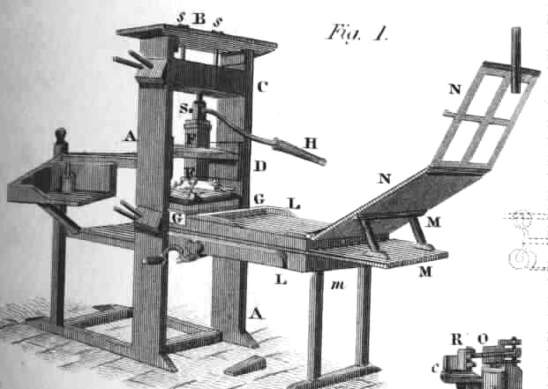
Since antiquity it had been scribes and later, monks
in the Medieval period, who copied all manuscripts
by hand …
UNTIL …
Johann Gutenberg invented a “printing press” – or,
the technique of printing from movable blocks of type letters.
Gutenberg was a 15th-century German craftsman, inventor, and printer. He used hand-set type cast in molds to print multiple copies of manuscripts. Copying now became
mechanized and much faster.
The invention of movable-type printing
facilitated an easier exchange of ideas
throughout Europe and helped spread
the ideas of the Renaissance.
PP Design of T. Loessin; Akins High School

Slide 5
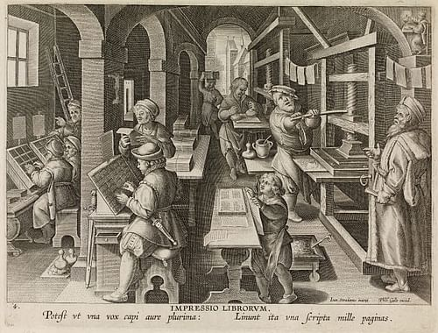
Renaissance Ideas Spread to Northern Europe
Johann Gutenberg invented a “printing press” – or,
the technique of printing from movable blocks of type letters.
Gutenberg's invention did not make him rich, but it laid the foundation for the first commercial mass production of books. The success of printing meant that books soon became cheaper, and the previously uneducated lower classes of the population could now afford them and it inspired them to learn to read, increasing literacy.
PP Design of T. Loessin; Akins High School

Slide 6
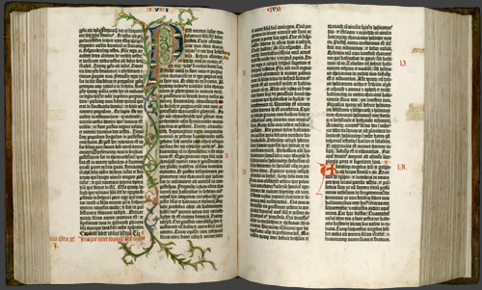
Renaissance Ideas Spread to Northern Europe
Johann Gutenberg invented a “printing press” – or,
the technique of printing from movable blocks of type letters.
It is said that other great historical events such as the Protestant Reformation of the 1500s, the Scientific Age of Enlightenment of the 1600s, and the French Revolution in the 1700s would likely have not been such transforming forces had it not been for the invention of the printing press. Explain why historians would make such an assertion.
The Gutenberg Bible
PP Design of T. Loessin; Akins High School

Slide 7
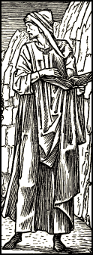
Renaissance Ideas Spread to Northern Europe
It is said that other great historical events such as the Protestant Reformation of the 1500s, the Scientific Age of Enlightenment of the 1600s, and the French Revolution in the 1700s would likely have not been such transforming forces had it not been for the invention of the printing press. Explain why historians would make such an assertion.
Made books cheaper and accessible to the mass population
Increased Literacy
Spreads Ideas and Learning
Examples:
Luther’s Ideas about Reforming the Church
People begin to read Bible for themselves
Scientific Ideas / Classical Education
Political Ideas / Movements / helped spark Revolutions !
PP Design of T. Loessin; Akins High School

Slide 8
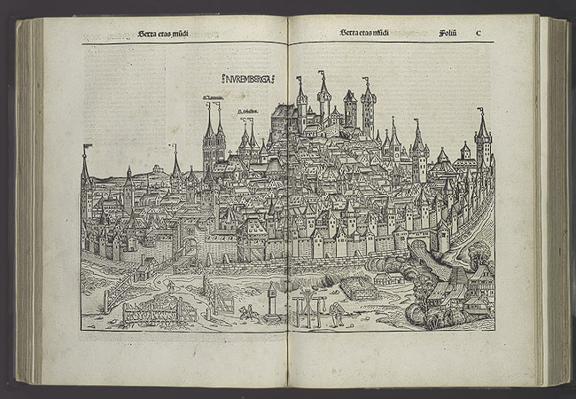
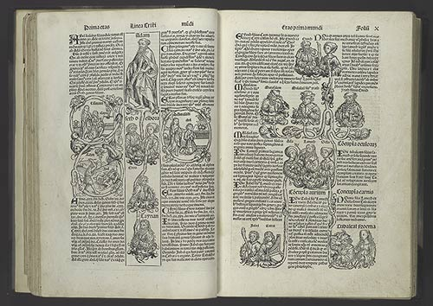
Renaissance Ideas Spread to Northern Europe
2. How did the invention of the printing press help spread learning and
Renaissance ideas?
Lowered price of books; more people could afford them;
books now written in the vernacular so people who had
no classical education (in Latin) could now read the classics;
this all led to increased literacy
as well as ordinary people’s awareness of what was happening
in their larger world.
How did they put pictures in books
now printed with the movable type press?
PP Design of T. Loessin; Akins High School

Slide 9
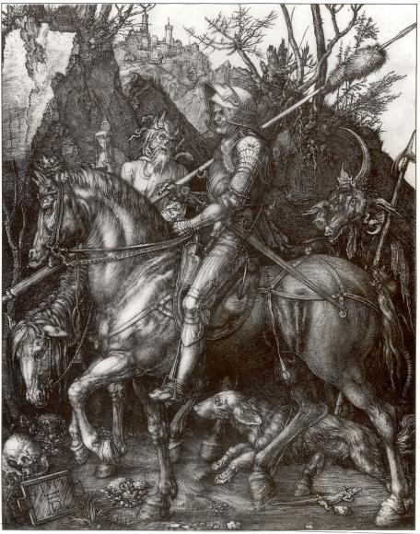
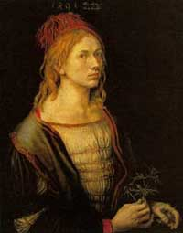
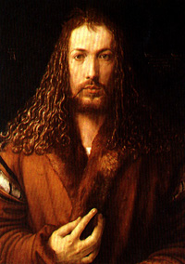
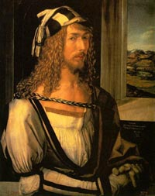
Artistic Ideas Spread to Northern Europe
Albrecht Durer – produced woodcuts and engravings whose realism influenced other northern artists.
His works were not just religious subject matter but showed classical mythology and realistic landscapes.
“Knight, Death,
and the Devil”
-engraving by
Albrecht Durer
PP Design of T. Loessin; Akins High School
Notes:
Shown here are Durer's own self-portraits at ages 22, 26 and 28 (now in the collections of the Louvre, Prado and Alte Pinakothek of Munich).

Slide 10
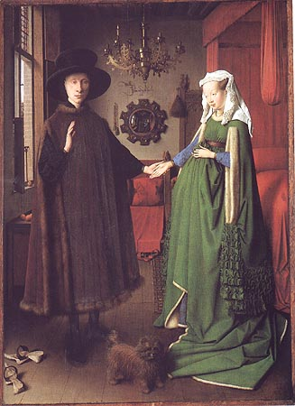
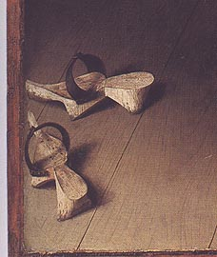
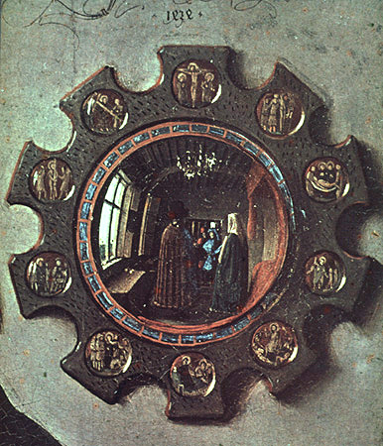
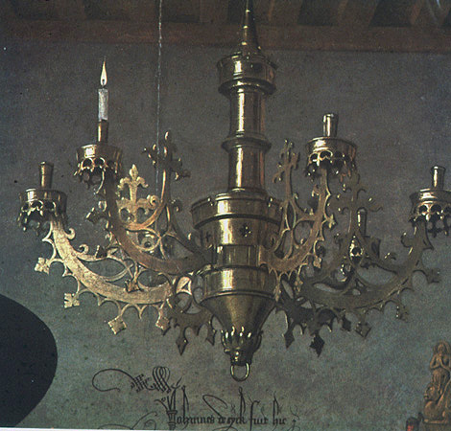
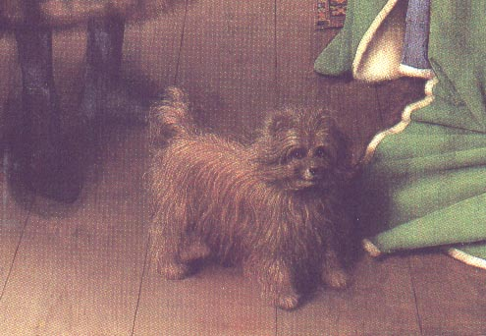
Artistic Ideas Spread to Northern Europe
Jan van Eyck – developed new creative techniques to achieve most realistic detail with oil-based paints, applying several layers to create variety of colors and 3-D appearance to clothing / jewelry.
“Wedding Portrait” *
-Jan van Eyck
PP Design of T. Loessin; Akins High School

Slide 11
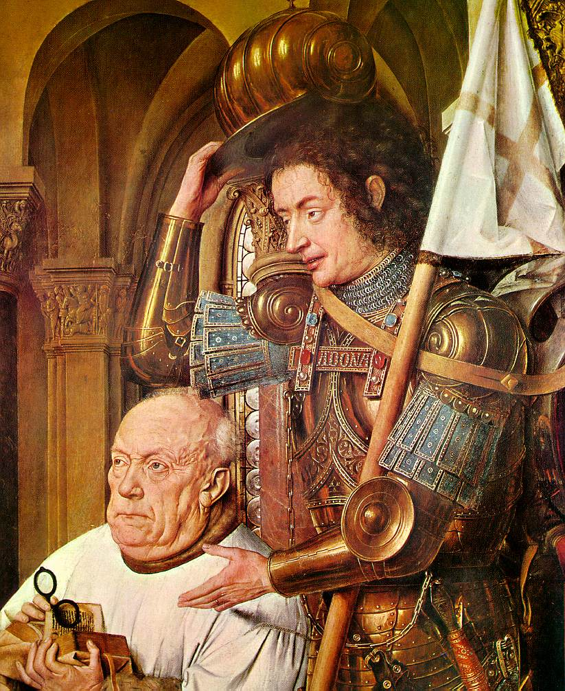
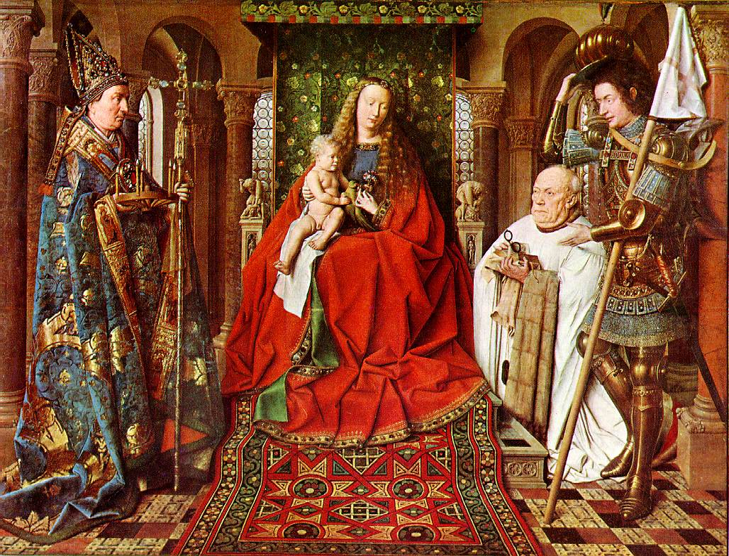
Van Eyck, Jan
The Madonna with Canon van der Paele
1436 Oil on panel 122 x 157 cm Het Groeninge Museum, Brugge
Notes:
Van Eyck, Jan
The Madonna with Canon van der Paele
1436
Oil on panel
122 x 157 cm
Het Groeninge Museum, Brugge

Slide 12
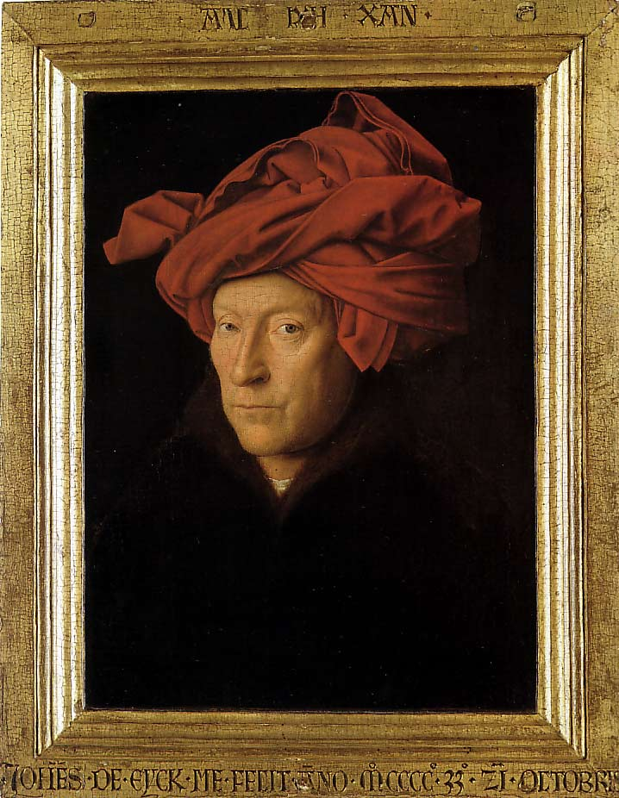
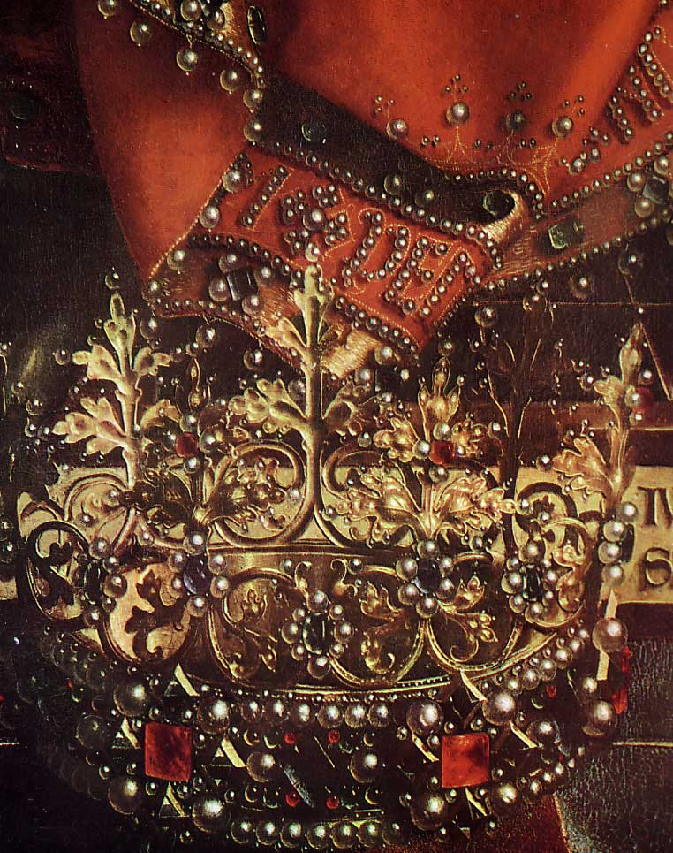
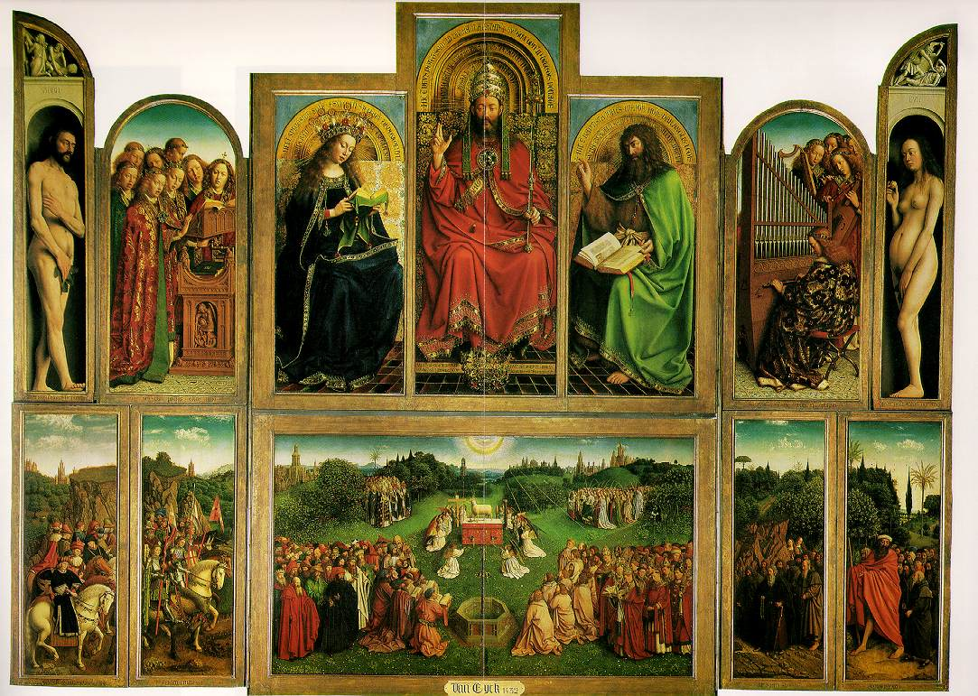
Notes:
Ghent alterpiece
Man in Turban

Slide 13
Artistic Ideas Spread to Northern Europe
Jan van Eyck – developed new creative techniques to achieve most realistic detail with oil-based paints, applying several layers to create variety of colors and 3-D appearance to clothing / jewelry.
“Wedding Portrait” *
-Jan van Eyck
PP Design of T. Loessin; Akins High School

Slide 14
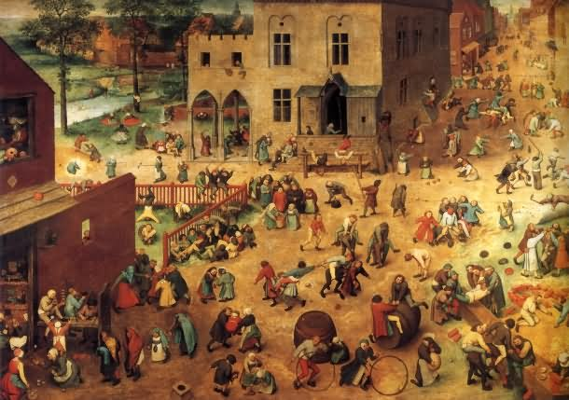
Artistic Ideas Spread to Northern Europe
Pieter Bruegel the Elder – Painted mostly scenes of everyday life – focused on realism and individual characteristics. Produced paintings that taught morals, illustrated proverbs, and strongly protested Spanish rule over his country.
“Children’s Games” *
- Pieter Bruegel the Elder
PP Design of T. Loessin; Akins High School

Slide 15
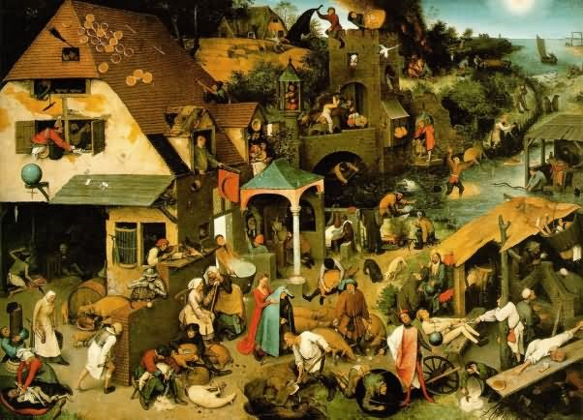
Bruegel’s “Netherland’s Proverbs,” 1559

Slide 16
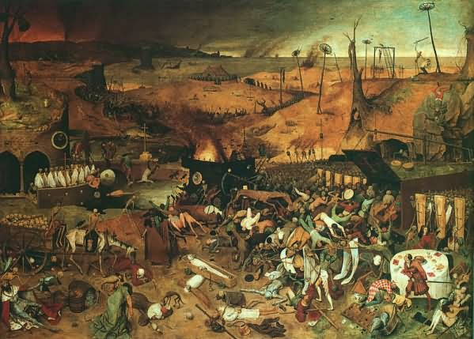
Bruegel’s “The Triumph of Death,” 1562

Slide 17
Artistic Ideas Spread to Northern Europe
Pieter Bruegel the Elder – Painted mostly scenes of everyday life – focused on realism and individual characteristics. Produced paintings that taught morals, illustrated proverbs, and strongly protested Spanish rule over his country.
“Children’s Games” *
- Pieter Bruegel the Elder
PP Design of T. Loessin; Akins High School

Slide 18
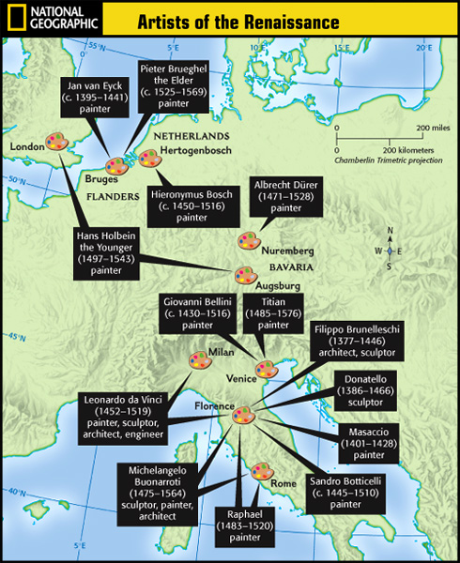


Slide 19
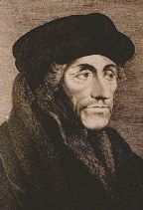
Northern Writers Try to Reform Society
“Northern Renaissance writers also adopted the ideas of Humanism...
however, some gave it a more religious slant
Desiderius Erasmus – a Christian humanist, wrote “The Praise of Folly” which poked fun at people’s human flaws such as greedy merchants, arrogant priests, etc. He believed mankind could improve society by reading the Bible and that Christianity was about “the heart” and not a bunch of “rules and ceremonies” done in Church.
Examining a Primary Source:
“In Praise of Folly,”
packet p. 17a – 17b
Erasmus was from the
Dutch region of Holland
and received many honors
in his lifetime. He was often critical of the “mindless” rituals Christians performed during church services and their ignorance about the actual Bible itself.
“It is the chief point of happiness when a man is willing to be what he is -
not what others would have him be.” ~ Erasmus, 1527.
PP Design of T. Loessin; Akins High School

Slide 20
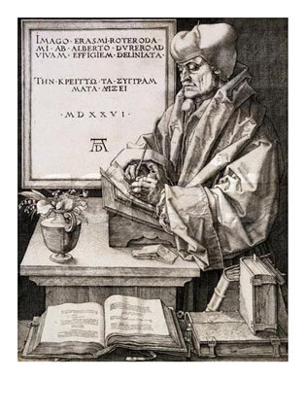
An illustration Albrecht Durer did
of someone he admired
in his own lifetime –
the Dutch Humanist, Erasmus.
PP Design of T. Loessin; Akins High School

Slide 21
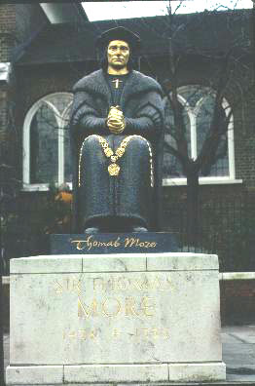
Northern Writers Try to Reform Society
Thomas More – an English humanist concerned about society’s
problems. He wrote “Utopia,” about an ideal model of society.
Utopia is Greek for “no place” – More’s sense of humor is shown since this perfect society he gives this name to clearly did not exist.
More served as Speaker in the House of Commons and Lord Chancellor during the reign of King Henry VIII of England. When Henry began his plan to separate the Church of England from the Catholic Pope, More defended Catholicism and the struggle with his king would lead eventually to his trial for treason and his beheading in 1535 at the Tower of London.
The events are dramatized in a classic film entitled “ A Man for All Seasons”,
Statue of More in Chelsea, London
PP Design of T. Loessin; Akins High School

Slide 22
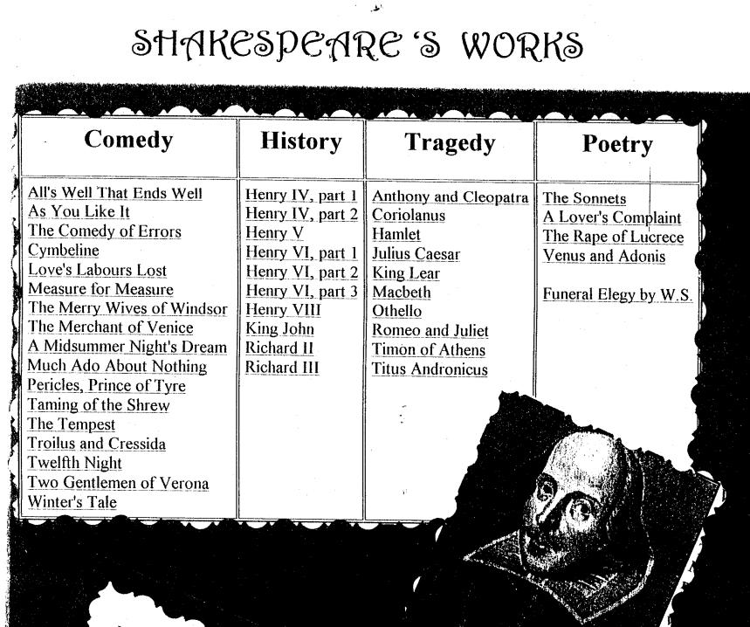
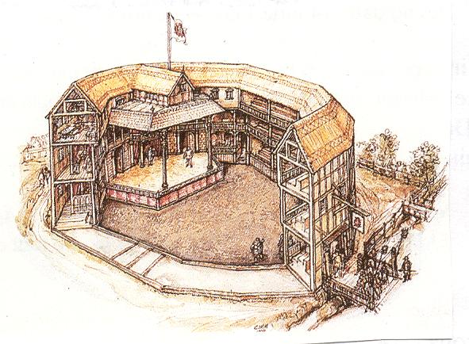
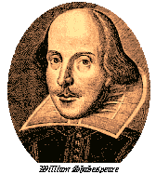
Northern Writers Try to Reform Society
William Shakespeare – English playwright whose plays
examine human flaws but also express the Renaissance view of
humanity’s potential. Many of his plays focus on Greek or
Roman subjects and classical plots.
The Globe Theater
Shakespeare had this “theater in the round” built on the banks of the Thames River in London, 1599 – 1614.
PP Design of T. Loessin; Akins High School

Slide 23
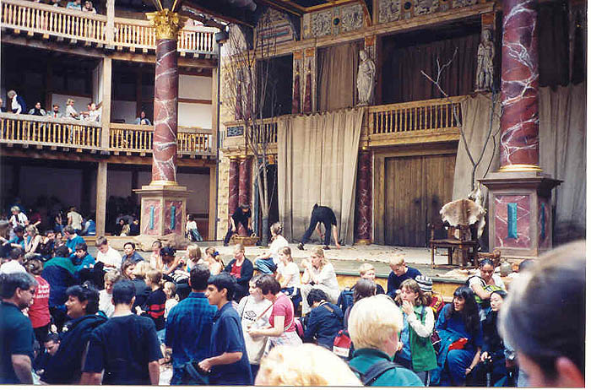
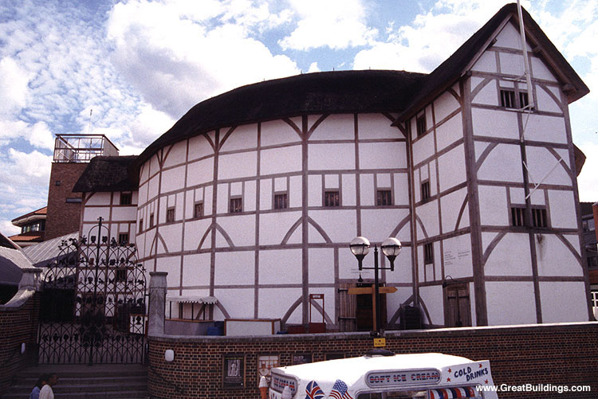
The famous Globe theater was recently rebuilt in London to the same specifications as
Have you seen the 1998 film “Shakespeare in Love” ?
If not, you really should!
Shakespeare had
designed…
every detail was copied even the types of building materials, theater seating (standing!), and the paint used in the
original 17th c. building.
PP Design of T. Loessin; Akins High School

Slide 24
TODAY’S ACTIVITIES:
Explain the origins and characteristics of the Northern Renaissance.
Trace the impact of the Renaissance on German and Flemish painters.
Profile key northern Renaissance writers.
Explain how the invention of the printing press spread Renaissance ideas.

