Slide 1
PRIMARY SECTOR: AGRICULTURE
MARÍA SANZ

Slide 2
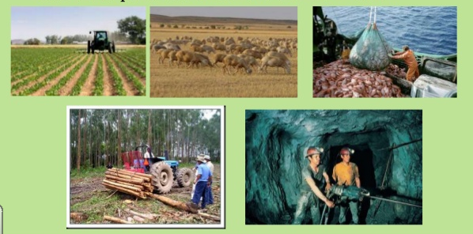
Definition
The Primary Sector consists of economic activities tha obtain resources from nature.

Slide 3
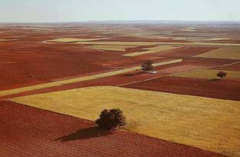
Agricultural space
People modify natural areas in order to use them for crop agriculture, livestock farming or forestry.
As a result of this transformation we have an agricultural space.

Slide 4
Agricultural space
Factors
Phisical factors
Human factors
Climate
Relief
Soil
Vegetation
Population growth
Economic and technological donditions
Land ownership
Farm size
Agricultural policy
Customs

Slide 5
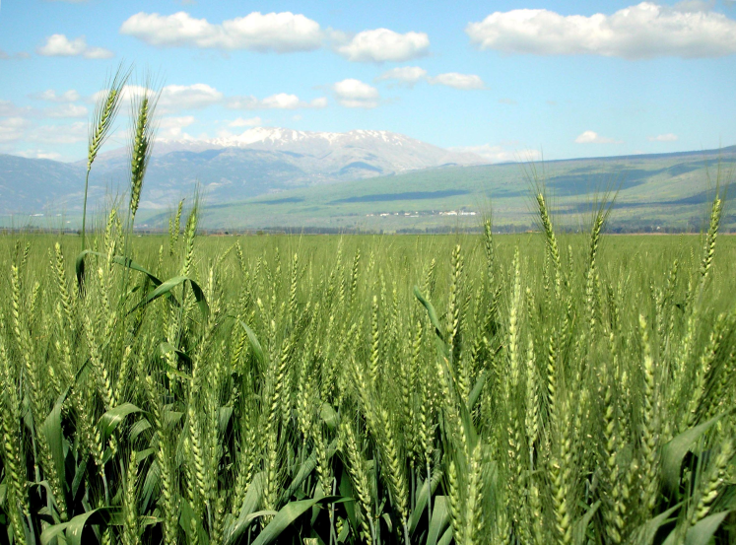
PHISICAL FACTORS
TEMPERATURE AND RAINFALL
  Plants need to grow:
    minimum temperatures: 10ºC-45ºC
    Rainfall (900-1200 mm annually)

Slide 6
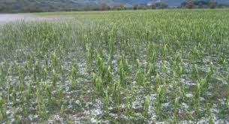
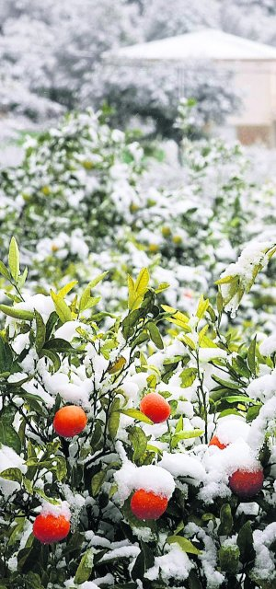
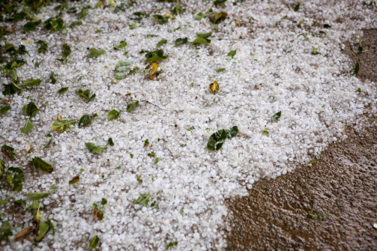
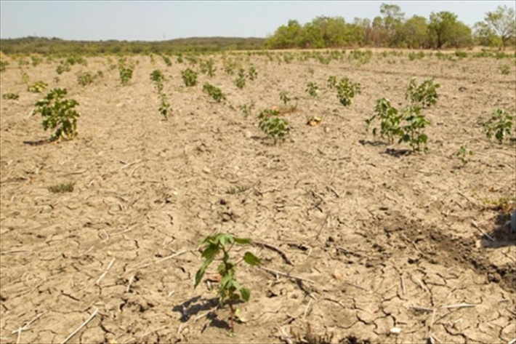
PHISICAL FACTORS
ADVERSE PHENOMENA

Slide 7
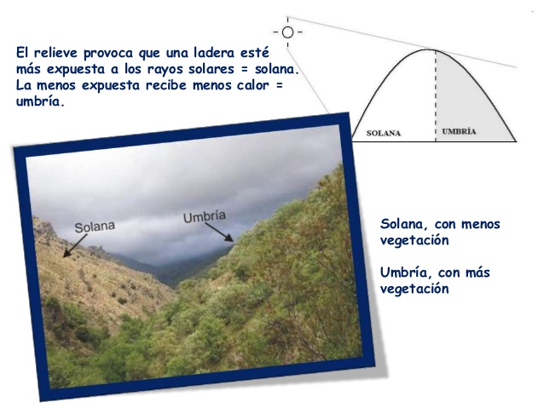
PHISICAL FACTORS
RELIEF
Sunny and shady sides of mountains.
Sunny south-facing sides are more appropiate for crops.
Shady north-facing sides

Slide 8
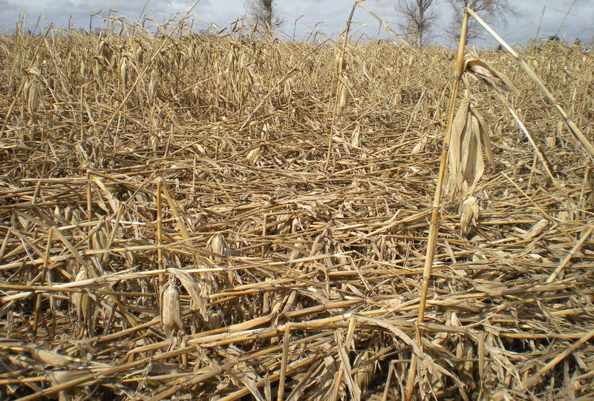
PHISICAL FACTORS
RELIEF
  Exposure to the wind: strong winds can damage crops.

Slide 9
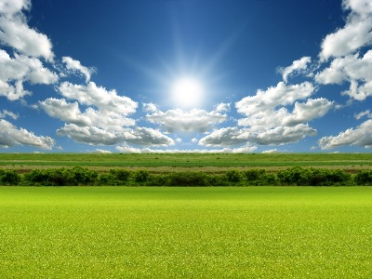
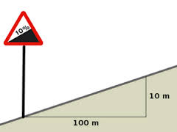
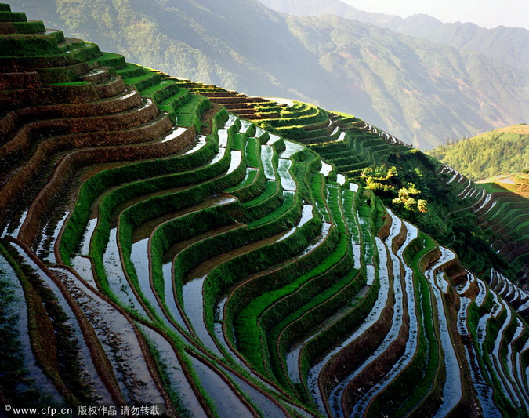
PHISICAL FACTORS
RELIEF
  Incline of slopes:
  flat surfaces facilitate agricultural work and very steep slopes make it more difficult.
  Gradients of terrain above 10ºC make it impossible to cultivate the land.
  Where it´s necessary, hard work can transform mountainsides into cultivated terraces.

Slide 10
PHISICAL FACTORS
RELIEF
  Altitude:
    for every 1000 m of altitude, temperatures fall by 6ºC.
    For this reason, after a certain altitude, cultivation is no longer possible.

Slide 11
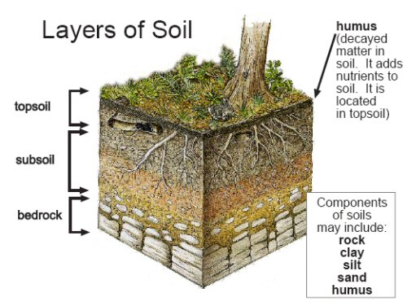
PHISICAL FACTORS
SOIL
  Thickness
    Deep soil is more appropiate for the cultivation of most crops because roots have more space to expand.

Slide 12
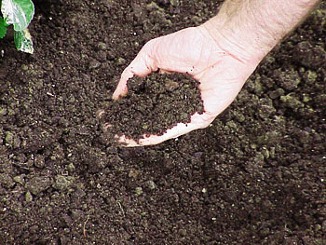
PHISICAL FACTORS
SOIL
  Nutrients
    The more appropiate nutrients the soil has, the better it is for agriculture.

Slide 13
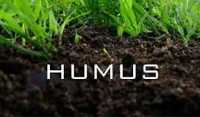
PHISICAL FACTORS
  VEGETATION
    Vegetation provides the soil with humus, so the more vegetation an area has, the more fertile the soil will be.

Slide 14
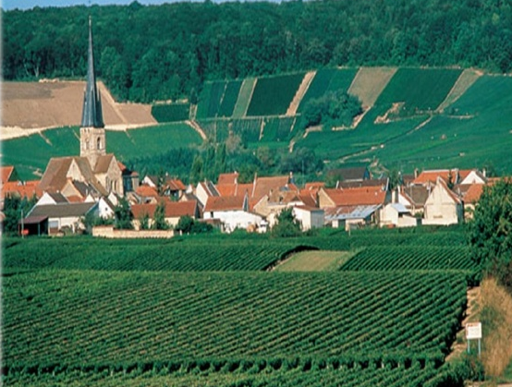
HUMAN FACTORS
POPULATION GROWTH
  The extension of agricultural space depends on it:
    The more population an area has, the more agricultural space they need to produce more food.

Slide 15
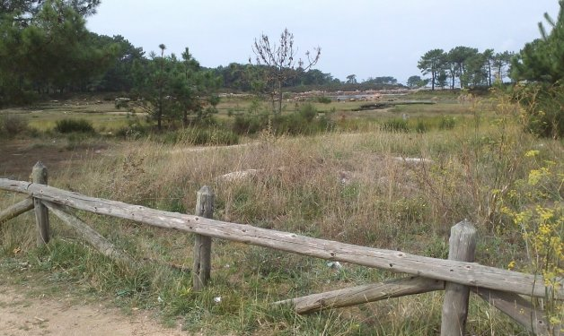
HUMAN FACTORS
POPULATION GROWTH
  The extension of agricultural space depends on it:
    A decrease in population means that cultivated land is abandoned because:
      there are not enough people to work the land
      It is not necessary to produce so much

Slide 16
HUMAN FACTORS
ECONOMIC AND TECHNOLOGICAL CONDITIONS
A country´s economy and the demand for certain products influence
The choice of crops
The technology used
The composition of agricultural space
Machinery
Fertilisers*
Pesticides*

Slide 17
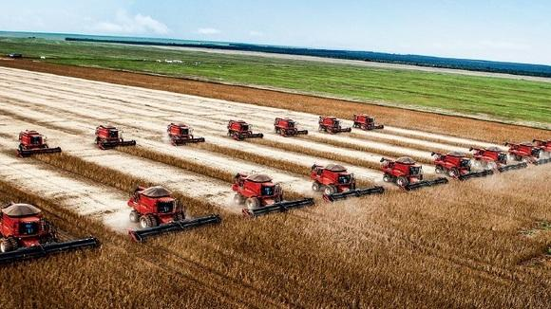
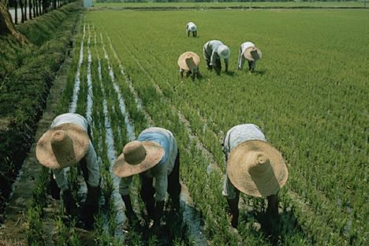
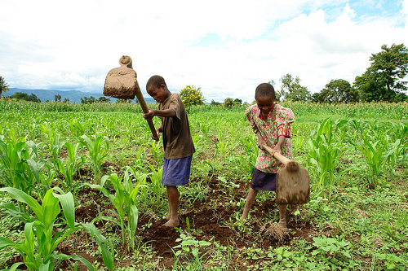

Slide 18
HUMAN FACTORS
LAND OWNERSHIP
Cultivated land ownership
One person
Several people
Individual ownership
Municipality
Cooperative*
company

Slide 19
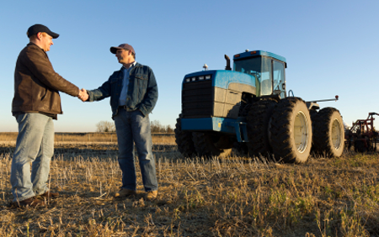

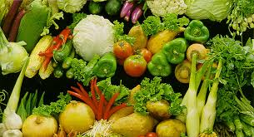
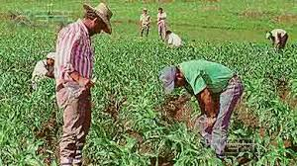
HUMAN FACTORS
LAND OWNERSHIP
Cultivated land work
The owner works the land directly
The owner transfers the land o other farmers who lease it
leasing*
The owner transfers the land to other farmers who work it as shrecroppers
Sharecropping*
The owner can also employ day labourers*

Slide 20
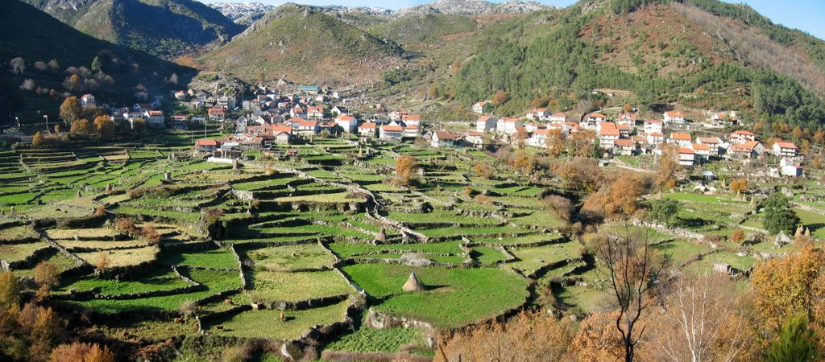
HUMAN FACTORS
FARM SIZE
  SMALLHOLDINGS

Slide 21
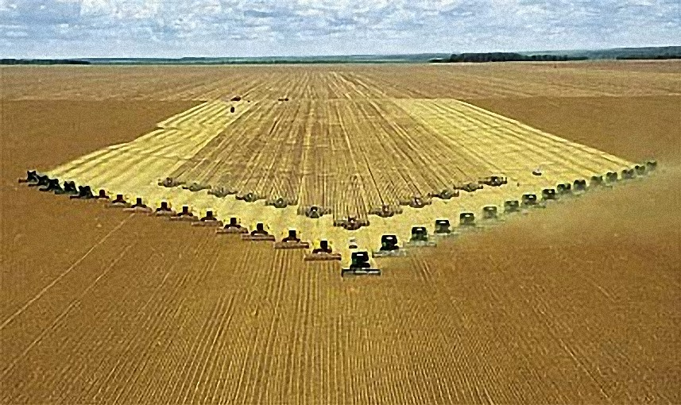
HUMAN FACTORS
FARM SIZE
  LARGE ESTATES

Slide 22





HUMAN FACTORS
AGRICULTURAL POLICY
  Measures and actions taken by:
    National government
    International institutions
  These measures affect crop agriculture and livestock farming.

Slide 23
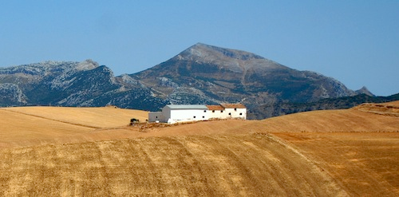
HUMAN FACTORS
CUSTOMS
  In some regions the land children inherit from their parents is not divide up:

Slide 24
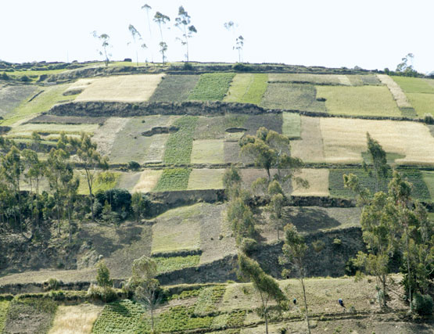
HUMAN FACTORS
CUSTOMS
  In other regions, children inherit a piece of their parent´s land:

Slide 25
STRUCTURE OF AGRICULTURAL SPACE
STRUCTURE
Cultivated space
Inhabited space

Slide 26
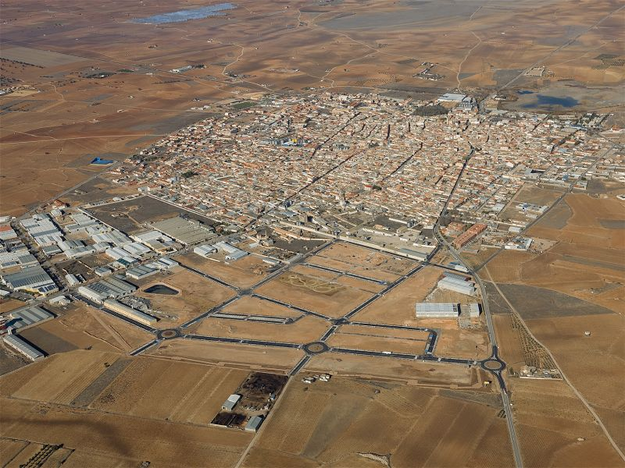
STRUCTURE OF AGRICULTURAL SPACE
INHABITED SPACE: Small towns

Slide 27
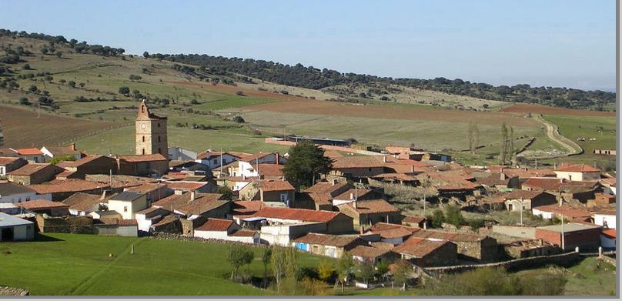
STRUCTURE OF AGRICULTURAL SPACE
INHABITED SPACE: Villages

Slide 28
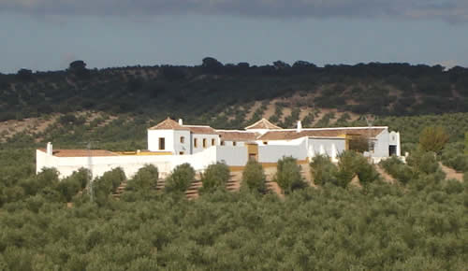
STRUCTURE OF AGRICULTURAL SPACE
INHABITED SPACE: Individual farms

Slide 29
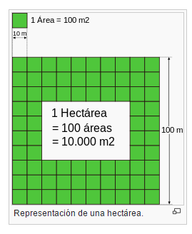
STRUCTURE OF
AGRICULTURAL SPACE
CULTIVATED SPACE
SIZE
Small
Medium
Large
Less than 1 ha
1ha – 10ha
More than 10 ha
1 ha = 10,000 m2

Slide 30
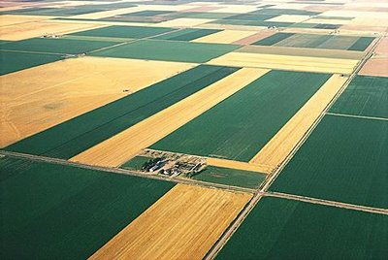
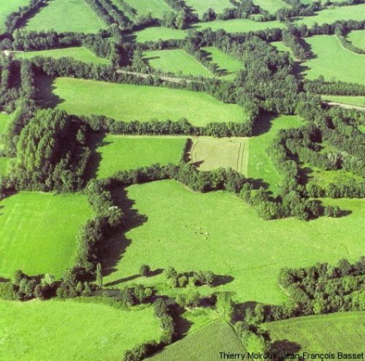
STRUCTURE OF
AGRICULTURAL SPACE
CULTIVATED SPACE: SHAPE
Regular or geometrical
Irregular

Slide 31
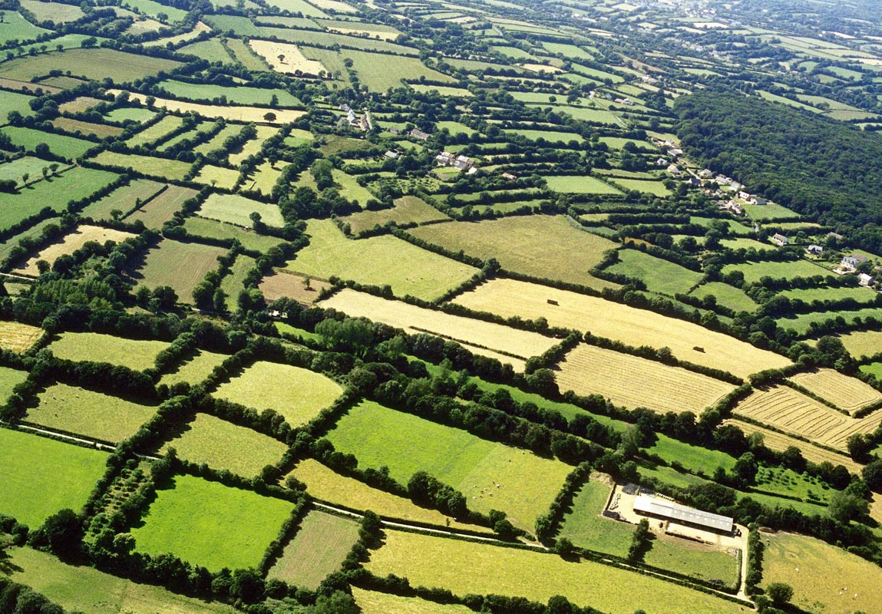
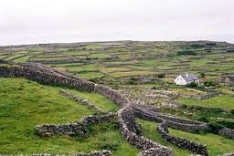
STRUCTURE OF
AGRICULTURAL SPACE
CULTIVATED SPACE: PLOT BOUNDARIES
BOCAGE
Small fields are separated by hedges, trees, stone or wooden fences.

Slide 32
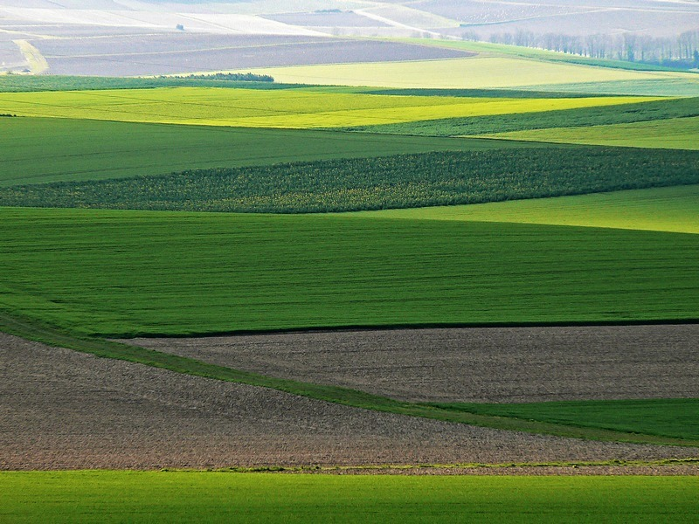
STRUCTURE OF
AGRICULTURAL SPACE
CULTIVATED SPACE: PLOT BOUNDARIES
OPENFIELD
Fields are open
Fields can only be differentiated by the type of crops ore the way they are used.

Slide 33
FARMING SYSTEMS
Depending on the use of water
Irrigated agriculture
Rain-fed agriculture

Slide 34
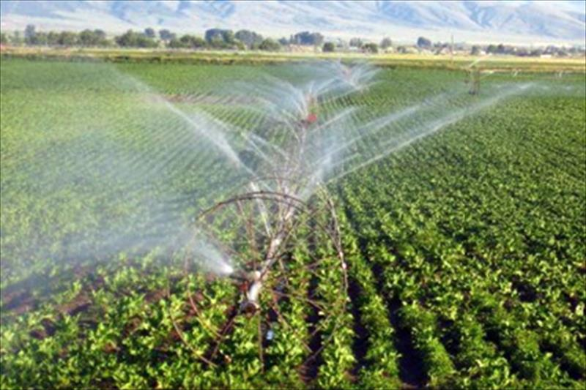
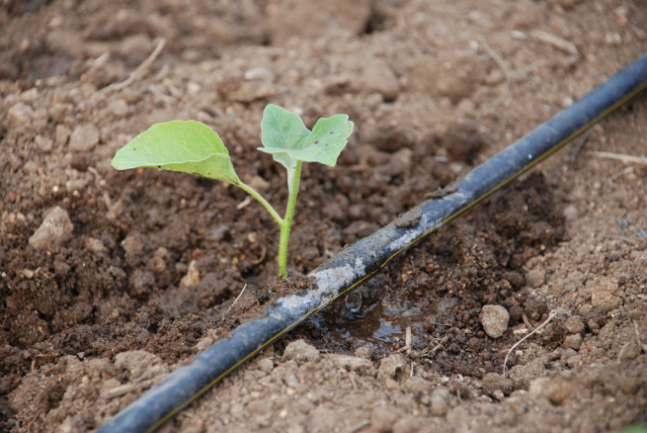
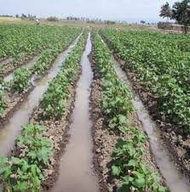
IRRIGATED AGRICULTURE
Crops receive water from man-made irrigation systems.
Drip irrigation
Sprinklers
Flood irrigation

Slide 35
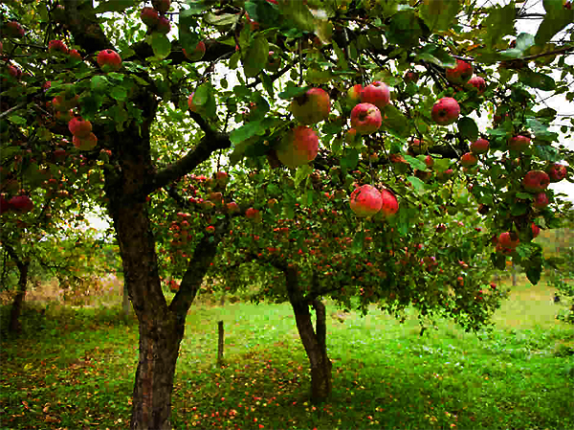
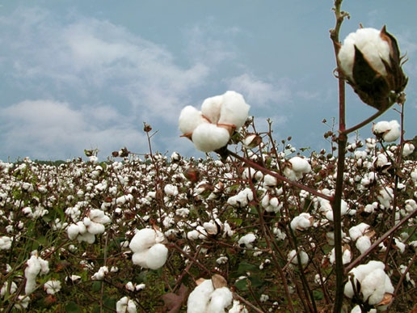
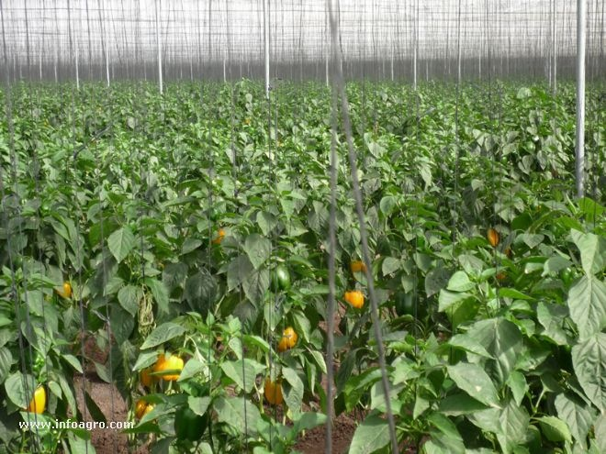
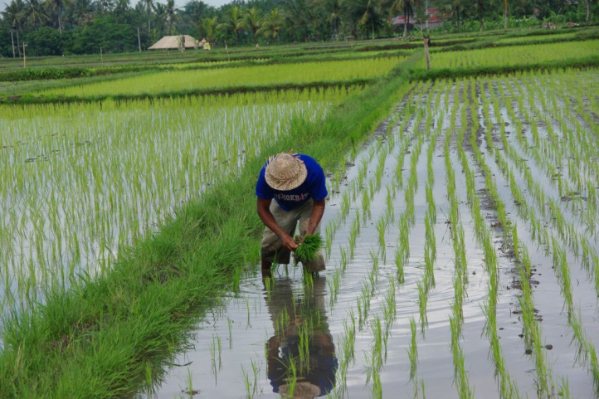
IRRIGATED AGRICULTURE
Cotton
Fruit trees
Vegetables
Rice

Slide 36
FARMING SYSTEMS
Depending on the variety of species
Monoculture
Mixed cropping

Slide 37
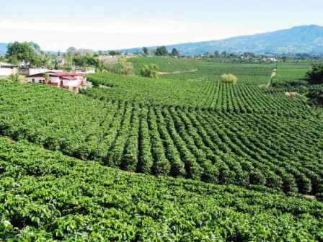
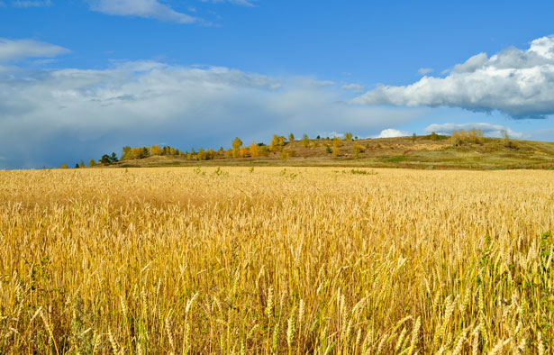
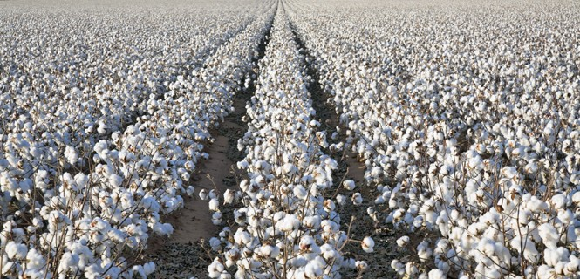
MONOCULTURE
The cultivation of a single species in an agricultural area.
Cereals
Coffee
Cotton

Slide 38
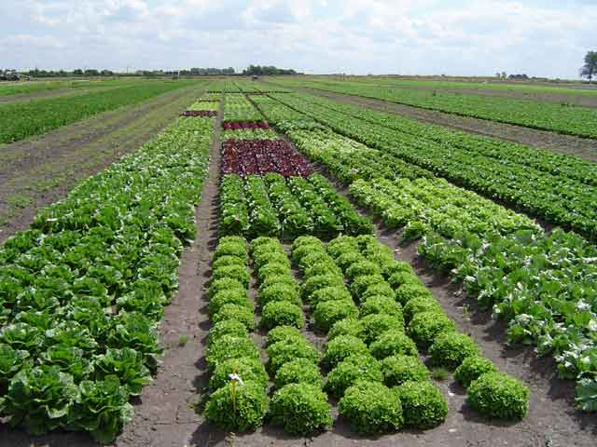
MIXED CROPPING
The cultivation of several species in an agricultural area.
Mixed crops grown by irrigated agriculture include:

Slide 39
FARMING SYSTEMS
Depending on the utilisation of the soil
Intensive agriculture
Extensive agriculture

Slide 40
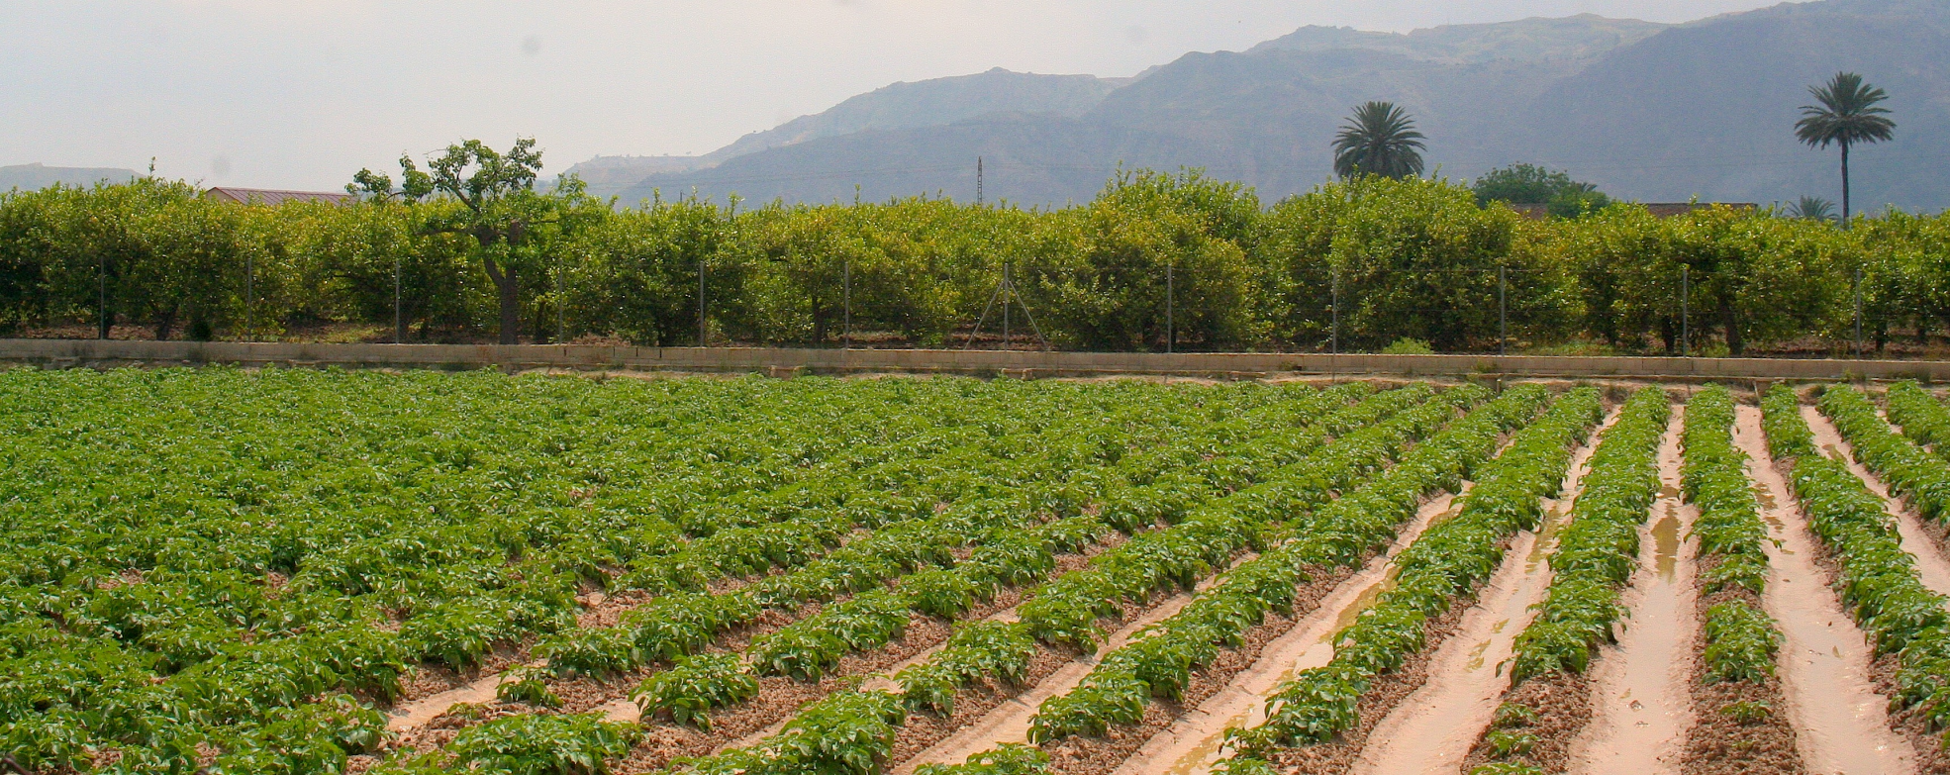
INTENSIVE AGRICULTURE
High capital investment (in tools, machinery, equipment, etc)
A lot of workers (labour)
Maximum yield for commercial purposes
Market gardens of Valencia and Murcia

Slide 41
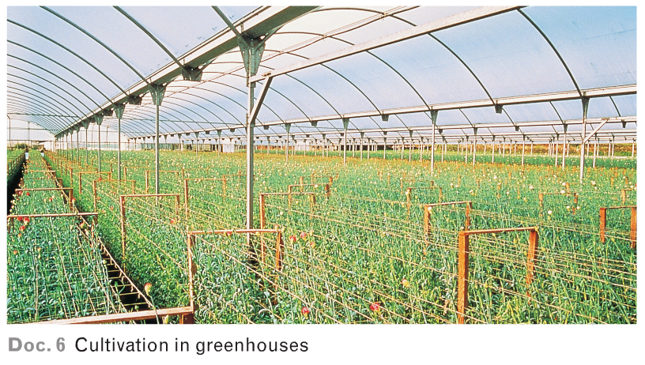
INTENSIVE AGRICULTURE
High capital investment (in tools, machinery, equipment, etc)
A lot of workers (labour)
Maximum yield for commercial purposes

Slide 42
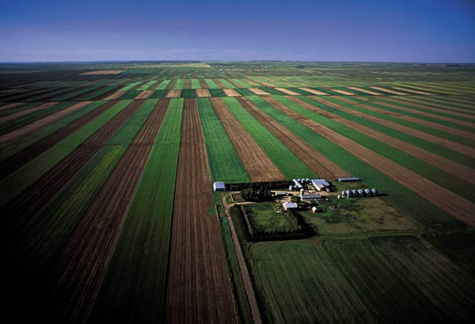
EXTENSIVE AGRICULTURE
It does not use all the technological or human resources (workers) available to obtain the maximum yield.
Production can be for sale:
  E.g. on the
  wheat plains in
  the USA
It explots part
of the plot,
dedicating
the rest to
regeneration of
fertility.

Slide 43
EXTENSIVE AGRICULTURE
La tradicional no cultiva todo el suelo, dejando una parte en barbecho, para evitar su agotamiento;
en cambio, la agricultura extensiva moderna no cultiva todo el suelo porque no es necesario, pues las parcelas son grandes y se emplean tecnicas modernas, ante la escasez de mano de obra.

Slide 44
AGRICULTURAL LANDSCAPES
Agricultural activities create different types of agricultural landscape.
Agricultural activities
Subsistence agriculture
Commercial agriculture

Slide 45
SUBSISTENCE AGRICULTURE
Subsitence agriculture
Ancient techniques
Low productivity
Most products are for farmer´s own consumption

Slide 46




SUBSISTENCE AGRICULTURE
Slash-and-burn agriculture
To prepare the land, the vegetation is cut down and burnt, and the ashes are used as fertiliser.

Slide 47



SUBSISTENCE AGRICULTURE
Slash-and-burn agriculture is used to grow millet sorghum tapioca

Slide 48



SUBSISTENCE AGRICULTURE
Intensive agriculture of Monsoon Asia
Rice is grown on small plots.

Slide 49
COMMERCIAL AGRICULTURE
Commercial agriculture
High investment
Advanced techniques
High productivity
High yield
Drip irrigation, greenhouses, fertilisers…
Crops are produced for commercial purposes

Slide 50



COMMERCIAL AGRICULTURE
Advanced agriculture of Europe
Cereals
Flowers
Market garden products

Slide 51



COMMERCIAL AGRICULTURE
Mediterranean agriculture
Rain-fed agriculture
Wheat
Vines
Olives

Slide 52


COMMERCIAL AGRICULTURE
Mediterranean agriculture
Irrigated agriculture
Fruit trees
Vegetables

Slide 53

COMMERCIAL AGRICULTURE
Extensive New World agriculture
Large farms employ few workers and use a lot of machinery.
They mostly
grow cereals.

Slide 54





COMMERCIAL AGRICULTURE
Plantations
Plantations are owned by big multinational companies.
Cocoa
Tea
Coffee
Bananas
Pineapples

