Slide 1
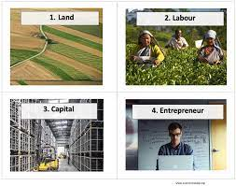
FACTORS OF PRODUCTION
IES SAN JUAN BAUTISTA
MARÍA SANZ

Slide 2

An entrepreneur is a risk-taker in search of profits.

Slide 3
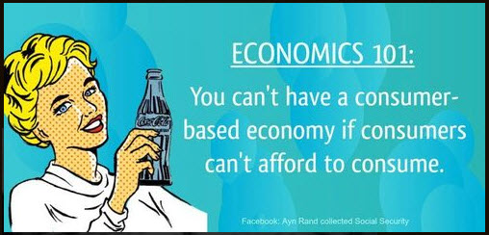

Slide 4
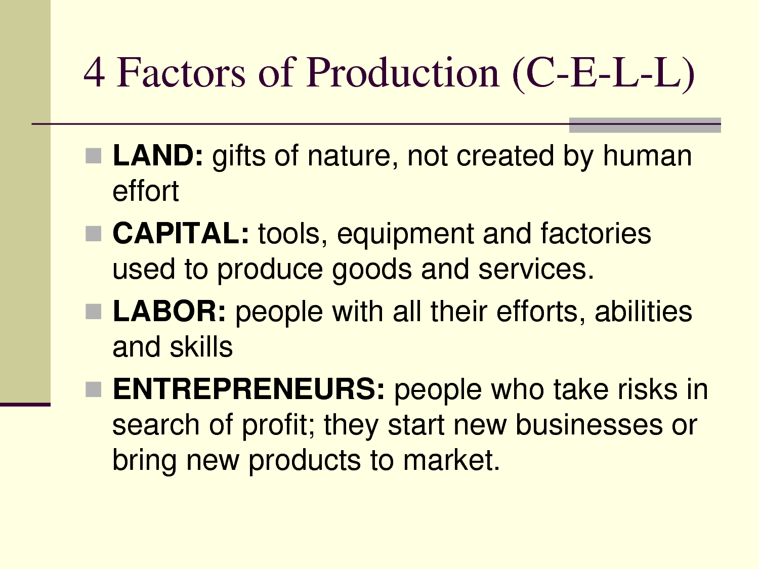

Slide 5
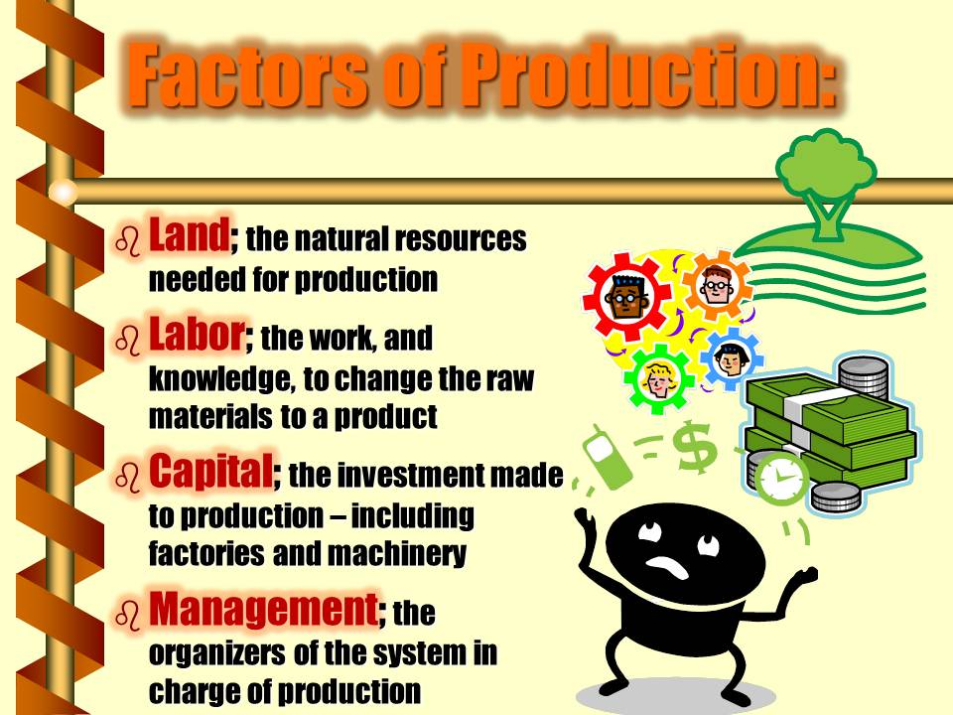

Slide 6
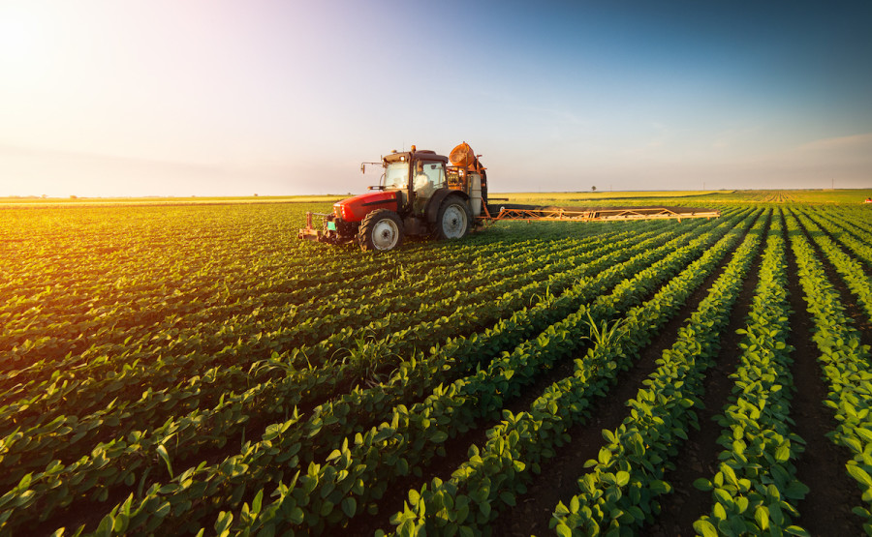
FACTORS OF PRODUCTION: LAND
LAND
The entire material universe exclusive of people and their products
◦Everything physical (other than human beings) which is not the result of human effort is within the economic definition of land.
This concept thus includes not merely the dry surface of the earth, but all natural materials, forces and opportunities.
The trees in a virgin forest are land; in a cultivated forest they are wealth.

Slide 7

FACTORS OF PRODUCTION: LABOUR
**All human exertion in the production of wealth
All who participate in production by their mental and/or physical effort are laborers in the economic sense. This would include their efforts, abilities and skills.

Slide 8
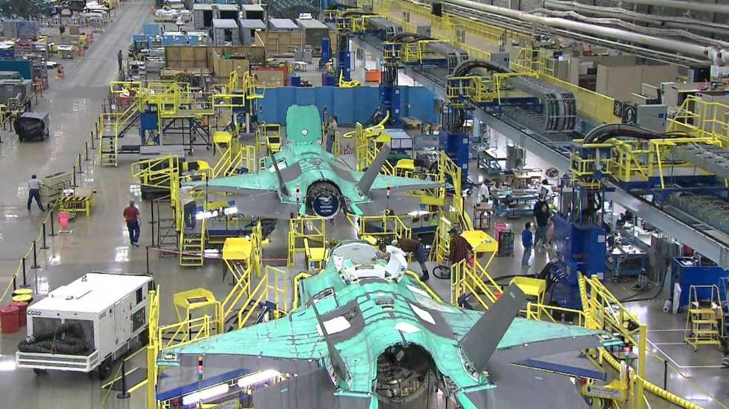
CAPITAL
Wealth used to produce more wealth, or wealth in the course of exchange.
A machine is wealth. If used to produce shoes or other wealth, the machine is wealth that is capital (capital good). So also would a merchant’s stock (inventory) of goods in trade be capital because the final exchange is not been completed.

Slide 9
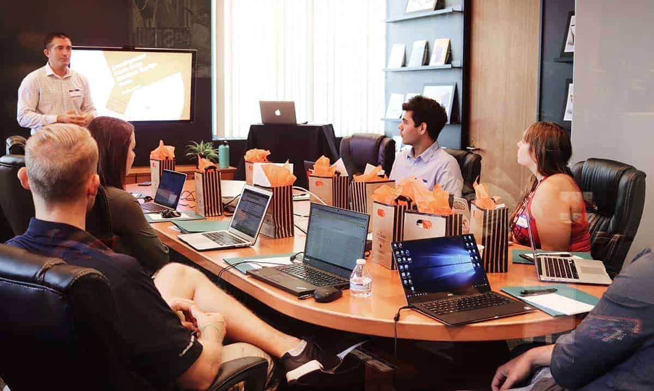
Entrepreneurship

Slide 10
PRODUCTION
When all factors of production (land, labor, capital and entrepreneurship) are present, production, or the process of creating goods and services, can take place.
Note!! Everything we produce require these factors.
GDP –The total production of goods and services created within a country during a calendar year.
gross domestic product (GDP)

Slide 11
The Factors of Production
All the processes involved in making wealth and bringing it from its place of origin to the ultimate consumer.
Land
Labor
Capital
Entrepreneurship

Slide 12
A free enterprise economy
is an economic system where businesses can operate competitively with minimal government regulations and consumers choose to purchase what they desire.
Standard of Living is the quality of life based on the possessions of the necessities and luxuries that make life easier.

Slide 13
Basic Business Concepts
Goods – items that are economically useful or satisfies an economic want
Consumer Goods – used by individuals to satisfy personal needs
Capital Goods – Goods used to produce other goods (Machines and tools)
Services – work that is preformed for someone or an act of assistance
Consumer(s) – a person who uses a good or service

