Slide 1
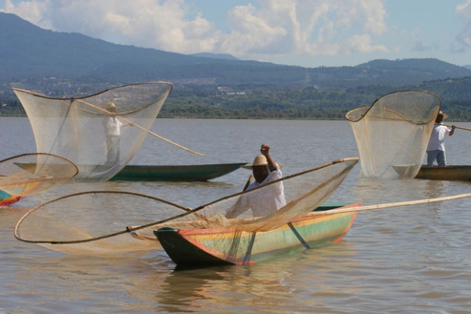
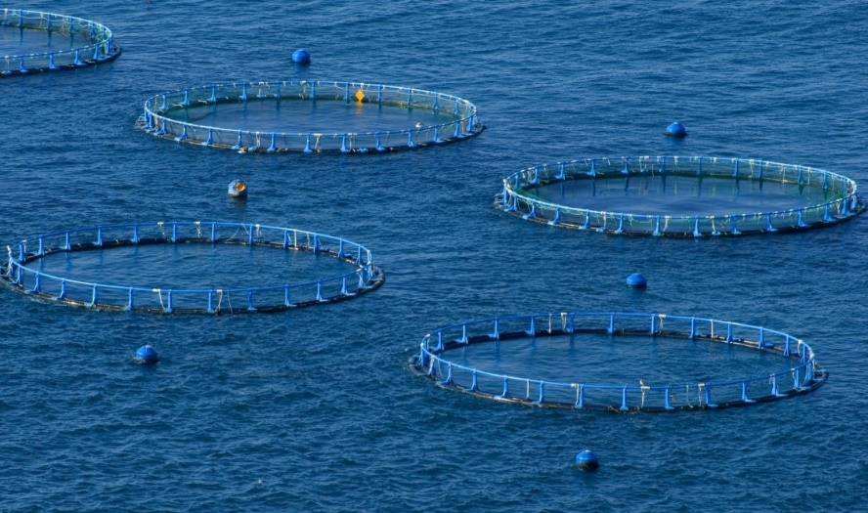
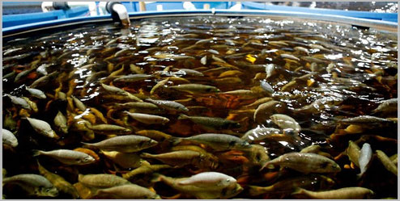
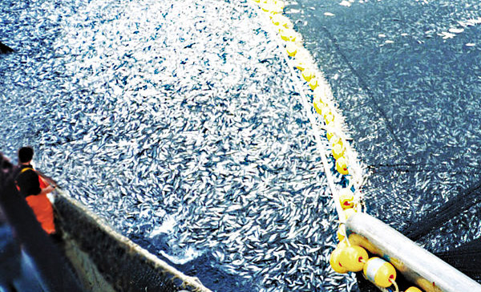
Fishing
IES SAN JUAN BAUTISTA
MARÍA SANZ
IES M ANUEL D

Slide 2
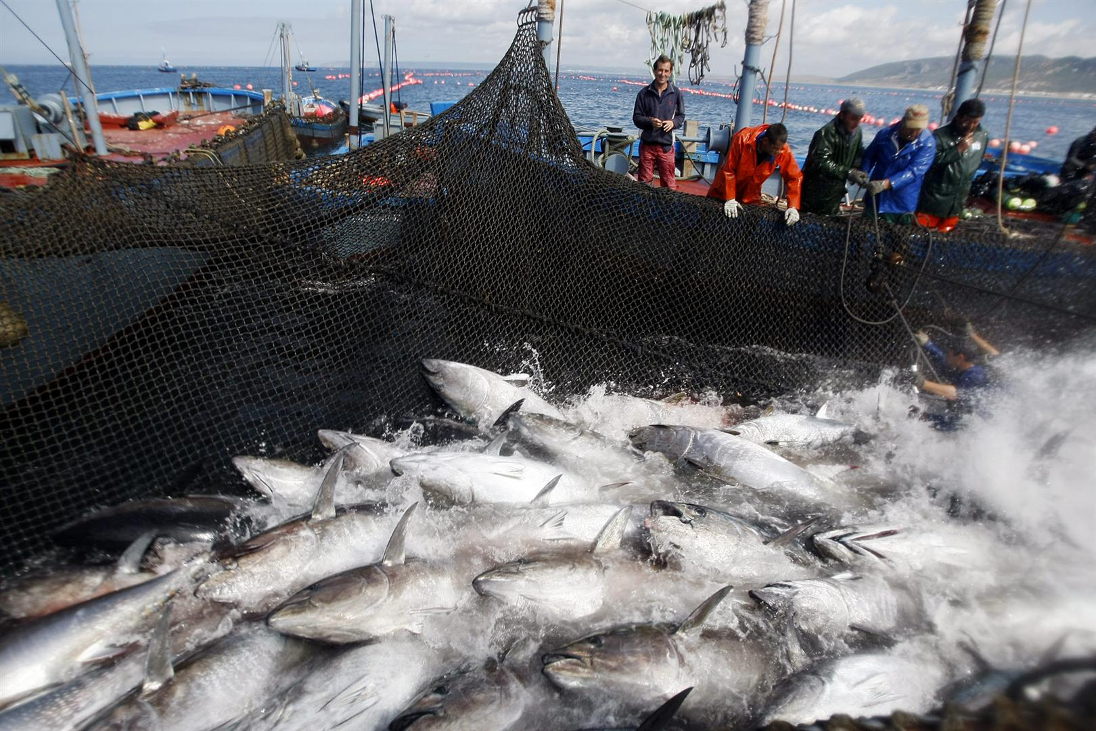
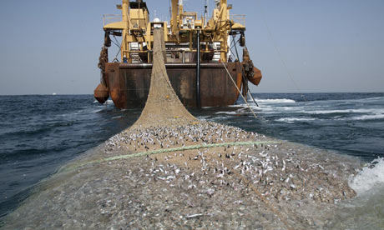
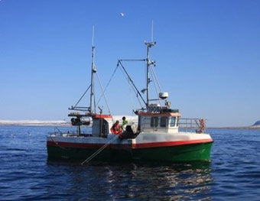
Fishing is the practice of catching fish and other water species for food or as raw materials for industry.
85% of the catching is for human consumption
Fish is more consumed in developed countries being imported from emerging and less developed countries.
China is highest fish production as well as the highest consumption per capita .

Slide 3
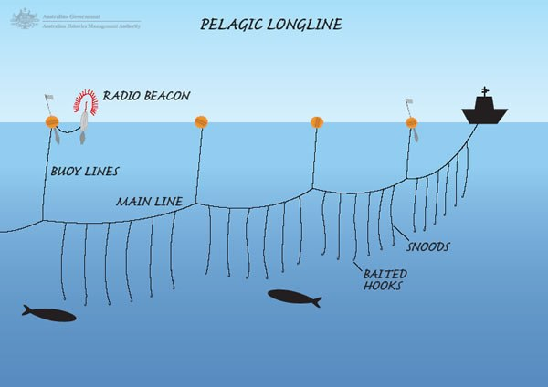
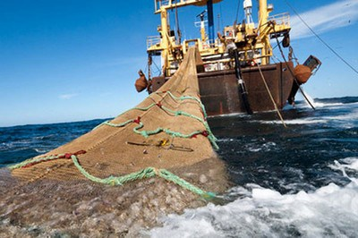
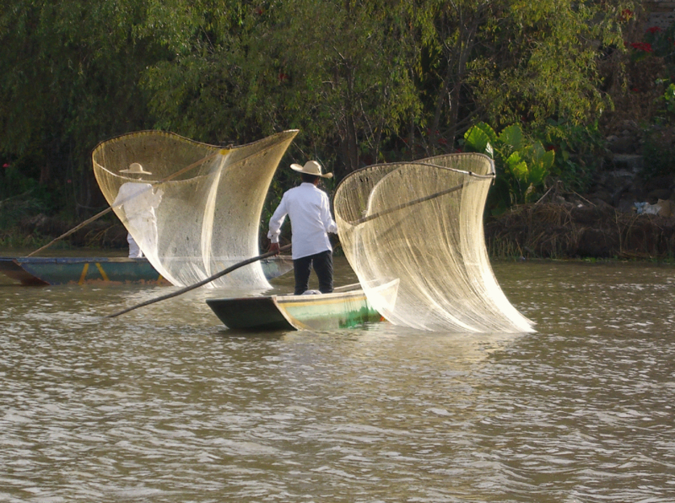
Longline fishing trawling lift netting
FISHING TECHNIQUES

Slide 4
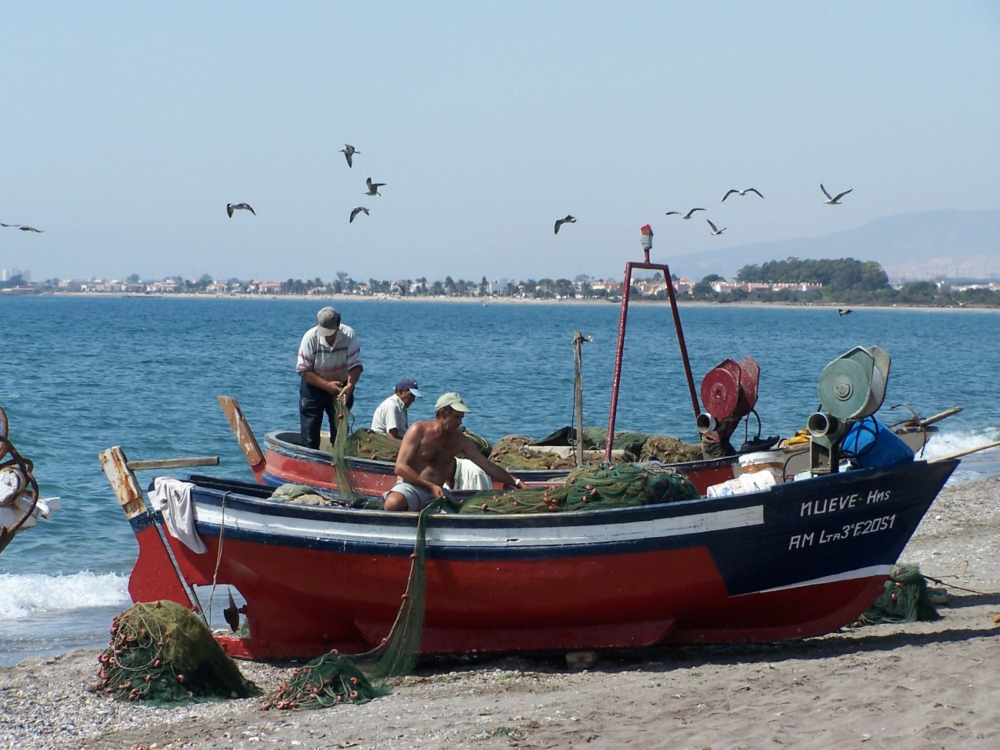
Types of fishing (I)
TRADITIONAL FISHING OR COASTAL FISHING uses small boats and it is done near the coast during the day and every day the fisherman sells his fish in the fish-market. It uses simple fishing techniques: hooks, networks, harpoons… This type of fishing play an important role in developing countries diet.

Slide 5
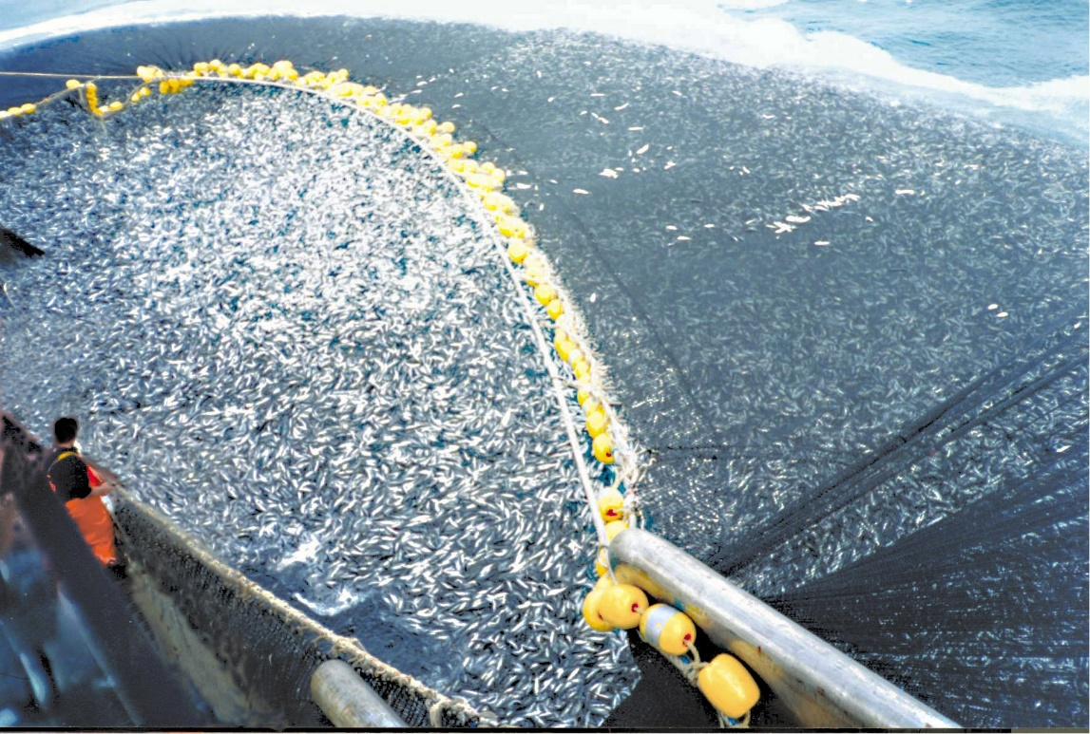
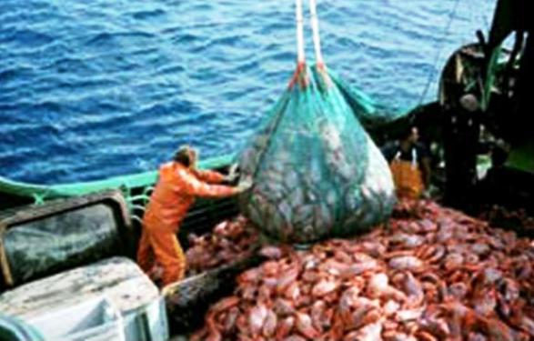
Types of fishing (II)
Industrial fishing is also called off-shore fishing or deep sea fishing. It is used to catch a great volume of fish. It uses huge and well equipped boats to remain at sea for weeks or months.
Their boats are large,called boat-factories and use advanced fishing techniques, like radars to detect shcool of fish. Also they have enormous freezers to preserve the fish in good conditions.
The catch can be transformed and packaged in the factory ships.

Slide 6
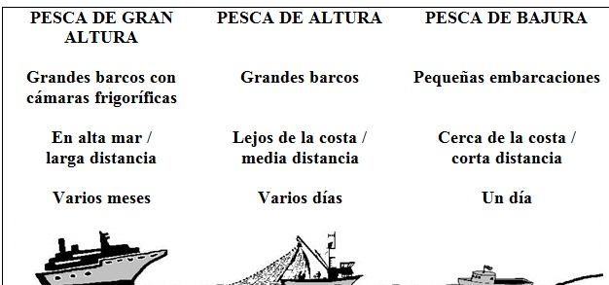

Slide 7
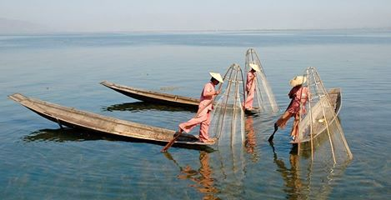
Fishing problems
Overfishing
Tradidional fishing grounds depleting.
International legislation to limit fishing and reserving the fisheries for the coastal countries
Sustainable fishing (avoiding trawling and limiting catches)

