Slide 1



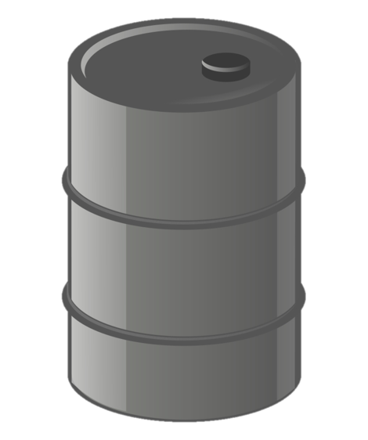
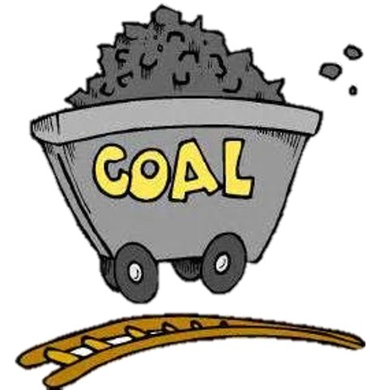

NON-RENEWABLE ENERGY
OIL
GAS
NEXT
COAL
NUCLEAR
IES FORTUNY
MARÍA SANZ

Slide 2

NON-RENEWABLE ENERGY
.
Non renewable energy sources cannot be replaced. Once they are used they will not be restored (or at least for millions of years).
Non-renewable energy include fossil fuels (coal,oil and gas) and also nuclear energy.
We are going to look at each non-renewable energy source and explore the advantages and disadvantages of each.
NUCLEAR
GAS
COAL
OIL
NEXT

Slide 3
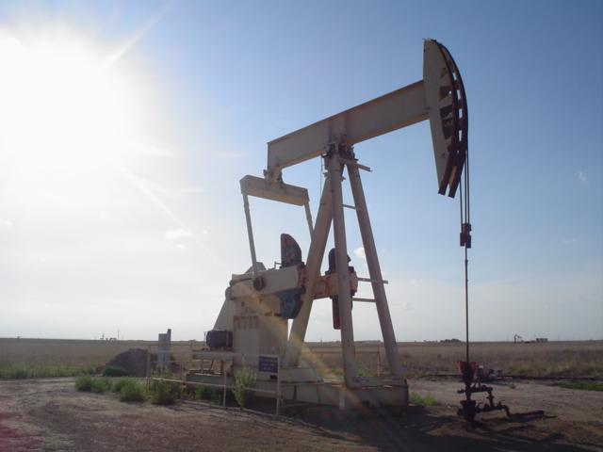
OIL
.
Oil is a liquid fossil fuel and is also known as crude oil or petroleum.
Oil is trapped by rock formations deep underground. Humans build a ‘drill rig’ on land or an ‘oil platform’ in the ocean to pump out the oil.
Once oil has been taken out of the ground it can be refined into many different products.
We use oil for many things (gasoline in cars, nail polish, rubbing alcohol).
Advantages of oil are that it is relatively inexpensive and provides us with many convenicies.
Disadvantages of oil include oil spills which are environmental disasters for ecosystems.
Burning gasoline also releases hazardous fumes into the air that we breath.
NEXT

Slide 4
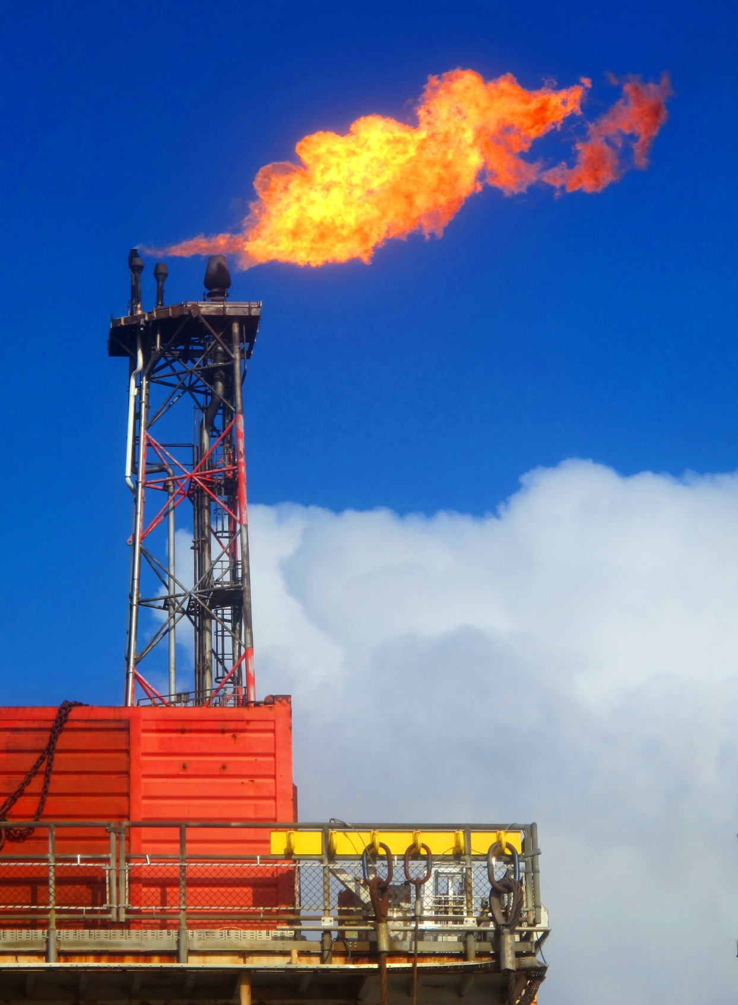
GAS
.
Natural gas is another fossil fuel trapped underground in reservoirs.
Natural gas is mainly made up of methane. Methane smells like rotten eggs.
We use natural gas for heating and cooking. Natural gas can also be burned to produce electricity.
Advantages of natural gas are that it is relatively inexpensive to extract and it is a ‘cleaner’ fuel than oil and gas.
The process used to extract natural gas is called ‘fracking’. Fracking has disadvantages because it can cause mini earthquakes and contaminate water sources.
NEXT

Slide 5
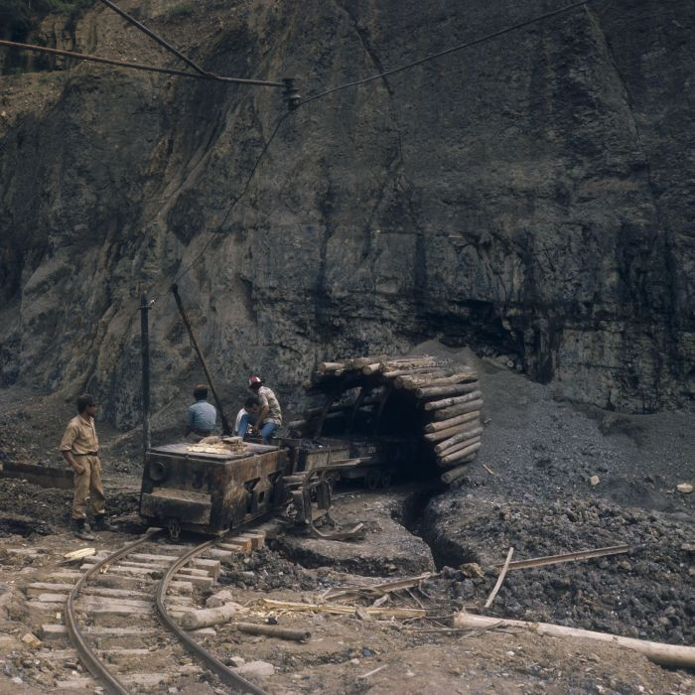
COAL
.
Coal is a black or brownish rock. We burn coal to create energy.
We mine coal both underground and on the surface.
About half of electricity in the USA comes from burning coal.
Advantages of coal are that it is a very reliable and a cheap source of energy.
Disadvantages of coal are that it is very dangerous to mine. Coal miners are exposed
to toxic dust. Coal also releases many toxic gases and pollutants into the atmosphere when it is burned.
NEXT

Slide 6
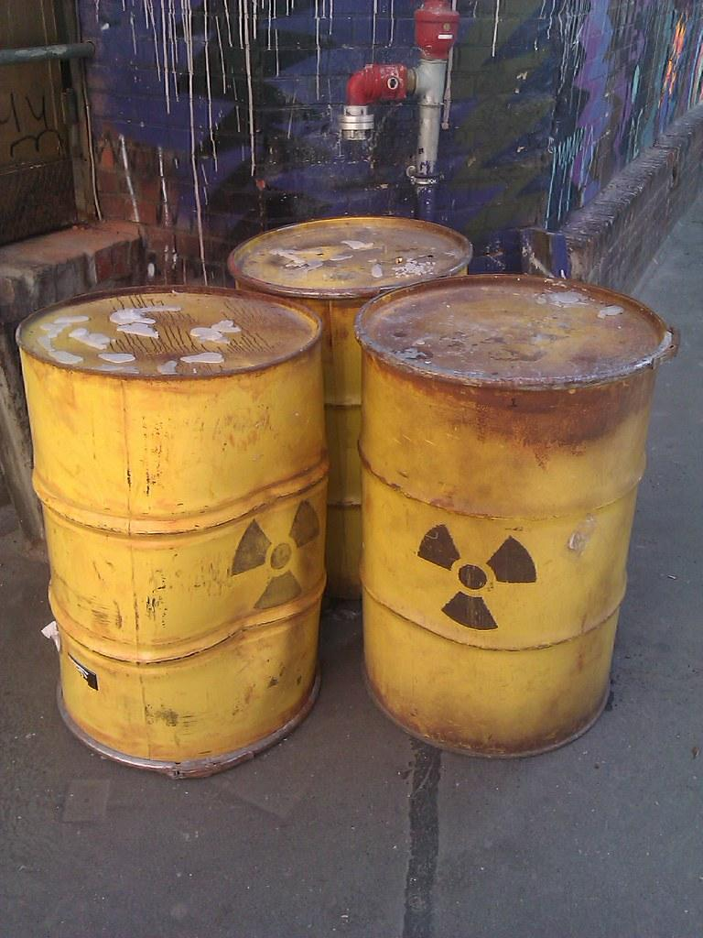
NUCLEAR
.
Nuclear is another form of non-renewable energy. The material used in nuclear
power stations is finite.
The material most often used in nuclear power plant is the element uranium.
Advantages of nuclear power is that it does not pollute the air or emit greenhouse gases.
Disadvantages of nuclear power are that nuclear power plants are very difficult to build and maintain. Nuclear energy also produces radioactive waste which is extremely toxic to the environment.

Slide 7



TRY AGAIN
MATEY
GO BACK

Slide 8
Unscramble the source of non-renewable energy.
Then search for it and click on it.
LIO

Slide 9


BRAVO,
ME HEARTIES
YE GOT 1/10
NEXT

Slide 10
TRY AGAIN
MATEY
GO BACK

Slide 11
Unscramble the source of non-renewable energy.
Then search for it and click on it.
CLNEUAR

Slide 12
BRAVO,
ME HEARTIES
YE GOT 2/10
NEXT

Slide 13
TRY AGAIN
MATEY
GO BACK

Slide 14
Unscramble the source of non-renewable energy.
Then search for it and click on it.
OALC

Slide 15
EXCELLENT,
ME HEARTIES
YE GOT 3/10
NEXT

Slide 16
TRY AGAIN
MATEY
GO BACK

Slide 17
Unscramble the source of non-renewable energy.
Then search for it and click on it.
SAG

Slide 18
WELL DONE,
ME HEARTIES
YE GOT 4/10
NEXT

Slide 19
TRY AGAIN
MATEY
GO BACK

Slide 20
Please read the question and then click the correct answer.
Which of these non-renewable energy sources produces radioactive waste?
Oil
B) Coal
C) Gas
D) Nuclear

Slide 21
GOOD JOB,
ME HEARTIES
YE GOT 5/10
NEXT

Slide 22
TRY AGAIN
MATEY
GO BACK

Slide 23
Please read the question and then click the correct answer.
Which of these is mined underground as well on the surface and releases a dangerous toxic dust?
Oil
B) Gas
C) Coal
D) Nuclear

Slide 24
YE DOING WELL,
ME HEARTIES
YE GOT 6/10
NEXT

Slide 25
TRY AGAIN
MATEY
GO BACK

Slide 26
Please read the question and then click the correct answer.
Which of these is refined into many different products including gasoline used in cars?
Coal
B) Gas
C) Oil
D) Nuclear

Slide 27
KEEP IT UP,
ME HEARTIES
YE GOT 7/10
NEXT

Slide 28
TRY AGAIN
MATEY
GO BACK

Slide 29
Please read the question and then click the correct answer.
__________ is the most common fuel used in nuclear power plants.
Coal
B) Uranium
C) Gasoline
D) Carbon

Slide 30
FANTASTIC,
ME HEARTIES
YE GOT 8/10
NEXT

Slide 31
TRY AGAIN
MATEY
GO BACK

Slide 32
Please read the question and then click the correct answer.
Which of these does not pollute the air or emit greenhouse gases when used .
oil
B) nuclear
C) gas
D) coal

Slide 33
FANTASTIC,
ME HEARTIES
YE GOT 9/10
NEXT

Slide 34
TRY AGAIN
MATEY
GO BACK

Slide 35
Please read the question and then click the correct answer.
Non-renewable energy resources once used cannot be _________?
expensive
B) harvested
C) cheap
D) replaced

Slide 36
FANTASTIC,
ME HEARTIES
YE GOT 10/10
NEXT

Slide 37
WHAT’S IN THE TREASURE CHEST?
CLUE: IT TALKS LIKE YOU BUT DOESN’T WALK LIKE YOU
NEXT

Slide 38

NEXT

Slide 39


NEXT

Slide 40

THANK YE MATEY FOR FREEING MY BEST FRIEND, POLO THE PARROT

