Slide 1
https://youtu.be/IPmSR--BktE
What is happening in this clip?

Slide 2
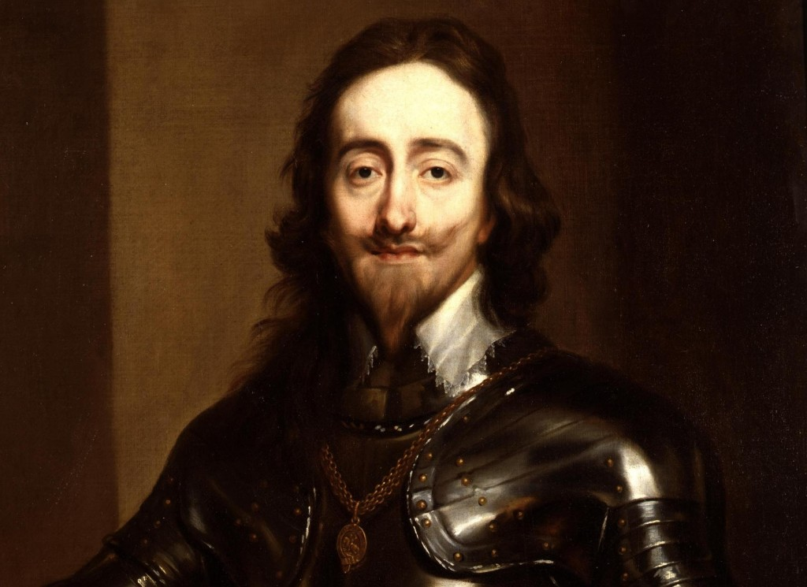
King Charles I

Slide 3
The Sentence
“This court does judge that Charles Stuart, a tyrant, traitor, murderer and public enemy of the people, shall be put to death by the severing of his head from his body.”

Slide 4
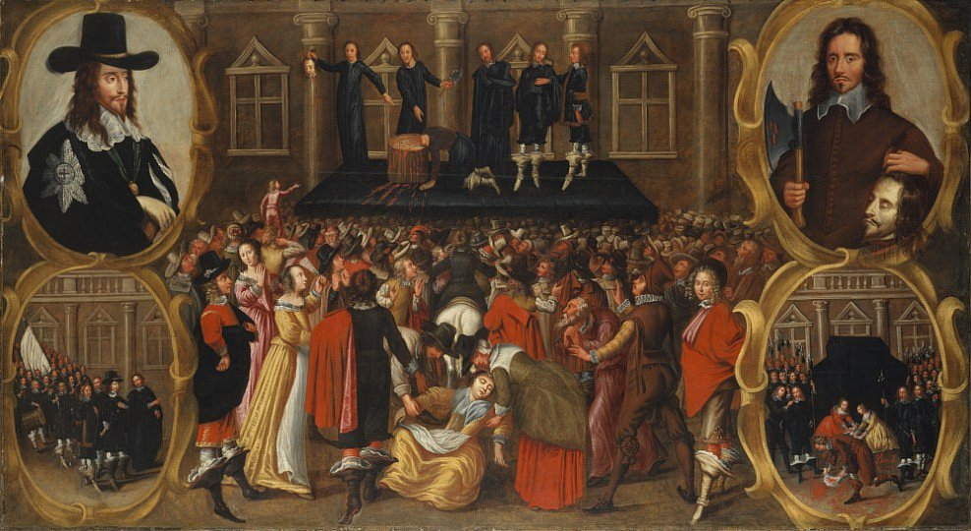
The execution of King Charles I, 1649
What questions would you want to ask about this event?

Slide 5
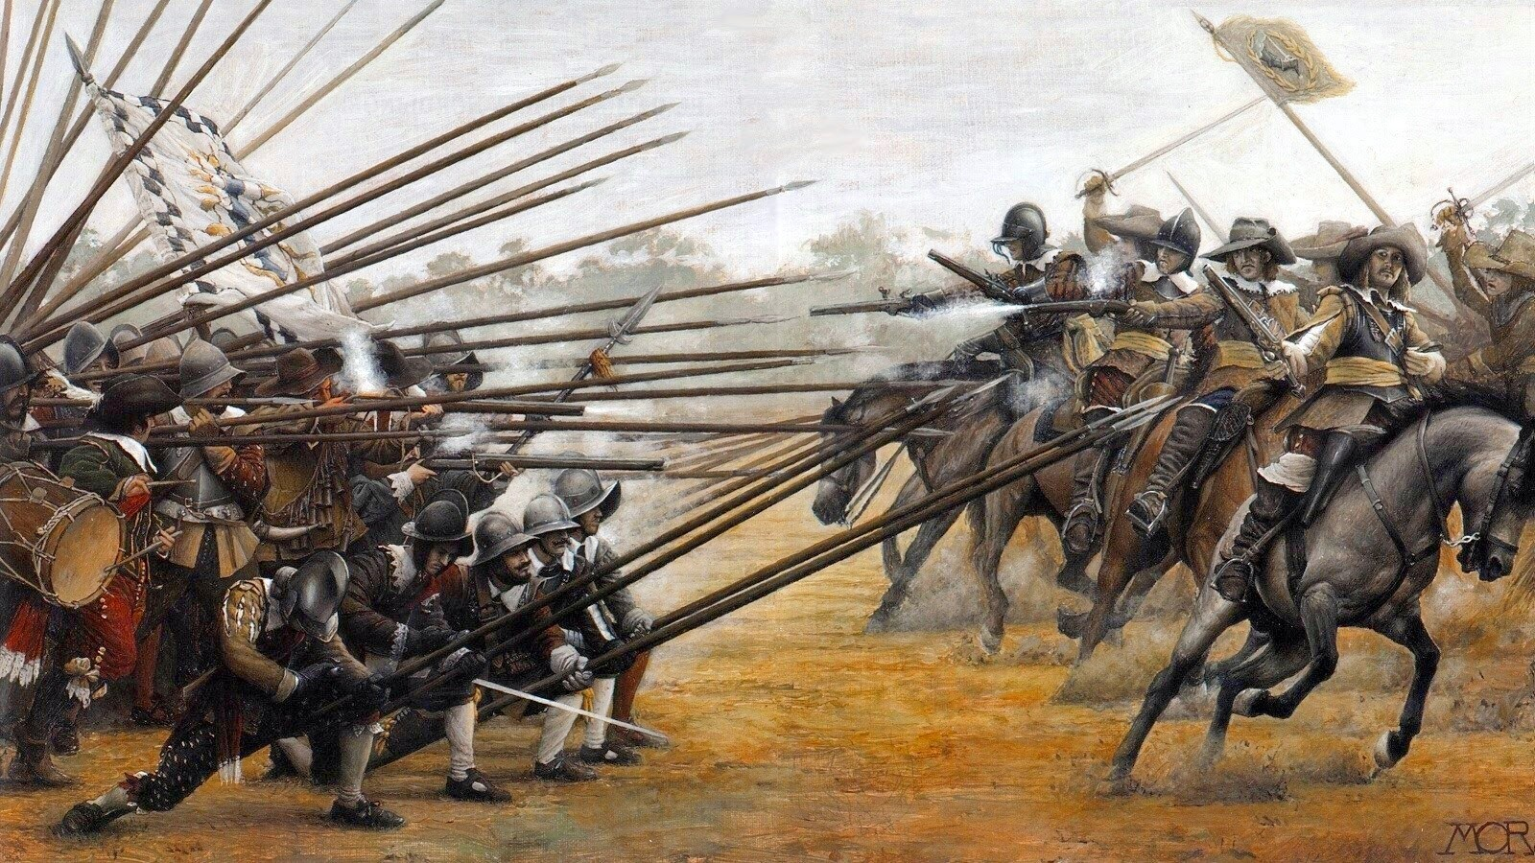
The English Civil War, 1642-1649
What is a Civil War?

Slide 6
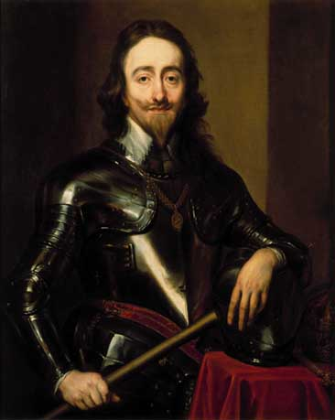
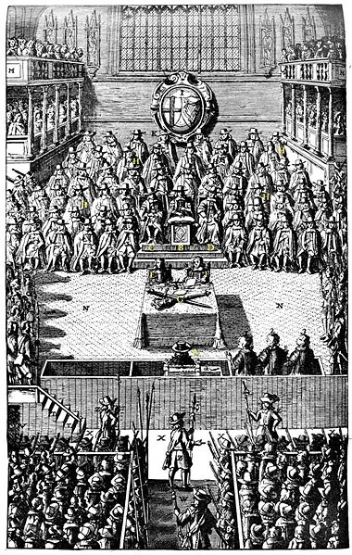
Who was the Civil War between?
The King
Parliament

Slide 7
What were the long-term causes of the English Civil War?
Look at the cards you have been given and sort them in to one of the 3 categories below:
* Religious
* Political/Power
* Financial/Wealth
Colour code the statements

Slide 8
The short-term causes of the English Civil War
Complete the worksheet using Pages 66-69 in the textbook

Slide 9


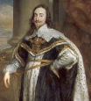
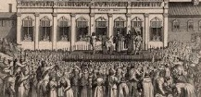

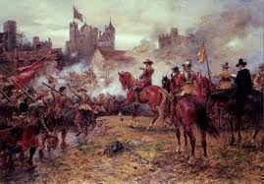
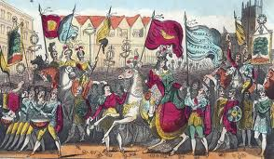
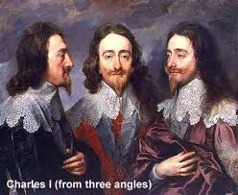



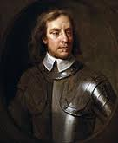





What were the main causes of the civil war?
How to complete a ‘Diamond 9’ exercise
A
The idea of a diamond 9 arrangement is to force you to make decisions on a subject. This is how you do it.
1. Take the 9 cards that have the information on.
2. Put the card that you think is the most important in position A.
3. Continue to place the cards in the arrangement shown here. Cards in the same row have equal importance.
B
4. Put the card that you think is the least important in position B.

Slide 10
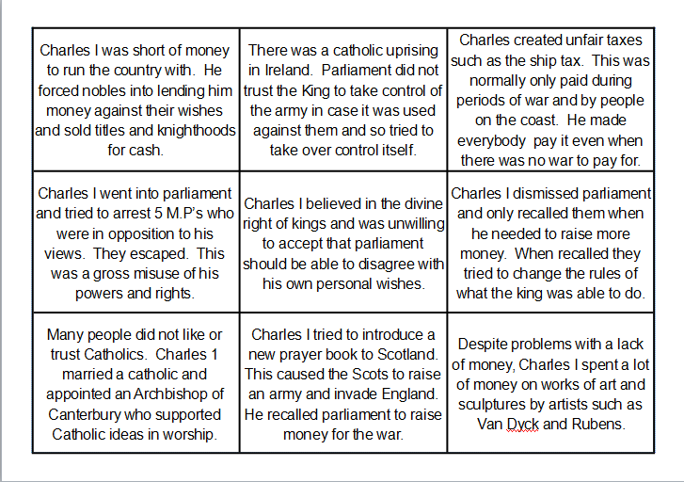
What were the main causes of the civil war?
These are the 9 cards that need to be considered in the diamond 9 exercise.

Slide 11
Why did the English Civil War break out in 1649?

