Slide 1
PRIMARY SECTOR: AGRICULTURE
María sanz
Ies Manuel de falla

Slide 2
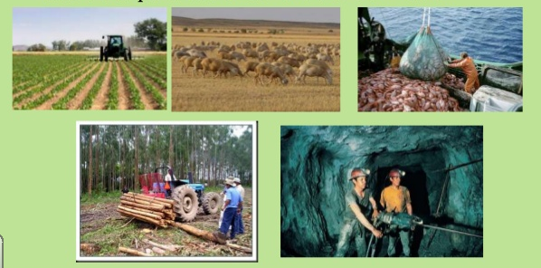
DEFINITION:
The Primary Sector consists of economic activities tha obtain resources from nature. It includes forestry, agriculture, livestock breeding, mining, fishing and aquaculture

Slide 3
IMPORTANCE OF THE
PRIMARY SECTOR
40% of world´s population works in the primary sector.
Agriculture represents 3% of world´s total production.
The primary sector in MEDCs employs between 1% to 5% of the active population and it represents the 4% or les s of the GDP with a high productivity .
The primary sector in emerging and les developoed countries is about the 10% of the GDP and half of the active population works in this sector. The poorest is a country, the more developed is the primary sector

Slide 4
LET´S PRACTICE
DO EXERCISES 1, 2 and 3 from page 64 of your textbook

Slide 5
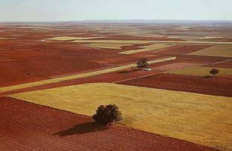
Agricultural space or agrarian landscape
People modify natural areas in order to use them for crop agriculture, livestock farming or forestry.
As a result of this transformation we have an agricultural space.

Slide 6
Agricultural space
Factors
Phisical factors
Human factors
Climate
Relief
Soil
Vegetation
Economic and technological conditions
Agriariancultural policy
Types of farming

Slide 7

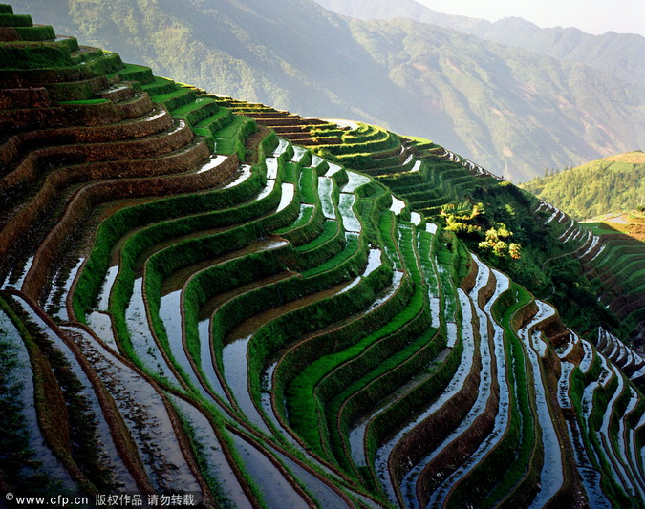
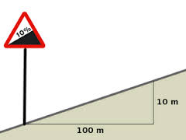
PHYSICAL FACTORS : RELIEF
RELIEF determines the landscapes . Two relief factors could be distinguished:
Gradient
Flat areas are good to use machinery. So farming takes place in plains and valleys.
Steep gradients (more than 10%) make cultivation difficult
Where it´s necessary, hard work can transform mountain slopes into cultivated terraces.

Slide 8

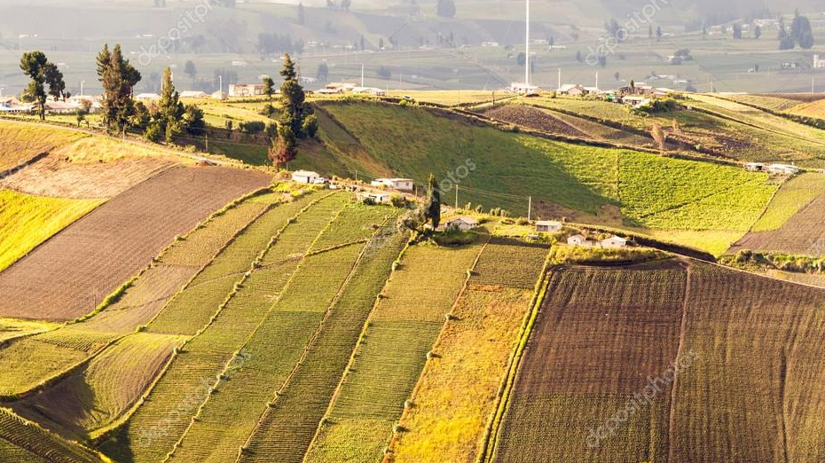
PHYSICAL FACTORS RELIEF
    ALTITUDE
    For every 1000 m of altitude, temperatures fall by 6ºC.
    For this reason, after a certain altitude, cultivation is no longer possible.
    Flat areas are the best for cultivation.
    Altitudes over 200 metres are less sutitable for agriculture

Slide 9
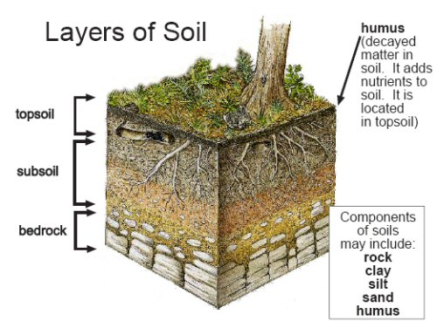
PHYSICAL FACTORS : SOIL
Deep soil is more appropiate for the cultivation of most crops because roots have more space to expand.
Plants absorb nutrients from the soil. When we analyze the soil , we consider:
Porosity determines the oxygen that the soil contains and the ability to retain water.

Slide 10

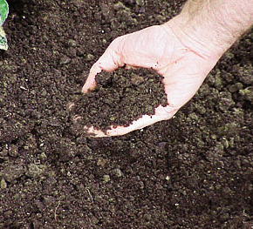



  Nutrients
  The more appropiate nutrients the soil has, the better it is for agriculture.

Slide 11
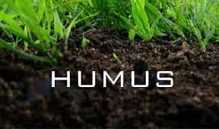
PHYSICAL FACTORS : SOIL
CHEMICAL AND BIOLOGICAL COMPOSITION OF THE SOIL
The richness of the soil is determined by the mineral nutrients and the organic matter

Slide 12
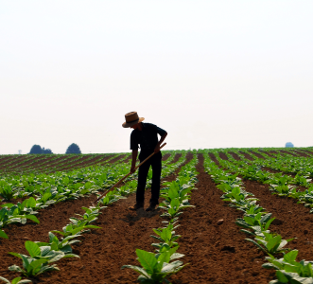
TYPES OF SOIL
CLAY
Soils with great amount of clay are rich in nutrients .
The disadvantage is that they absorb water and and needs good drainage.

Slide 13
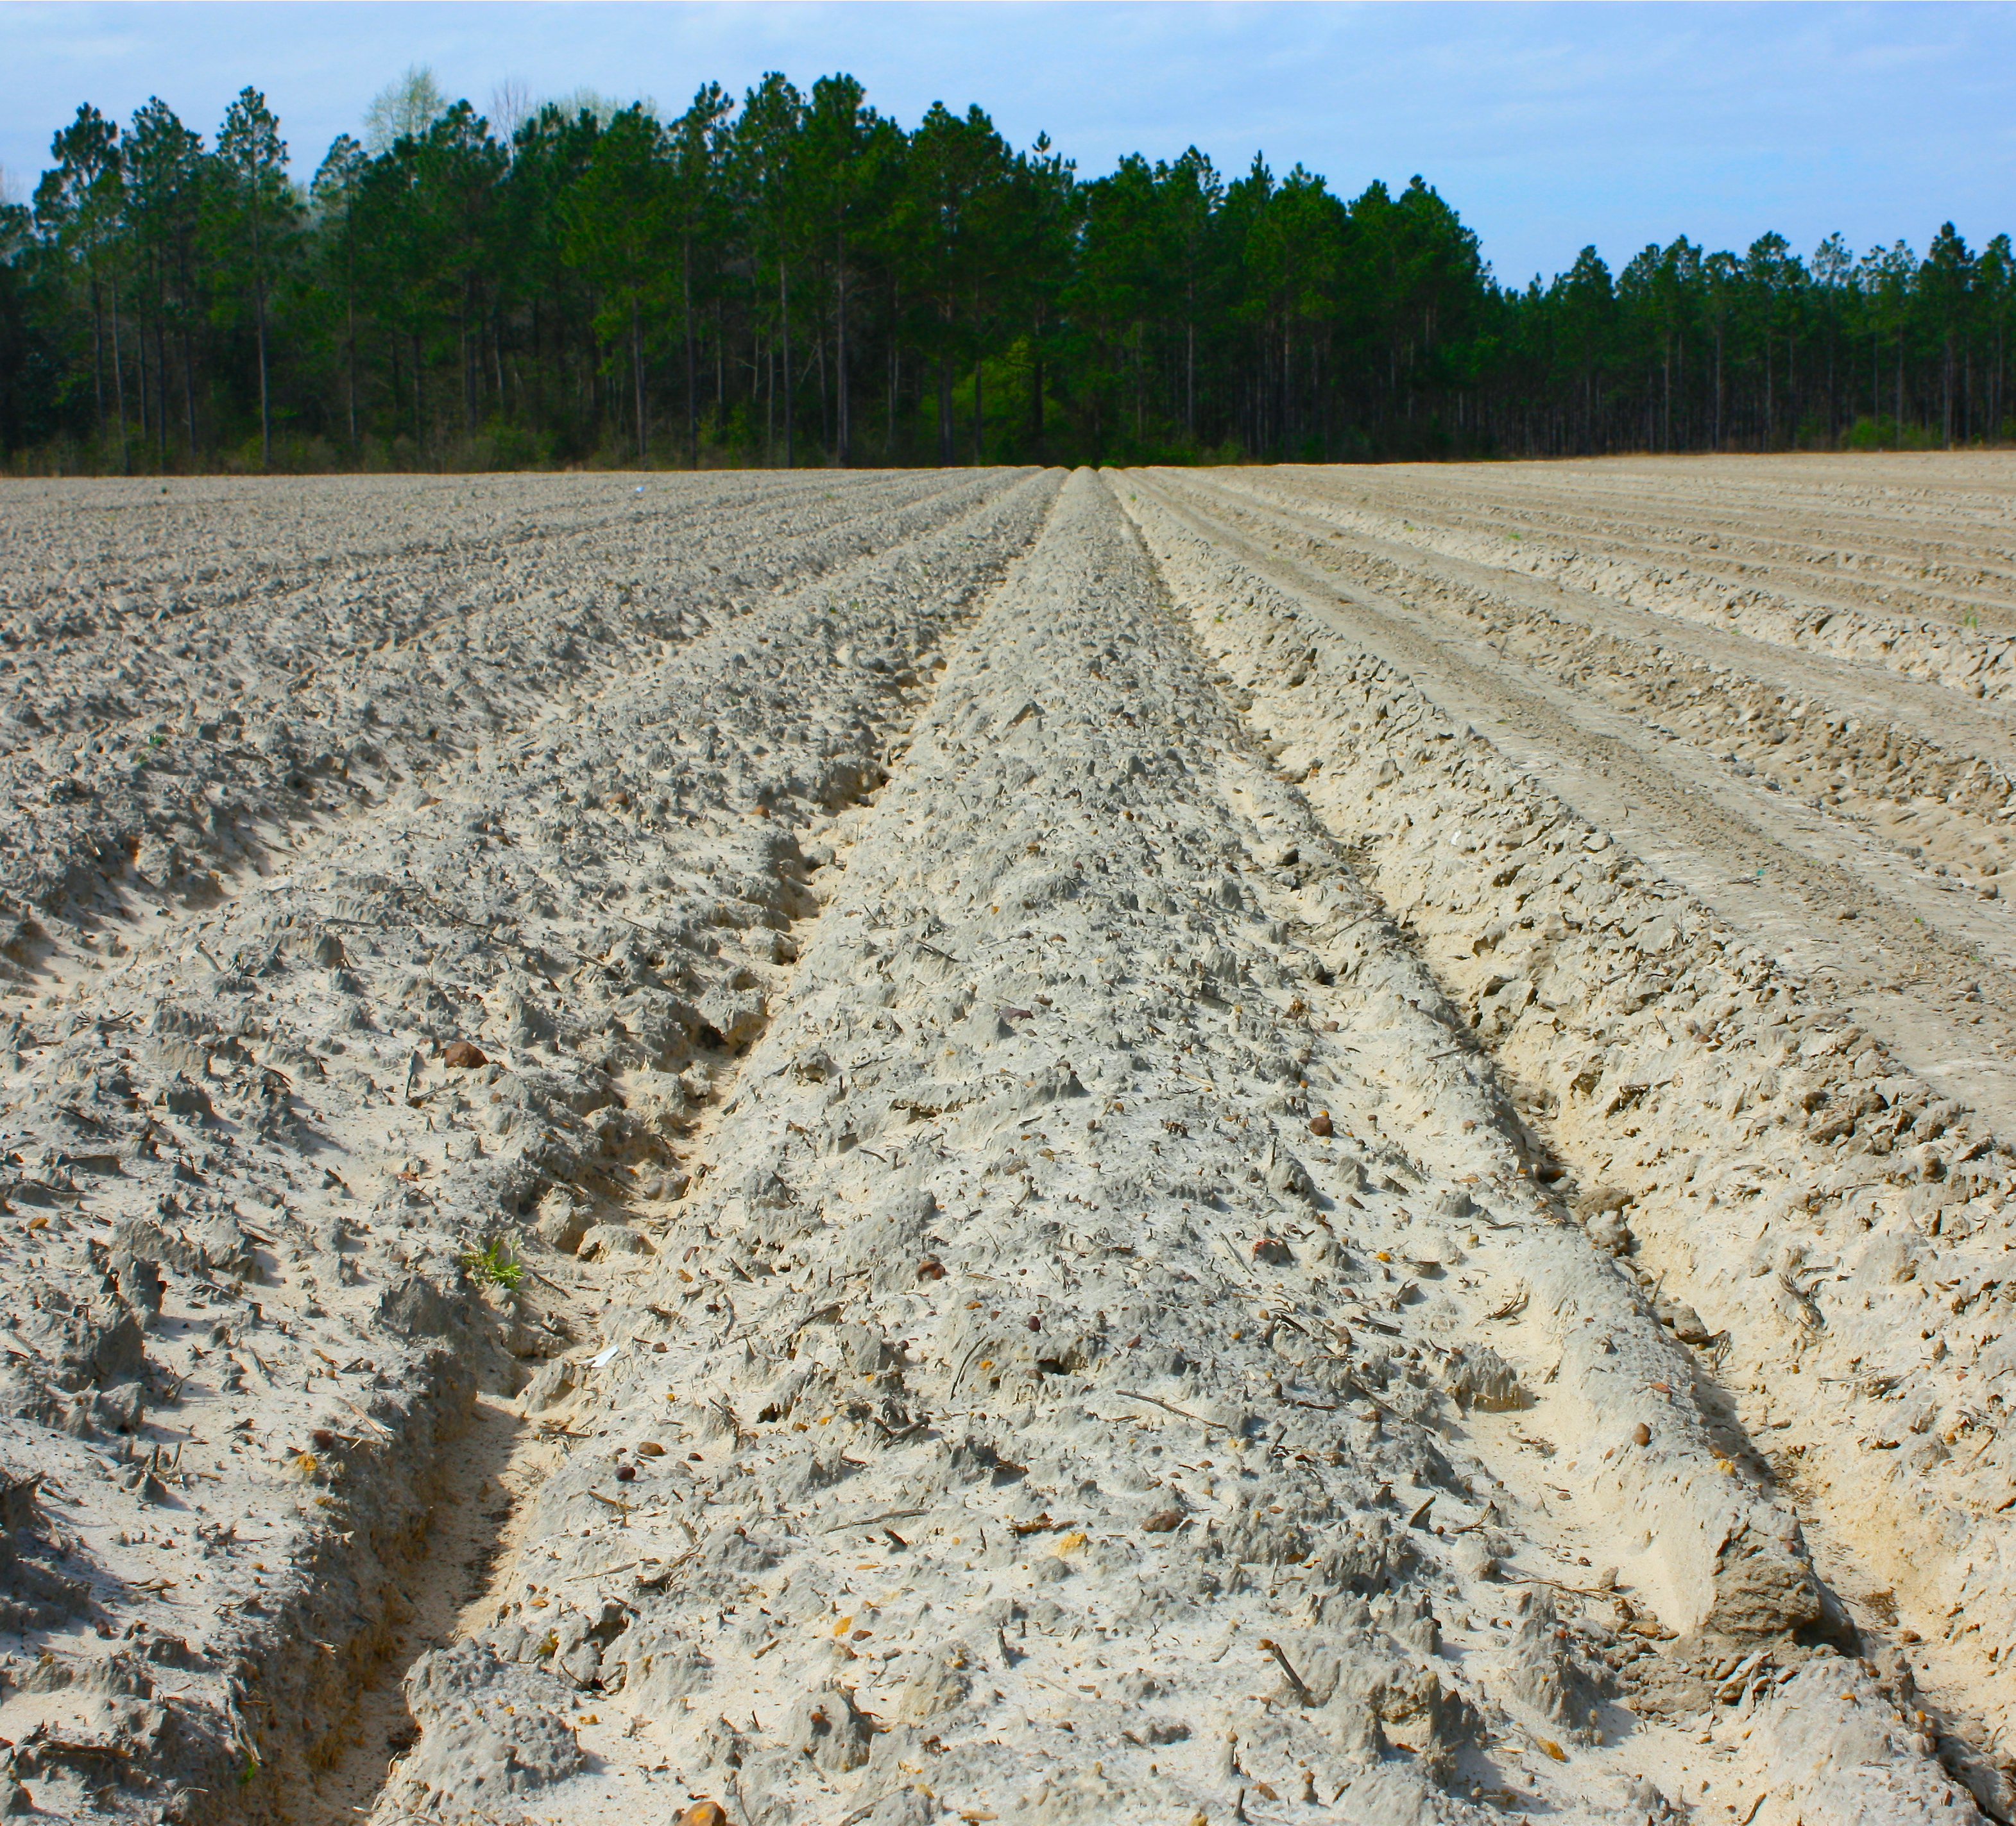
TYPES OF SOIL
Sandy soils do not retain nutrients or water so fertilizers and irrigation are needed.

Slide 14
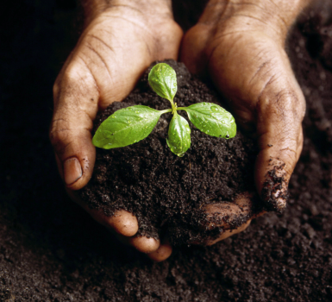
TYPES OF SOIL
HUMUS
Vegetation provides the soil with humus, so the more vegetation an area has, the more fertile the soil will be.

Slide 15
PHYSICAL FACTORS: CLIMATE
Each crop needs different conditions to grow. Climate factors affecting crops are:
Extreme cold limits cultivation growth. Temperatures below 10ºC make agriculture difficult.
Excessive heat is difficult to resist for plants (maximum temperatures for crops are 45ºC)
Humidity and rainfall favours farming but it also produces soil erosion
Dry conditions endanger plants growth.
The Poles, tropical rainforests and deserts cannot have agricultura.

Slide 16
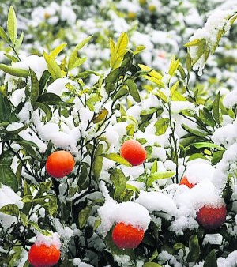
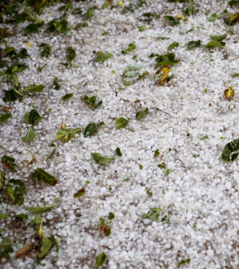
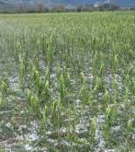
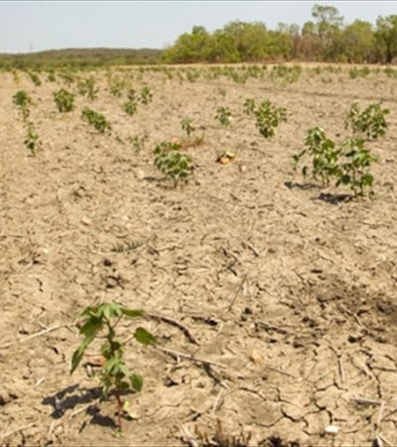
ADVERSE PHENOMENA

Slide 17
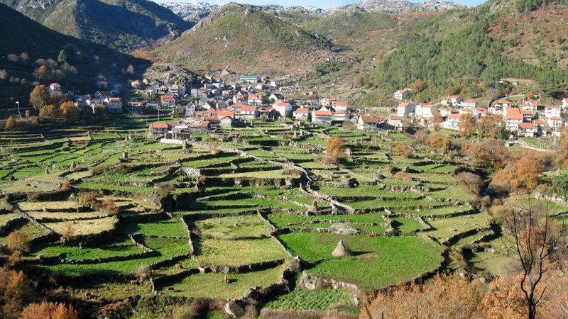
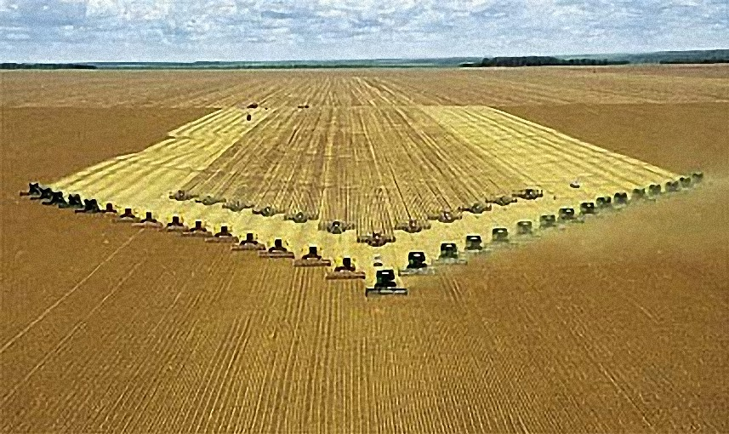
HUMAN FACTORS:
AGRICULTURAL HOLDING
Agricultural holdings are units of agricultural production used for farming, livestock or forestry.
Plots can have different sizes:
Small with less than a 1 hectare
Medium from 1 to 10 hectares
Large over 10 hectares

Slide 18
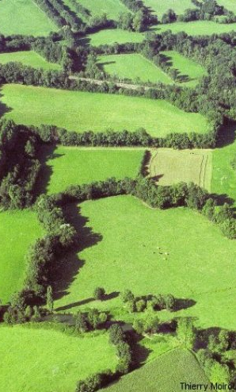
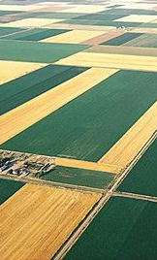
HUMAN FACTORS:
AGRICULTURAL HOLDINGS
Plots according to their shape can be:
Regular when have a defined geometrical shape
Irregular when their shape is not defined.

Slide 19
CULTIVATED SPACE
SIZE
Small
Medium
Large
Less than 1 ha
1ha – 10ha
More than 10 ha

Slide 20
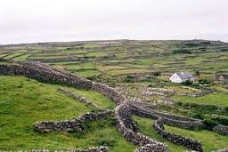
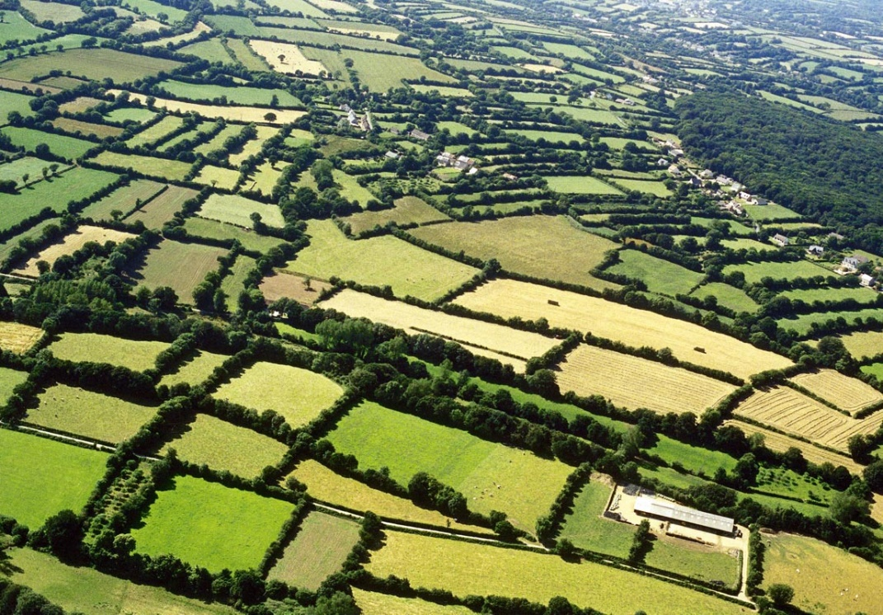
HUMAN FACTORS:
AGRICULTURAL HOLDINGS
Plots could be classified according to their borders.
1 BOCAGE
Small fields are separated by hedges, trees, stone or wooden fences.

Slide 21
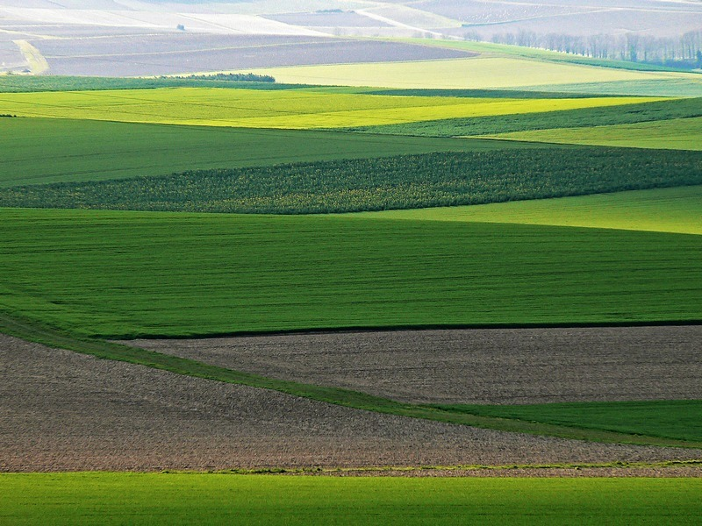
HUMAN FACTORS:
AGRICULTURAL HOLDINGS
2 OPENFIELD
Fields are open : there are not fences separating them.
Fields can only be differentiated by the type of crops or the way they are used.

Slide 22
TYPES OF FARMING: DEPENDING ON WATERING SYSTEMS
Depending on the use of water
Irrigated agriculture
Rain-fed agriculture

Slide 23
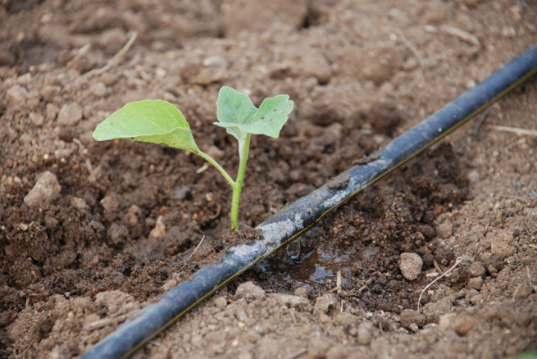
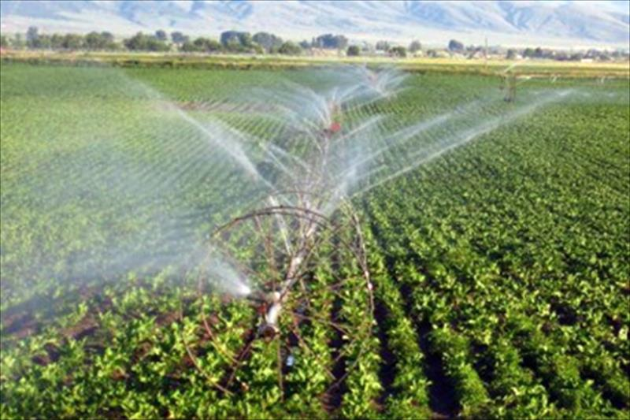
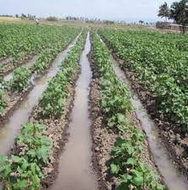
IRRIGATED AGRICULTURE
Crops receive water from man-made irrigation systems.
Sprinklers
Drip irrigation
Flood irrigation

Slide 24
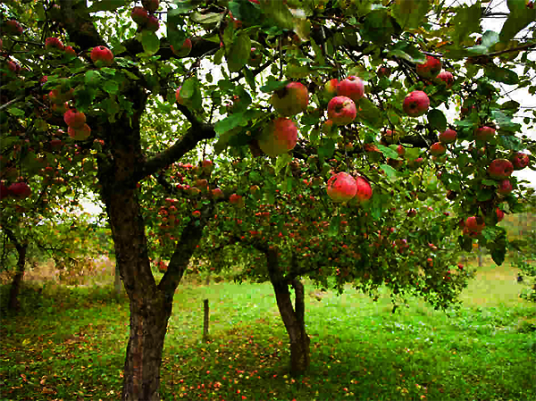
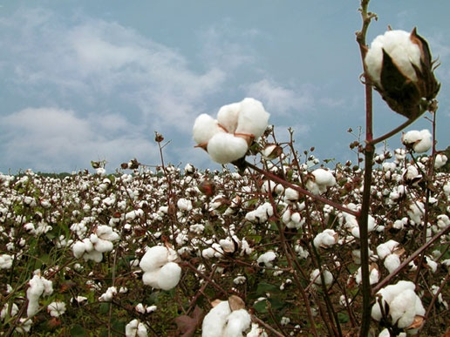
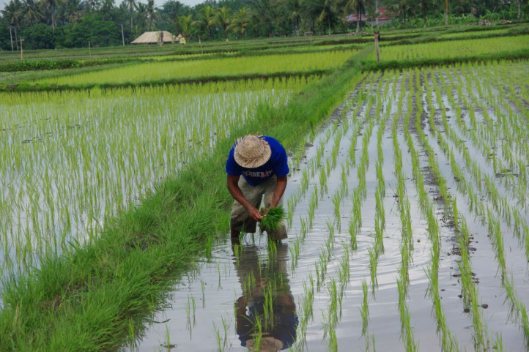
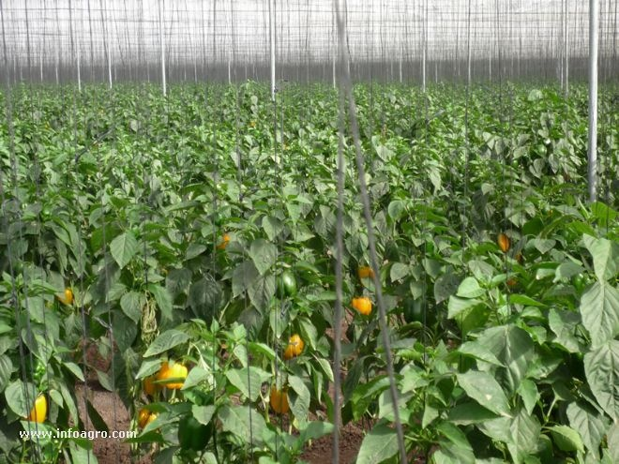
IRRIGATED AGRICULTURE

Slide 25
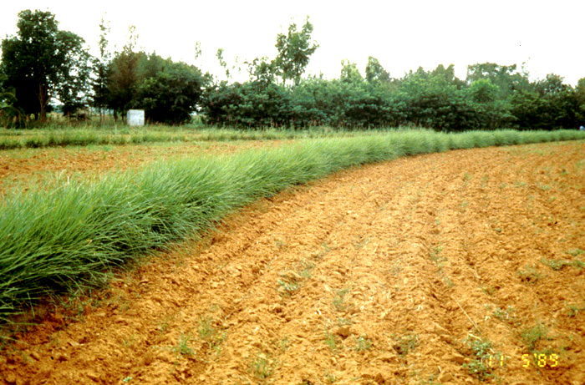
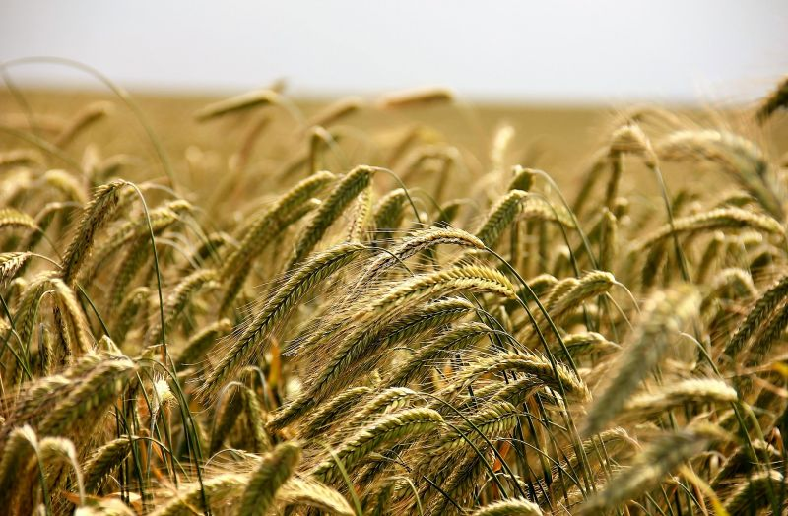
RAIN - FED AGRICULTURE
This type of agriculture depends on rainfall
Sometimes it is irrigated during droughts.

Slide 26
TYPES OF FARMING: DEPENDING ON THE NUMBER OF CROPS CULTIVATED
Depending on the variety of species
Monoculture
Polyculture or mixed crops

Slide 27
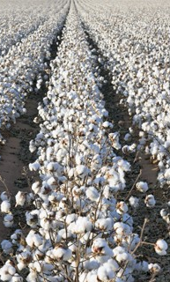
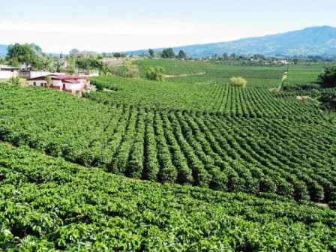
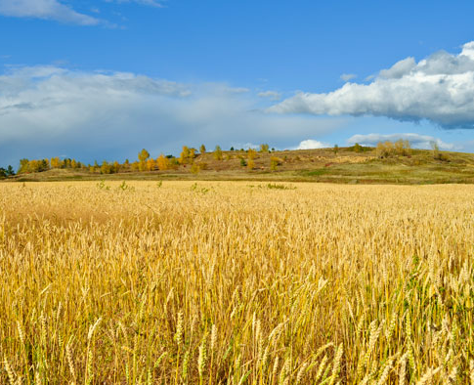
MONOCULTURE
The cultivation of a single crop in a large farm with mechanizaion to produce large amounts at a competitive cost.

Slide 28
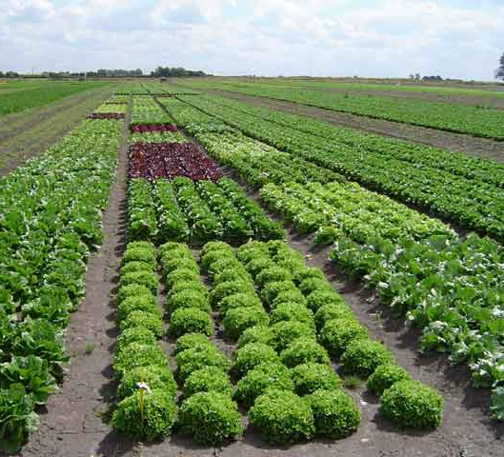
POLYCULTURE
The cultivation of several species in an agricultural area.

Slide 29
FARMING SYSTEMS
Depending on the utilisation of the soil
Intensive agriculture
Extensive agriculture

Slide 30
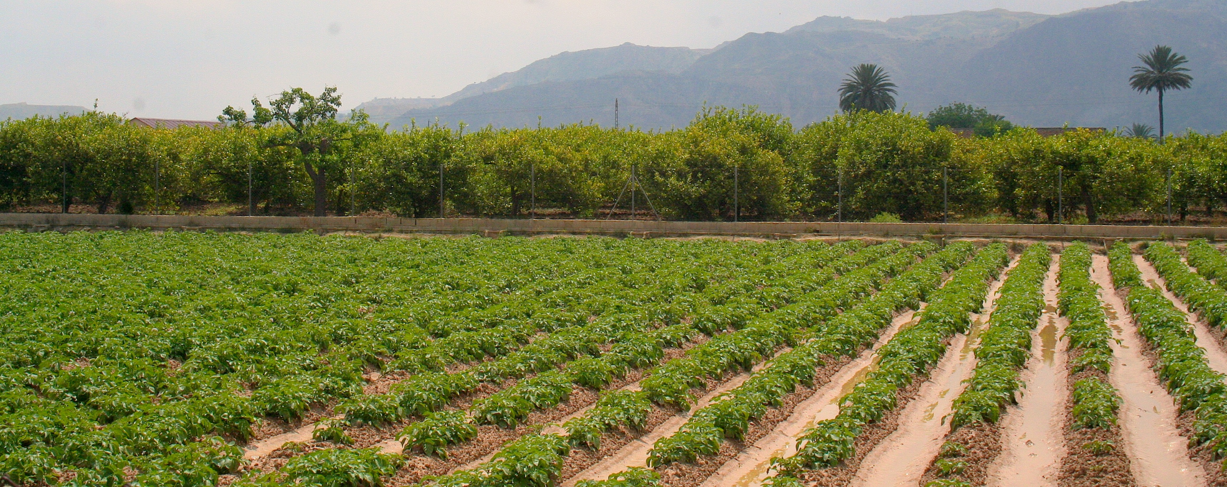
INTENSIVE AGRICULTURE
High capital investment (in tools, machinery, equipment, etc)
A lot of workers (labour)
Maximum yield for commercial purposes

Slide 31
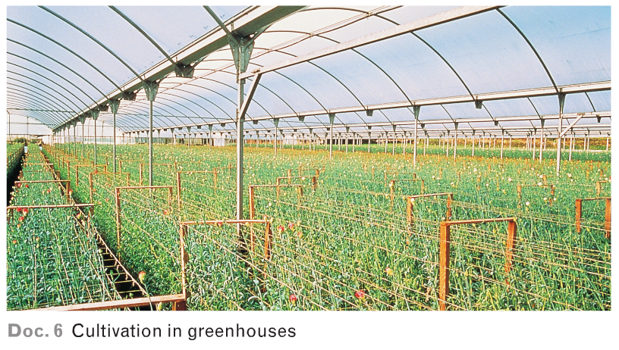
INTENSIVE AGRICULTURE

Slide 32
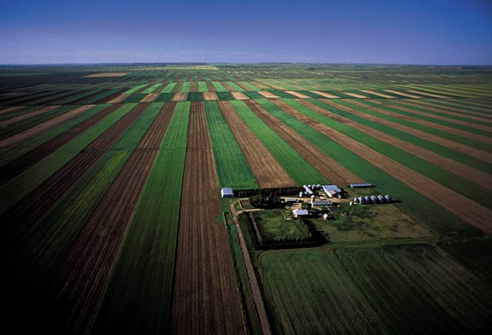
EXTENSIVE AGRICULTURE
It does not use all the technological or human resources (workers) available to obtain the maximum yield.
Production can be for sale: wheat plains in the USA.
Traditionally part of the plot is left to fallow to regenetarty its fertily however, nowadays almost all the plot is cultivated as they use machinery due to lack of workers (developed countries)

Slide 33
AGRICULTURAL LANDSCAPES
Agricultural activities create different types of agricultural landscape.
Agricultural activities
Subsistence agriculture
Commercial agriculture

Slide 34
AGRICULTURE IN DEVELOPED REGIONS (COMMERCIAL AGRICULTURE)
The agricultural revolution took place in Europe in the late 18th century.
New innovations and technics were introduced to feed a booming population.
Commercial agriculture
High investment
Advanced techniques
High productivity
High yield
Drip irrigation, greenhouses, fertilisers…
Crops are produced for commercial purposes

Slide 35
AGRICULTURE IN DEVELOPED REGIONS
Commercial agriculture
Fertilizers regenerate the soil
High yield seeds increase production
Greenhouses, new irrigation systems make cultivation posible in por soils
Machinery replaces human labor and makes processes simple
Mechanization
Specialization in one product simplifying machinery and labour
Storage, transport and commercialization is fast
Modern farming methods

Slide 36
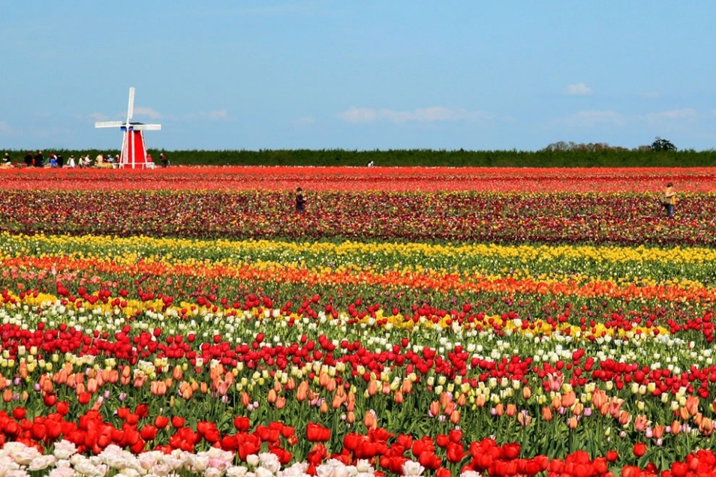
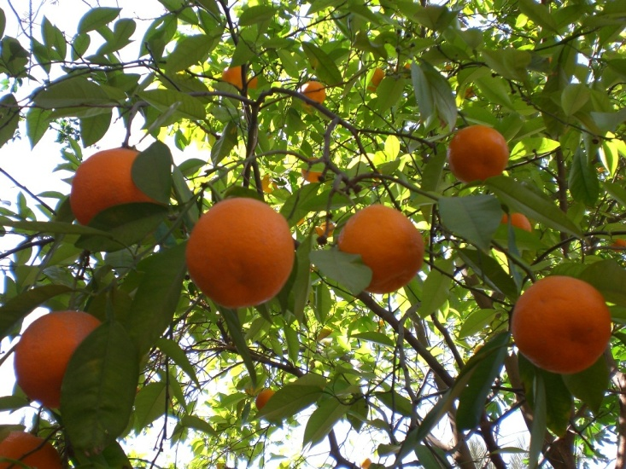
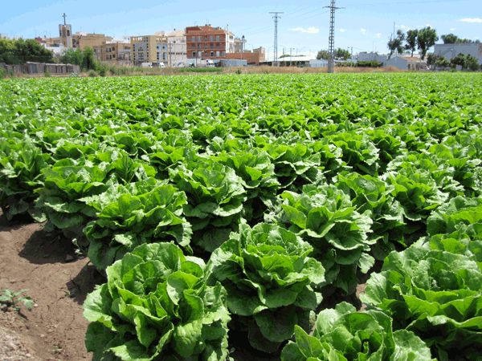
AGRICULTURE IN DEVELOPED REGIONS

Slide 37
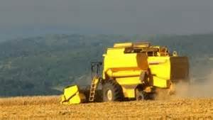
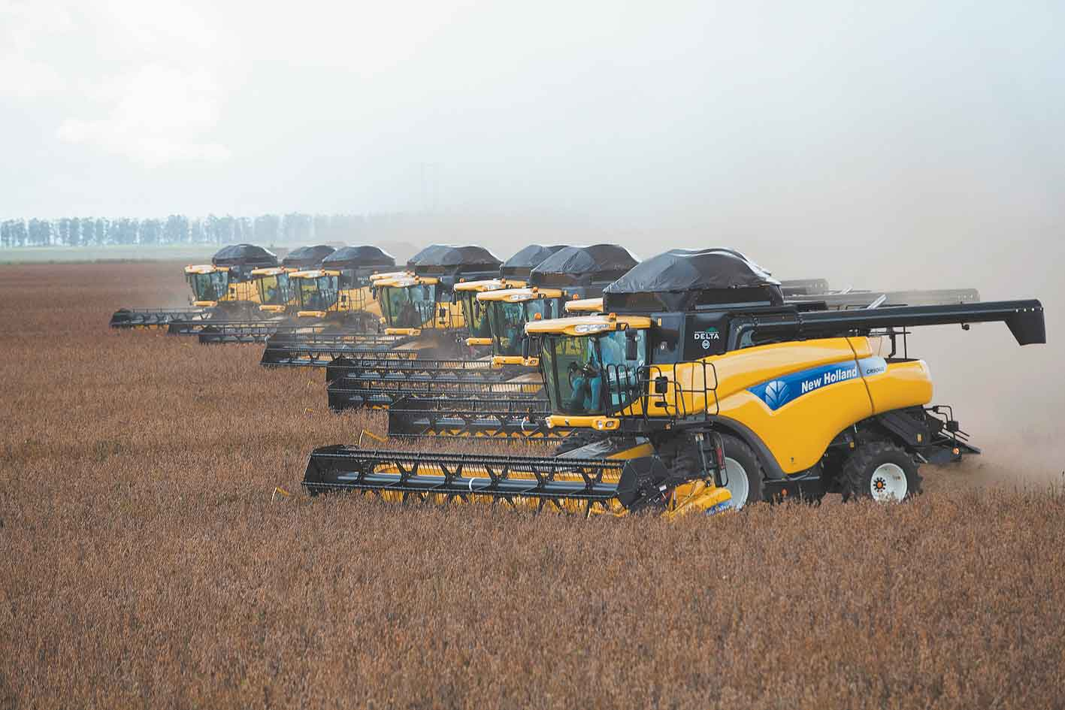
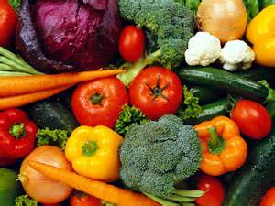
AGRICULTURE IN DEVELOPED REGIONS

Slide 38
BENEFITS AND COSTS OF COMMERCIAL AGRICULTURE
A) BENEFITS
LOWER PRICES DUE TO HIGH PRODUCTIVITY AND MASSIVE PRODUCTION
EFFICIENT AND SPECIALIZED TRANSPORTATION MAKES COMMERCIALIZATION QUICK EVEN IN LONG DISTANCE TRANSPORT.
COSTS
POLLUTION DUE TO THE USE OF FERTILIZERS AND PESTICIDES
WATER USE
RURAL EXODUS , DUE TO LACK OF JOB OPPORTUNITIES YOUNG PEOPLE MOVE TO CITIES.

Slide 39
AGRICULTURE IN LESS DEVELOPED AREAS
Subsitence agriculture
Ancient techniques and polyculture
Low productivity due to manual labor
Most products are for farmer´s own consumption

Slide 40
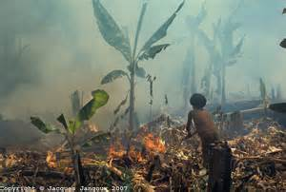
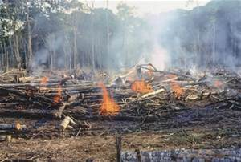
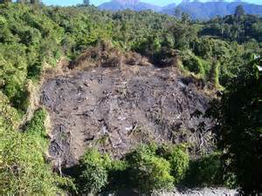
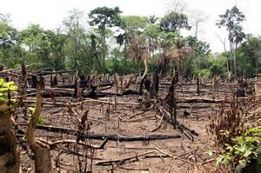
TYPES OF TRADITIONAL AGRICULTURE: SHIFTING CULTIVATION
Slash-and-burn agriculture or shifting cultivation is typical from Africa, South America and South-west of Asia-
The crops planted are tubers and cereals.
To prepare the land, the vegetation is cut down and burnt, and the ashes are used as fertiliser.

Slide 41
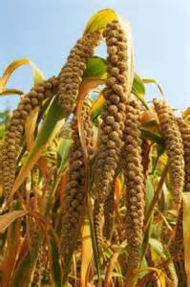
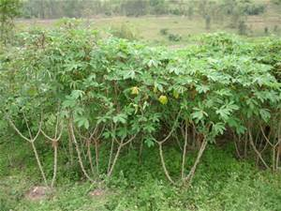

TYPES OF TRADITIONAL AGRICULTURE: SHIFTING CULTIVATION
Slash-and-burn agriculture is used to grow millet , sorghum and tapioca

Slide 42

TYPES OF TRADITIONAL AGRICULTURE: SEDENTARY RAINFED CULTIVATION
IT is typical of Savannah regions using the rotation system. One part of the plot is cultivated with cereals, the other is for nuts and tubers while the third part is left fallow.

Slide 43



TYPES OF TRADITIONAL AGRICULTURE:
IRRIBATED MONSOON CULTIVATION
It is typical from Eastern China, South –East Asia and on the coast of India.
In these areas the monsoon rains flood the plots where rice is cultivated.
Small plots are cultivated by many workers.

Slide 44



PLANTATION AGRICULTURE
Plantation are large farms located in LDCs mainly in Africa, Central and South America and India.
The first plantation were created by the Europeans in America and India where crops that do not do well in Europe are cultivated.
Coffe in Brazil, rubber in Indonesia and Malaysia and tea in India.
Plantations have increased due to globalization.
It is a type of commercial agricultura since the benefits they generate are high.
Large extentions are required as well as investment in transport and modern machinery and abundant cheap labour.

Slide 45
ADVANTAGES AND DISADVANTAGES OF PLANTATION
BENEFITS ARE FOR MULTINATIONAL COMPANIES
BENEFITS FOR DEVELOPING COUNTRIES ARE :
JOBS
TRANSPORT NETWORK IMPROVEMENTS
MODERN FARMING TECHNIQUES ARE USED
DISADVANTAGES FOR LEDCs:
Crops are exported so benefits are for developed countries
Small farmers sell their land to plantations as they can not compete.
Exploitation is intensive then there are environmental issues.
Prices determine the wages .

Slide 46



