Slide 1
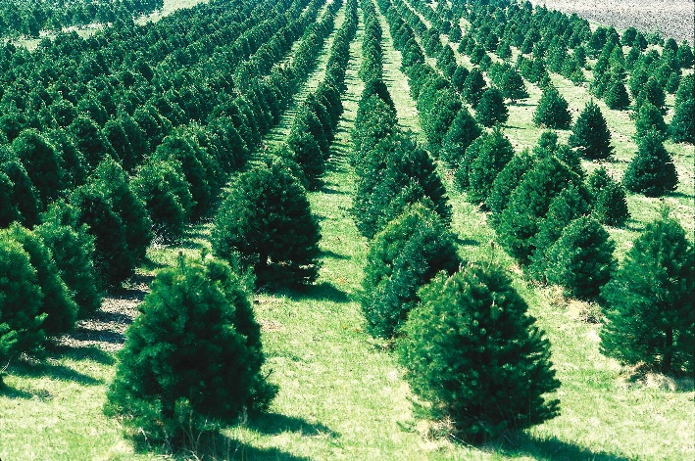
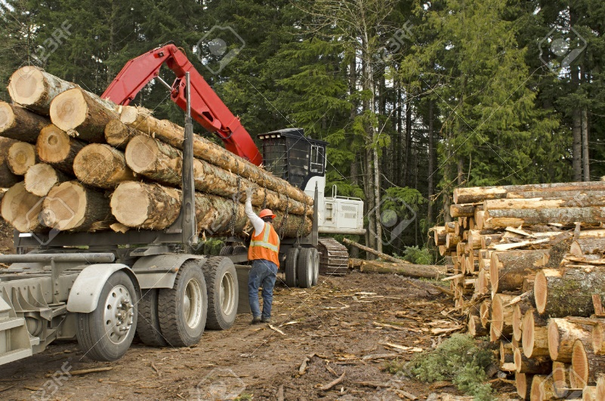
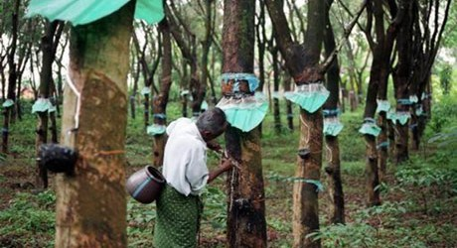
FORESTRY
IES MANUEL DE FALLA
MARÍA SANZ

Slide 2
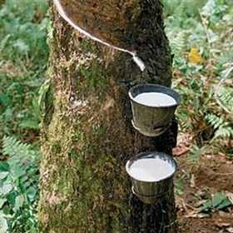
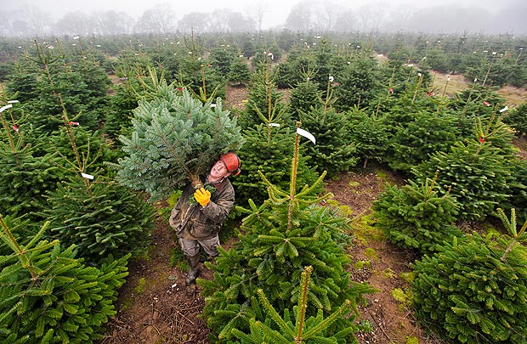
FORESTRY
FORESTRY IS THE FOREST ECONOMIC EXPLOITATION USING FOREST PRODUCTS SUCH AS CORK, RESIN, TIMBER, FRUIT, RUBBER, FIRE WOOD , CELLULOSE .
OTHER PRODUCTS FROM THE FOREST ARE USED TO ELLABORATE PHARMACEUTICAL PRODUCTS AND PERFUMES.

Slide 3
TYPES OF FORESTS
FORESTS OCCUPY 30% OF THE EARTH´S SURFACE AND WOODLANDS HAVE ADAPTED TO DIVERSE CLIMATES.
THE MAIN TYPES OF FORESTS ARE:
HUMID EQUATORIAL AND TROPICAL WOOLANDS which contain tall and hardwood trees such mahogany, teak and ebony.
TEMPERATE WOODLAND is located in middle latitudes. It includes smaller trees grouped together. Chesnuts, oak and beech have been exploited traditionally but they have been replaced by invasive but more profitable species such as eucliptus.
BOREAL FORESTS OR TAIGA are located in high latitudes. Dense coniferous forests contain pines, firs and birch all of them with softwood.

Slide 4
FOREST SUSTAINAVILITY
To make sure that forest exploitation is sustainable, forestry and silviculture manage the forest resources.
Although some forests are cultivated to obtain products from them, tres should be allowed to regenerae with measures like reforestation and recycling forest products
Forestry is practice in is practiced in natural stands while silviculture is practice in plantations.
Reforestations tend to avoid soil erosion as well as solving the devastating effects of fires.
Fir plantations tend to avoid cutting down firs for Christmas celebrations.

