Slide 1
Primary sector: livestock breeding
María sanz
Ies Manuel de falla

Slide 2
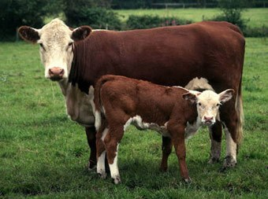
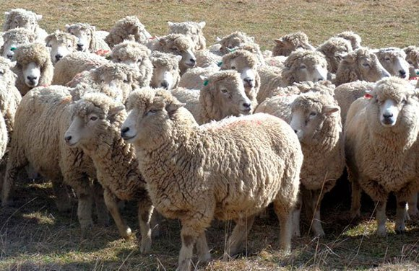
What is livestock farming?
It is an economic activity which raises animals to obtain different products from the animals.
Mainly: meat, milk, wool, fur, eggs or honey.

Slide 3
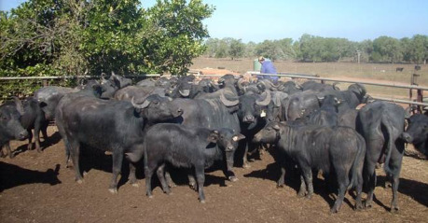
Types of livestock farming
CATTLE INCLUDES COWS, OXEN, BULLS, BUFFALO, ZEBU
PRODUCTS: MILK , DAIRY PRODUCTS, FUR

Slide 4
Types of livestock farming
2. GRAZING ANIMALS: SHEEP AND GOATS
MILK- MILK- CHEESE- WOOL - FUR

Slide 5
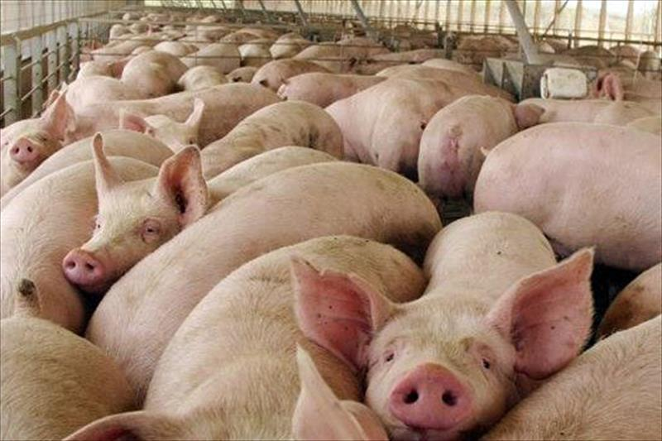
Types of livestock farming
3 PIGS
PRODUCTS : MEAT , SAUSAGES, HAM , BACON, ETC

Slide 6
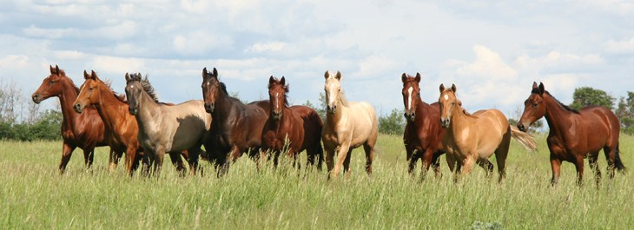
Types of livestock farming
EQUINE : HORSES, MULES AND OTHER EQUINES
– WORK(RIDING AND TRACTION)
RECREATION(RIDING/RACING)
FUR AND MEAT

Slide 7
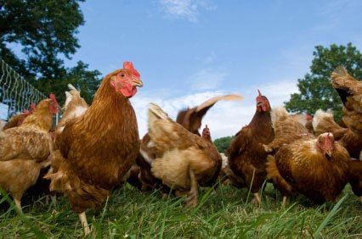
Types of livestock farming
5 POULTRY (HENS, CHICKENS, DUCKS, TURKEYS)
MEAT
EGGS
FEATHERS
PATÉ

Slide 8
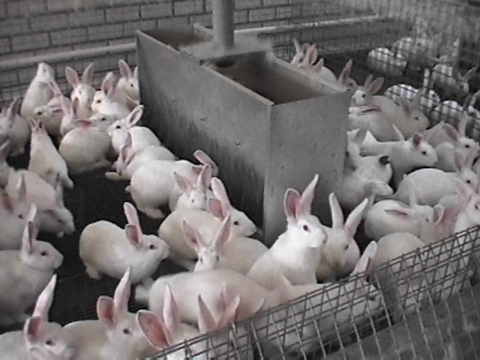
Types of livestock farming
. CUNICULTURE OR RABBIT BREEDING
– MEAT /FUR/PETS

Slide 9
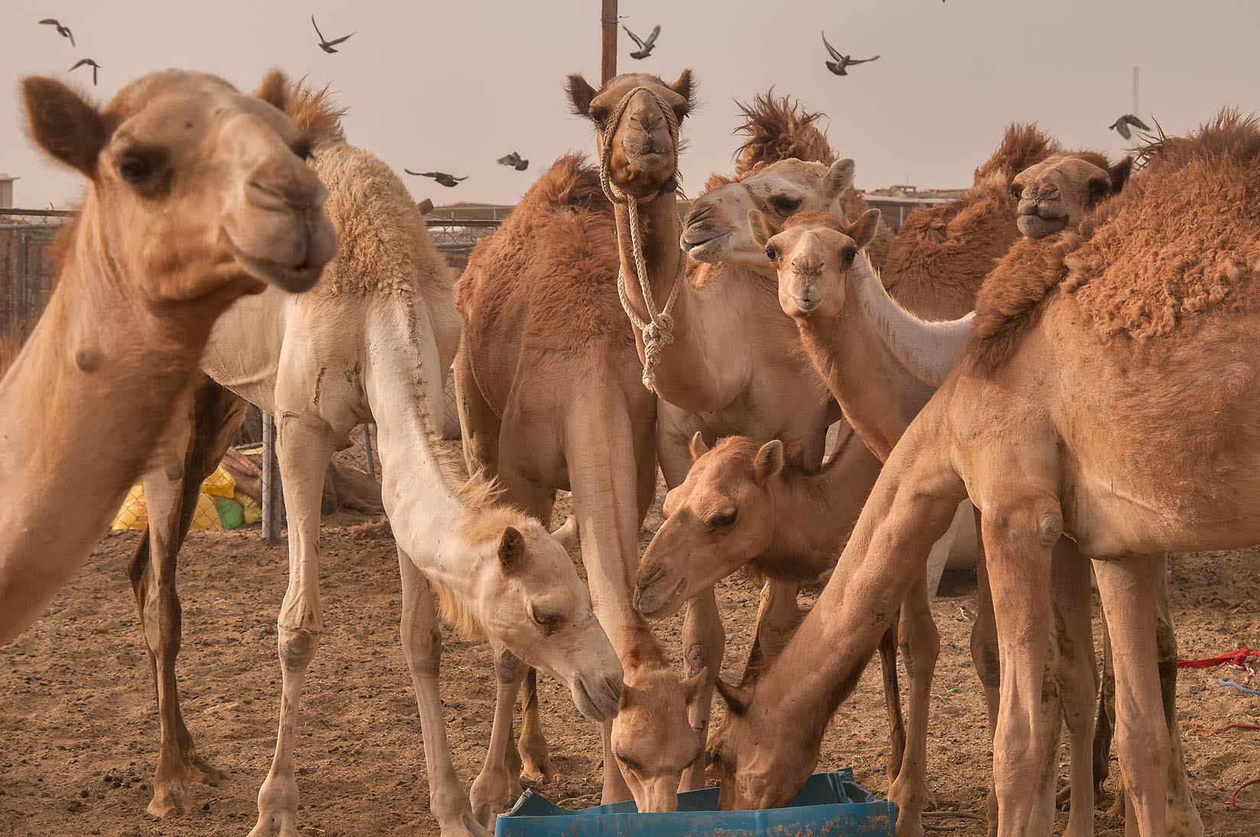
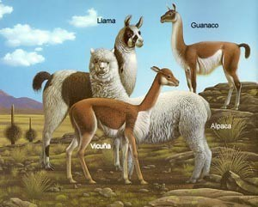
Types of livestock farming
7. APICULTURE OR BEEKEEPING
HONEY , BEEWAX
8. CAMELIDS (CAMELS , ALPACAS AND LLAMAS)
WOOL/ MEAT/ MILK/ TRANSPORT

Slide 10
CRITERIA TO CLASSIFY LIVESTOCK FARMING
ACCORDING CAPITAL AND INVESTMENT COULD BE :
INTENSIVE, EXTENSIVE AND ORGANIC
ACCORDING TO FOOD AND LIVESTOCK METHODS:
GRAZING LIVESTOCK,
SEMI-CONFINED OR SEMI-STABLED
AND STABLED OR CONFINED
ACCORDING TO MOBILITY CAN BE CLASSIFIED INTO:
NOMADIC HERDING
TRANSHUMANCE
SEDENTARY

Slide 11
EXTENSIVE LIVESTOCK FARMING
IT CAN BE FOUND IN DEVELOPED AND DEVELOPING COUNTRIES
IT IS PRACTICED IN LARGE FARMES WHERE ANIMALS GRAZE IN NATURAL PASTURES
REQUIRES LITTLE INVESTMENT IN LABOUR AND TECHNOLOGY
PRODUCTIVITY IS LOW
THIS TYPE OF LIVESTOCK FARMING IS FOUND IN AREAS WITH ABUNDANT PASTURES: ARGENTINA, BRAZIL, AUSTRALIA, SOUTH AFRICA, UNITED STATES.
IT IS BASED ON CATTLE AND SHEEP

Slide 12
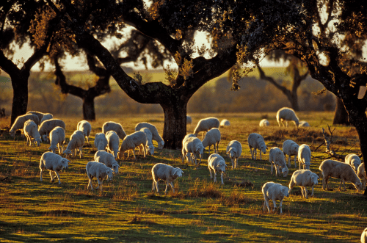

Slide 13
INTENSIVE LIVESTOCK FARMING
MAINLY IS FOUND IN DEVELOPED COUNTRIES.
FARMS SPECIALIZE IN ONE ANIMAL
REQUIRE LARGE INVESTMENTS IN SELECTIVE BREEDING, FACILITIES AND ANIMAL FEED.
HIGH PRODUCTION
PRODUCTIVITY IS HIGH
ANIMALS ARE STABLED OR SEMI- STABLED.
MAINLY FOR CATTLE , PIGS AND POULTRY.

Slide 14
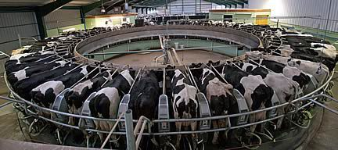

Slide 15
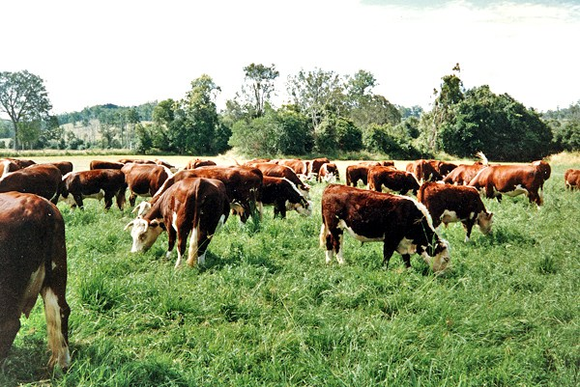
GRAZING LIVESTOCK FARMING
ANIMALS ARE FED ON GRASS AND PASTURES

Slide 16
STABLED LIVESTOCK FARMING
ANIMALS ARE KEPT IN SHEEDS AND EAT ANIMAL FEED

Slide 17
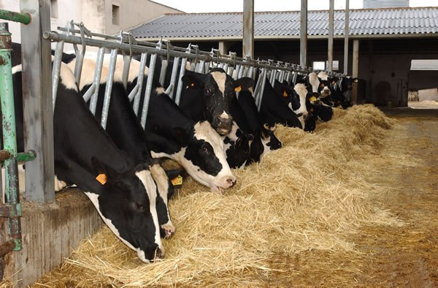
SEMI – STABLED LIVESTOCK FARMING
livestock in summer animals eat grass when there is not enough grass they eat feed.

Slide 18
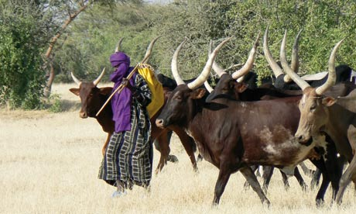
NOMADIC HERDING
HERDERS AND THEIR FAMILIES ARE CONSTANTLY MOVING IN SEARCH OF PASTURE.

Slide 19
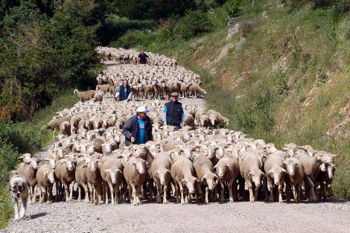
TRANSHUMANCE OR SEASONAL MIGRATION LIVESTOCK FARMING
HERDERS MOVE THEIR ANIMALS SEVERAL TIMES A YEAR BETWEEN WINTER AND SUMMER PASTURES.

Slide 20
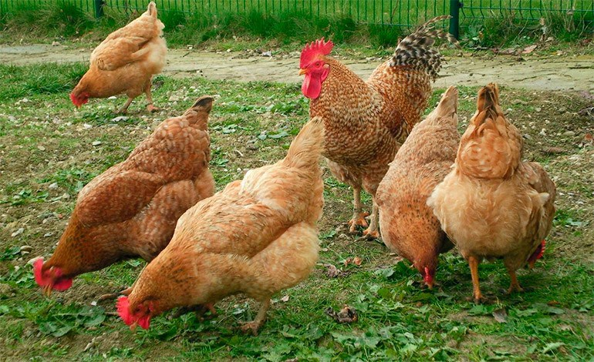
ORGANIC LIVESTOCK FARMING
Respects the environment and animal welfare. Animals are not fed artificially as well as they are not grown using stimulants. Production is low but high quality.

