Slide 1
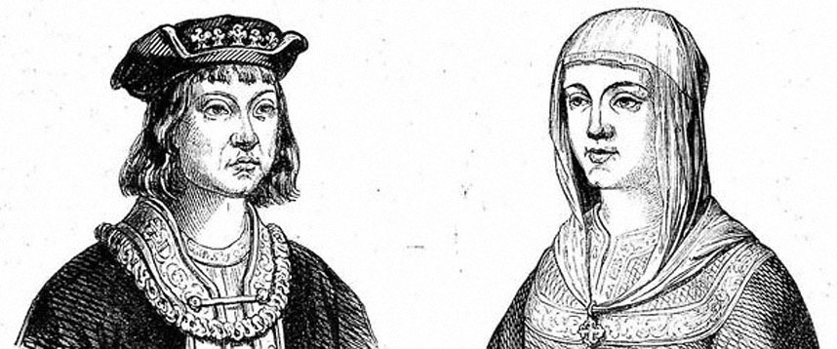
THE
CATHOLIC
MONARCHS

Slide 2
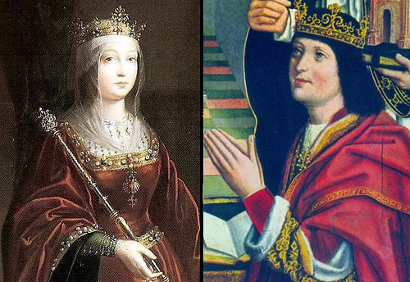

Slide 3
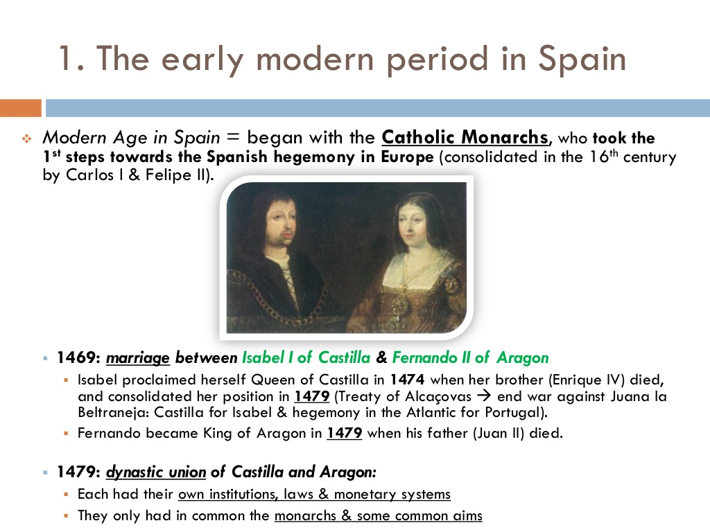

Slide 4
1469: marriage of Isabel and Fernando.
1474: Isabel proclaimed herself queen of Castilla after
the death of her brother, King Enrique IV.
1476: she defeated her niece and rival to the throne,
Juana la Beltraneja.
1479: Fernando acceded to the throne.. Dynastic union was fulfilled:
both two kingdoms had the same monarchs. each of them preserved their own institutions, laws, currencies,…
The Catholic Monarchs promoted religious and territorial unity.

Slide 5
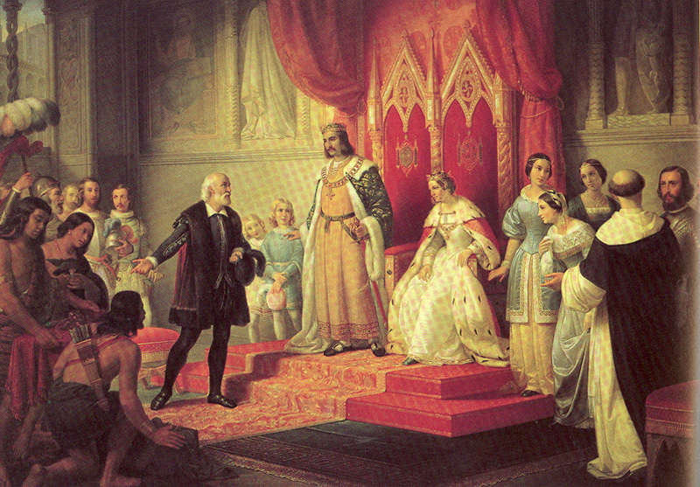

Slide 6
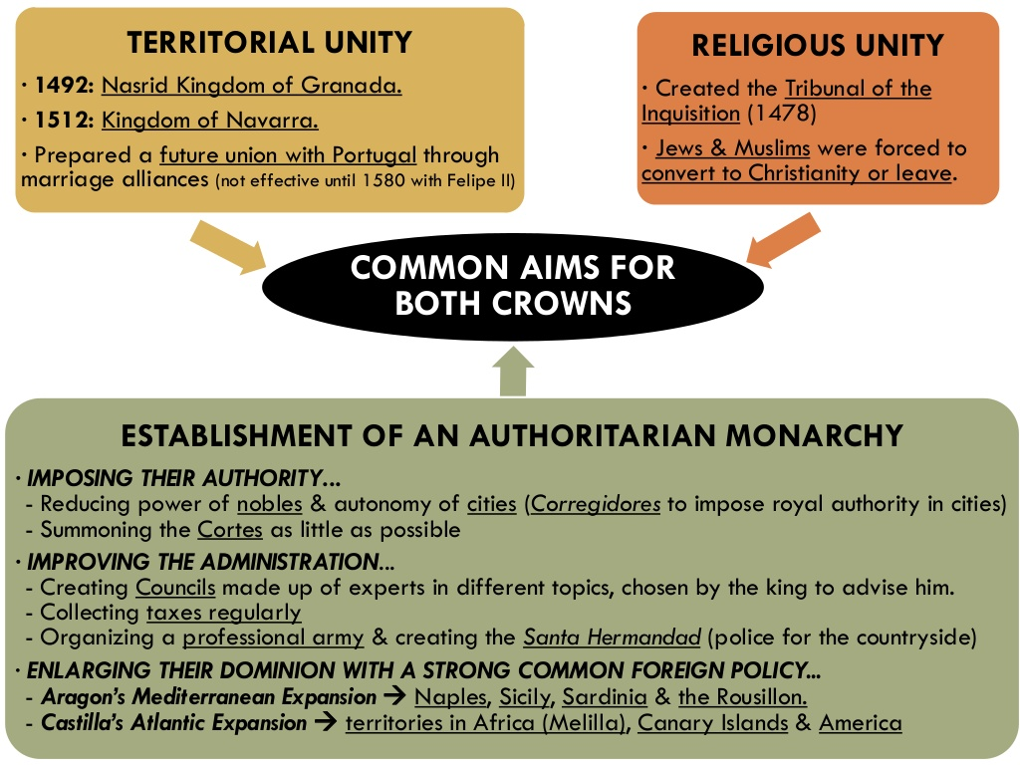

Slide 7
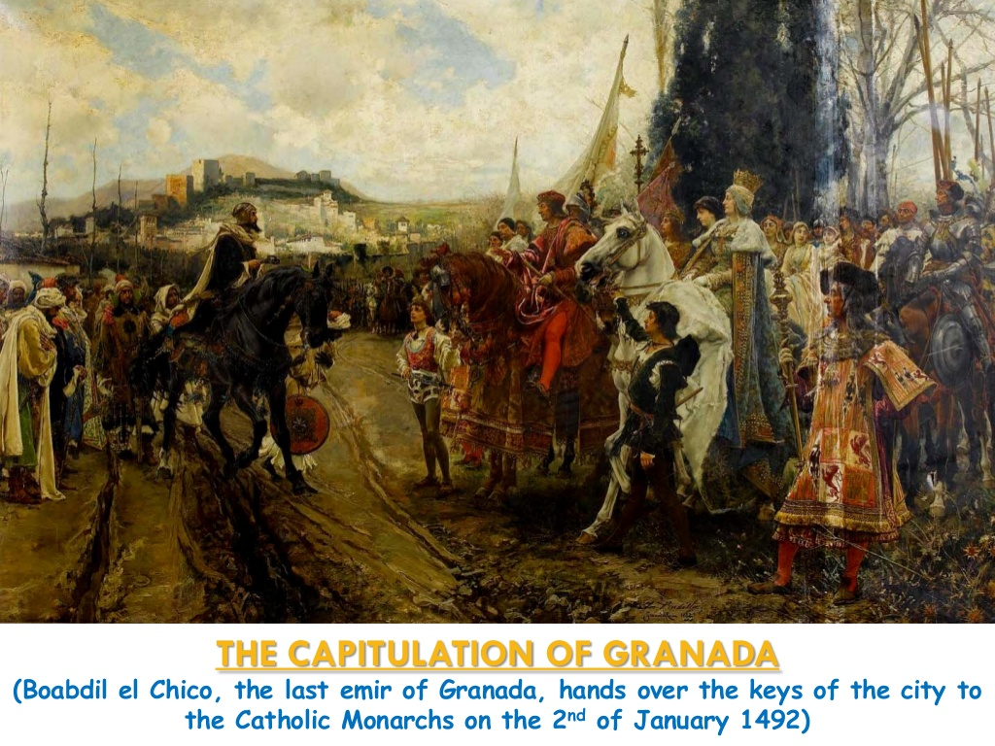

Slide 8
Religious unity:
1478: Tribunal of the Inquisition.
Jews and Muslims had to convert or leave:
1492: expulsion of the Jews (ca. 80.000).
Cardinal Cisneros forced Muslims to convert.
1499: rebellion of Las Alpujarras.
1500: expulsion of Muslims.

Slide 9
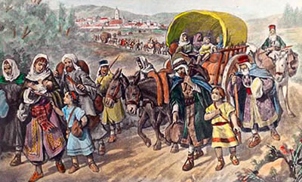

Slide 10
Foreign policy:
Marriage policy to strengthen their links to other European royal families.
Atlantic and Mediterranean expansion:
  Naples, Sicily, Sardinia were recovered.
  Melilla, Oran, Algiers and Tripoli.
  Canary Islands (1496).
  Discovery of America (1492).

Slide 11
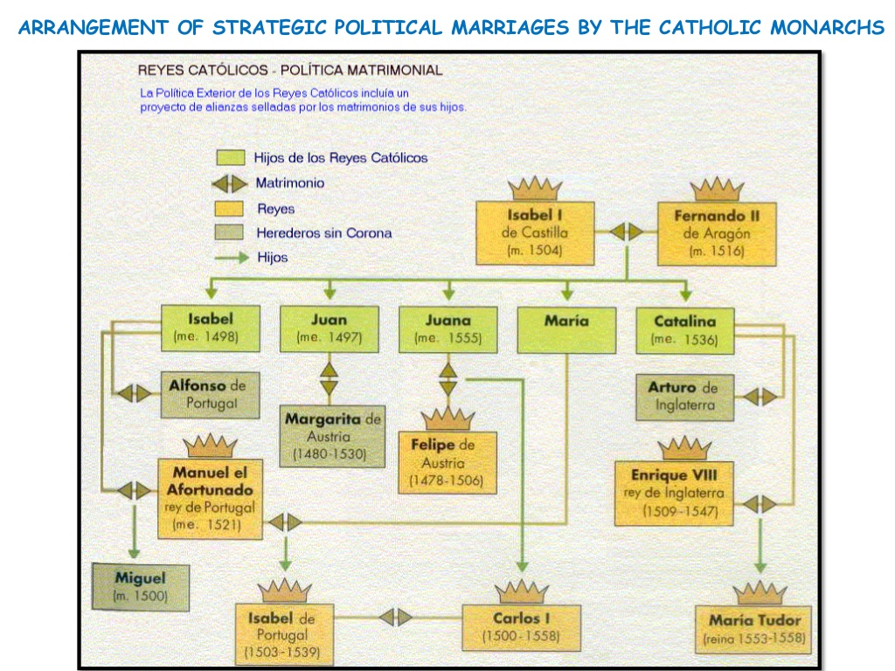

Slide 12
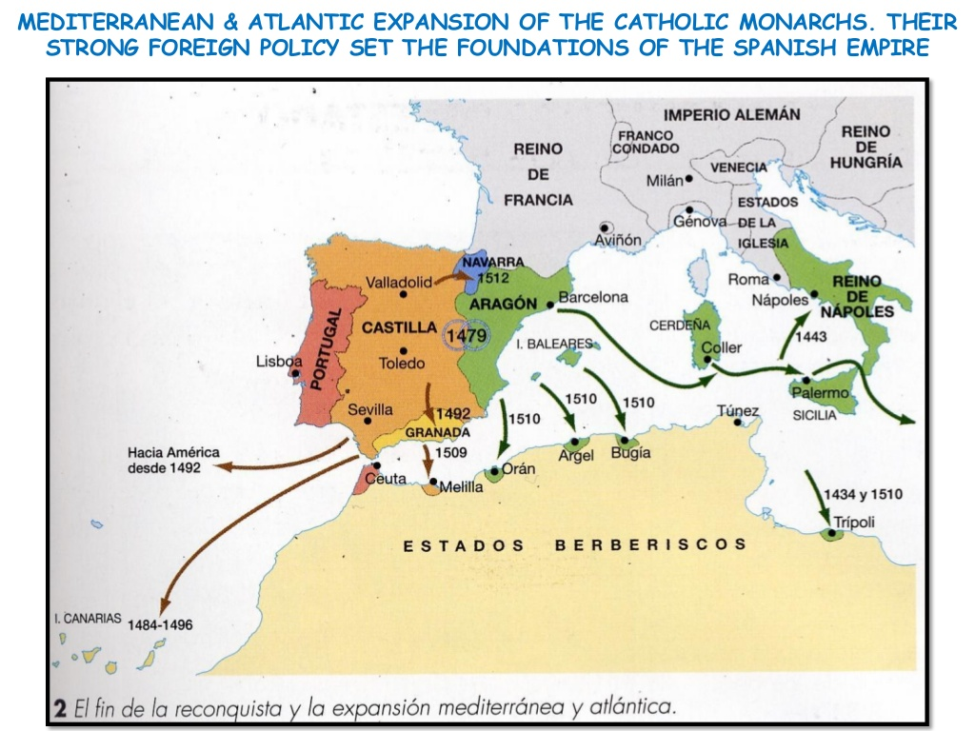

Slide 13
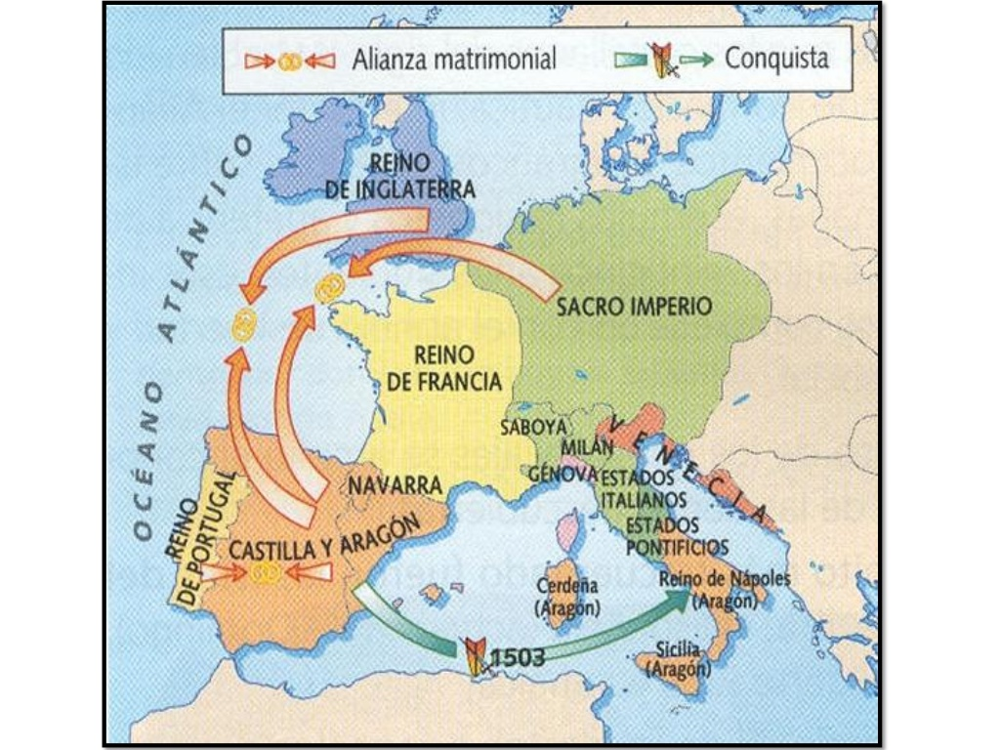

Slide 14
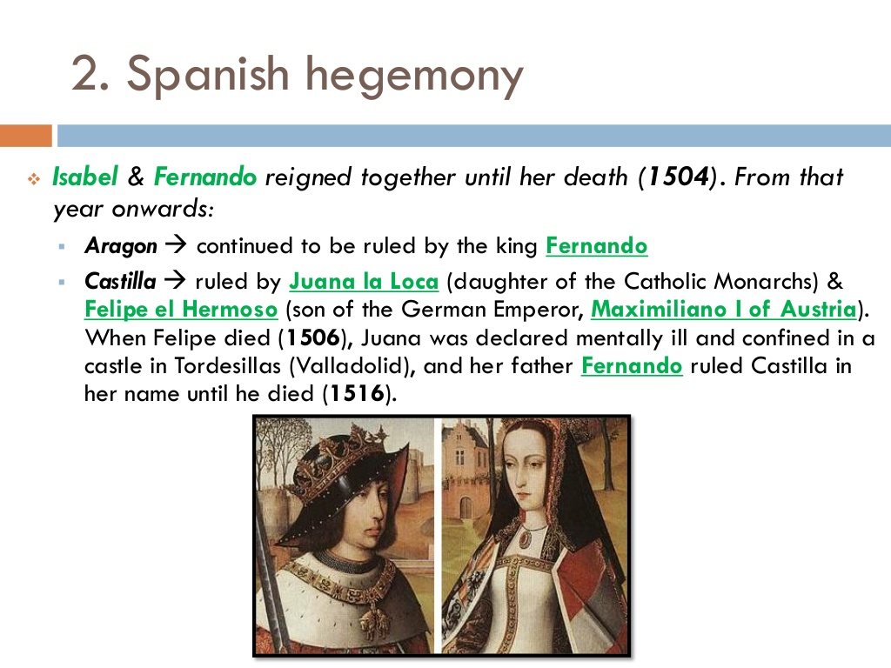

Slide 15
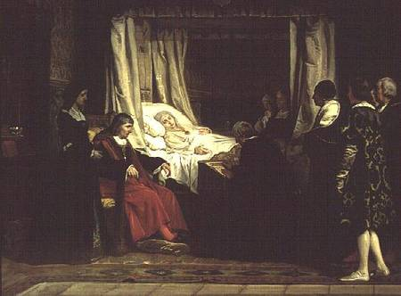

Slide 16
