Slide 1
NORTHERN RENAISSANCE
MARÍA SANZ

Slide 2
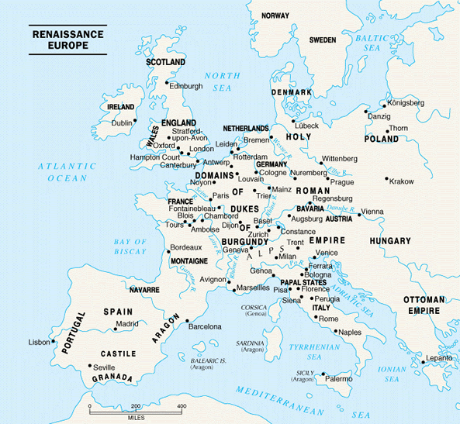
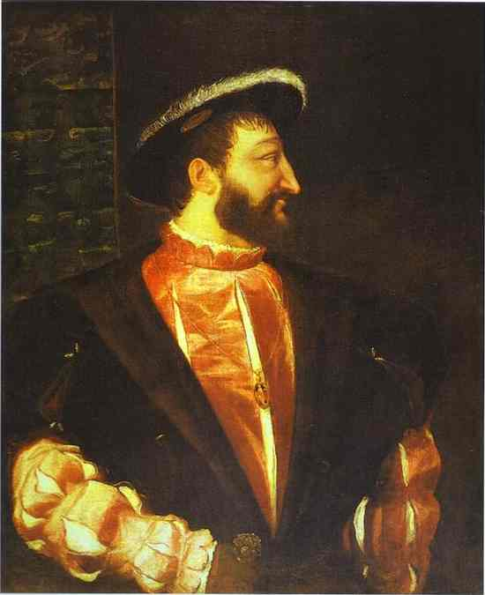
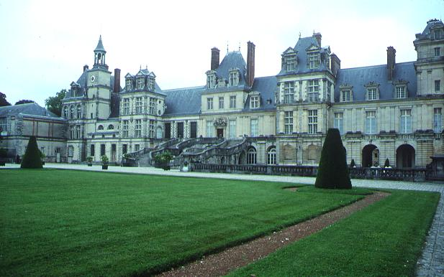
What factors led to the
beginning of the Renaissance
in northern Europe?
the northern population
began to recover from
the plague.
Hundred Years’ War
finally ended.
cities were growing
rapidly
city merchants were
becoming wealthy
enough to become
“patrons” as well as
educated in Humanist
pursuits.
Monarchs in England and in France (such as Francis I who hired Italian architects to build his palace at Fontainebleau) supported the arts and introduced Renaissance styles to northern Europe.
PP Design of T. Loessin; Akins High School

Slide 3
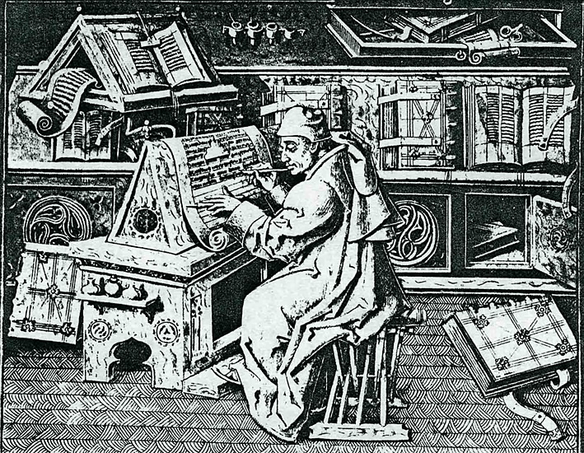

Slide 4
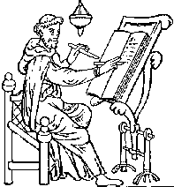
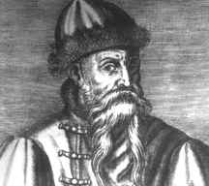
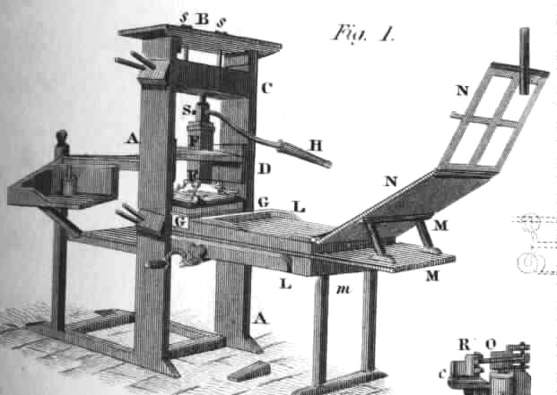
Since antiquity it had been scribes and later, monks
in the Medieval period, who copied all manuscripts
by hand …
UNTIL …
Johann Gutenberg invented a “printing press” – or,
the technique of printing from movable blocks of type letters.
Gutenberg was a 15th-century German craftsman, inventor, and printer. He used hand-set type cast in molds to print multiple copies of manuscripts. Copying now became
mechanized and much faster.
The invention of movable-type printing
facilitated an easier exchange of ideas
and helped spread
the ideas of the Renaissance.
PP Design of T. Loessin; Akins High School

Slide 5
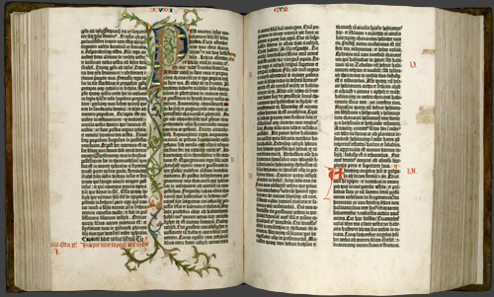
Renaissance Ideas Spread to Northern Europe
Johann Gutenberg invented a “printing press” – or,
the technique of printing from movable blocks of type letters.
It is said that other great historical events such as the Protestant Reformation of the 1500s, the Scientific Age of Enlightenment of the 1600s, and the French Revolution in the 1700s would likely have not had such impact it not been for the invention of the printing press..
The Gutenberg Bible – one of only 5 existing copies
PP Design of T. Loessin; Akins High School

Slide 6
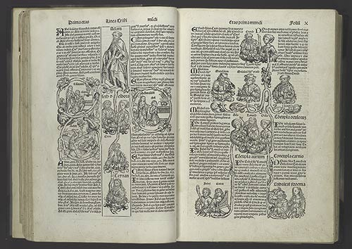
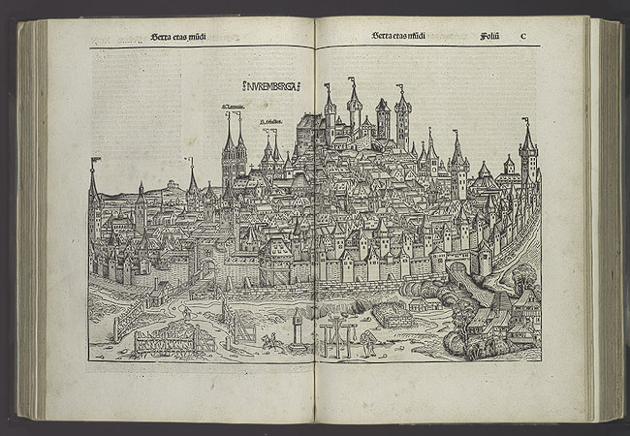
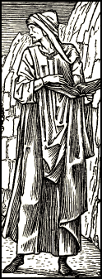
Renaissance Ideas Spread to Northern Europe
How did the invention of the printing press help spread learning and
Renaissance ideas?
Lowered price of books; more people could afford them;
books now written in the vernacular so people who had
no classical education (in Latin) could now read the classics;
this all led to increased literacy
How did they put pictures in books
now printed with the movable type press?
Using engravings
PP Design of T. Loessin; Akins High School

Slide 7
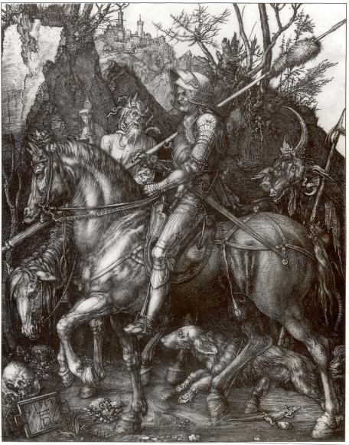
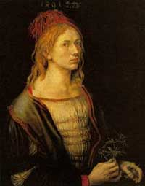
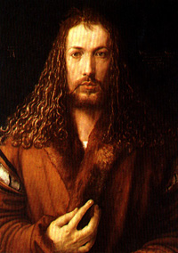
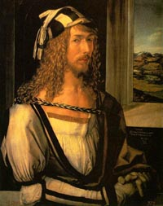
Artistic Ideas Spread to Northern Europe
Albrecht Durer – produced engravings whose realism influenced other northern artists.
His works were not just religious subject matter but showed classical mythology and realistic landscapes.
“Knight, Death,
and the Devil”
-engraving by
Albrecht Durer
PP Design of T. Loessin; Akins High School
Notes:
Shown here are Durer's own self-portraits at ages 22, 26 and 28 (now in the collections of the Louvre, Prado and Alte Pinakothek of Munich).

Slide 8
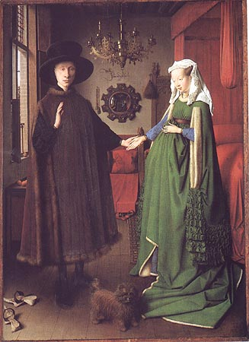
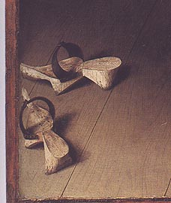
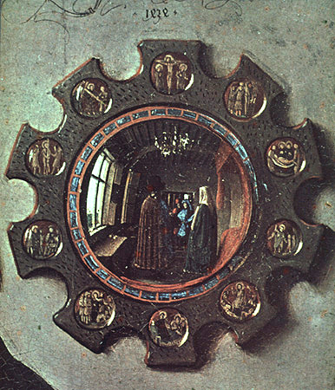
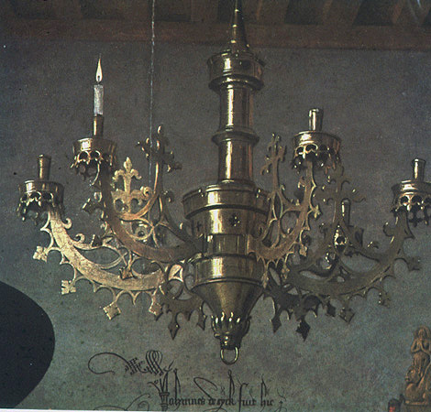
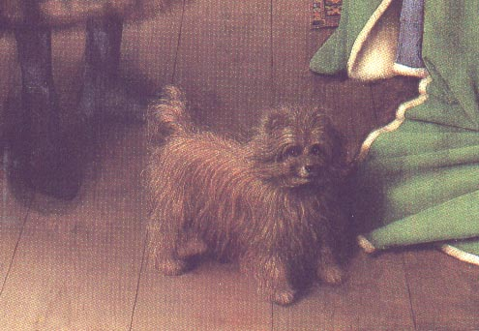
Artistic Ideas Spread to Northern Europe
Does Jan van Eyck pay attention to details?
Are his paintings realistic or idealized?
What type of colors does he use?
“Wedding Portrait” *
-Jan van Eyck
PP Design of T. Loessin; Akins High School

Slide 9
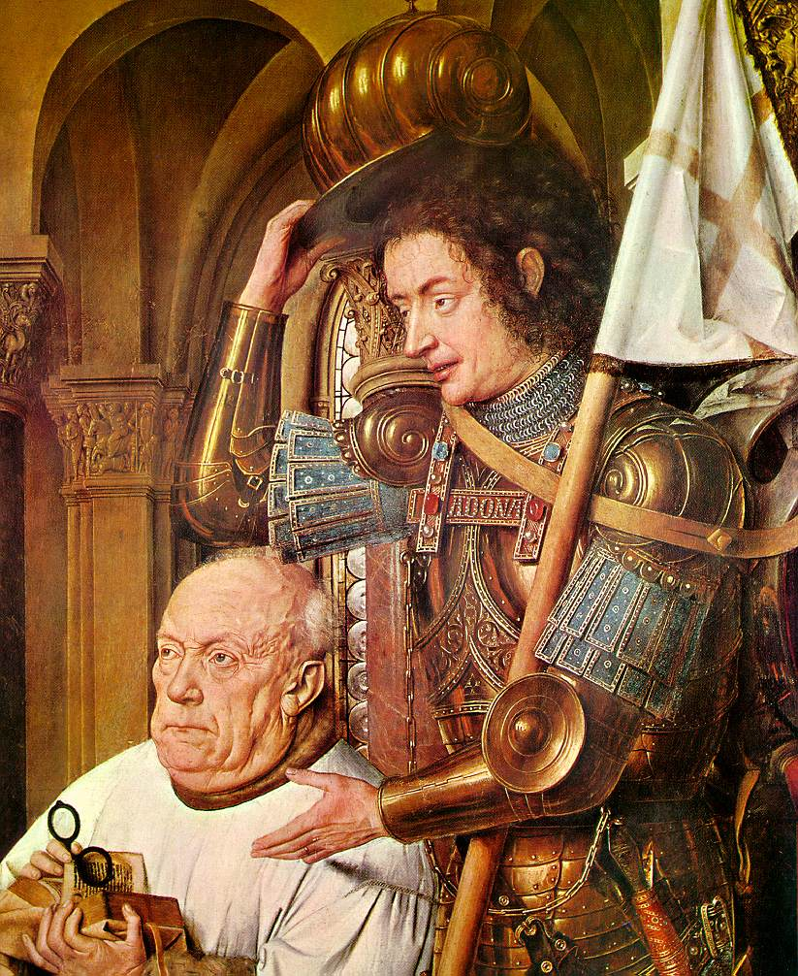
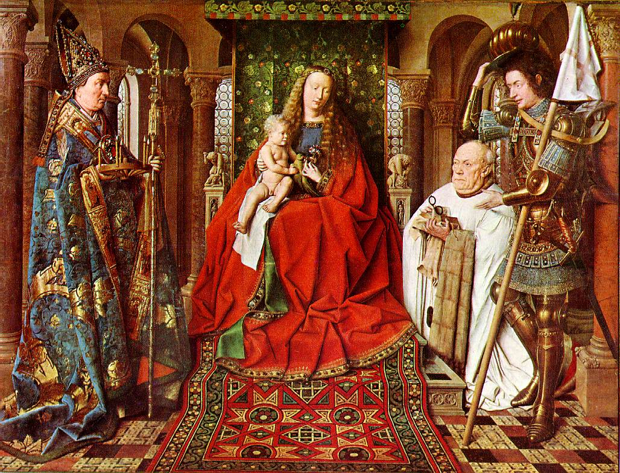
Van Eyck, Jan
The Madonna with Canon van der Paele
1436 Oil on panel 122 x 157 cm Het Groeninge Museum, Brugge
Notes:
Van Eyck, Jan
The Madonna with Canon van der Paele
1436
Oil on panel
122 x 157 cm
Het Groeninge Museum, Brugge

Slide 10
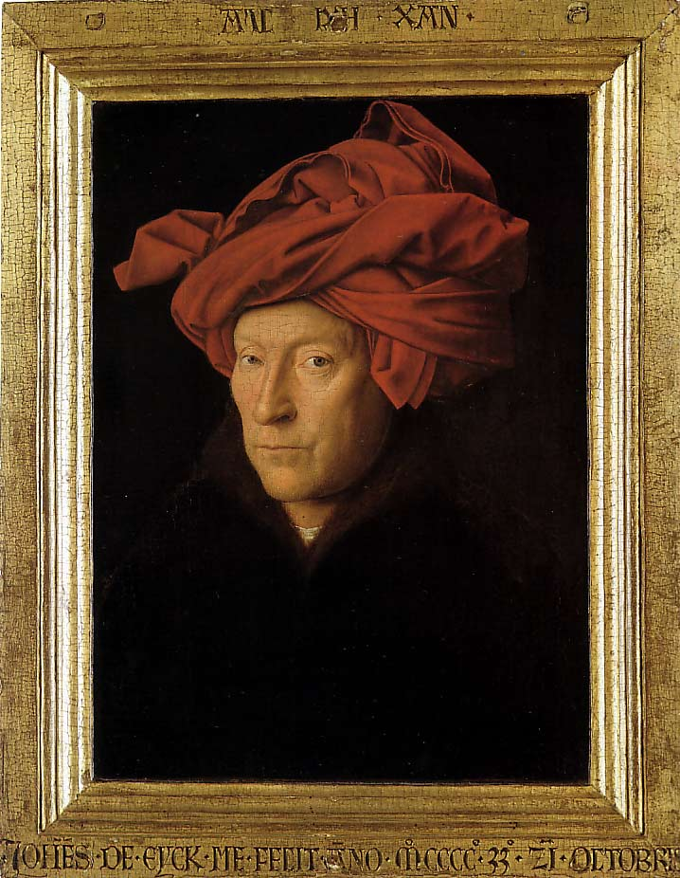
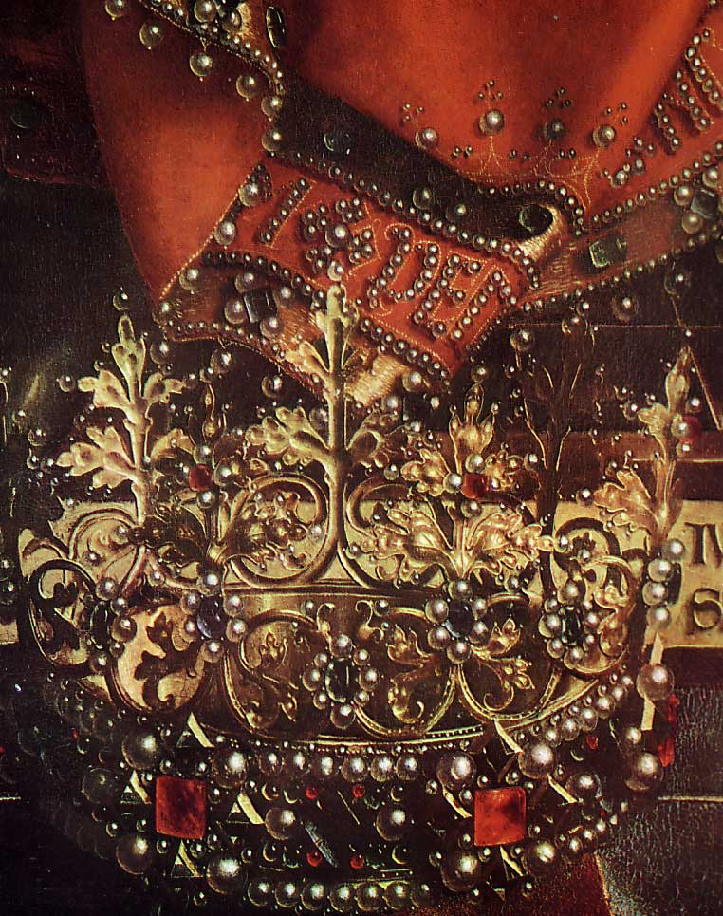
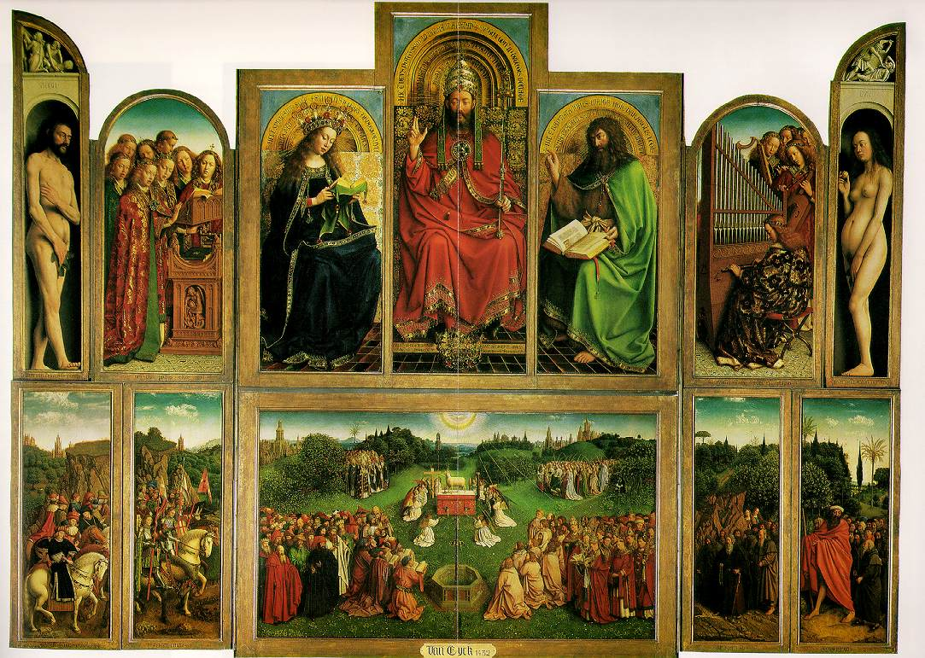
Notes:
Ghent alterpiece
Man in Turban

Slide 11
Artistic Ideas Spread to Northern Europe
Jan van Eyck – developed new creative techniques to achieve more realistic detail with oil-based paints, applying several layers to create variety of colors and 3-D appearance to clothing / jewelry.
“Wedding Portrait” *
-Jan van Eyck
PP Design of T. Loessin; Akins High School

Slide 12
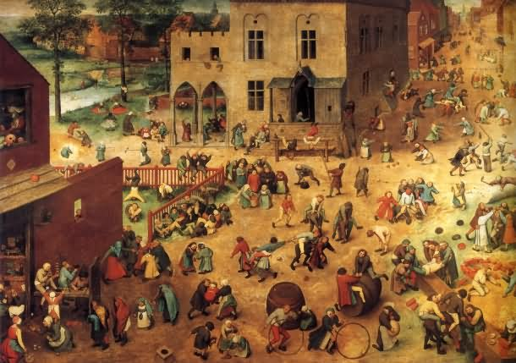
Artistic Ideas Spread to Northern Europe
Pieter Bruegel the Elder – Painted mostly scenes of everyday life – focused on realism and individual characteristics. Produced paintings that taught morals, illustrated proverbs, and strongly protested Spanish rule over his country.
“Children’s Games” *
- Pieter Bruegel the Elder
PP Design of T. Loessin; Akins High School

Slide 13
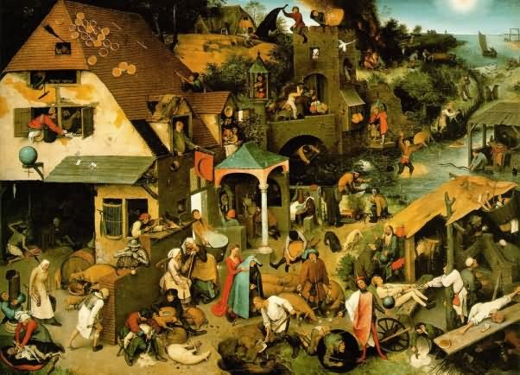
Bruegel’s “Netherland’s Proverbs,” 1559

Slide 14
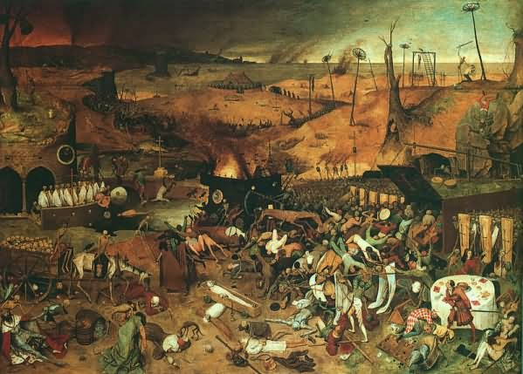
Bruegel’s “The Triumph of Death,” 1562

Slide 15
Artistic Ideas Spread to Northern Europe
“Children’s Games” *
- Pieter Bruegel the Elder
PP Design of T. Loessin; Akins High School

Slide 16
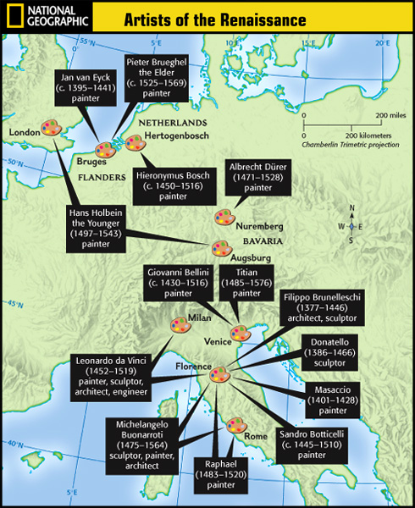


Slide 17
TODAY’S ACTIVITIES:
Explain the origins and characteristics of the Northern Renaissance.
Trace the impact of the Renaissance on German and Flemish painters.
Explain how the invention of the printing press spread Renaissance ideas.

