Slide 1

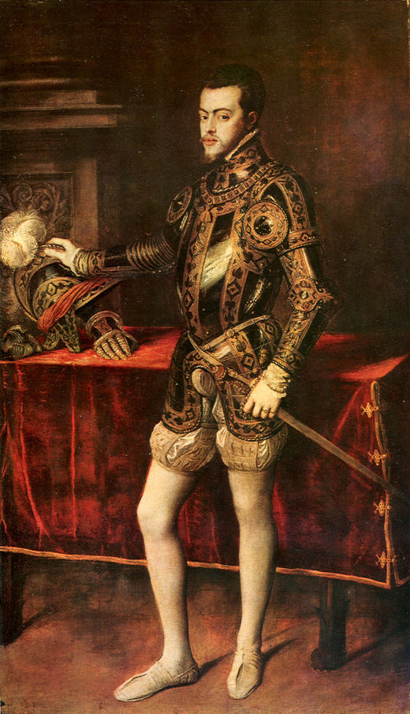
Philip II
(1556-1598)

Slide 2
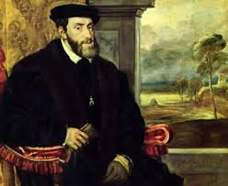
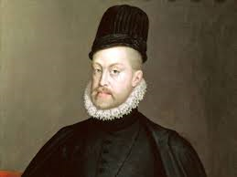
PHILIP II
Felipe was born in 1527.
In 1554 before his marriage to Mary Tudor he got the thrones of Naples and Sicily
Spain reached the peak of its power: “The sun never sets”.
He established the capital in Madrid (1561).

Slide 3
CHARLES V ABDICATION
Charles V abdicated parts of his empire:
  In 1554 Charles abdicated the thrones of Sicily and Naples and the Duchy of Milan to his son Philip.
  On 25th October 1555 Charles announced his abdication of Flanders.
  On January 1556 Charles abdicated of the Spanish Empire.
Philip did not inherit the German Empire.
Charles V's brother, Ferdinand, inherited the German Empire. For decades he served as deputy of his brother during his many absences.

Slide 4
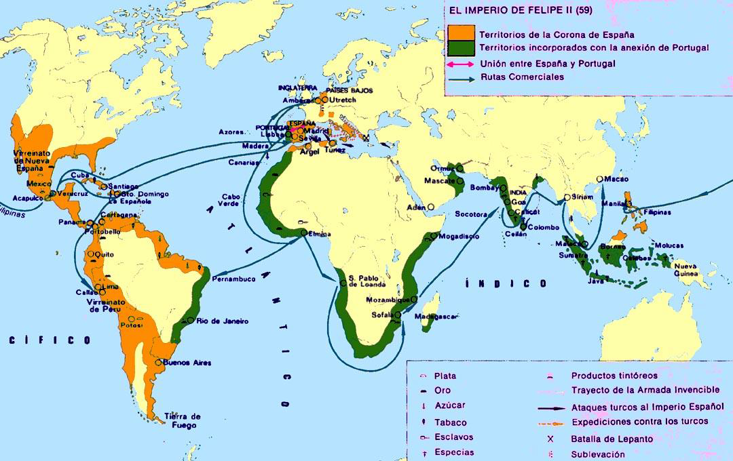

Slide 5
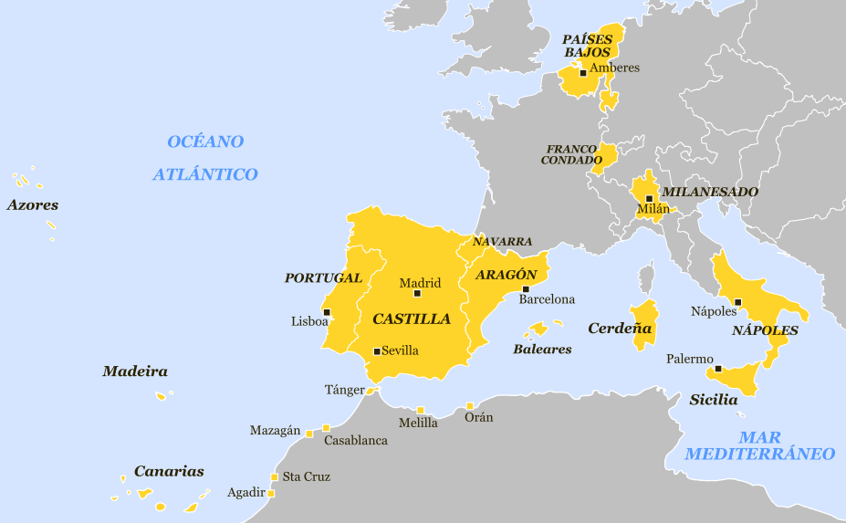
Philip´s dominions in Europe in 1581

Slide 6

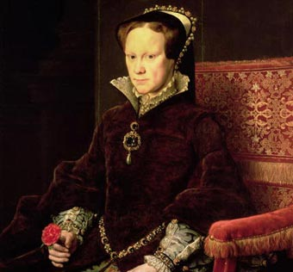
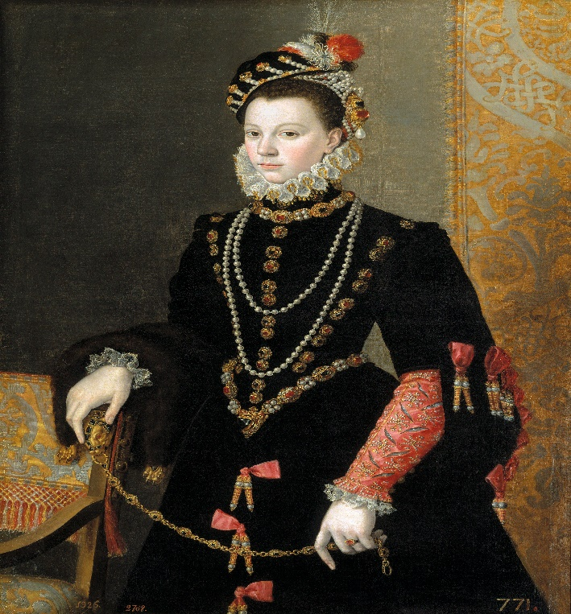
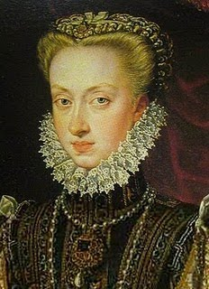
PHILIP II WIVES.
María Manuela
of Portugal.
Mary Tudor,
Queen of England,
his aunt.
Anne of Austria,
his niece.
Elizabeth of
Valois, France

Slide 7
GOVERNMENT.
He established Madrid as capital city.
Philip's empire was huge and ungovernable as a unitary State.
Each territory had its privileges and representative assemblies.
The size of the Empire and the distances made direct governance impossible and communication between the territories was extremely slow.

Slide 8
PHILIP II MAIN OBJECTIVES OF HIS REIGN.
OBJECTIVES
DEFENSE OF
THE EMPIRE
DEFENSE OF
CATHOLICISM
PROBLEMS
WAR AGAINST
FRANCE
WAR AGAINST
THE PROTESTANTS
WAR AGAINST
THE MUSLIMS, THE
OTTOMANS
WAR AGAINST
ENGLAND

Slide 9
DEFENSE OF THE CATHOLICISM
- Prohibition of Protestantism in his kingdoms.
- Reinforcement of the Inquisition.
- Prohibition of importing books from Europe.
- Spanish students could not study abroad.
- “Blood cleanliness” in the Administration.
Blood Cleanliness: A common accusation was that the New Christians were false converts, secretly practicing their former religion. Authorities checked the backgrounds of parents and grandparents. The religious and military orders, guilds and other organizations incorporated in their bylaws clauses demanding proof of cleanliness of blood. The first statue of blood cleanliness appeared in Toledo in 1449.

Slide 10
INTERNAL CONFLICTS
Revolt of the Moriscos (1568):
  Philip II issued a royal decree ending all toleration of Moorish culture in Spain.
  outbreak of armed rebellion in Granada
Revolt in Aragón (1590):
  Philip II tried to reduce the power of the region's fueros and traditional rights, causing a popular revolt.

Slide 11
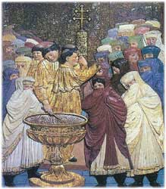
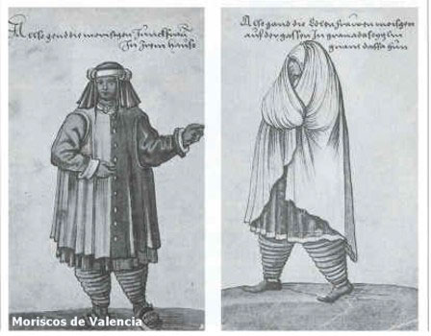
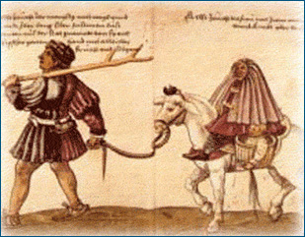
WHO WERE THE MORISCOS?.
Cardinal Jimenez de Cisneros forced conversions, burnt Islamic texts, and prosecuted many of Granada's Muslims. In response, Granada's Muslim population rebelled in 1499.
In 1501 Castilian authorities delivered an ultimatum to Granada's Muslims: they could either convert to Christianity or be expelled. Most converted but many continued to dress in their traditional fashion, speak Arabic, and secretly practiced Islam. Many used the aljamiado writing system: spanish but with Arabic expressions.

Slide 12
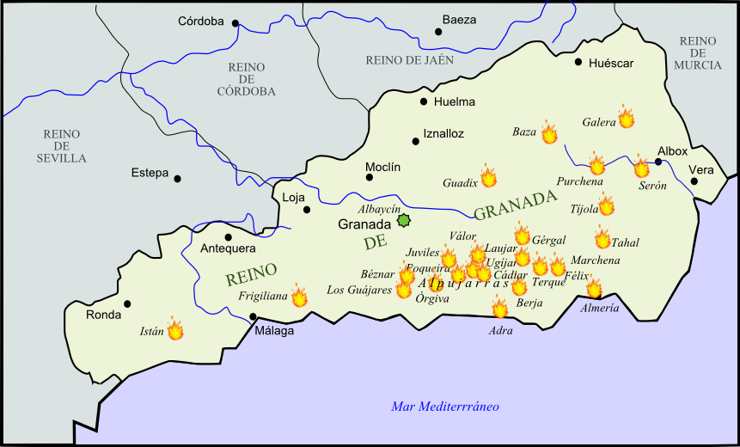
ALPUJARRAS' REVOLT.
With the conquest of Granada by the Catolic Kings, the Muslims were then forced to into Christian baptism or to emigrate. Those who chose the first option became known as Moriscos.
The measure provoked many reactions against the kings and the most violent was the protest in the Alpujarras in 1500. This was followed by the suppression of their language and customs.
In 1567 King Philip II issued an edict that forced Christianity on the children of the Moors, which caused an uprising a year later in the Alpujarras. The nobleman Fernando de Cordova became the leader of the Moors and took the name of Aben Humeya, crowned king of the Alpujarras.

Slide 13
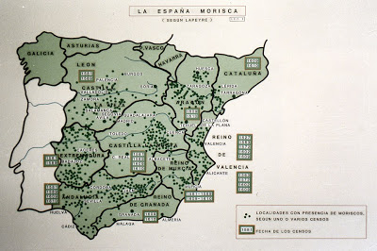
After the defeat, more than 70,000 Moriscos were dispersed around the lands of Castile. This had a negative effect on the economy because Moriscos were good farmers (especially in irrigated lands and artisans (silk). The Moriscos were finally expelled from Spain in 1609.

Slide 14
EXTERNAL CONFLICTS
Rivalry with France:
  France was surrounded by the Habsburgs.
  French were defeated by Philip II (Battle of St. Quentin, 1557)
Expansion of the Ottoman Empire:
  Threat to the empire in Central Europe and the Mediterranean.
  Philip II in an alliance with Venice and the Pope formed a fleet to defeat the Turks (Battle of Lepanto, 1571).
  c. Anexxion of Portugal.
Rebellion in the Low Countries:
  - Provinces in the Low Countries demanded autonomy and rebelled against Philip II.
  --The northern provinces declared independence in 1579 but it was not achieved until 1648.
War with England:
  - England supported the Dutch rebellion and sponsored pirate attacks on ships trading with America
  - Philip II planned an attack on England using the Spanish Armada

Slide 15
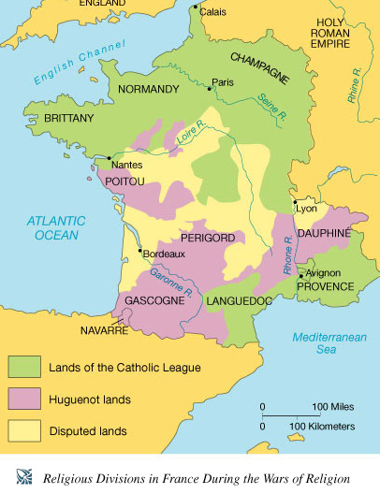
WAR AGAINST FRANCE
- At the beginning of his reign Philip defeated France at the Battle of San Quintin.
- French War of Religion (1562-1598): fought between French Catholics and Protestants (Huguenots). The conflict involved the factional disputes between the aristocratic houses of France, such as the House of Bourbon and House of Guise (Lorraine), and both sides received assistance from foreign sources.

Slide 16
WAR AGAINST FRANCE
At the end of his reign the Vervins Treaty was signed recognizing the results of the French war of religión, recognizing the right of succession of the first Borbon monarch.
Peace with was mantained for more than 30 years.

Slide 17
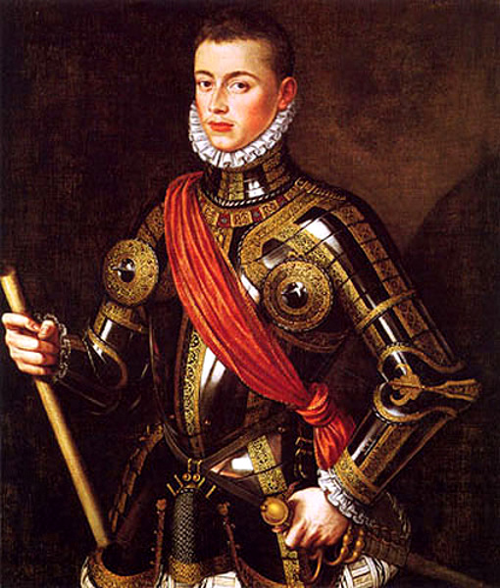
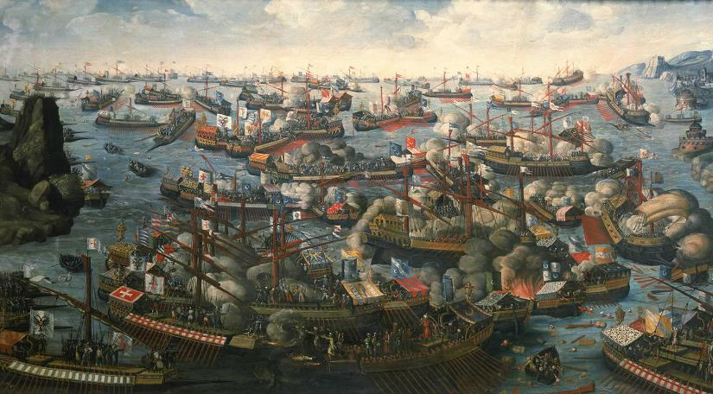
WAR AGAINST THE OTTOMAN TURKS
- The Turks threatened Spanish possessions in the Mediterranean Sea.
- Philip II formed an alliance with the Pope and Venice (also threatened by the Turks).
- The alliance, commanded by Don Juan de Austria, Philip's half brother, defeated the Turks at the Battle of Lepanto (1571).

Slide 18
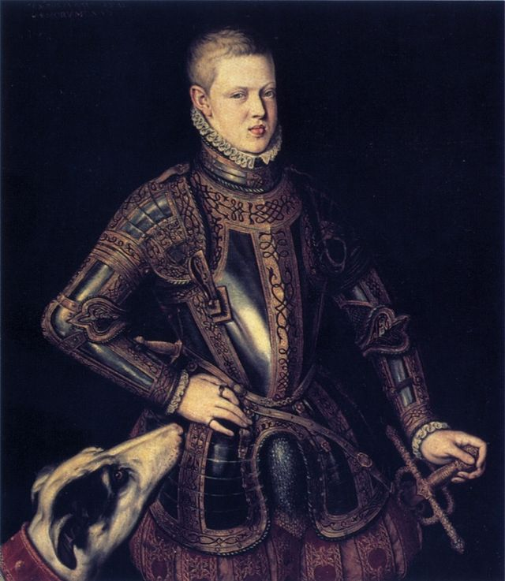
PHILIP II, KING OF PORTUGAL, 1580.
In 1578 young king Sebastian I of Portugal died while fighting a Crusade in Morocco.
The portuguese throne was disputed by several claimants. Among them were:
  Antonio, a illegitimate son of Sebastian's brother.
  Philip II of Spain.
King Sebastian I.

Slide 19
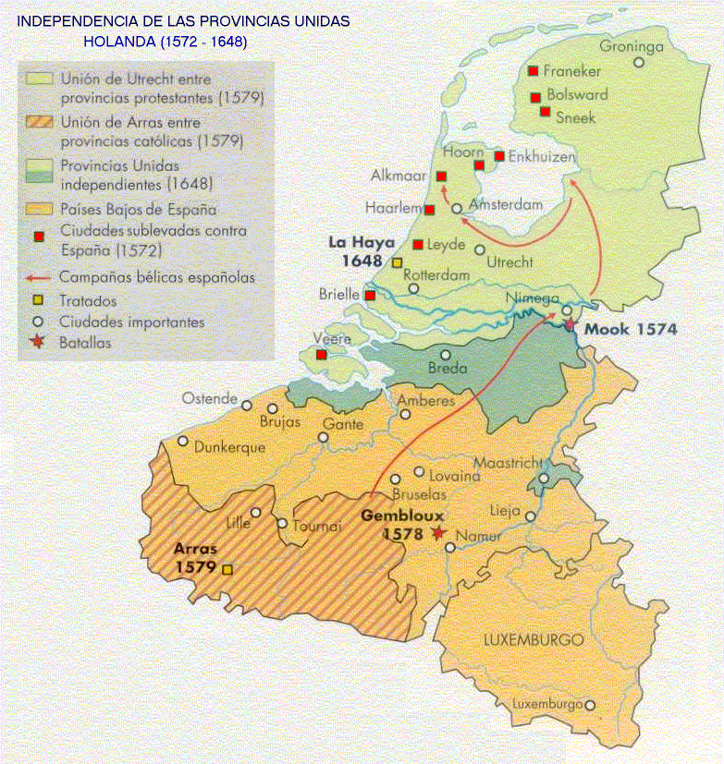
THE NETHERLANDS' REVOLT
- The Protestant Reformation spread in northern provinces of Flanders.
- Philip focused on suppressing Protestantism in his kingdoms.
- Philip II refused to give his subjects freedom of religion.
-Catholicism was a mean to unify his kingdoms and subjects.

Slide 20
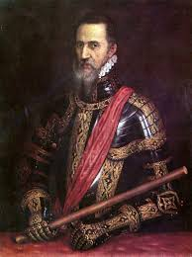
- The Inquisition acted against heretics.
- Most of the northern provinces of Flanders, which nowadays is The Netherlands, had converted to Protestantism. They were disappointed with the religious intolerance of the Spanish monarch.
- In 1566 The Netherlands rebelled against Philip and declared their independence.
Fernando Álvarez de Toledo,
Duke of Alba.

Slide 21
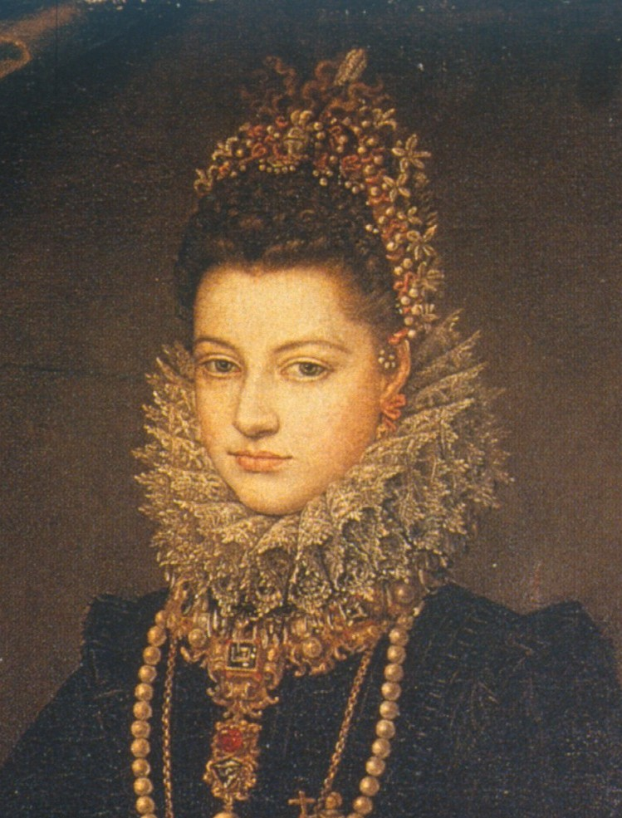
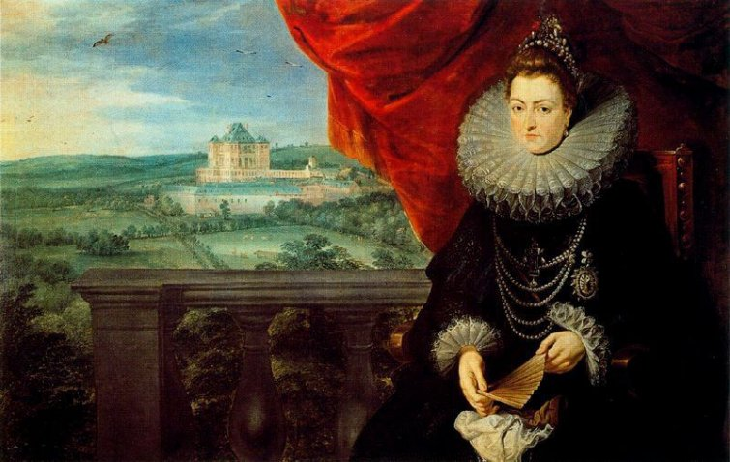
- The war lasted 80 years.
- The rebels obtained financial support from England.
- Spanish troops attacked the rebels but the war against England forced king Philip to stop the attacks.
- By the end of his reign Philip tried to solve the situation by appointing his daughter Isabel Clara Eugenia as governor of Flandes. The agreement with the Flemish was: if she had descendants Flanders would become independent, if she had not they would become again subjects of the Spanish Monarchy.

Slide 22
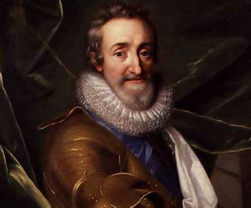
Philip financed the Catholic League during the French Wars of Religion. He directly intervened in the final phases of the wars and perhaps dreaming of placing his favourite daughter, Isabel Clara Eugenia, on the French throne.
Henry IV of France (1589-1610),
House of Bourbon.

Slide 23
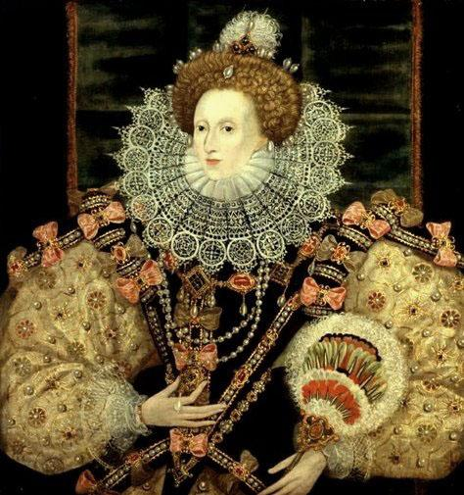
WAR AGAINST ENGLAND.
- Before Charles V's abdication, Philip married Queen Mary of England inb 1554.
- They had no children and when Queen Mary died in 1558 the throne passed to her sister Elizabeth, the Protestant daughter of Henry VIII.

Slide 24
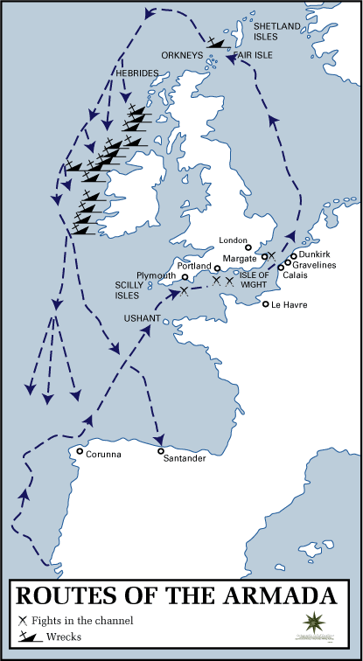
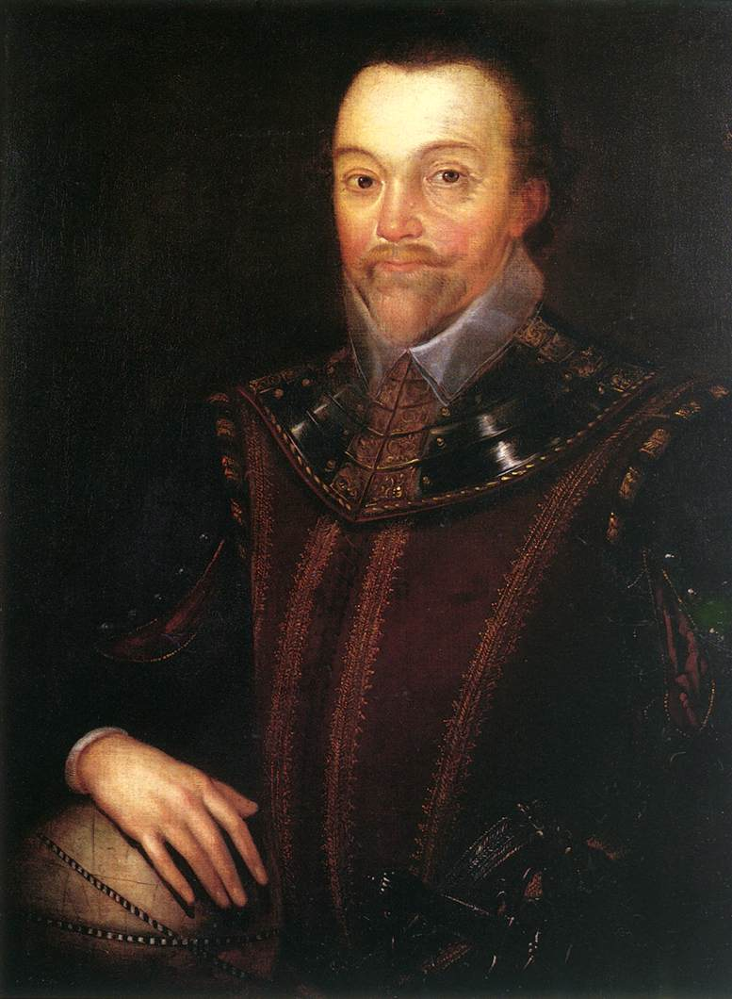
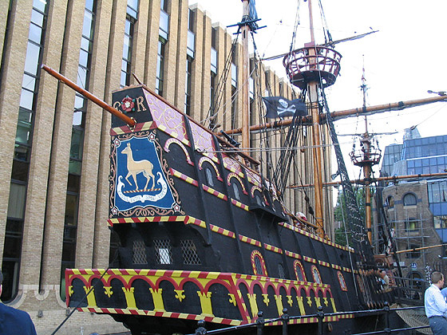
Then English supported the rebellion of the protestants in The Netherlands.
- English pirates attacked the fleets which came from America.
- Philip II decided to invade England with a great army, the Spanish Armada.
Sir Francis Drake

Slide 25
