Slide 1
SPANISH
RENAISSANCE
ART
María Sanz

Slide 2
ARCHITECTURE
It was inspired in Italian models.
Periods:
  Plateresque style (1500-1530)
  Purist style (1530-1560)
  Herrerian style (1560-1600)

Slide 3
Plateresque (1500-1530).
The inside of buildings was decorated in Gothic style.
Outer parts of the buildings adopted Renaissance motifs: coats of arms, medallions,…
Name comes from “works of a silversmith” because the extensive decoration.
Façades were designed as like real altarpieces.
Examples: façades of the University of Salamanca and the convent of San Marcos in León.

Slide 4
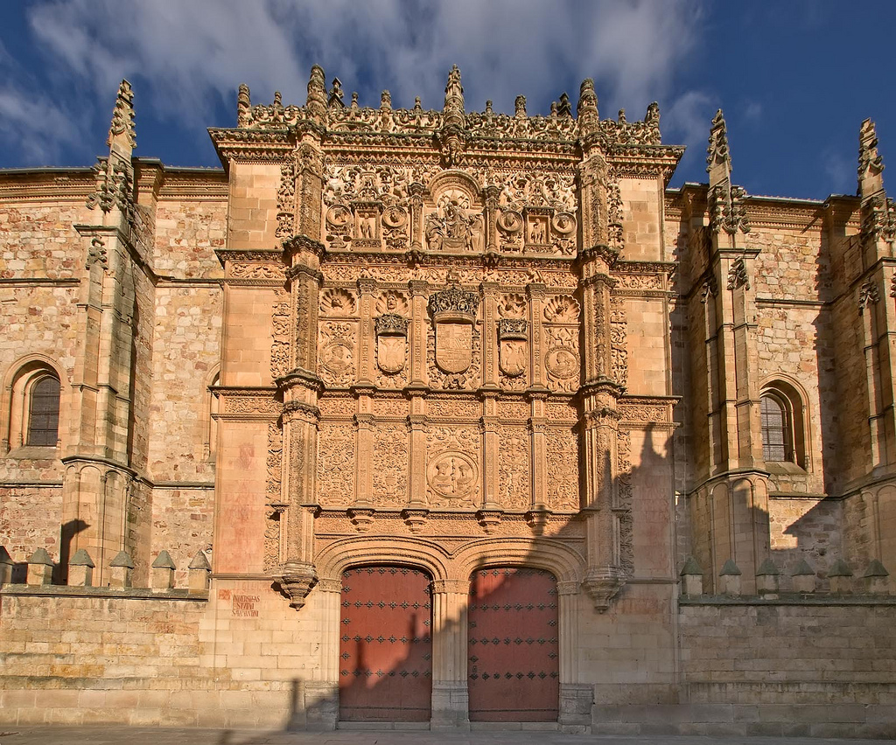

Slide 5
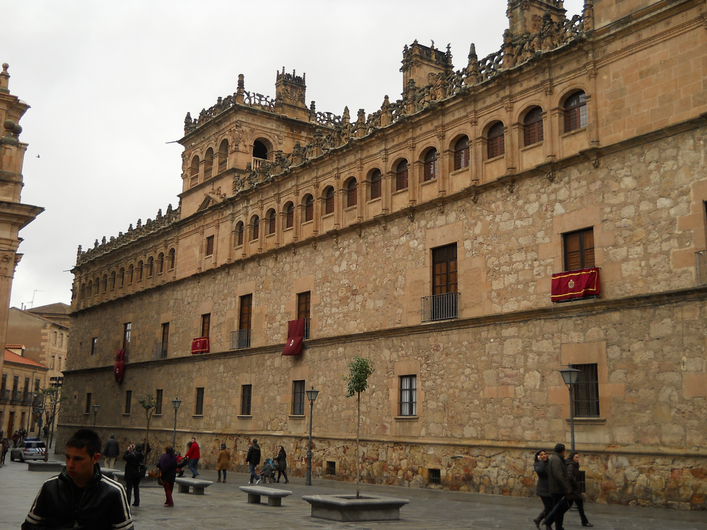
PURE RENAISSANCE
Adopted Renaissance elements in the building structure.
They enlarged the decorative elements.
Examples: the Palace of Charles I in Granada, the palace of Monterrey in Salamanca and the façade of the University of Alcalá de Henares.

Slide 6
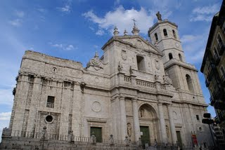
HERRERIAN STYLE
Named after the architect Juan de Herrera.
Elements:
  Simple structures.
  Slate roofs.
  Bare decoration.
  Extremely austere.
Examples: monastery of El Escorial and the Cathedral of Valladolid.

Slide 7
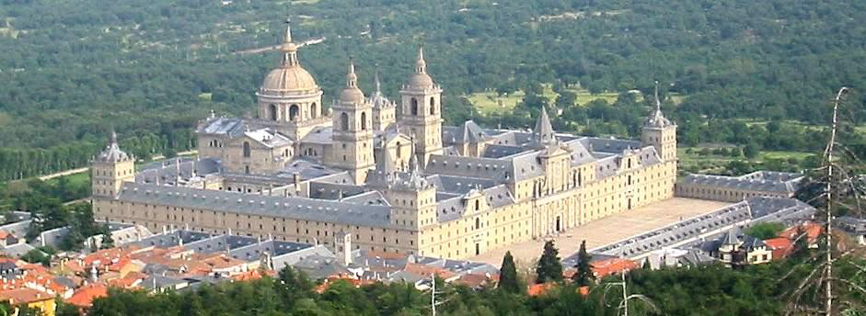

Slide 8
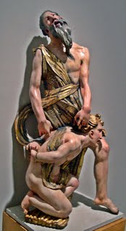
SCULPTURE
Polychrome sculpture.
Very realistic: movement and expression.
Main material: wood.
Most common themes: religious (altarpieces, choir stalls, chapels)
Alonso Berruguete and Juan de Juni.

Slide 9
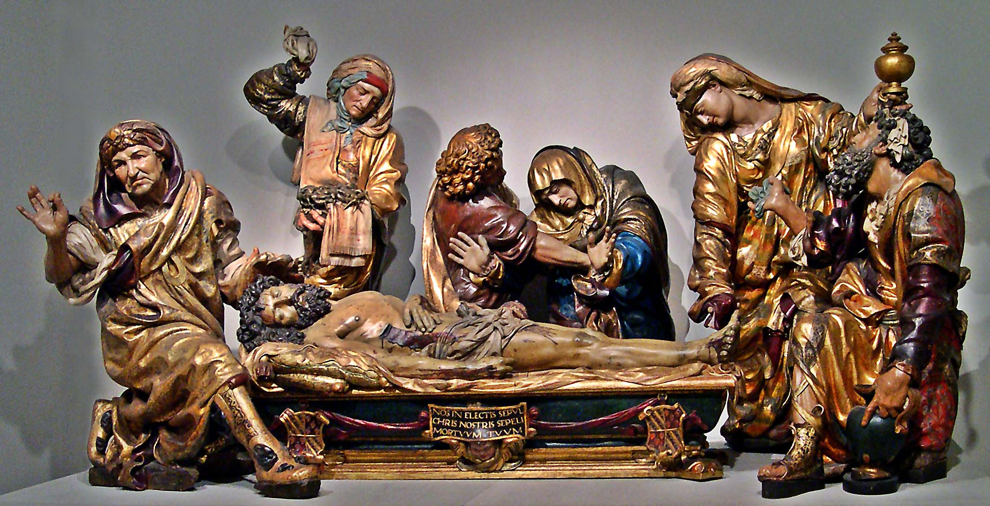

Slide 10
PAINTING
Spanish Renaissance painting was mainly influenced by Cinquecento masters.
The main characteristic was the absence of mithological paintings and the main topics were religious and portraits.
Nobles, kings and the church were the most important sponsors.

Slide 11
VICENTE MASIP
He is considered a Quattrocento painter.
The Museo del Prado owns two of his paintings representing the Visitation and the Martyrdom of St. Agnes, executed for the chapel of St. Thomas of Villanova in the convent of San Julián de Valencia
Somewhat overshadowed by the fame of his son who had more an emotional and sweet style, but certainly better equipped, experts doubt the attribution of some works between parent and child, especially those who had attributed the father.

Slide 12
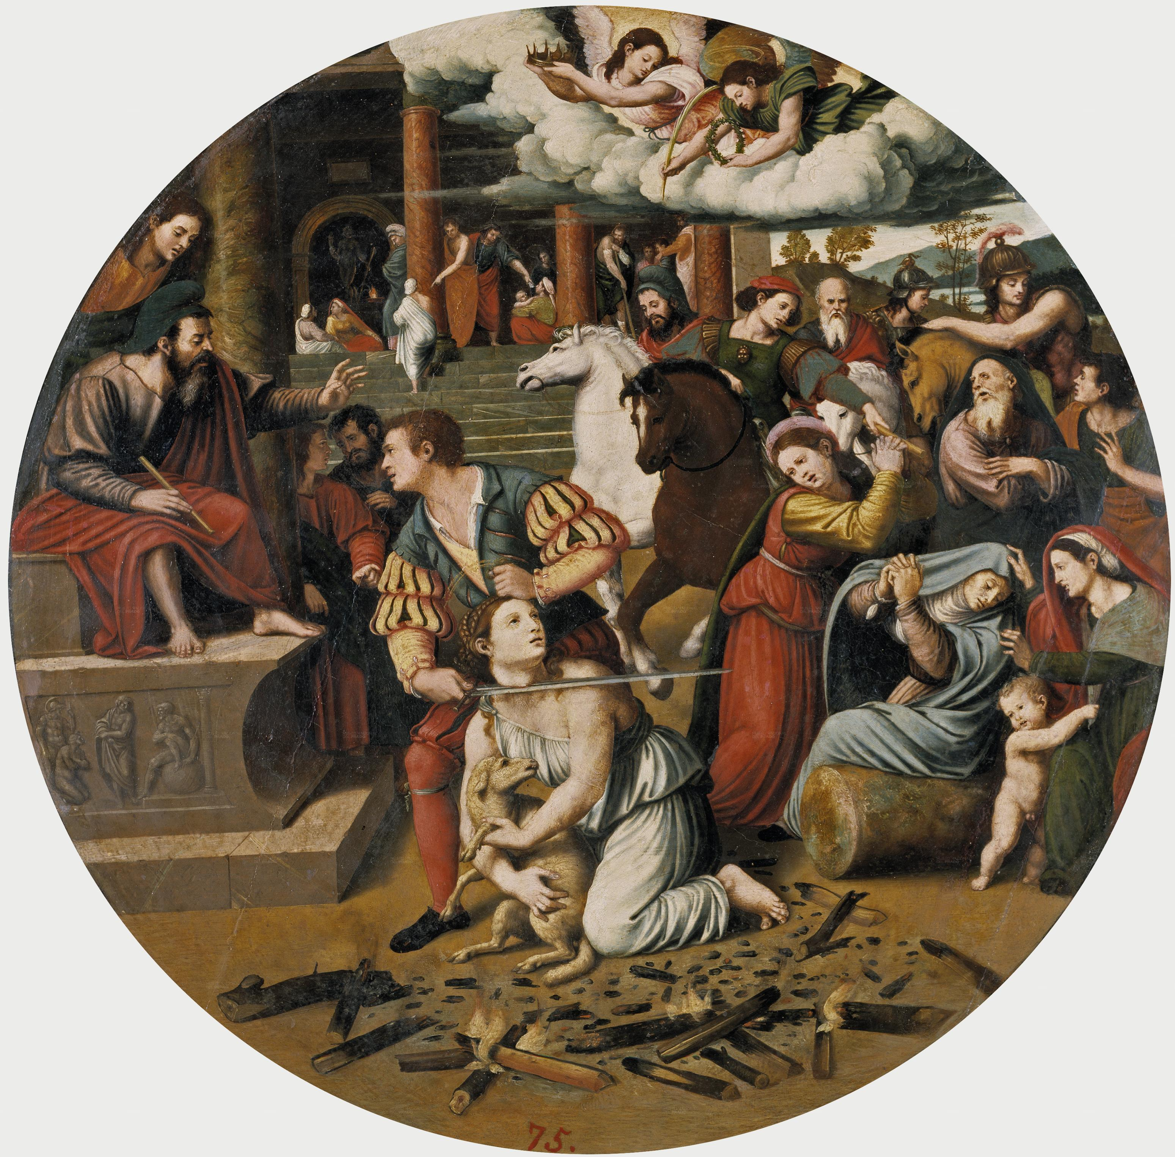
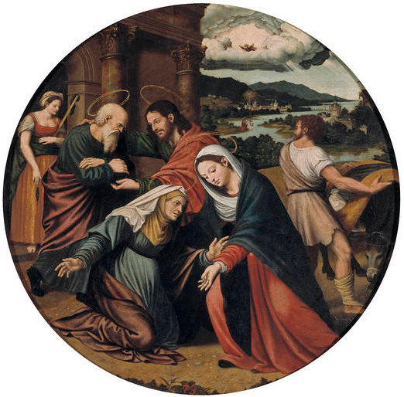

Slide 13
JUAN DE JUANES
Vicente Juan, known as Juan de Juanes, spent a large part of his life creating Spanish Renaissance religious icons.
He trained in the workshop of his father, the painter Vicente Macip, and was influenced by the drawing and idealising trend of Raphael's school.
His works show that he is an Italianising painter, with a considerably high technical and artistic level.
One of his better works is "The Last Supper“, which stands out because of its bright colours and perfectly balanced composition
"The Burial of St. Stephen" is also an example of his delicate style.

Slide 14
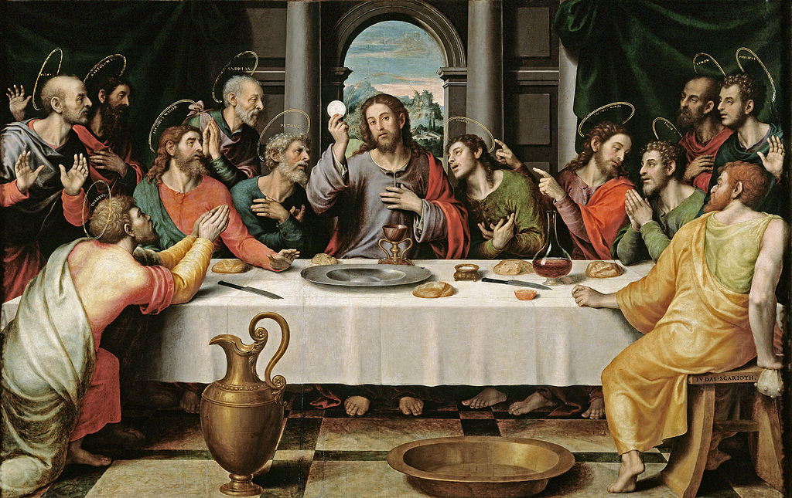
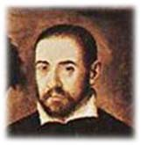
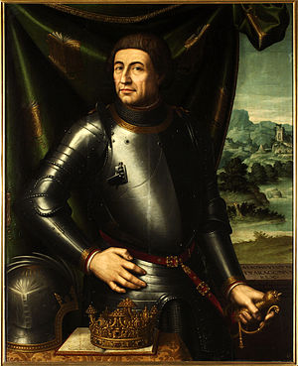
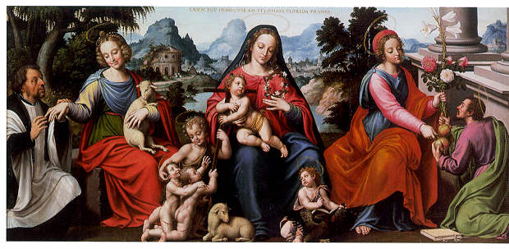

Slide 15
LUIS MORALES
He produced many altarpieces and religious paintings.
The combination of artists and influences from Flanders and Castile explains an essential part of Luis de Morales’s painting. Knowledge of works by other artists, especially Alonso Berruguete and Sebastiano del Piombo, helped shape his style.
With a commercial sense, Morales adapted a painstakingly executed artistic and devotional product, based on a combination Flemish traditions and Italianate elements and models to suit his clientele.

Slide 16
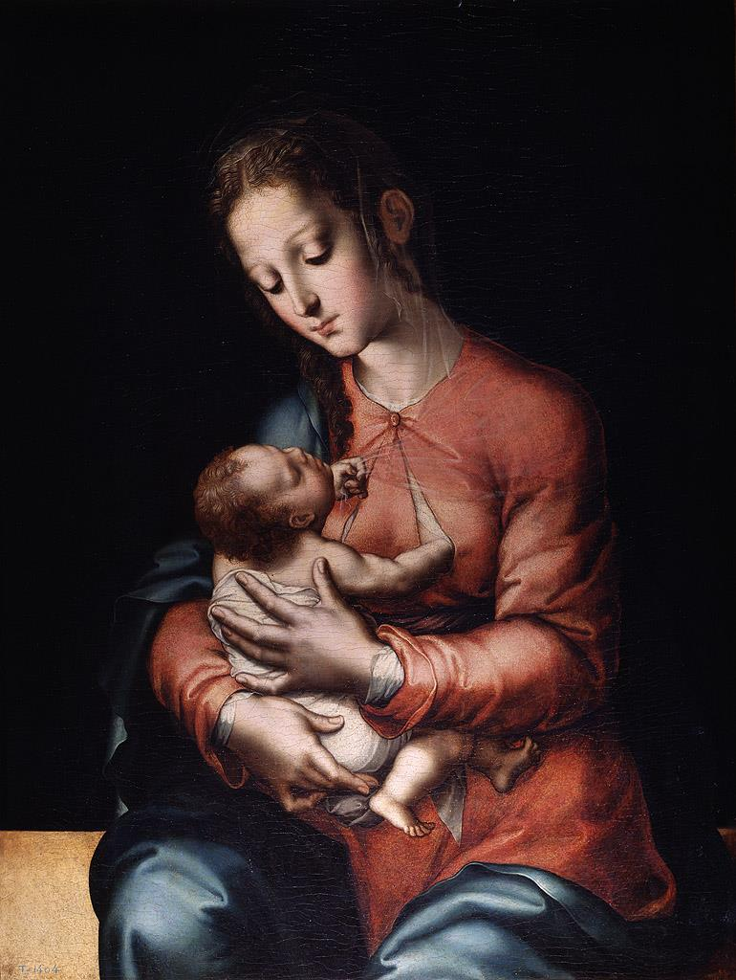
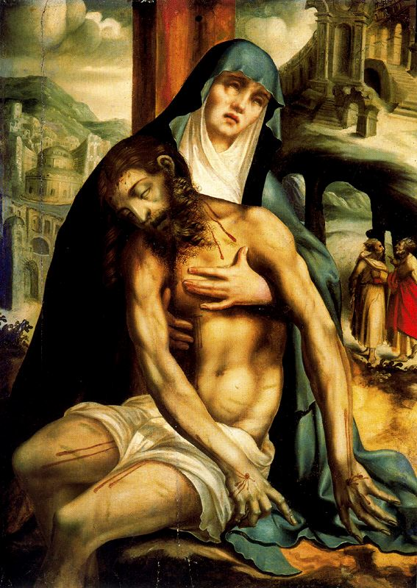
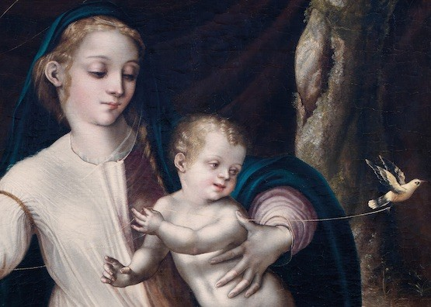

Slide 17
EL GRECO
El Greco (1541 - 1614) was a painter who had his own workshop during the Renaissance era.
After several years he left Crete for Venice. El Greco would stay in Venice until 1570 and it was thought he was a disciple of Titian. It would be during his time in Italy that he developed his style with foundations of Mannerism with the Venetian Renaissance.
After that El Greco moved on to Rome and to Spain. El Greco first settled in Madrid in 1577 before moving on to Toledo.
El Greco's dramatic and expressionist style puzzled other painters at the time, but came to be appreciated in the 20th century. El Greco is considered to have influenced the expressionism and cubism.
He is best known for long figures and dramatic coloring, combining Byzantine traditions with Western painting traditions. His paintings generally have very bright parts contrasting with very dark ones.

Slide 18
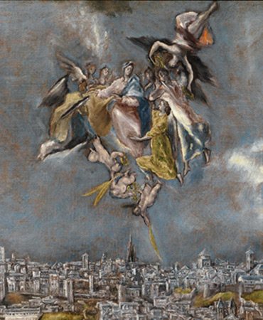
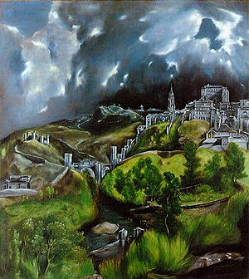
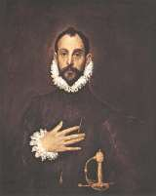
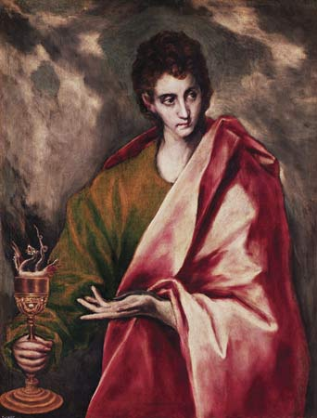

Slide 19
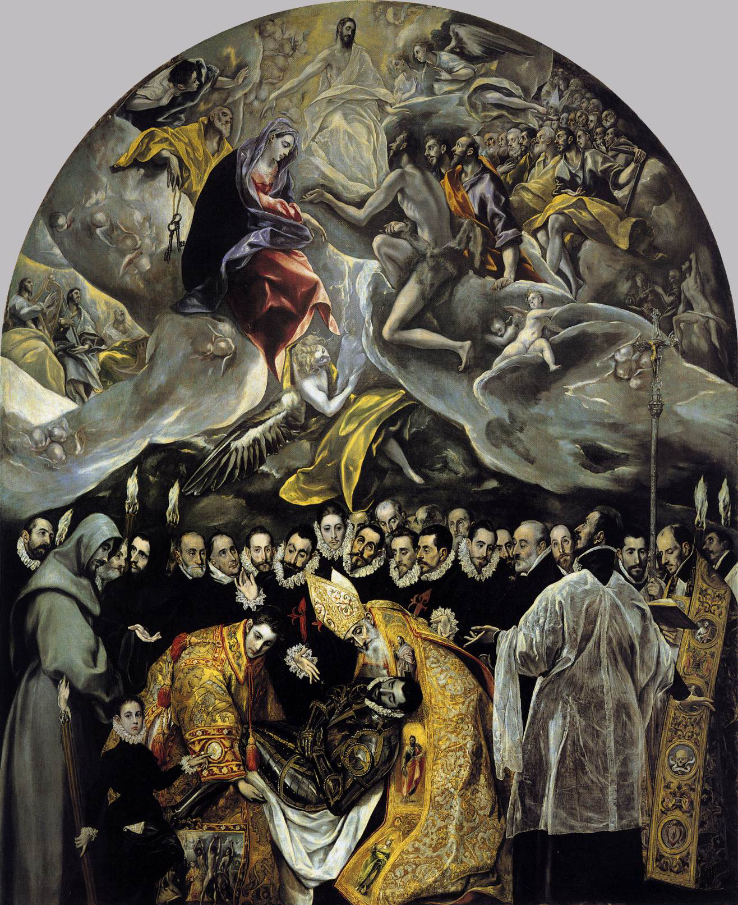
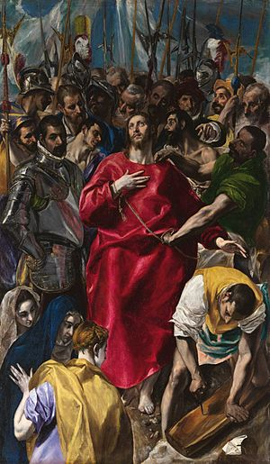
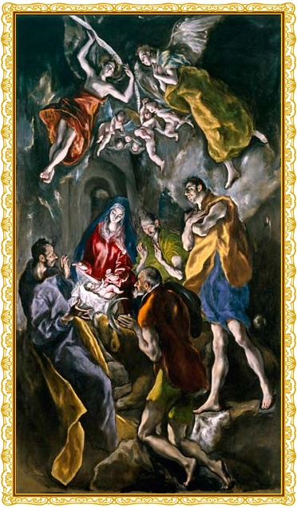

Slide 20
