Slide 1
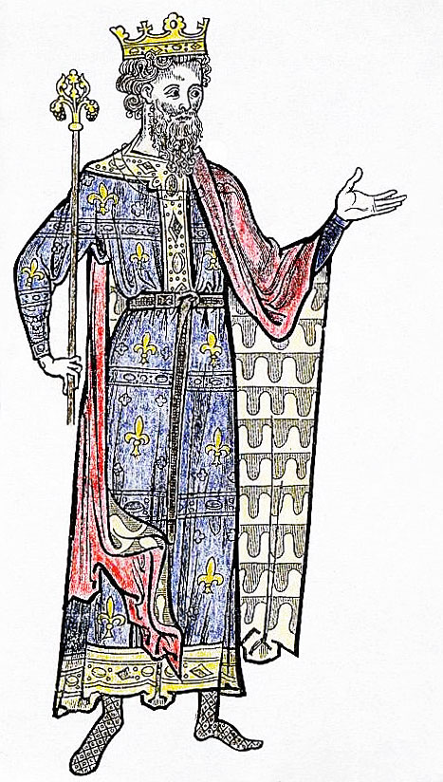
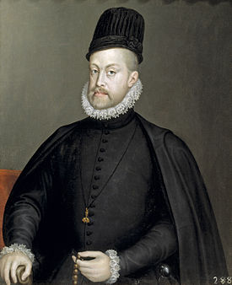
THE MODERN STATE: changes in the monarchies
VS.

Slide 2
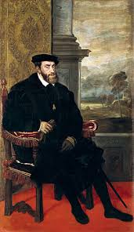
Who are these guys?

Slide 3
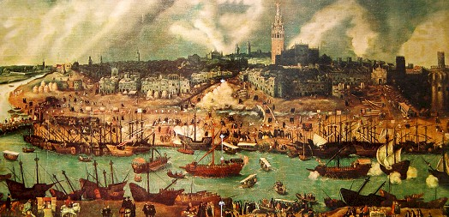
16th Century: Changing times.
ECONOMY: Growth and change. Towards capitalism and mundialization.
SOCIETY: The rise of a new bourgeosie.
POLITICS: The rise of the monarchies and the modern state.
CULTURE: New horizons (discoveries), new styles (Renaissance), new religions (Luther)

Slide 4
FEUDAL MONARCHY
Middle Age
Kings Control only their own fiefs.
Nobles and Parliaments challenge his power
Irregular income:
Scarce resources.
AUTHORITARIAN
MONARCHY
16th century
Real control over the
Whole country
Nobles became officials and generals.
Parliaments lose power.
More income: regular resources
VS

Slide 5
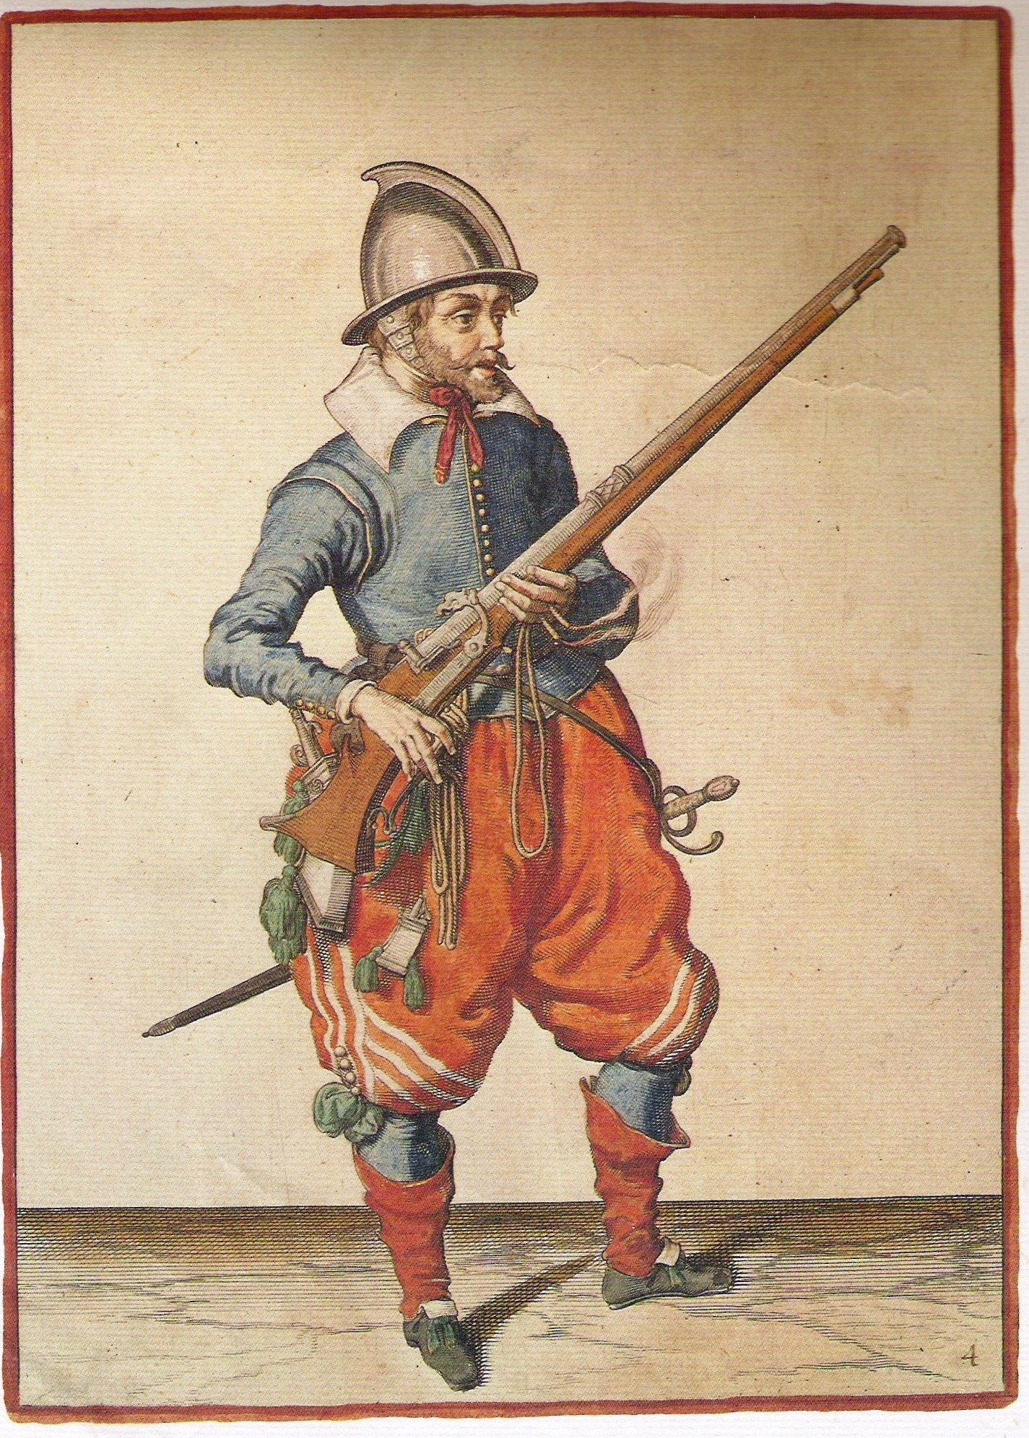
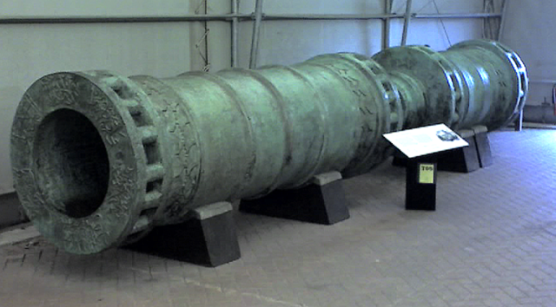
ELEMENTS OF THE
MODERN MONARCHY
The army.
More income allows the kings to keep a state army, not longer depending on the private armies of the nobles
The weapons are now more expensive and armies bigger.

Slide 6
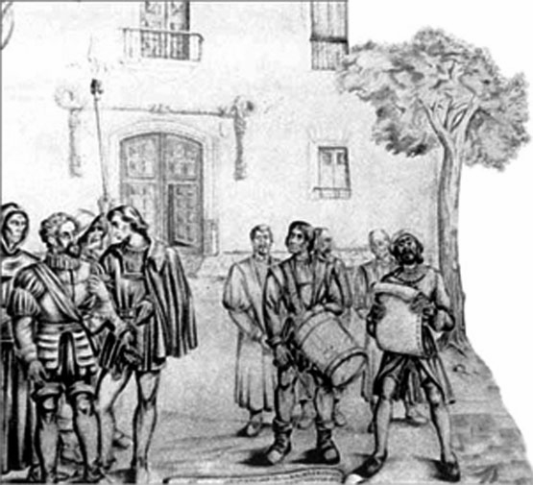
BUREAUCRACY
The state has now more people working for them
(justice,
taxes, administration

Slide 7
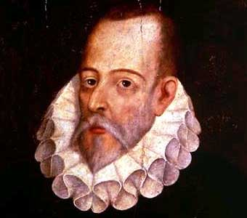
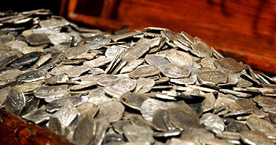
HIGHER TAXATION
Kings had now a
Regular income
From new taxes
(trade, for instance)
Cervantes was a tax collector
He standed accused of corruption,
And condemned to jail.

Slide 8
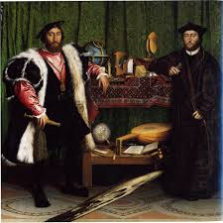
DIPLOMACY
Increased in
The 16th century.
Ambassadors
became known
representing
the king’s
interests

Slide 9
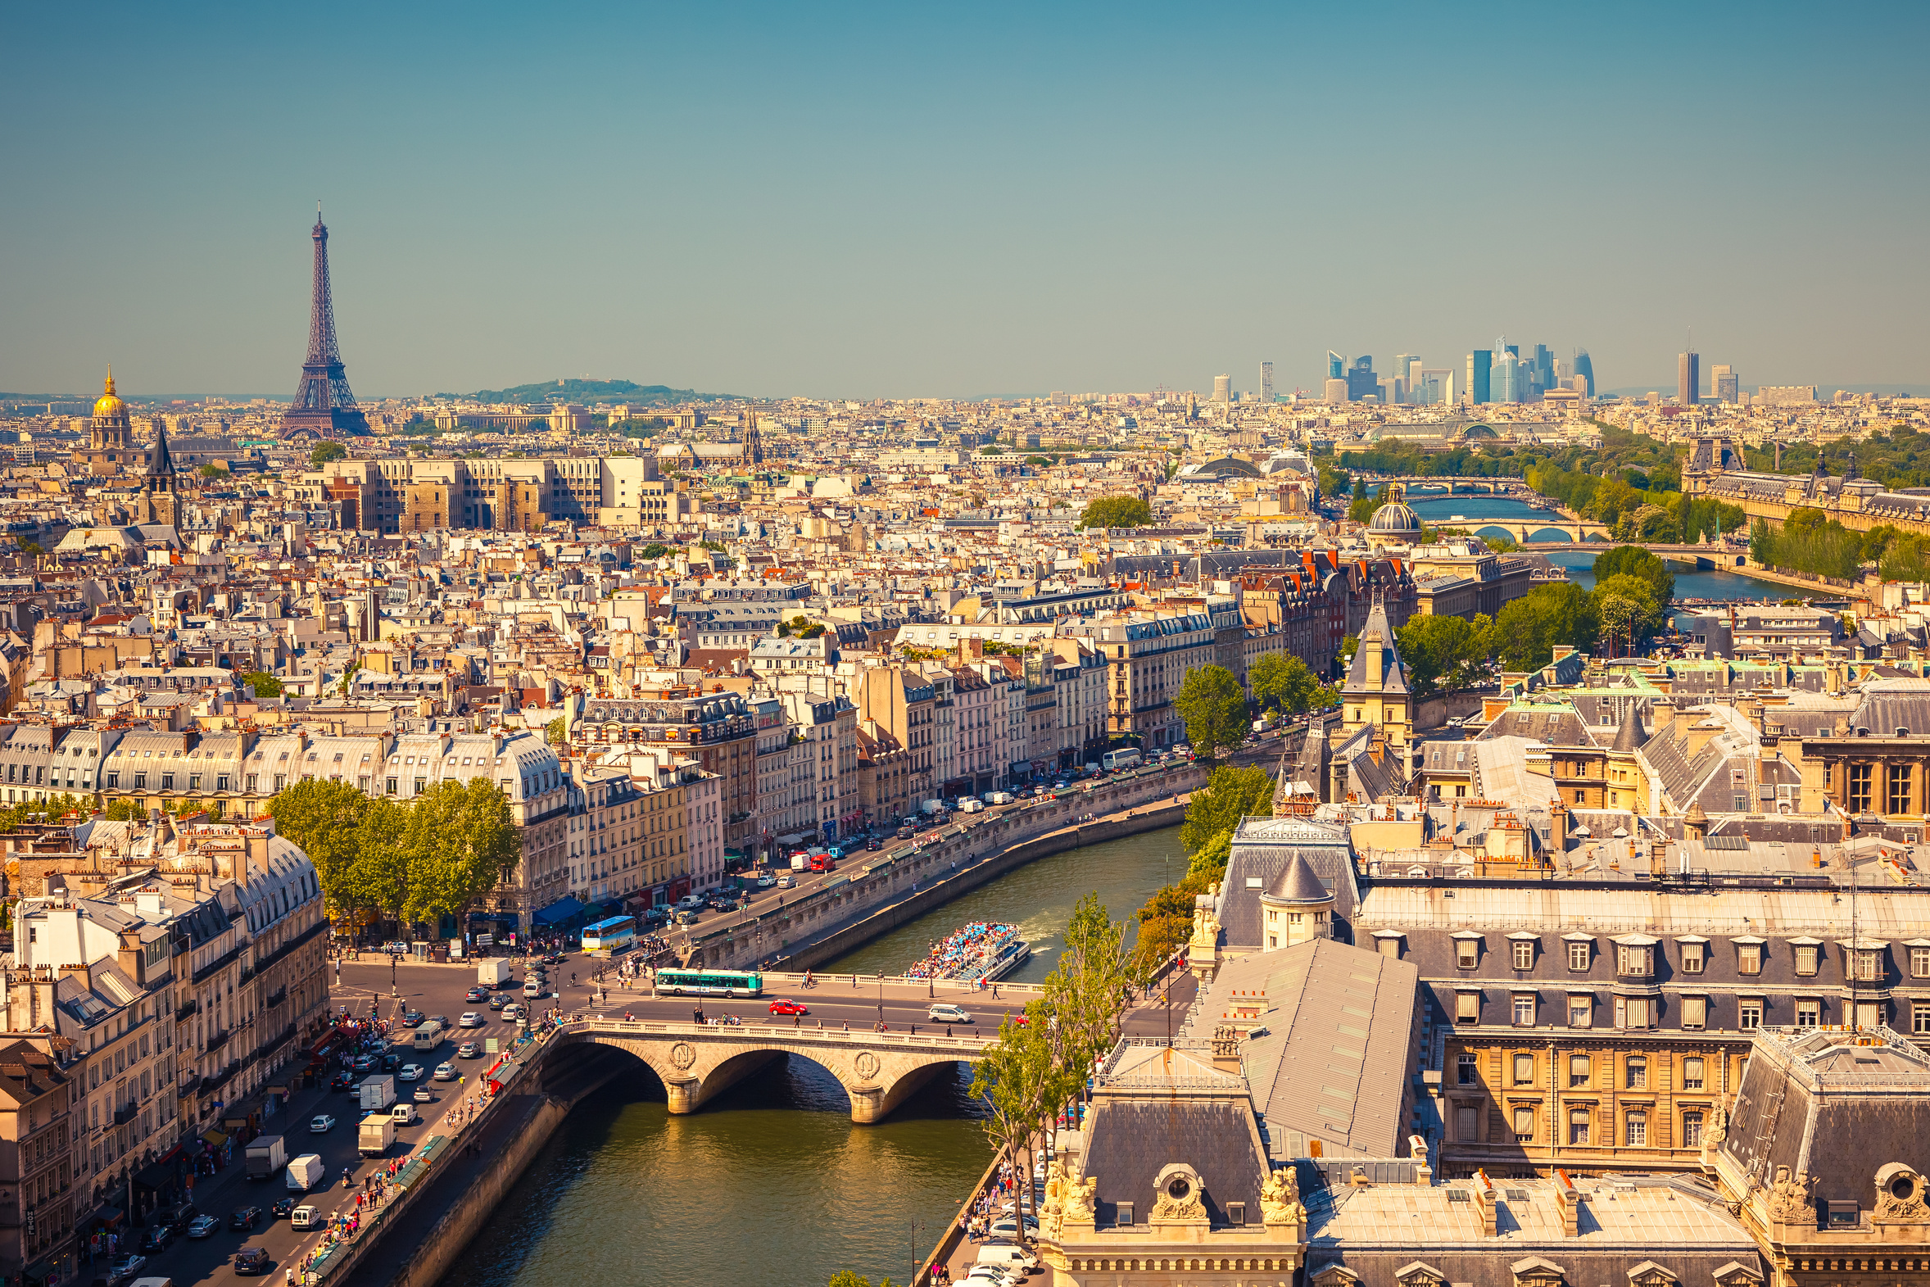
CAPITALS
The kings
Started to
live in a single
place, and
Became the
Main centre of
The country.

Slide 10
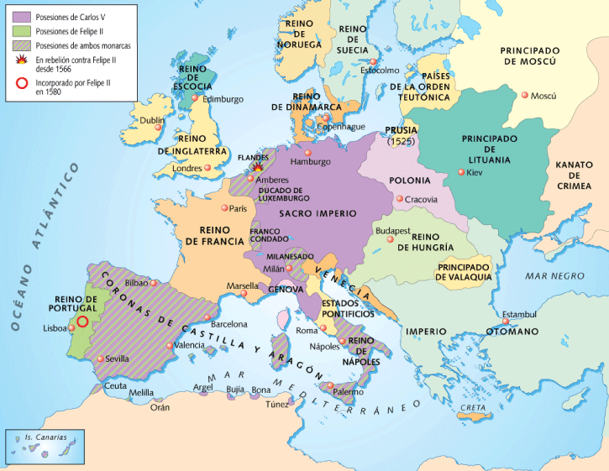
EUROPE: XVI CENTURY

Slide 11
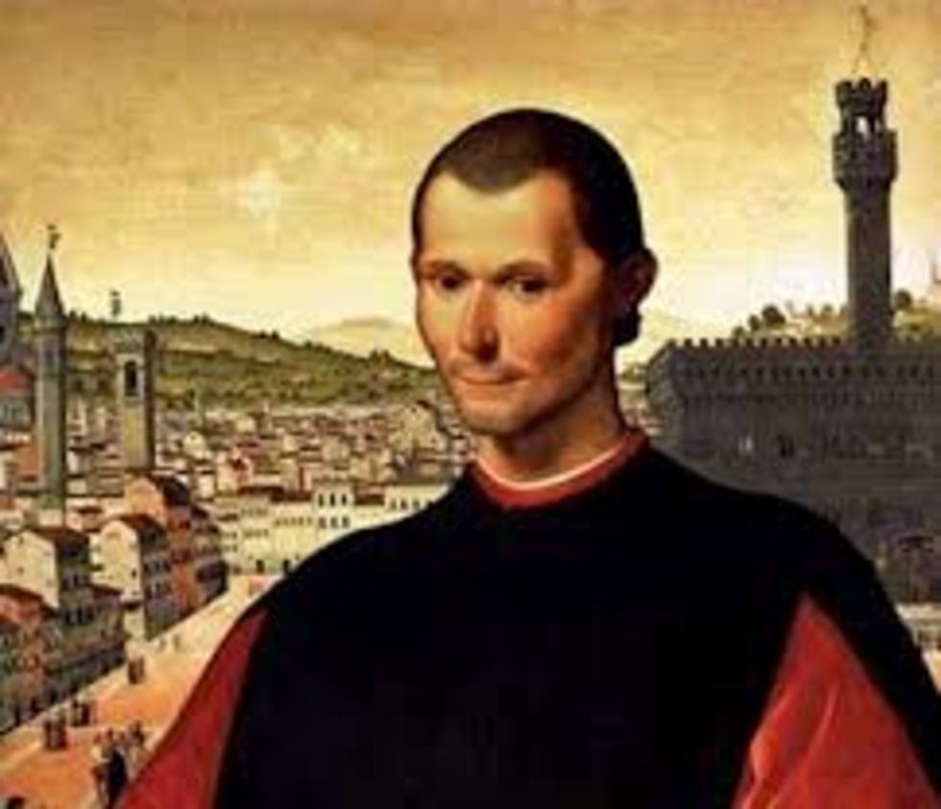
MAQUIAVELO
“A prince should not
care about being cruel
if he keeps his subjects united and loyal”

Slide 12
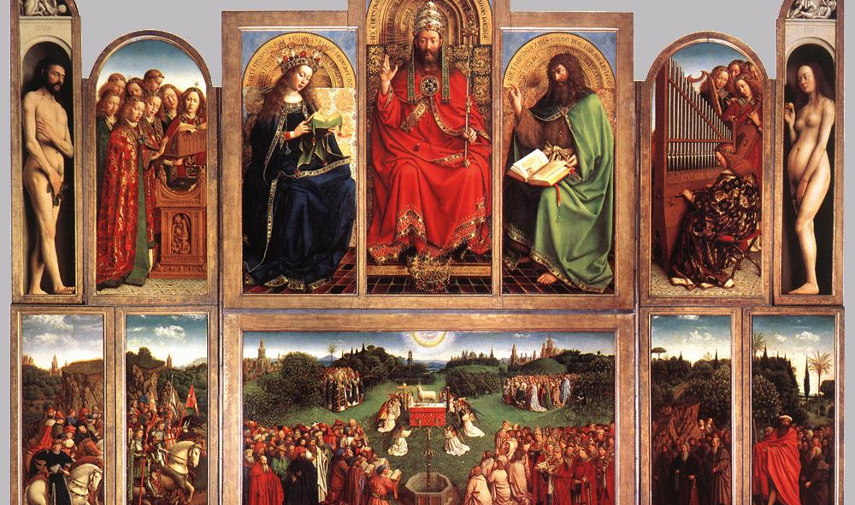
New European Monachies

Slide 13
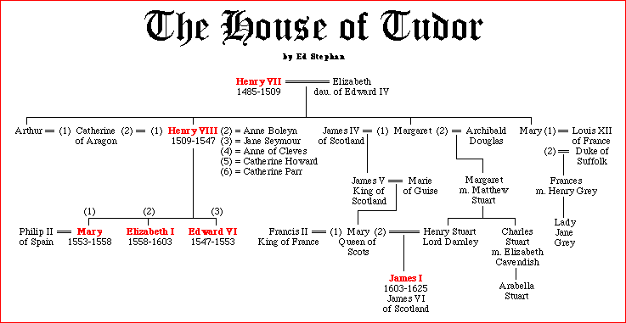
The Tudors of England

Slide 14
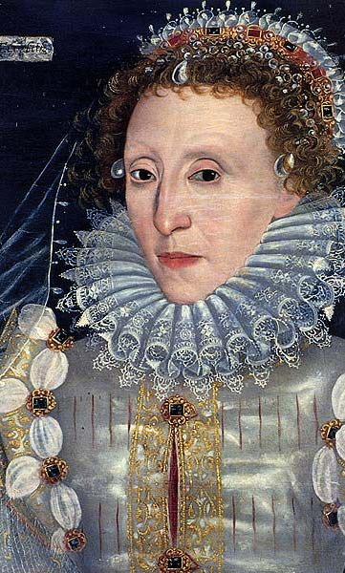
England
Defeat from Hundred Years War led to economic hardship and power struggle for monarchy
The War of the Roses erupted in the 1450s between House of Lancaster and House of York
Henry Tudor (VII) defeated Richard III and established the Tudor dynasty.
Henry VIII centralized the country and founded Anglicanism. King is the head of Anglican Church.
Elizabeth I defeated Felipe II to maintain her kingdom.

Slide 15
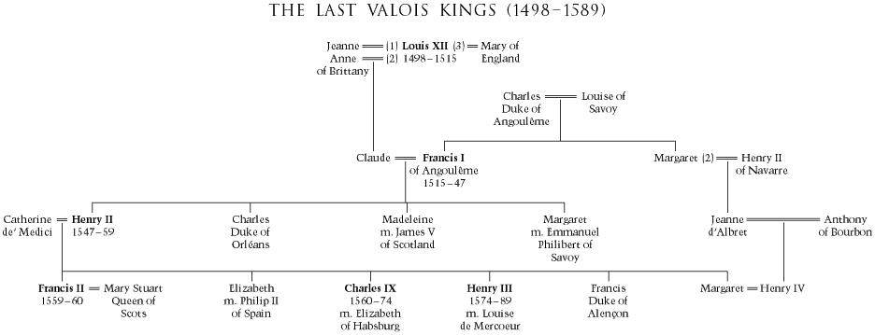
The Valois Dynasty in France

Slide 16
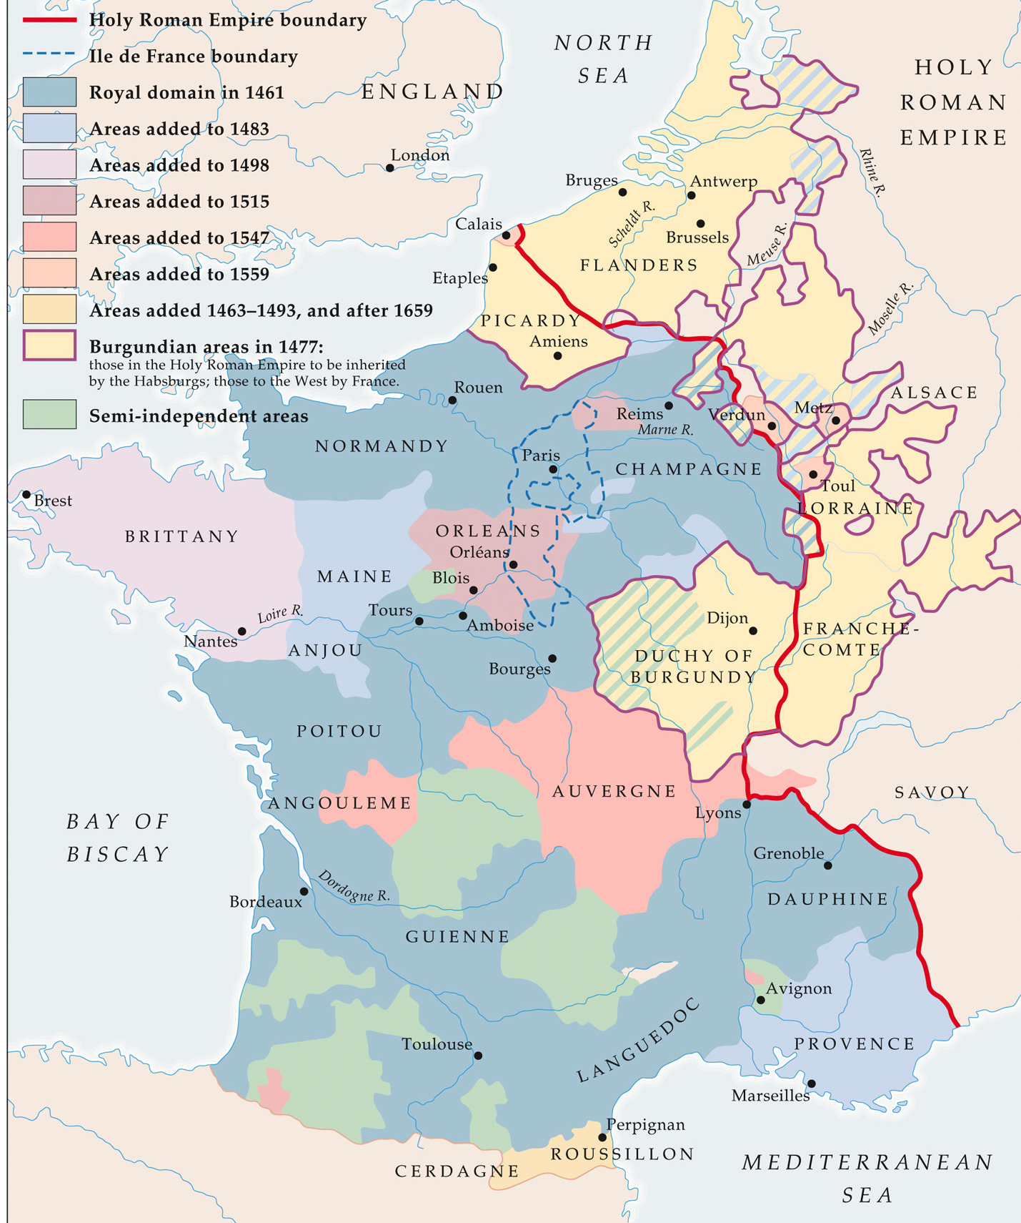
France in the 15th and 16th centuries

Slide 17
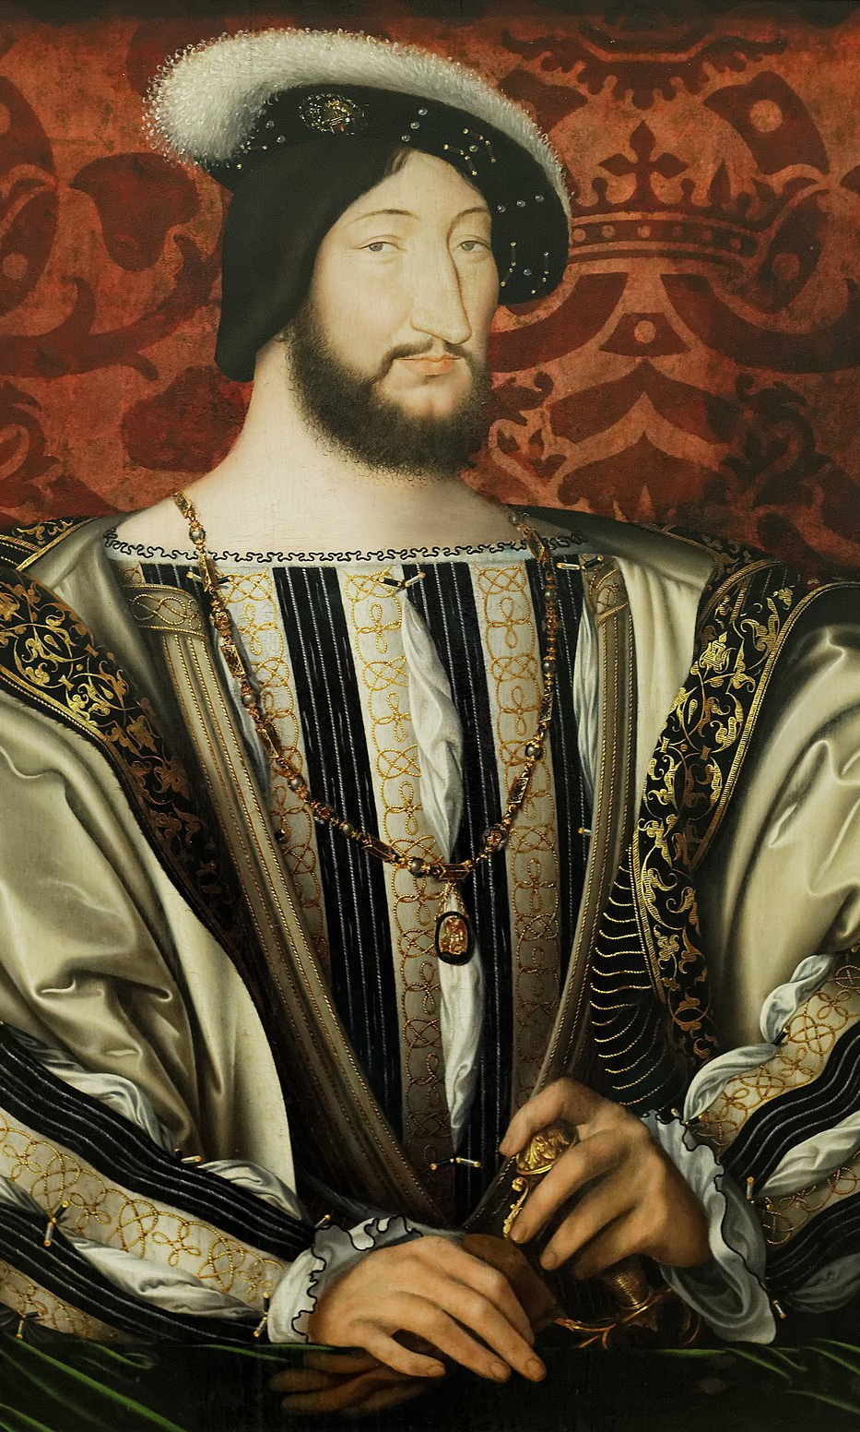
The Valois Dynasty in France
After the war, economically devastated, farmland destroyed, lives lost, but national UNITY!!
Nationalism and strong monarchy
Valois family reduced power of nobility by use of taille (tax on land and property)
King Charles VII took power away from Estates-General and secured power over Church.
Francis I controlled the Church by signing a concordat with the pope.

Slide 18
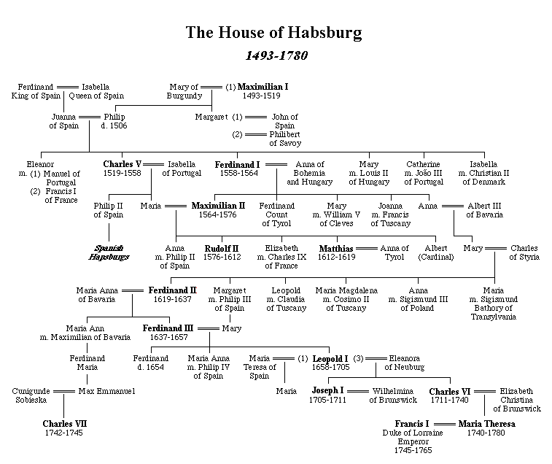
The Habsburg Dynasty

Slide 19
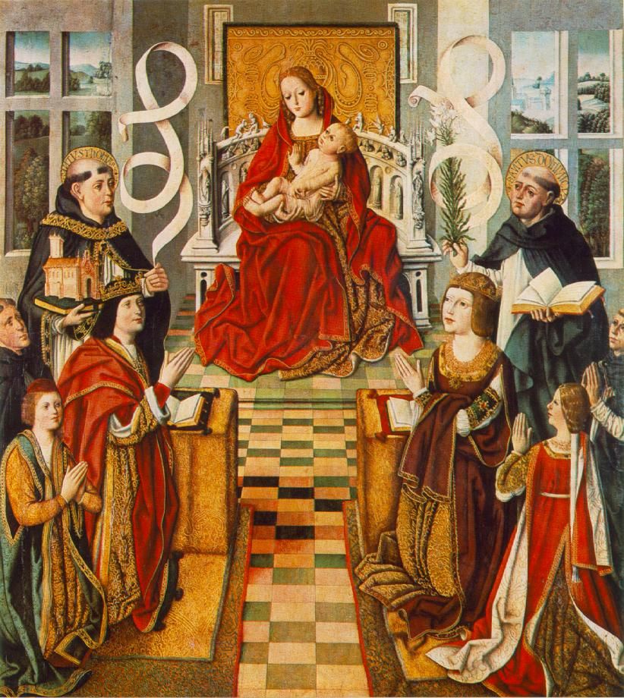
Ferdinand & Isabella of Spain

Slide 20
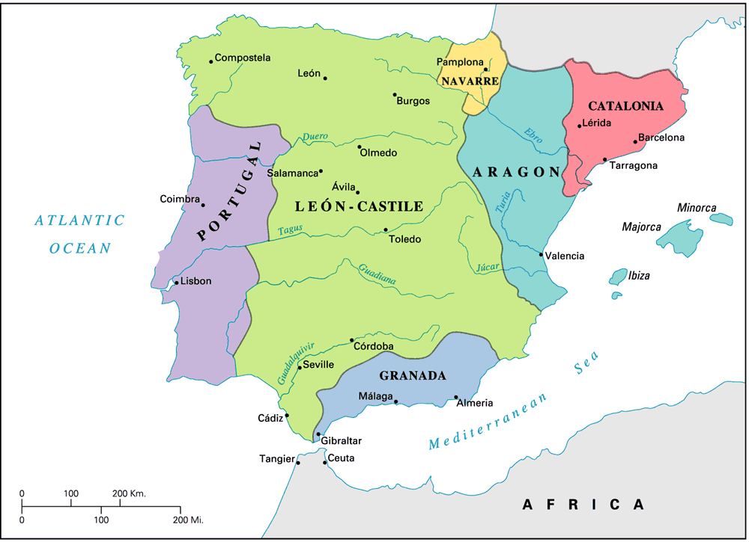
Kingdoms of Spain: 1492

Slide 21
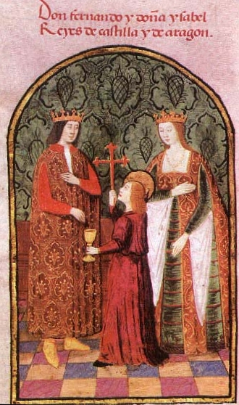
Spain
1469—marriage of Isabella of Castille and Ferdinand of Aragon united two dynasties under the Hapsburg family
  Did not create a unified nation
  together secured borders, ventured abroad militarily, Christianized Spain
Strengthened royal authority and army

Slide 22
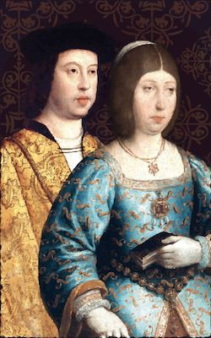
Spain
Created hermandades (political units) to control the aristocracy
Completed reconquista of lands held by Muslims.
Inquisition—monitored the political and religious atmosphere of Spain
  1492 expelled Jews
Promoted voyages of exploration

