Slide 1
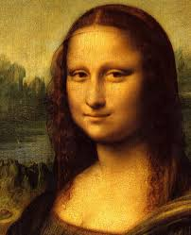
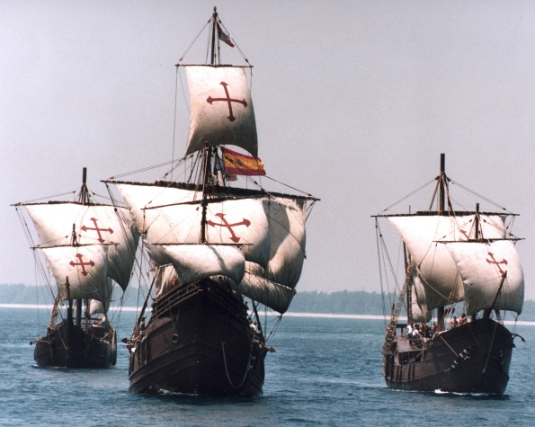
HOW DID ECONOMY AND SOCIETYCHANGE IN EARLY MODERN AGE?
MARÍA SANZ
IES SAN JUAN BAUTISTA

Slide 2
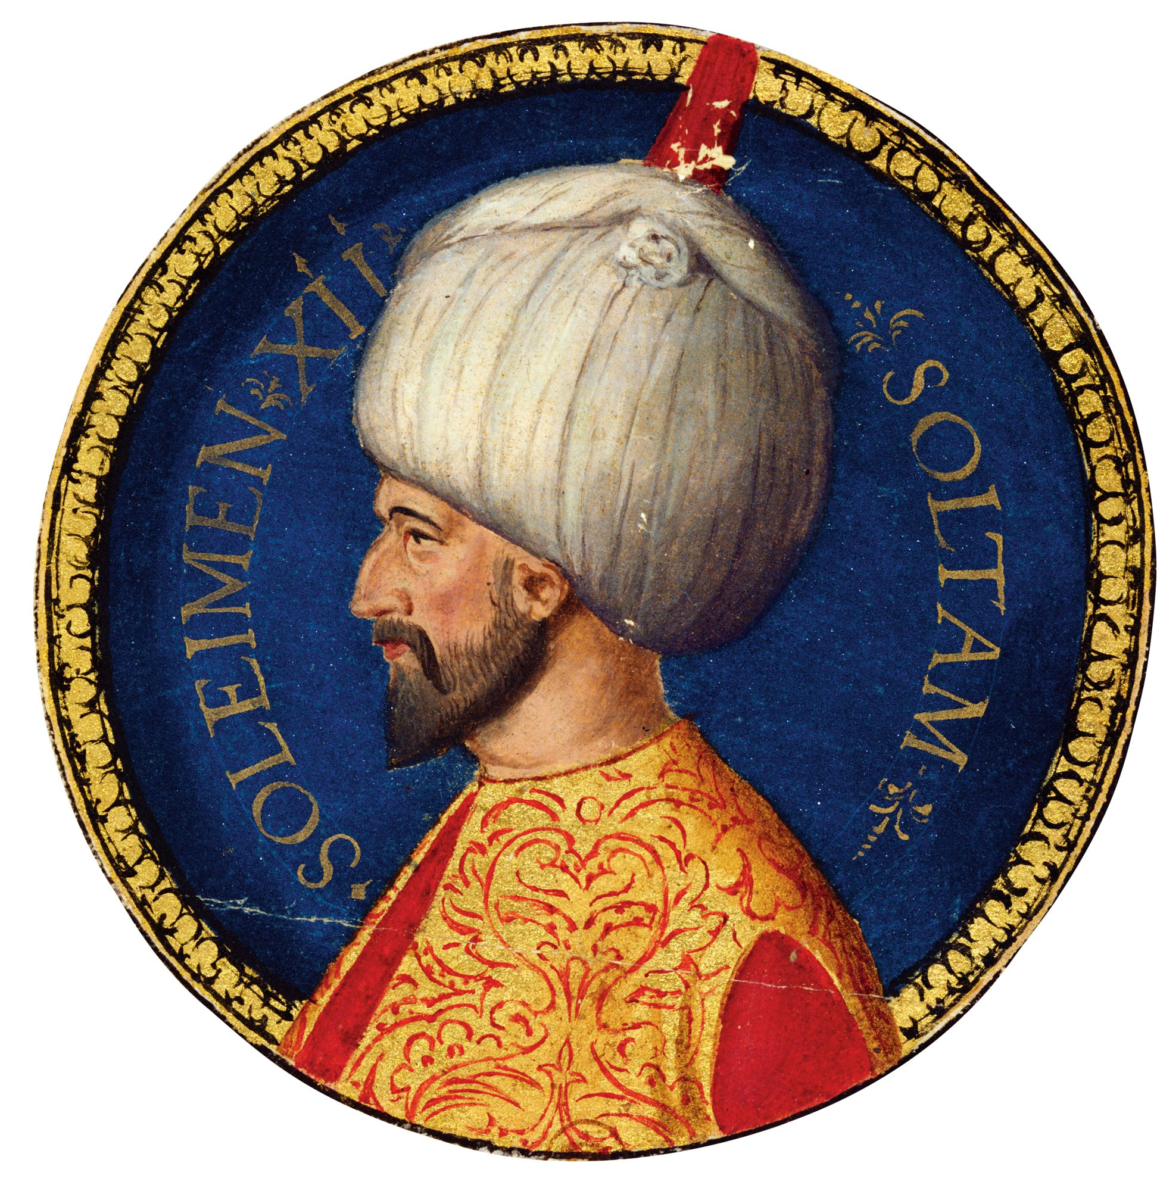
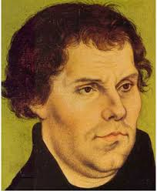
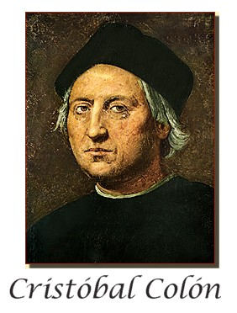
THE BEGINNING
OF MODERN AGE
1453
End of hundred years war
Fall of Constantinople
1492
End of Reconquista
Discovery of America
1516
Luther against the
Catholic Church
1519
Death of Leonardo
Hernan Cortés conquests México

Slide 3
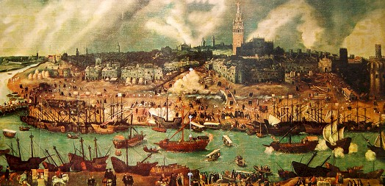
16th Century: Changing times.
ECONOMY: Growth and change. Towards capitalism and mundialization.
SOCIETY: The rise of a new bourgeosie.
POLITICS: The rise of the monarchies and the modern state.
CULTURE: New horizons (discoveries), new styles (Renaissance), new religions (Luther)

Slide 4
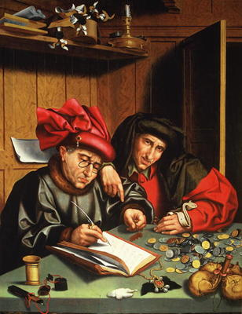
ECONOMY: GROWTH AND EXPANSION
CAUSES
EVIDENCES
CAUSES OF
GROWTH

Slide 5
ECONOMY 16th CENTURY: GROWTH AND EXPANSION
CAUSES
EVIDENCES
CAUSES OF
GROWTH

Slide 6
ECONOMY: GROWTH AND EXPANSION
EVIDENCES
CAUSES
Population +
Death rate lower
Healthier people
Less diseases
Production +
Richer cities
And merchants
CAUSES OF
GROWTH
Social stability
Less troubles
Less wars..
Trade +
America
Far East
MONEY
INCOME
More precious metals from America

Slide 7
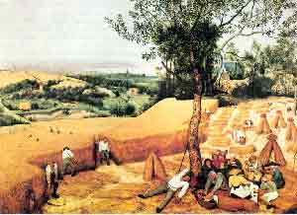
Economic growth
The agricultural production increased
More lands
To cultivate
More
production
Demographic
growth
Greater
demand
New
Techniques
(irrigation,
Channels…)

Slide 8
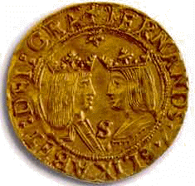
The growth of economy
More currency
(silver and gold
From America)
Financial improvements
(bankers lend money, loans)
Greater
demand
More
production
ECONOMIC
GROWTH
New markets
And trade routes
The discovery of rich mines of silver in Central Europe and South America brought more money to spend in the economy.

Slide 9
RISE OF PRECIOUS METALS
New silver mines were discovered at this time (central Europe, America).
As a consequence a bigger amount of money is avalaible in the market.
This motivates more production and a stimulus for the economy.
But in the long run, too much money generates a rise in the prices (inflation) and a crisis (people can’t buy so many goods as before).

Slide 10
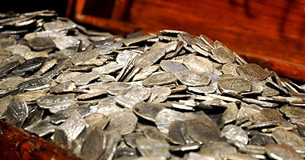
WHAT CAN IT MEAN IF WE FIND SPANISH SILVER COINS, MADE IN MEXICO, IN THE TOMBS OF THE CHINESE EMPERORS?

Slide 11
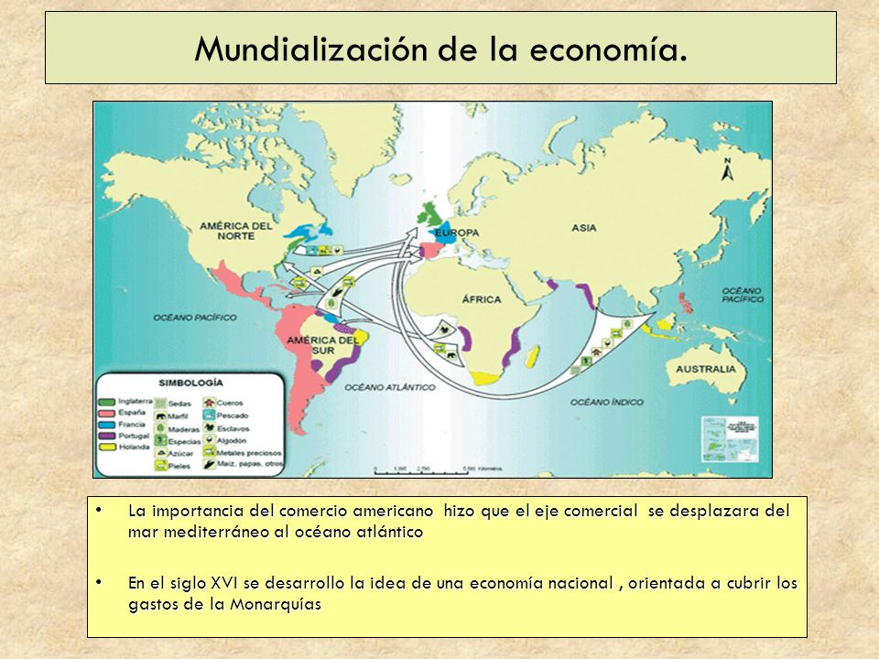

Slide 12
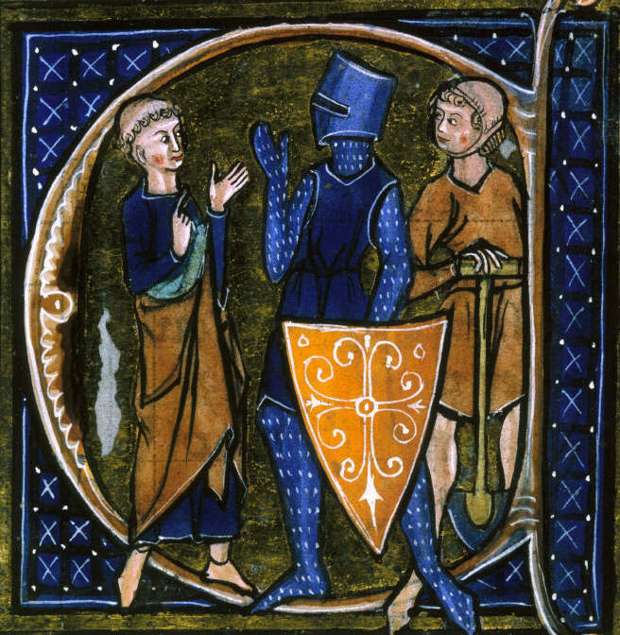
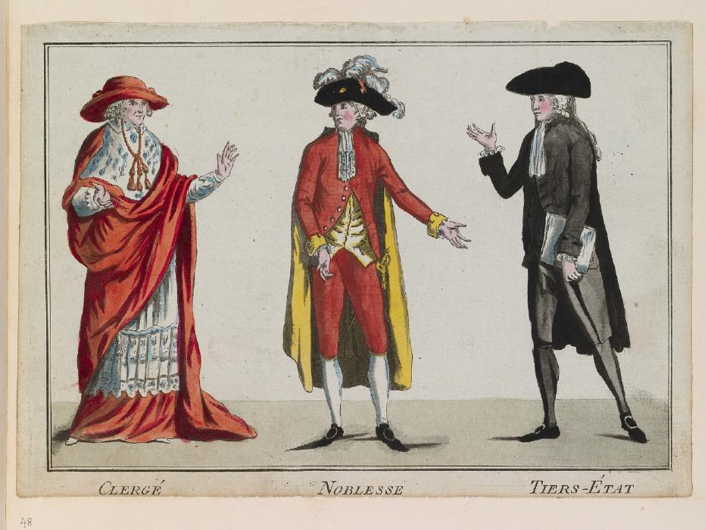
SOCIETY
A slow and continuos change
XII CENTURY
What was the
Name for this
society?
XVIII CENTURY

Slide 13
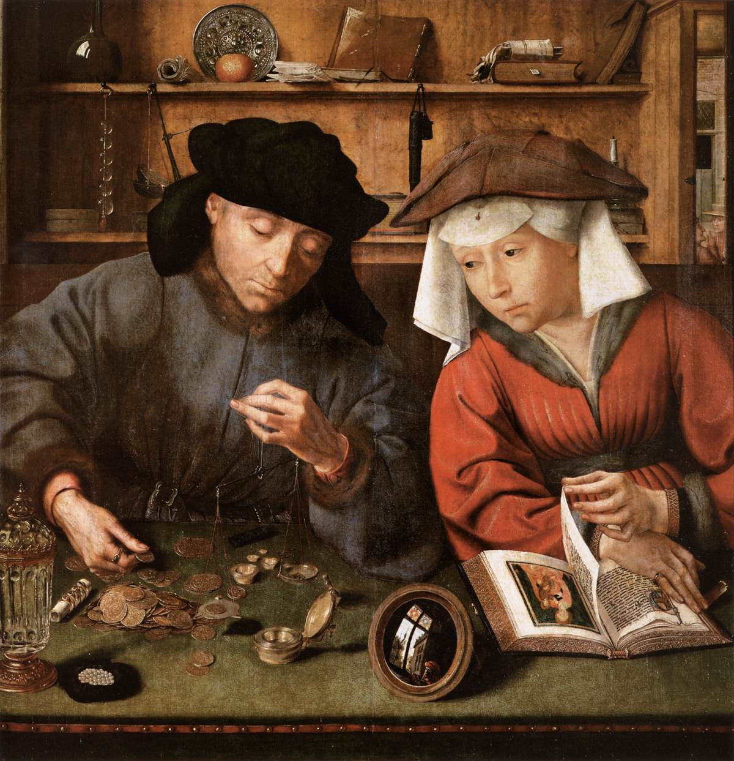
SOCIETY IN 16th CENTURY
THE
BOURGUEOISIE
More wealthy
And powerful.
Bankers and
Big merchants
Will lend money
To kings.

Slide 14
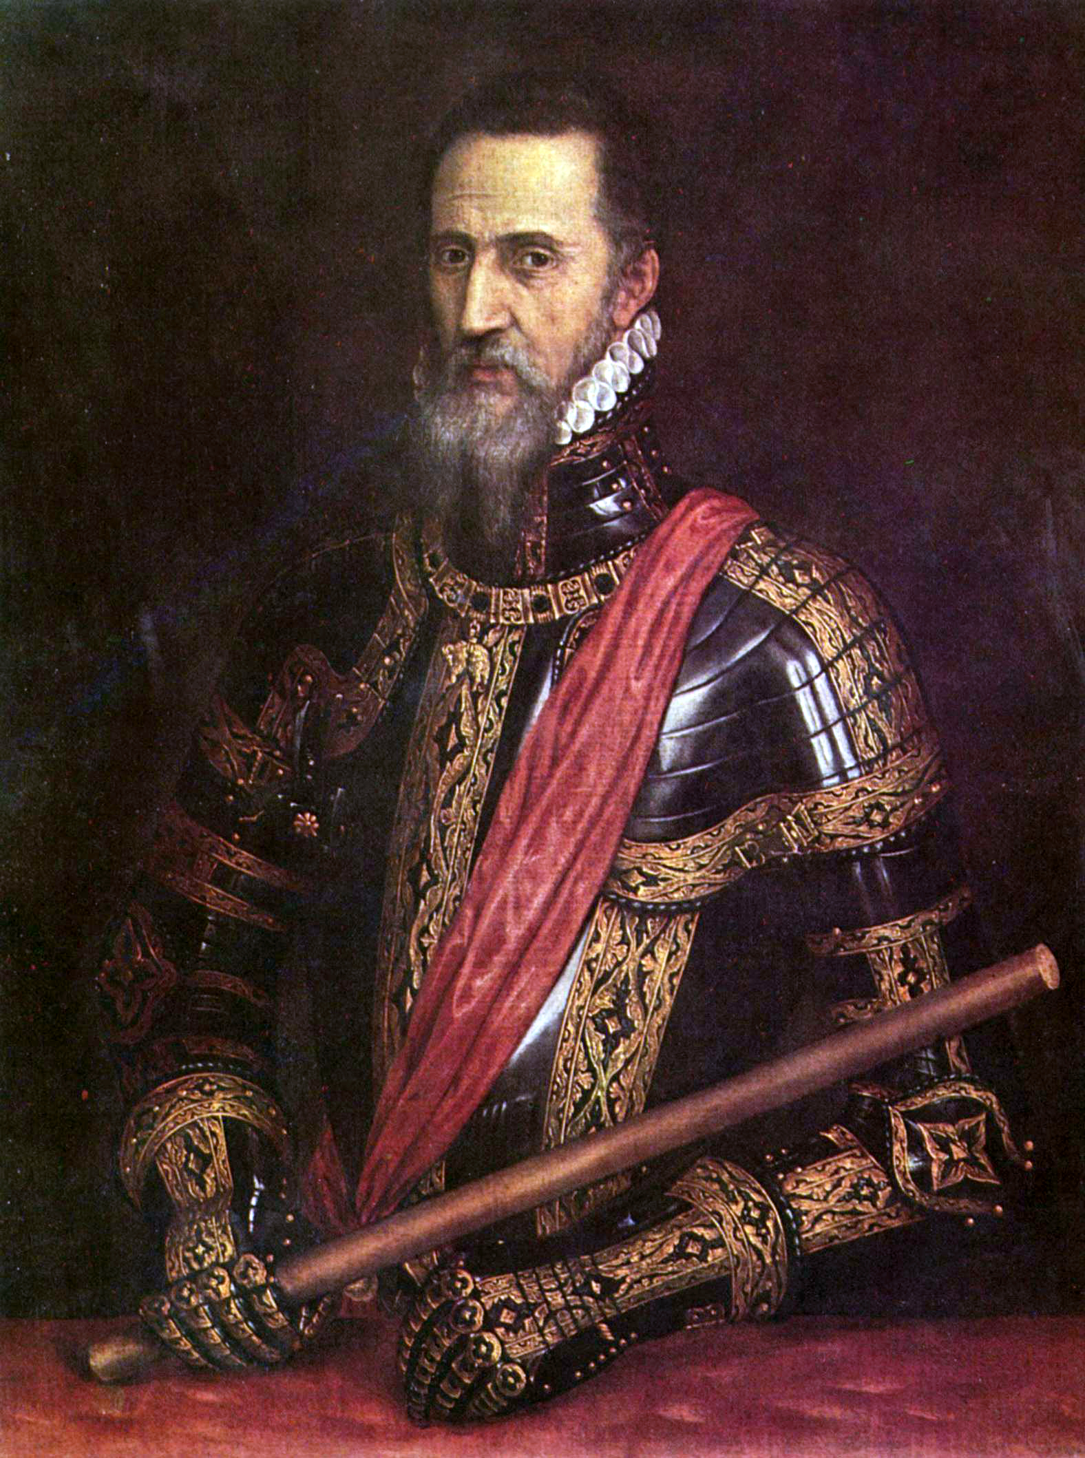
THE NOBILITY
They lost part of their political power, and will start to work for the kings.
In exchange, kings will
increase their wealth
and prestige.

Slide 15
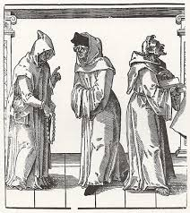
THE CHURCH
Being a priviledged estate in the Middle
Age, their conditions will change dramatically after
Reformation in some countries.

Slide 16
THE PEASANTS
Feudal obligations
dissapeared in Western
Europe (they are not
Serfs any longer).
Their life conditions
remained
hard and unpleasant.

