Slide 1
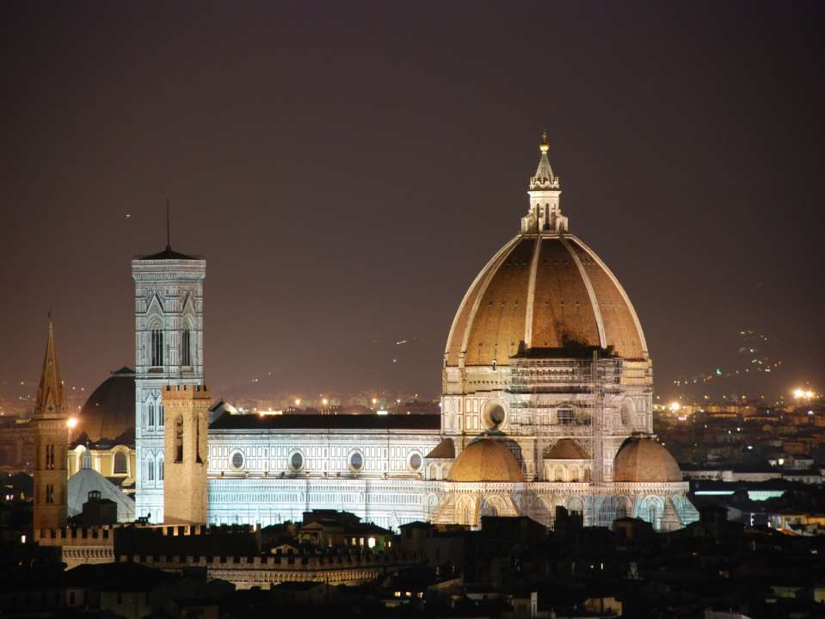


Slide 2



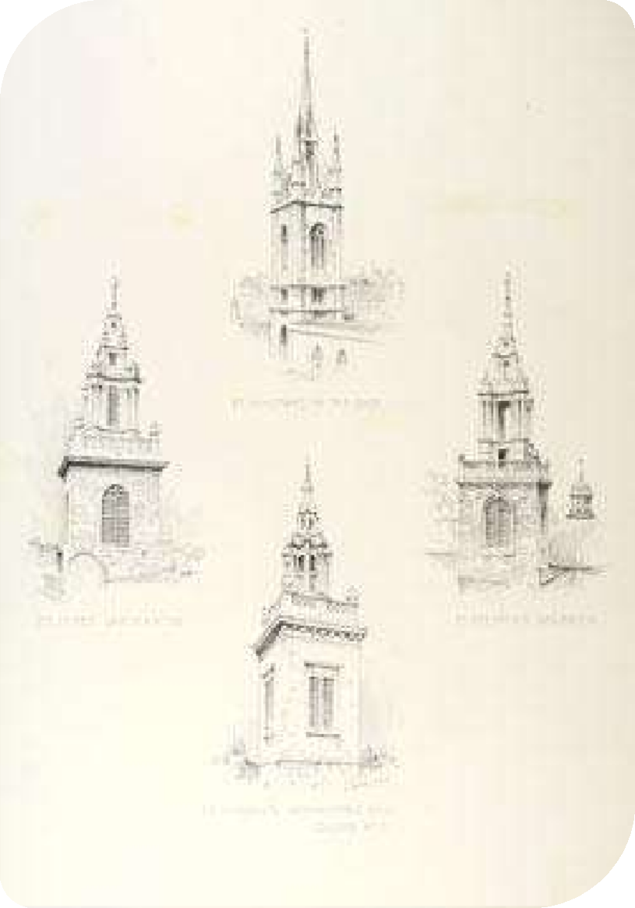

Renaissance Architecture is the architecture of the period between the early 15th and early 17th centuries in different regions of Europe, demonstrating a revival of certain elements of ancient Greek and Roman culture.

Slide 3

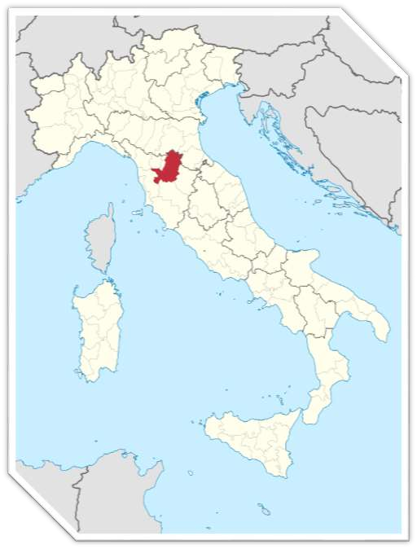

Italy of the 15th century, and the city of Florence in particular, was home to the Renaissance. It is in Florence that the new architectural style had its beginning

Slide 4






Historians often divide the Renaissance in Italy into three phases. Whereas art historians might talk of an "Early Renaissance" period, in which they include developments in 14th-century painting and sculpture, this is usually not the case in architectural history. Historians often use the following designations:
Renaissance (ca. 1400–1500); also known as
the Quattrocento] and sometimes Early Renaissance[
High Renaissance (ca.1500–1525)
Mannerism (ca. 1520–1600)

Slide 5







In the Quattrocento, concepts of architectural order were explored and rules were formulated.
The study of classical antiquity led in particular to the adoption of Classical detail and Ornamentation.

Slide 6



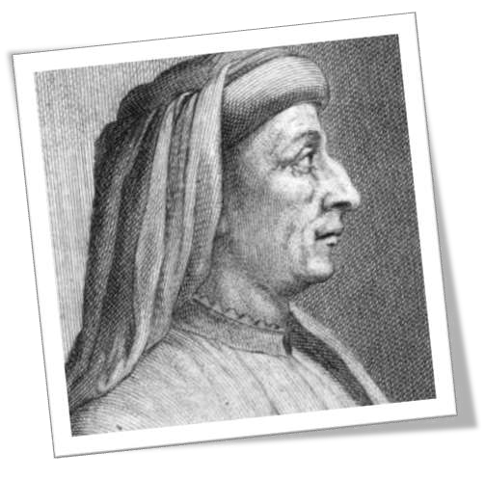











Filippo Brunelleschi; 1377 – April 15, 1446) was one of the foremost architects and engineers of the Italian Renaissance

Slide 7
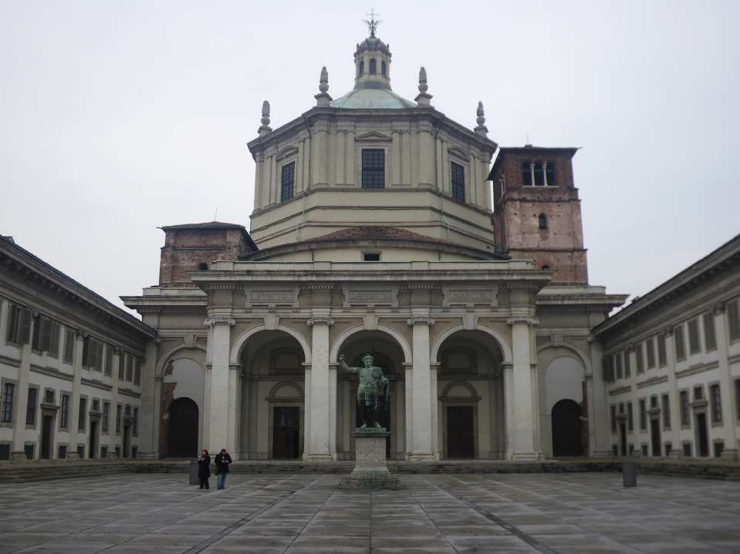

Slide 8
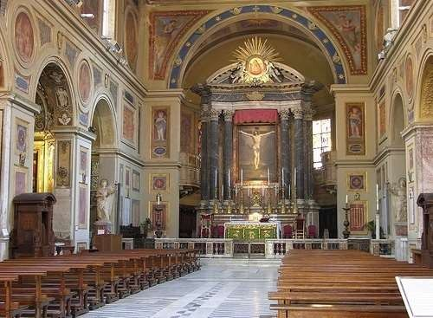



Slide 9
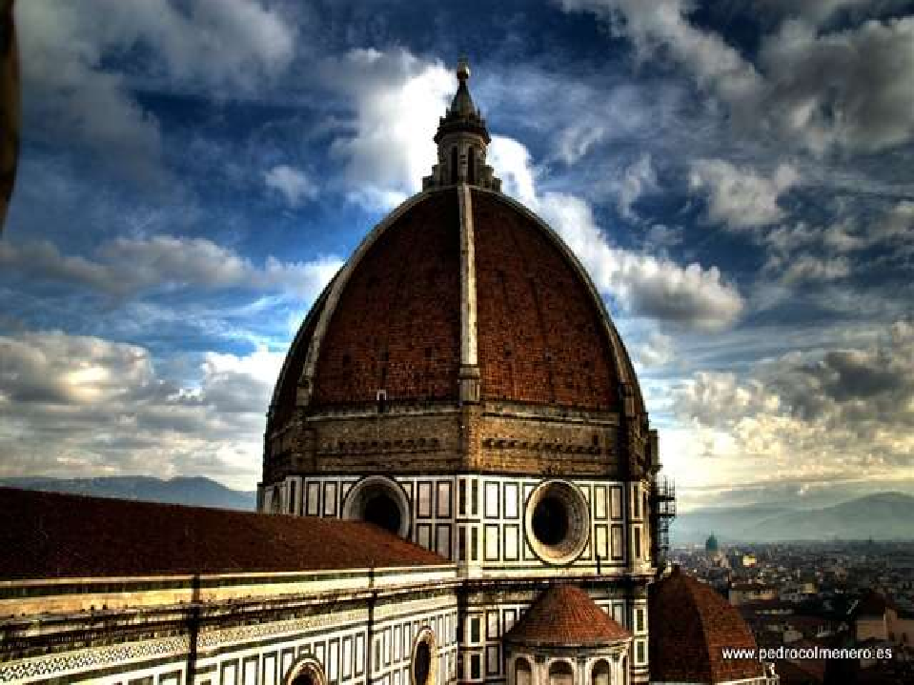

Slide 10
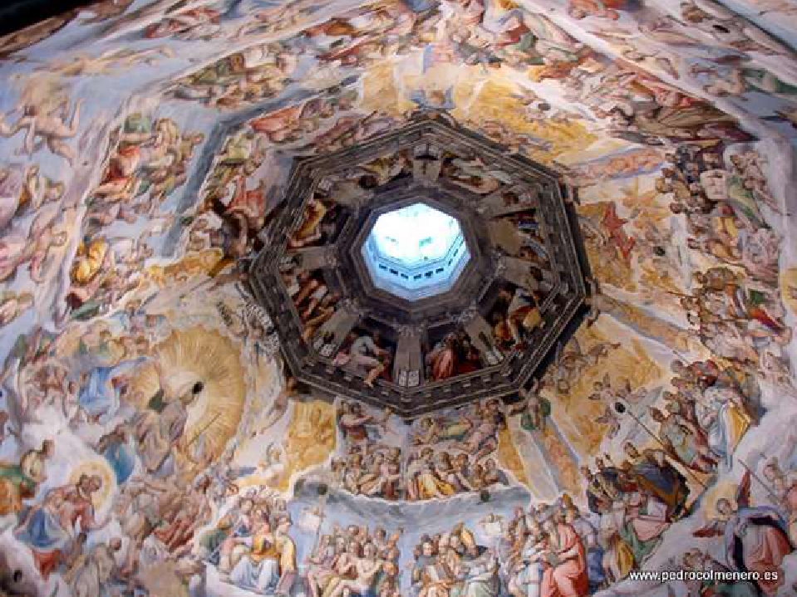

Slide 11
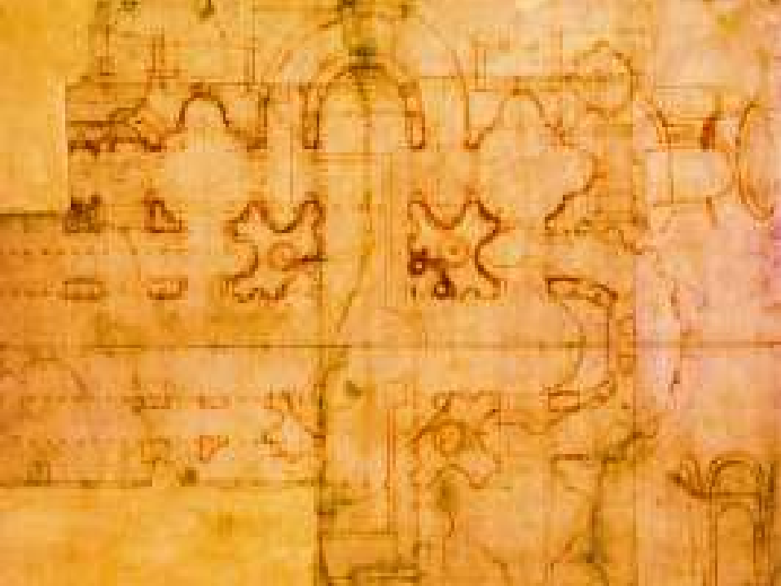






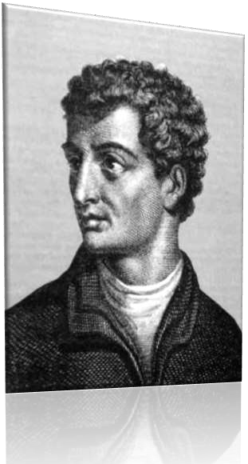






























Leon Battista Alberti[1] (February 14, 1404 –
April 20, 1472) was an Italian humanist author, artist, architect, poet, priest, linguist, philosopher and cryptographer; he epitomised the Renaissance Man.

Slide 12
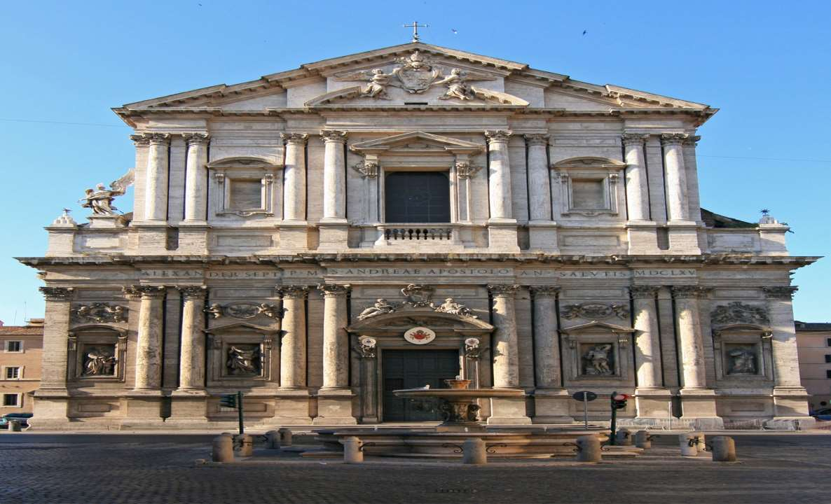





Slide 13
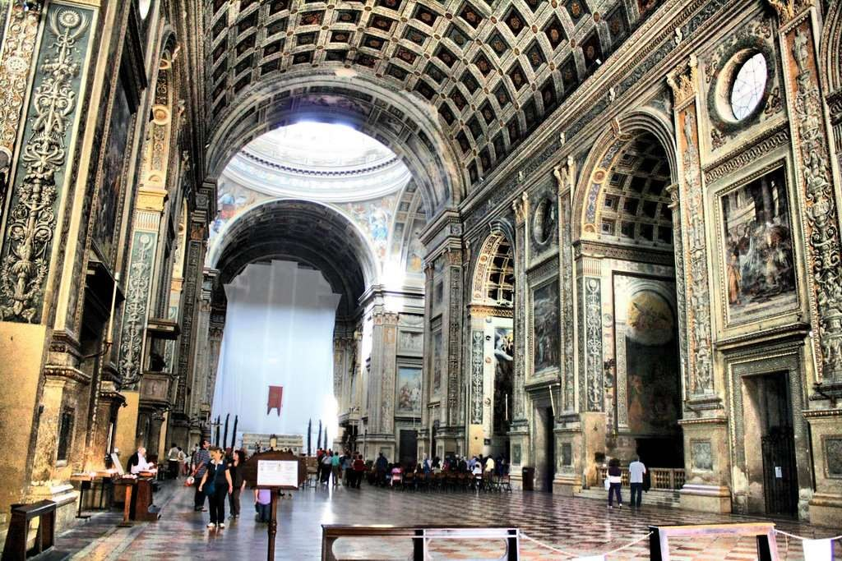





Slide 14
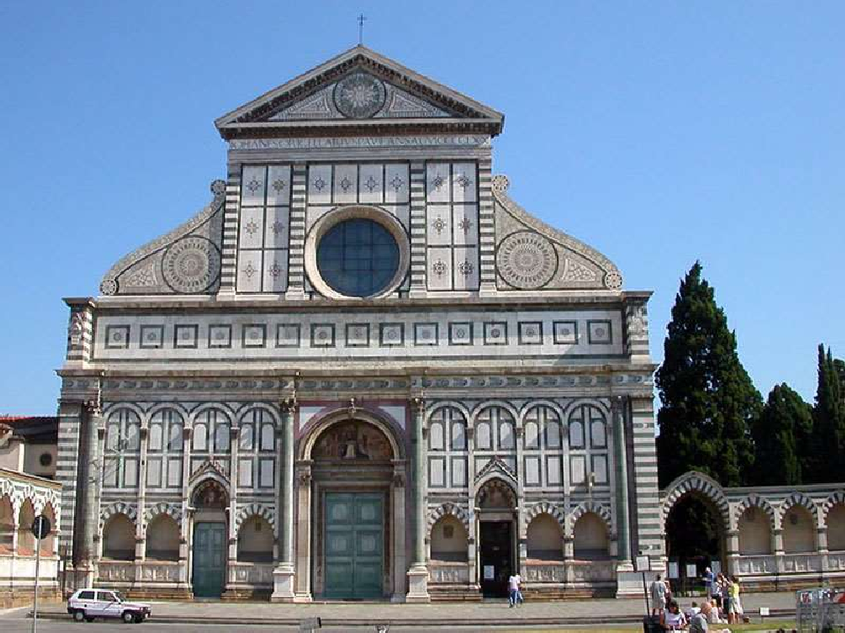



Slide 15
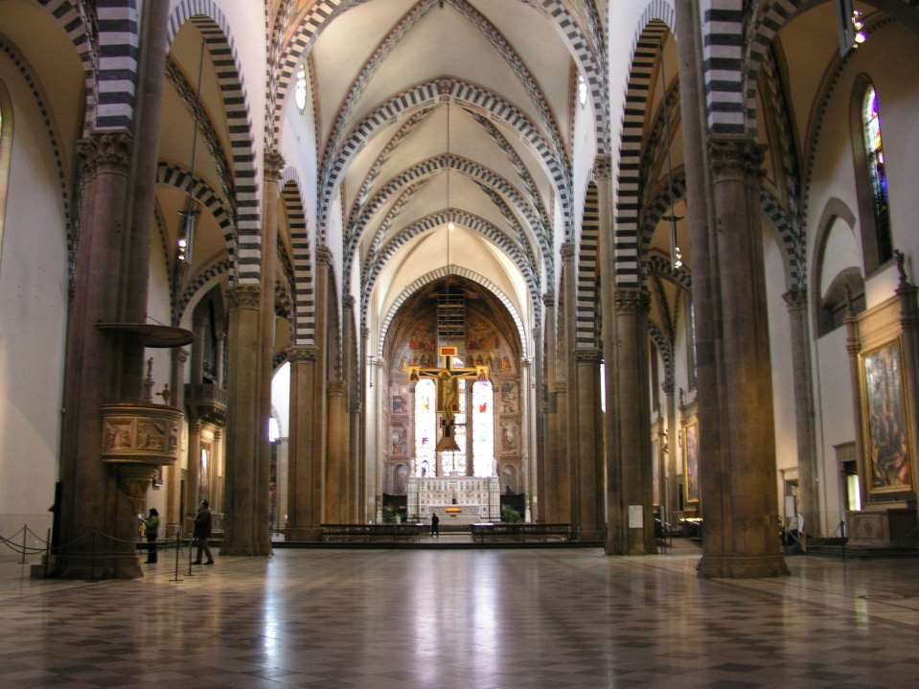

Slide 16





















During the High Renaissance, concepts derived from classical antiquity were developed and used with greater surety. The most representative architect is Bramante (1444–1514) who expanded the applicability of classical architecture to contemporary buildings. His San Pietro in Montorio (1503) was directly inspired by circular Roman temples. He was, however, extremely inclined to the classical forms and it was his style that was to dominate Italian architecture in the 16th century.

Slide 17

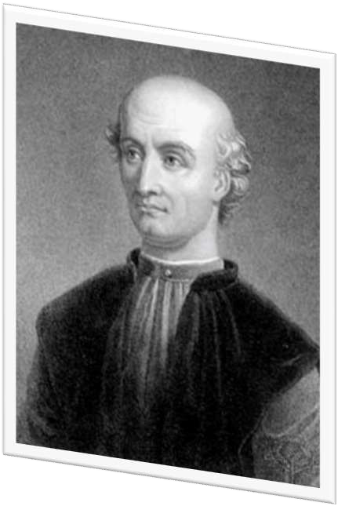














Donato Bramante (1444 – 11 March
1514) was an Italian architect, who introduced Renaissance architecture to Milan and the High Renaissance style to Rome.

Slide 18
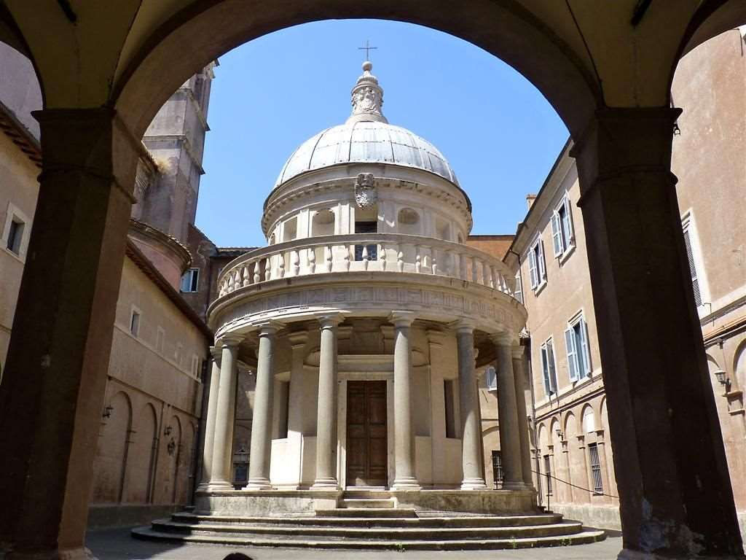

Slide 19
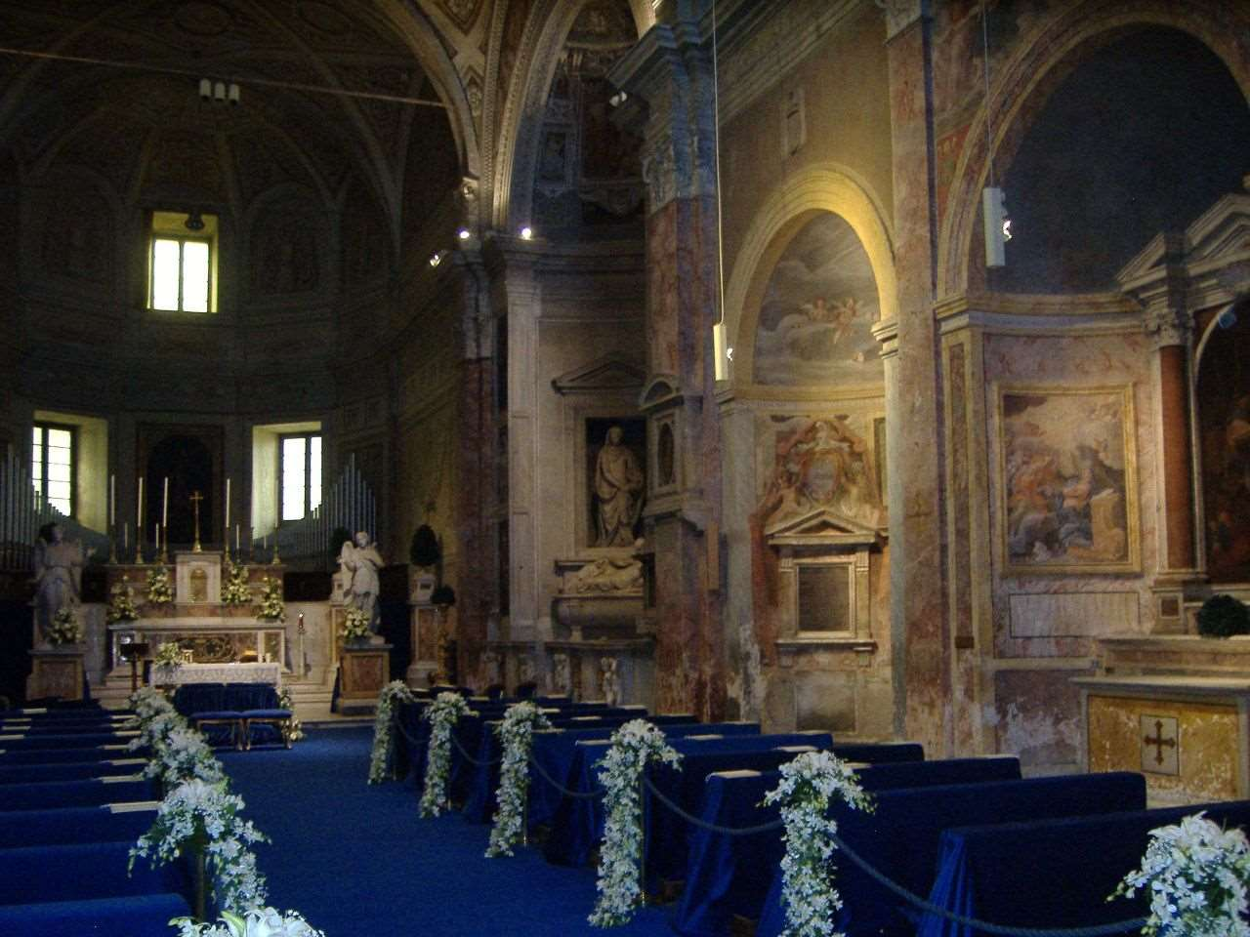

Slide 20




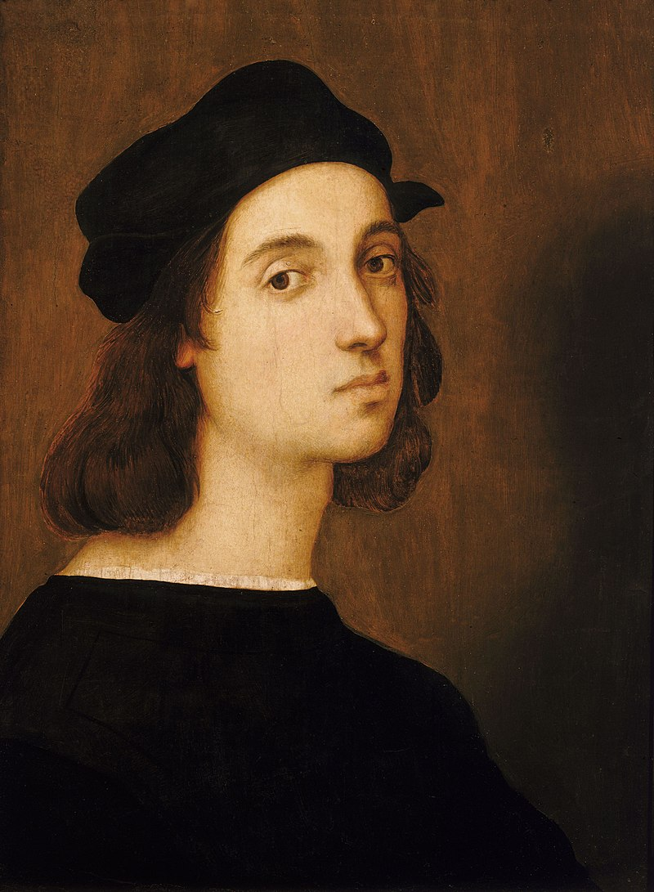











Raphael, (1483–
1520), Urbino. Raffaello da Urbino, better known simple as Raphael, was an Italian painter and architect of the high Renaissance.

Slide 21
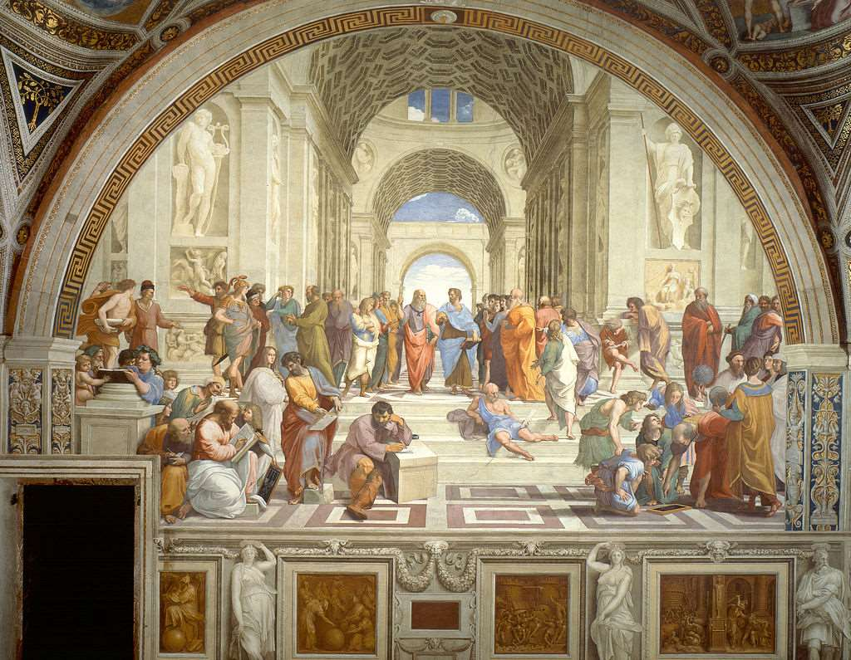

Slide 22
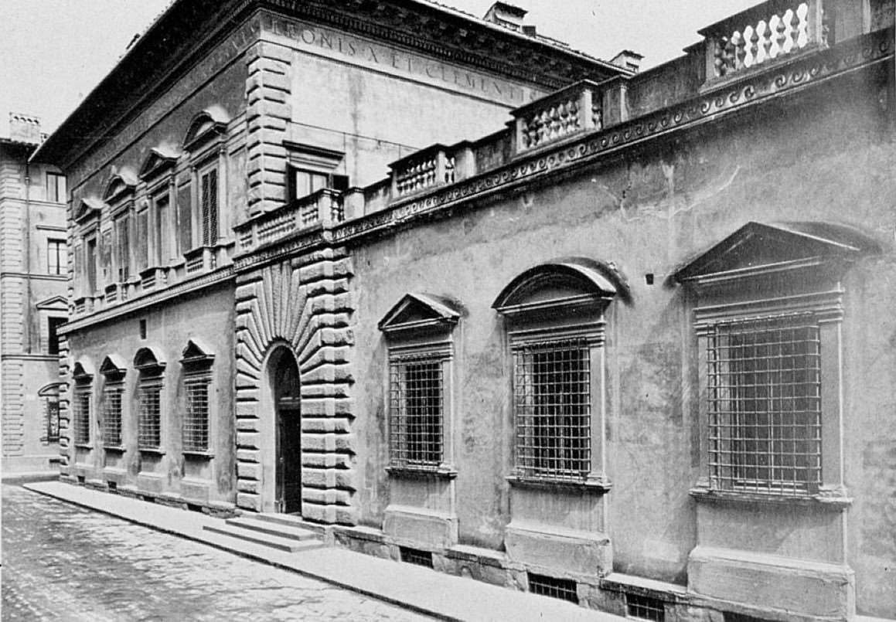

Slide 23
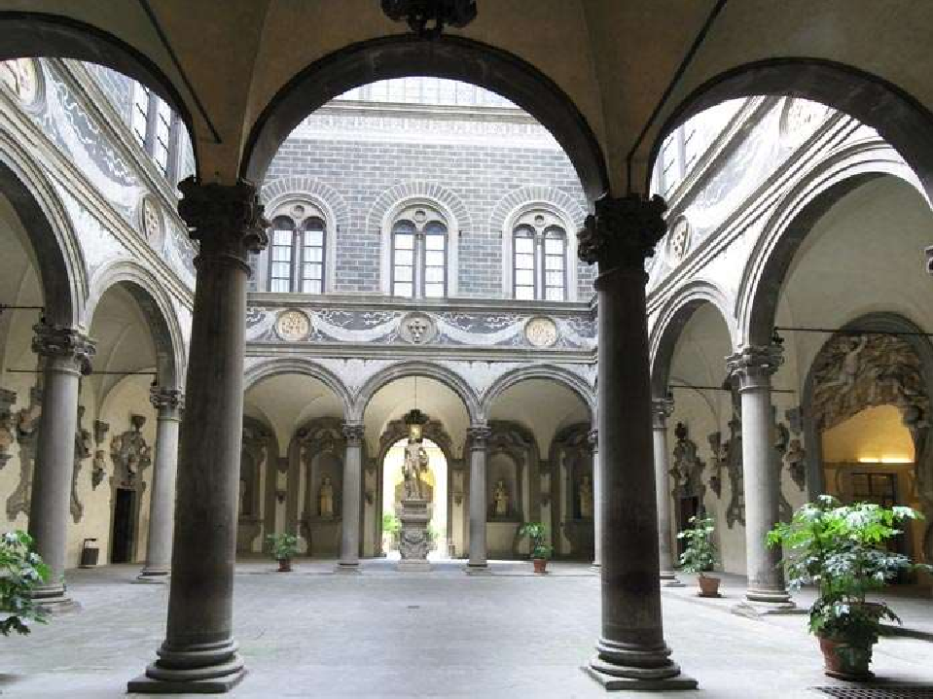

Slide 24










During the Mannerist period, architects experimented with using architectural forms to emphasize solid and spatial relationships. The Renaissance ideal of harmony gave way to freer and more imaginative Rhythms.

Slide 25




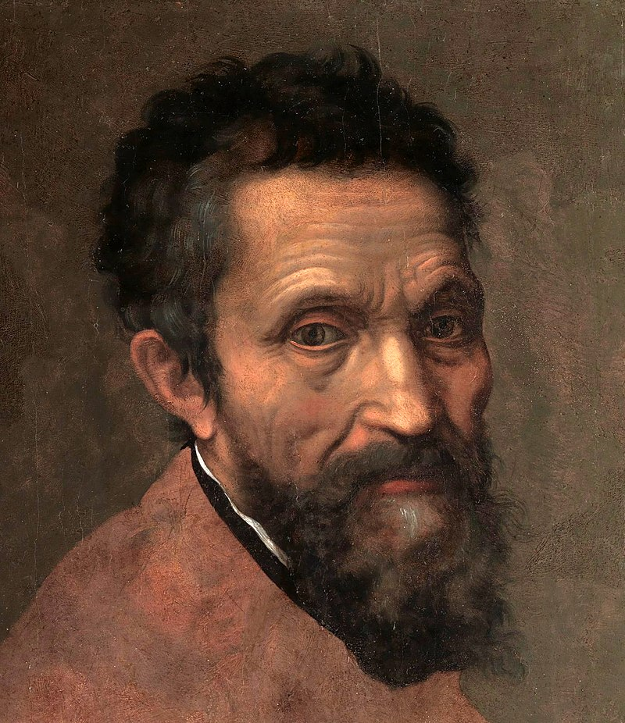
1475 - 1564
Italian Renaissance sculptor, painter, architect and poet. Generally considered one of the greatest artists ever. He worked in Florence and Rome. Michelangelo receives his formal education from the painter Domenico Ghirlandaio and the sculptor Bertoldo di Giovanni. In Florence Michelangelo becomes acquainted with Classical antiquity, which will have enormous influence on his work. Via Lorenzo de' Medici Michelangelo meets some of the greatest scientists of his days.

Slide 26
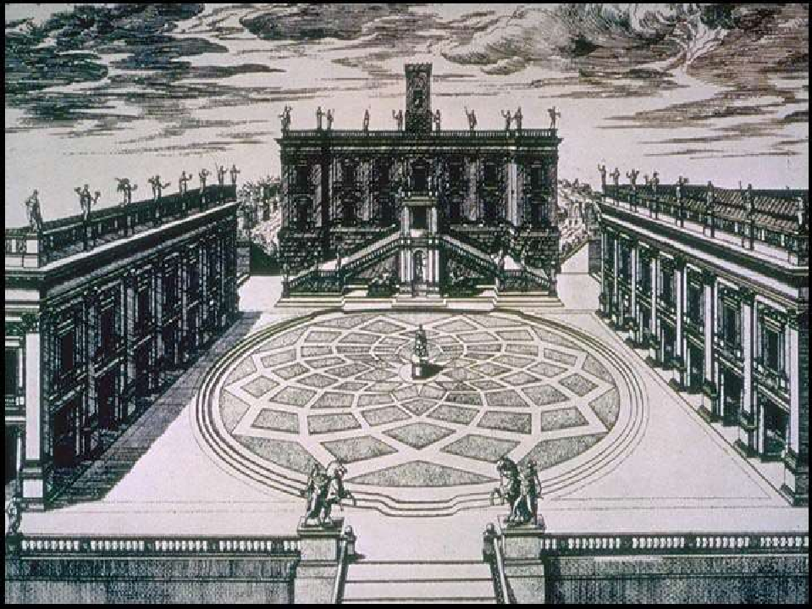



Slide 27
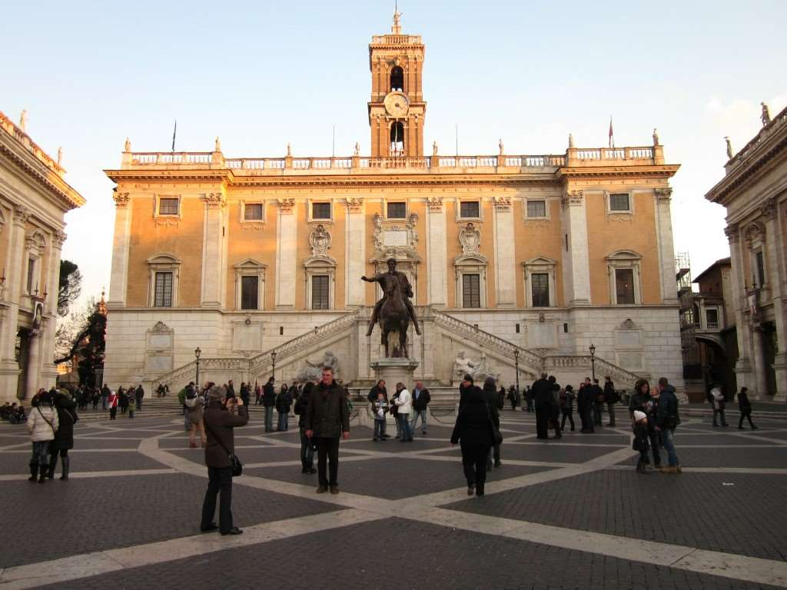



Slide 28
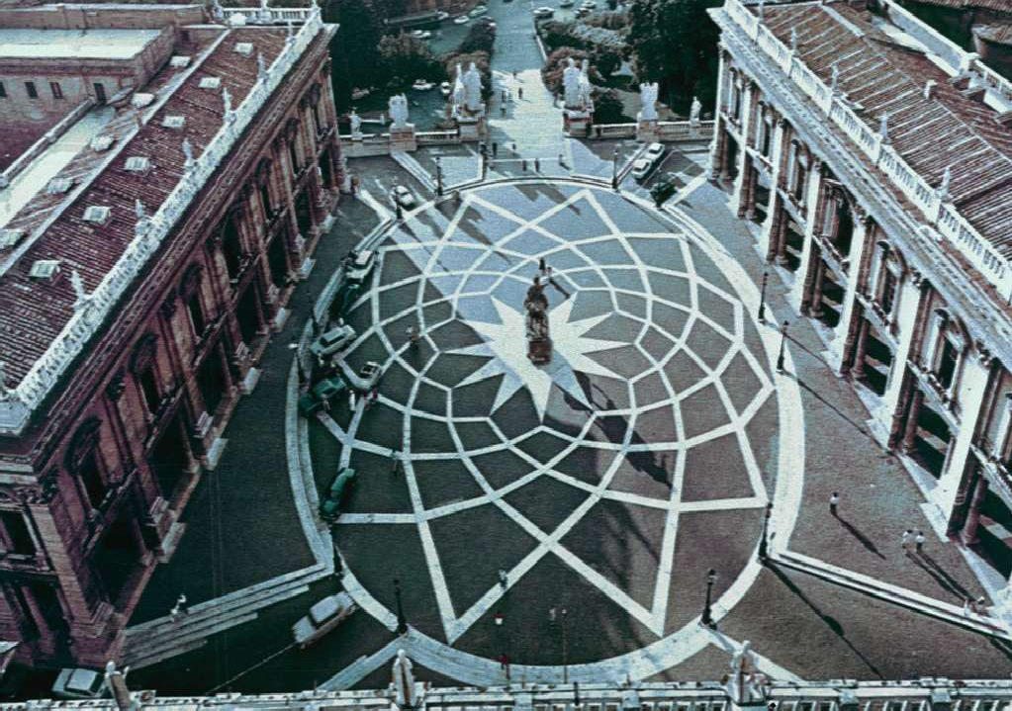



Slide 29
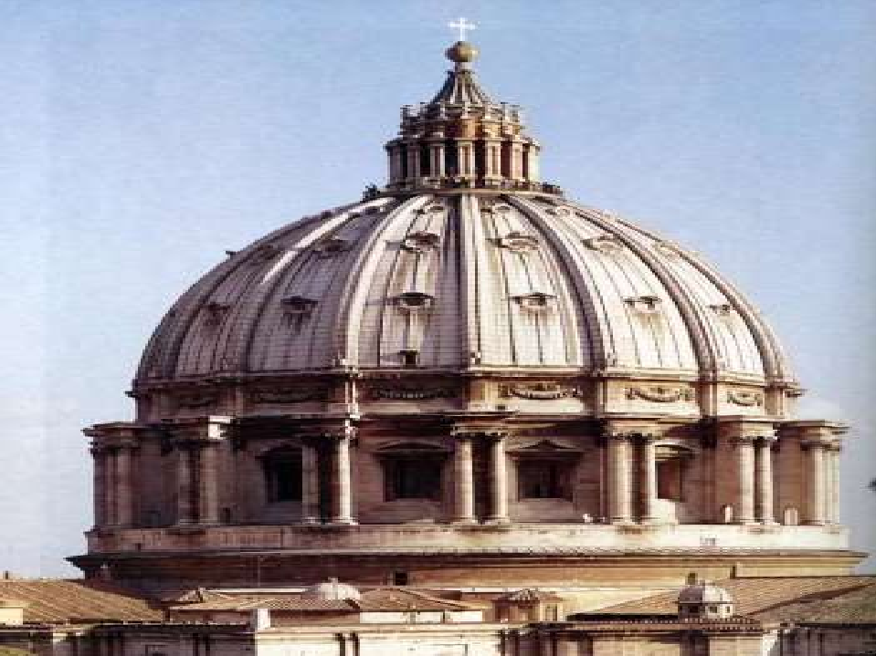


Slide 30
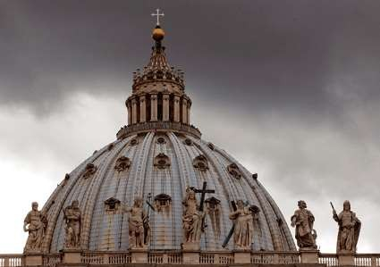
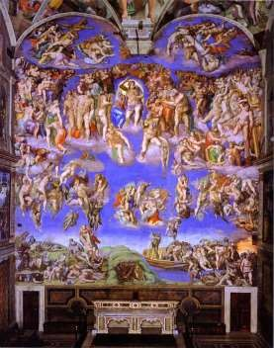

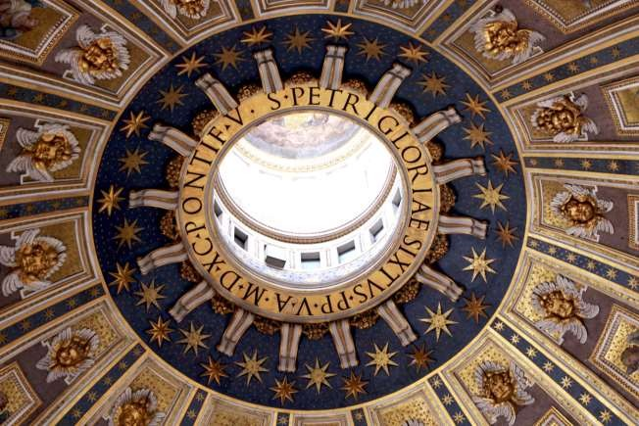
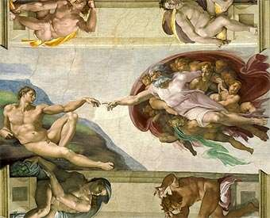

Slide 31
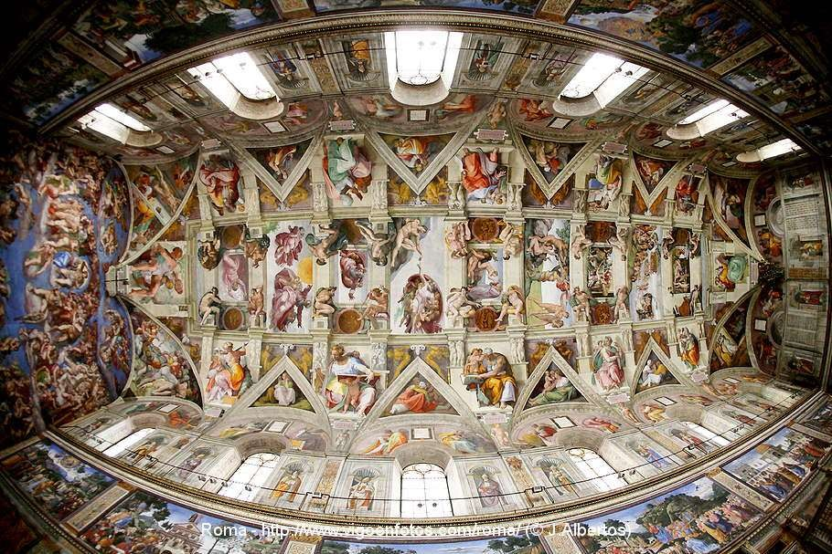

Slide 32






















Renaissance style places emphasis on symmetry, proportion, geometry and the regularity of parts as they are shown in the architecture of classical antiquity and in particular ancient Roman architecture, of which many examples remained. Orderly arrangements of columns, pilasters and lintels, as well as the use of semicircular arches, hemispherical domes, niches replaced the more complex proportional systems and irregular profiles of medieval buildings.

Slide 33
















The plans of Renaissance buildings have a square, symmetrical appearance in which proportions are usually based on a module within a church the module is often the width of an aisle.

Slide 34
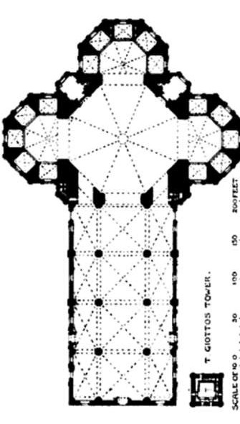
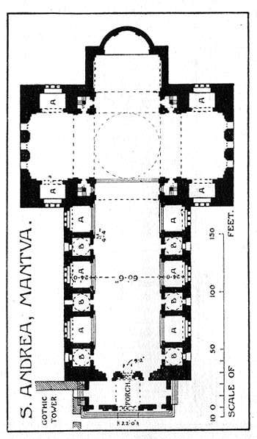

Slide 35
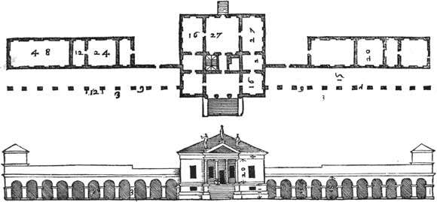

Slide 36
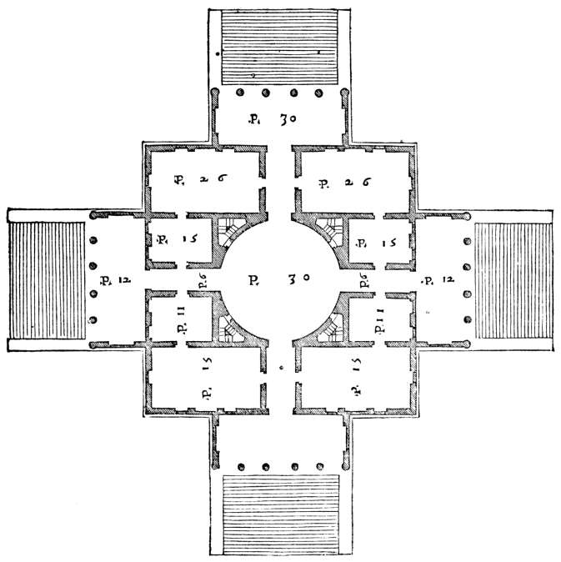

Slide 37

























The Roman orders of columns are used:-Tuscan, Doric, Ionic, Corinthian and Composite. The orders can either be structural, supporting an arcade or architrave, or purely decorative, set against a wall in the form of pilasters.
During the Renaissance architects aimed to use columns, pilasters as an integrated system.

Slide 38
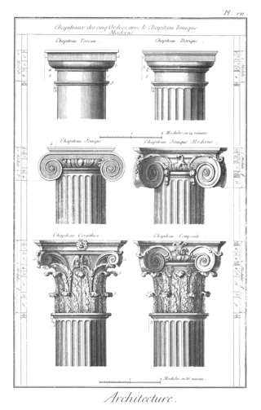
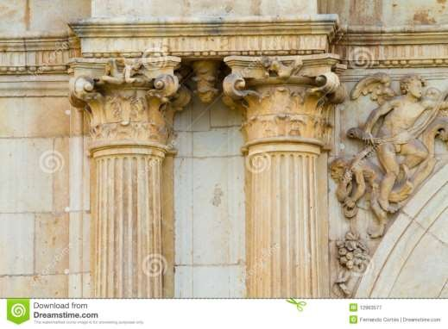
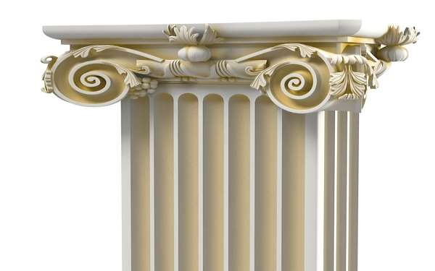

Slide 39
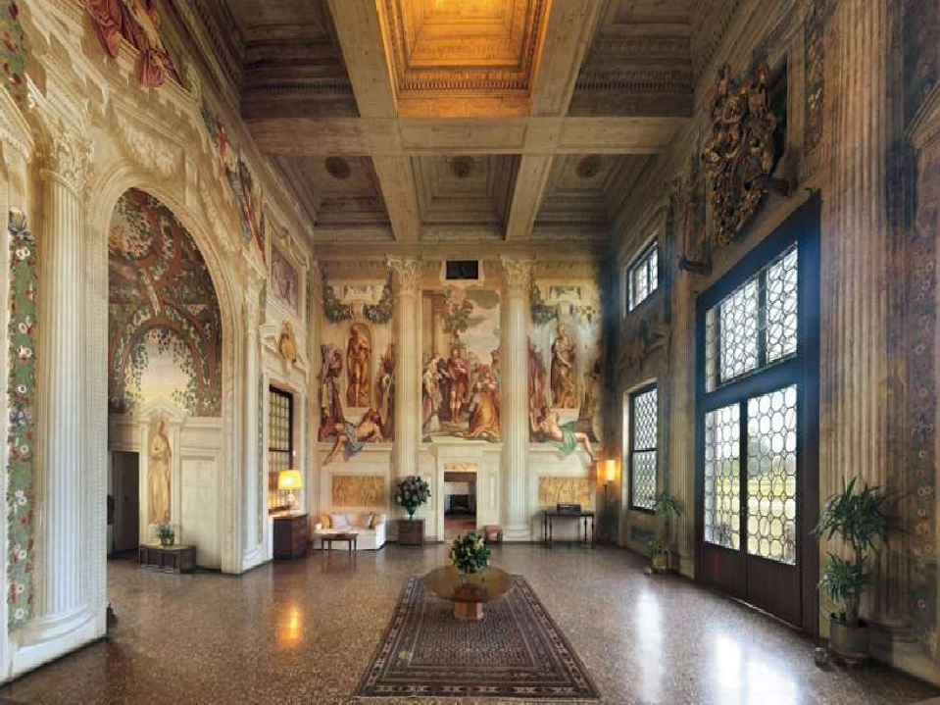


Slide 40
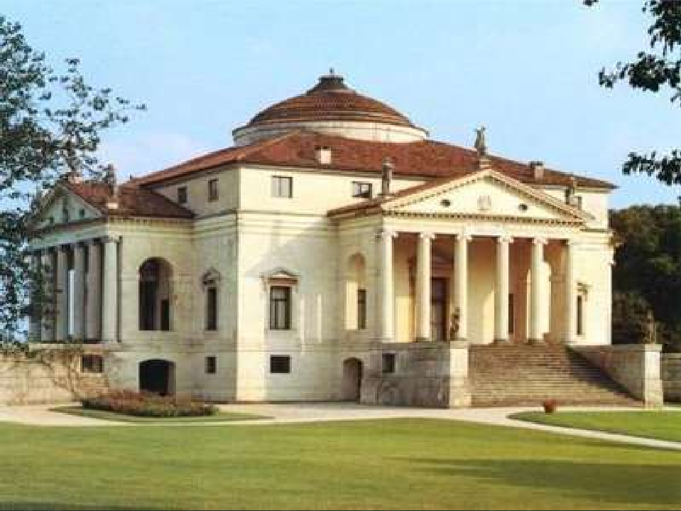


Slide 41
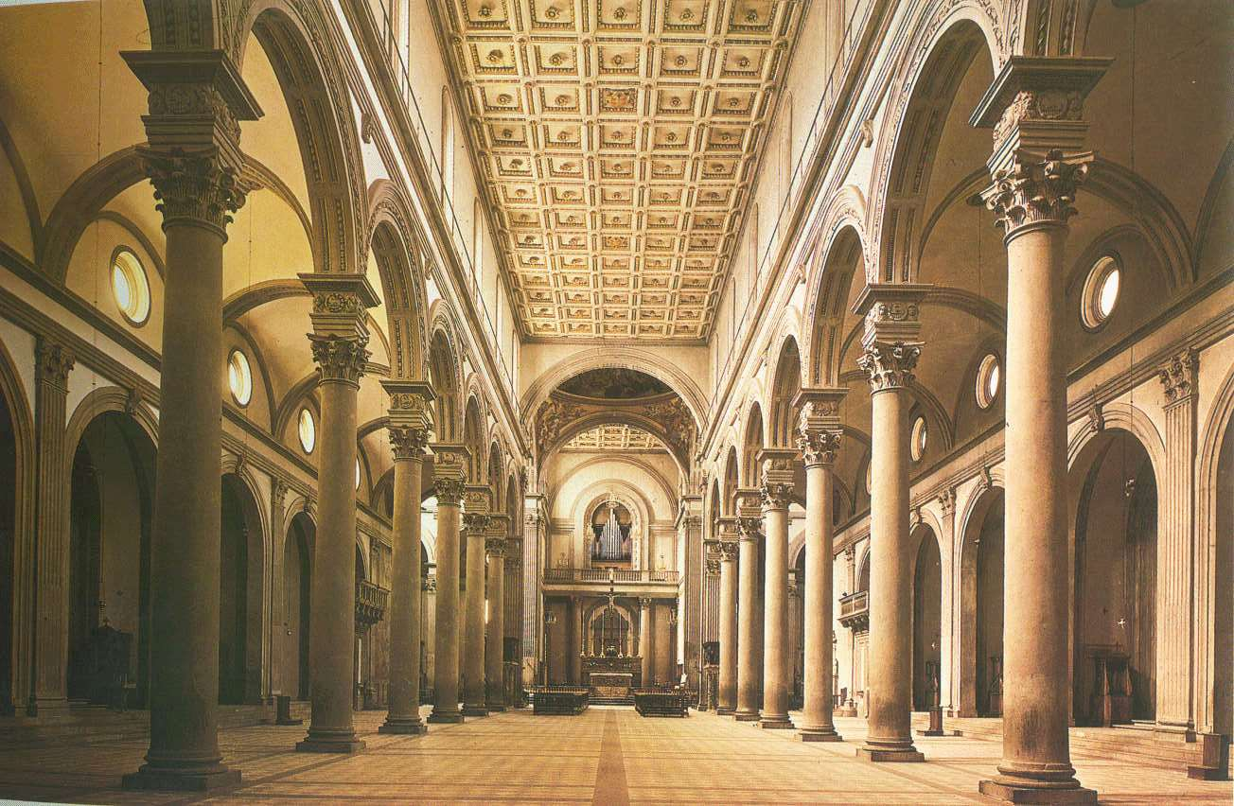

Slide 42
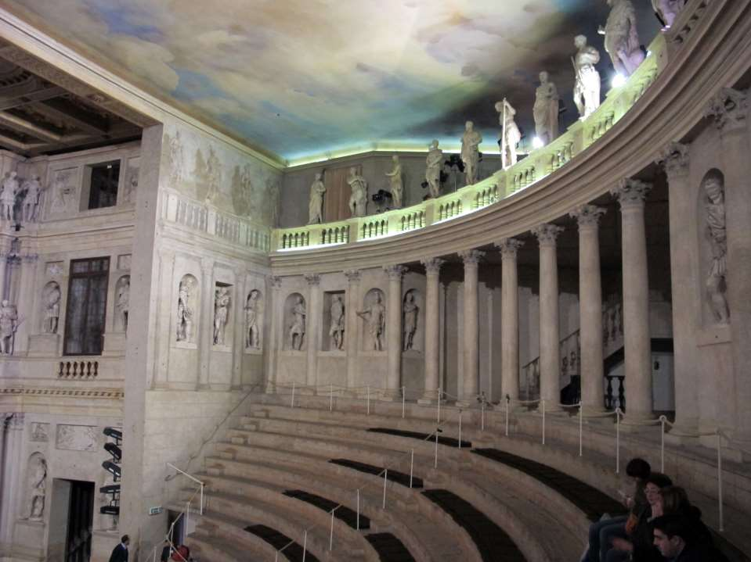


Slide 43


Arches are semi-circular or (in the Mannerist style) segmental. Arches are often used in arcades, supported on piers or columns with capitals.
Arches and domes were popular. This was again taken from Roman and Greek architecture.

Slide 44
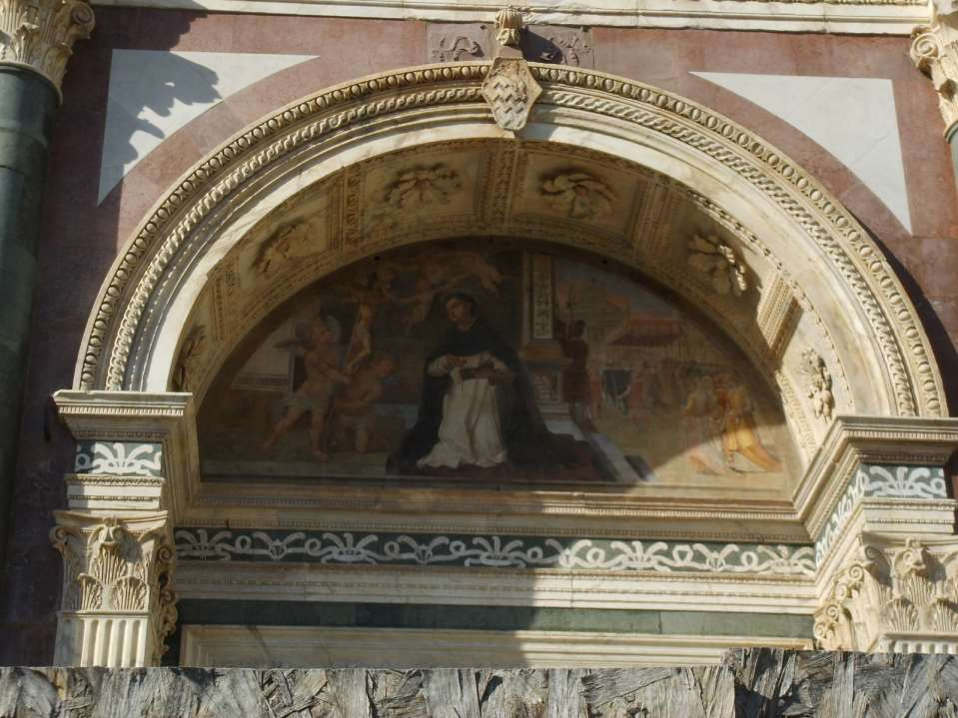

Slide 45
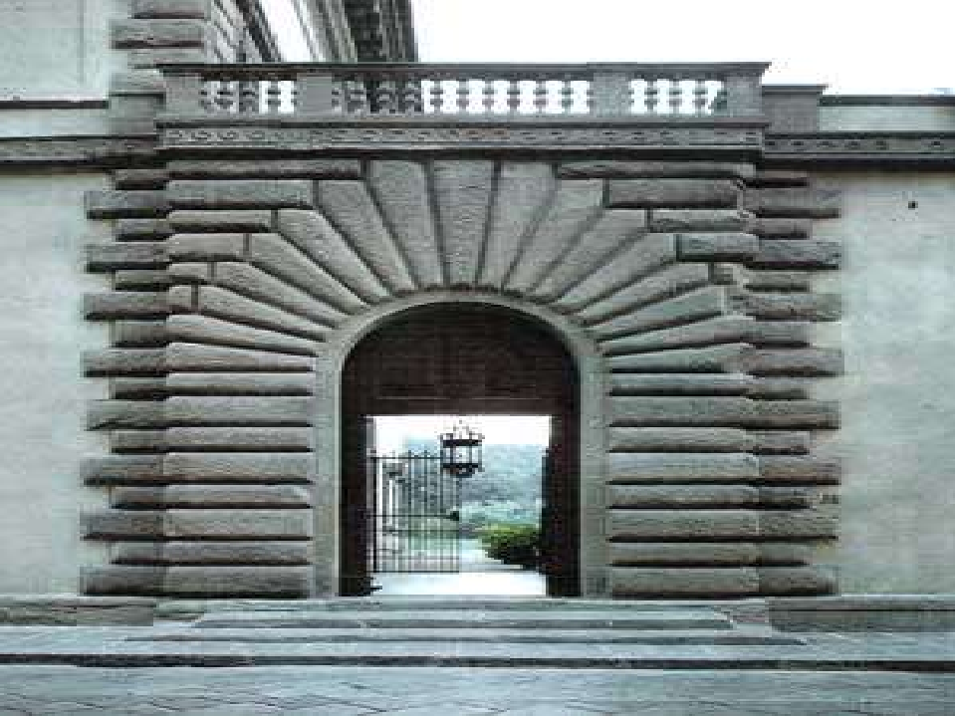


Slide 46
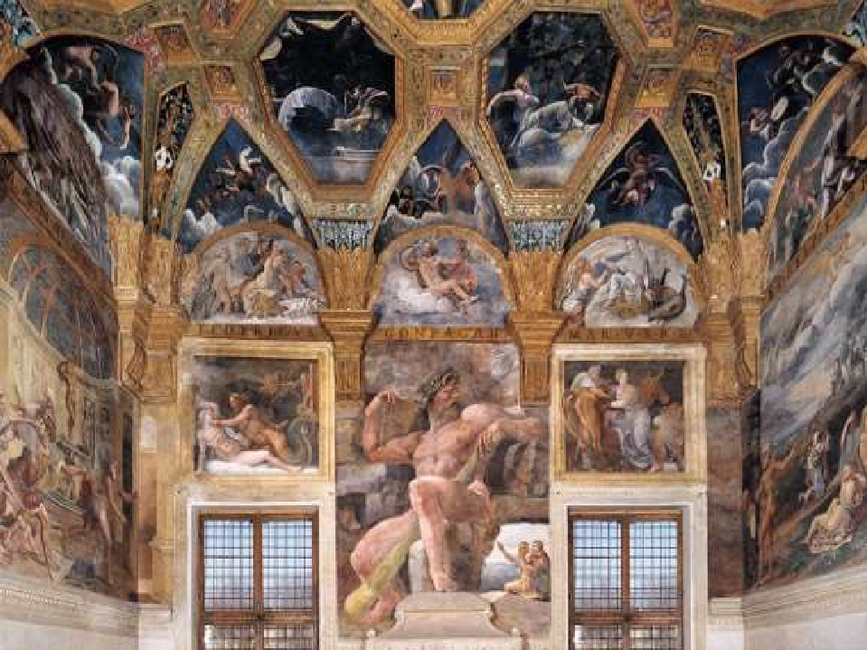



Slide 47
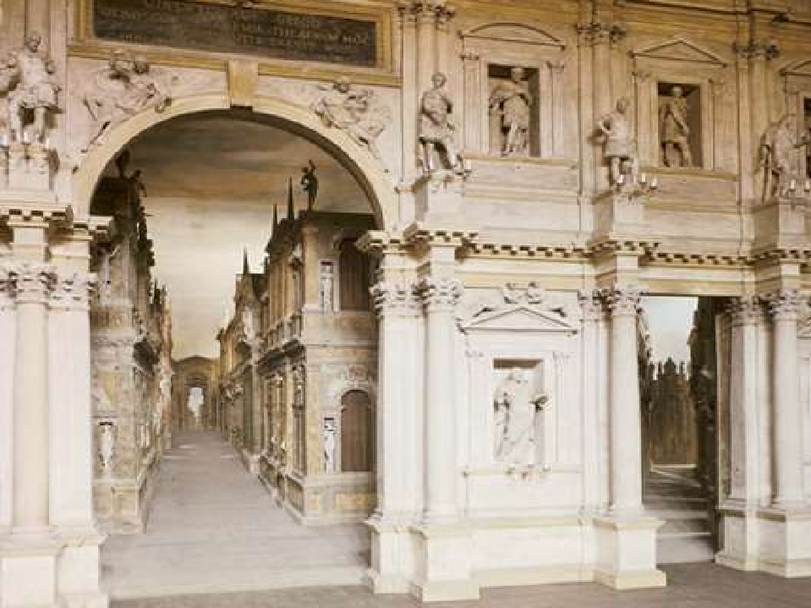


Slide 49
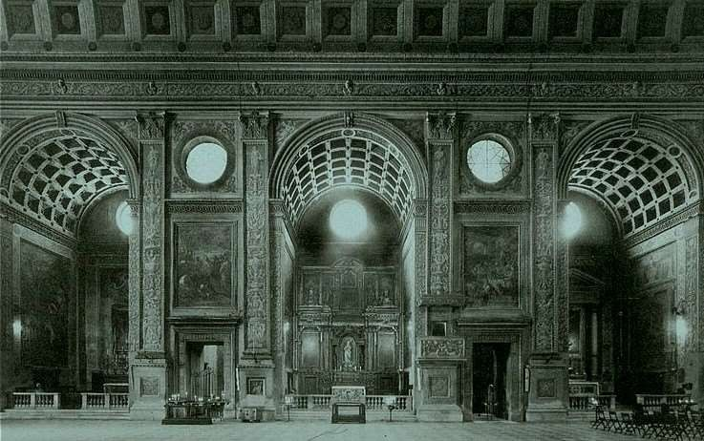

Slide 50


Vaults do not have ribs. They are semi- circular or segmental and on a square plan, unlike the Gothic vault which is frequently rectangular.

Slide 51
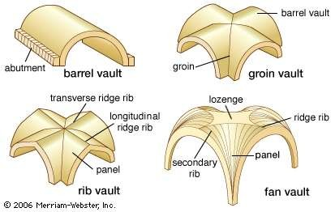
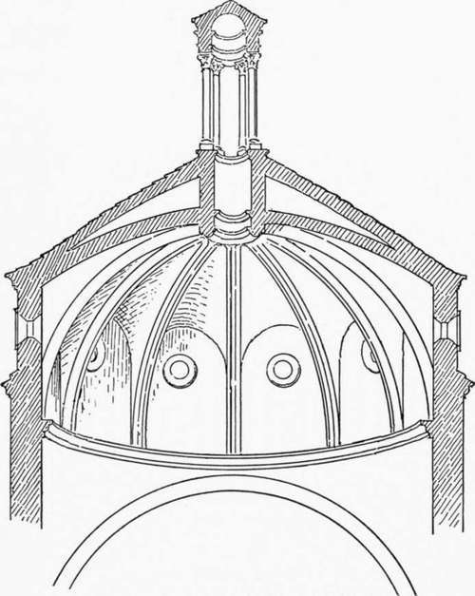

Slide 52
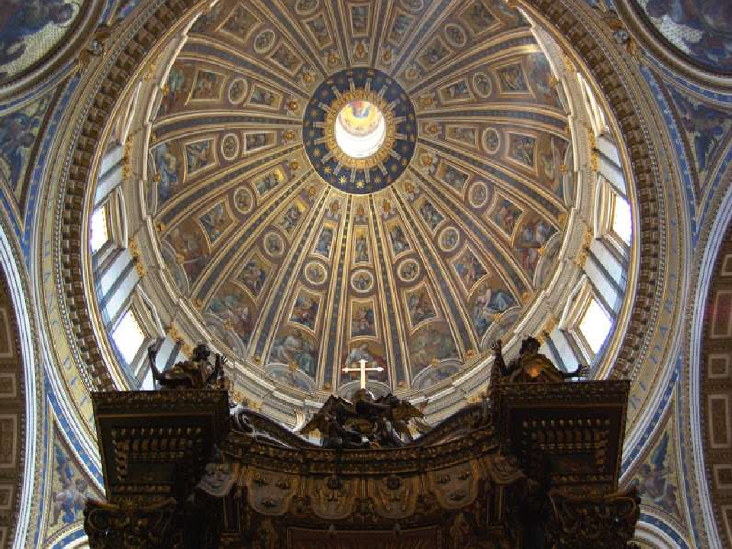

Slide 53






Slide 54


Slide 55




The 16th century saw the economic and political ascendancy of France and Spain, and then later of Holland, England, Germany and Russia. The result was that these places began to import the Renaissance style as indicators of their new cultural position. This also meant that it was not until about 1500 and later that signs of Renaissance architectural style began to appear outside Italy.

Slide 56





Mediterranean Sea

