Slide 1
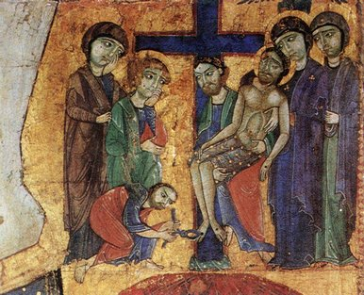
How did
Renaissance Art
And Architecture
Differ from the
Medieval Period?
Do Now: Study the picture above then answer the questions
on your handout

Slide 2
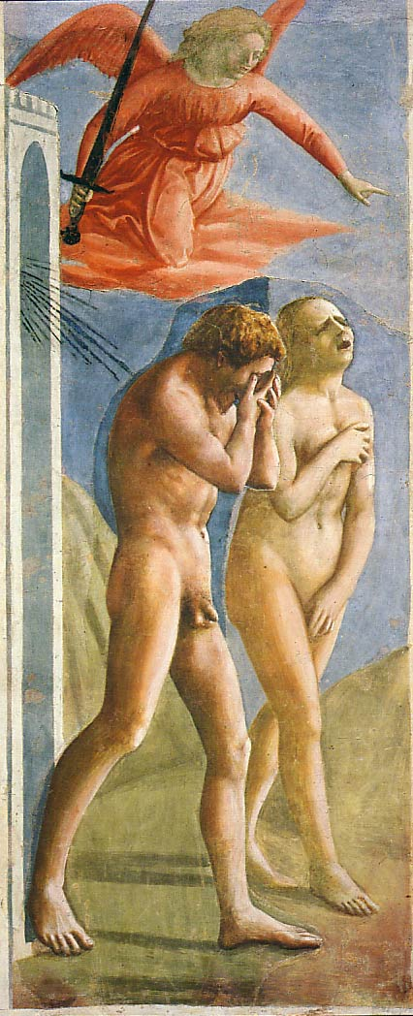
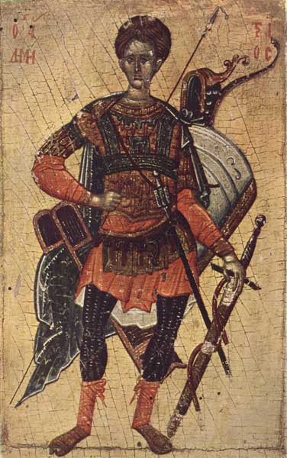
1. Realism & Expression
Expulsion from the Garden
Masaccio
1427
First nudes since
classical times.
Before
SAINT DEMETRIUS OF SALONICA.
High Middle Ages
End of 14th century

Slide 3
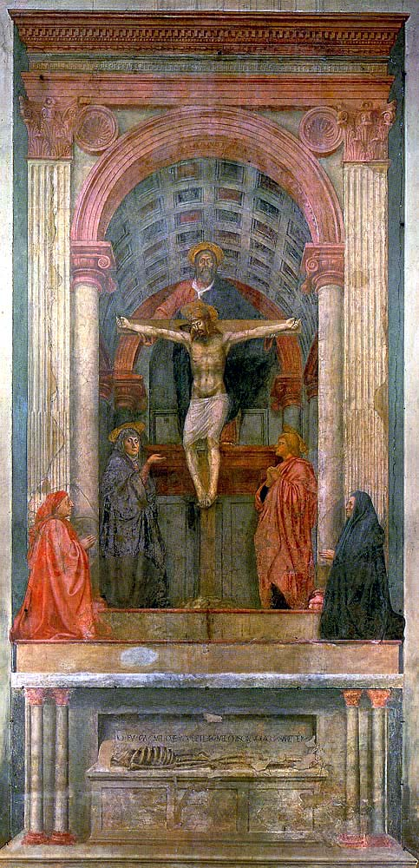
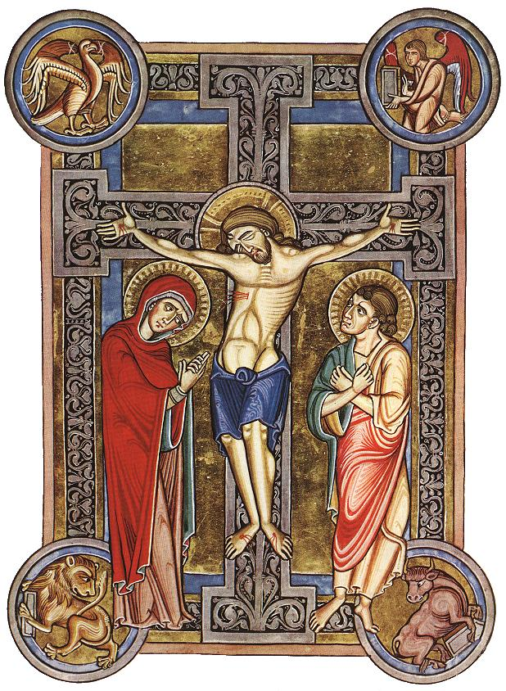
Masaccio’s “Trinity”
Before
The first known painting to apply
Brunelleschi’s system of linear
perspective.
Church of Santa Maria Novella,
Florence

Slide 4
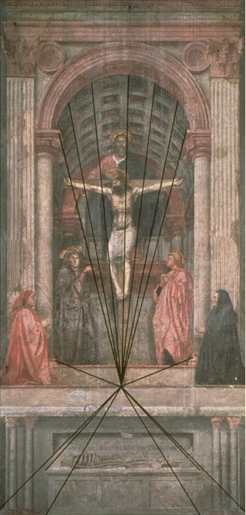
2. Perspective
The Trinity
Masaccio
1427
Perspective!
Perspective!
Perspective!
Perspective!
Perspective!
Perspective!
Perspective!
First use
of linear
perspective!
What you are, I once was; what I am, you will become.

Slide 5
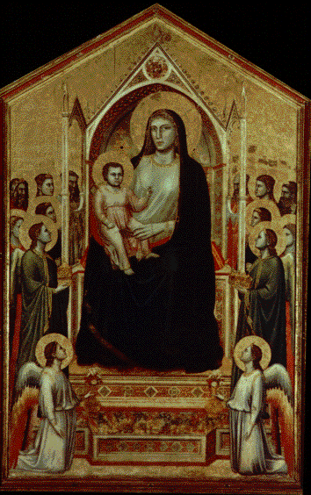
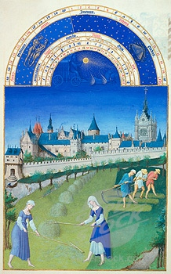
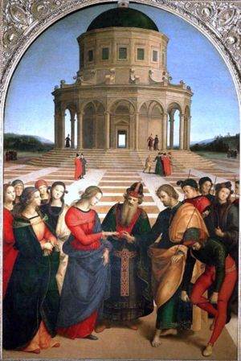
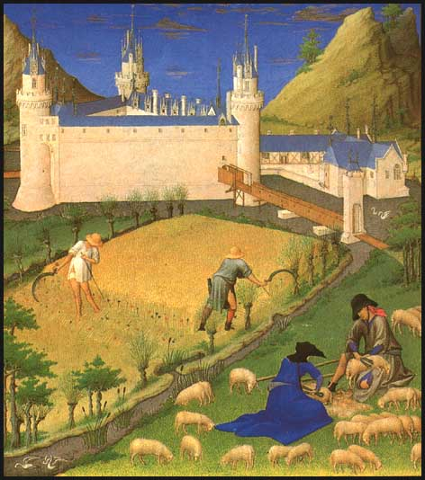
Progression of the Use of Perspective
1280’s
1380’s
1480’s

Slide 6
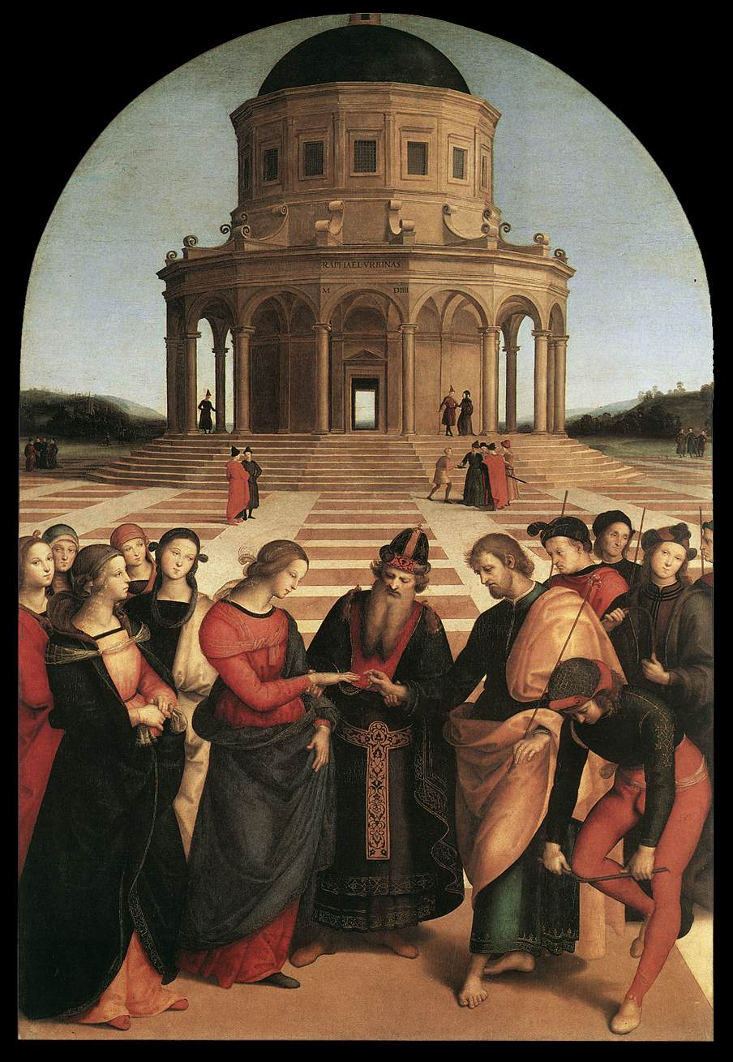
Perspective!
Betrothal
of the Virgin
Raphael
1504

Slide 7
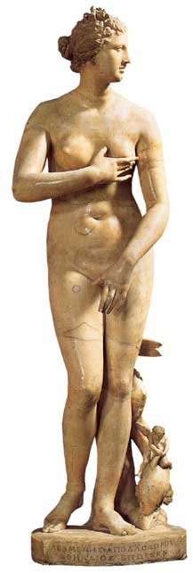
3. Classicism and Realism
Greco-Roman influence.
Secularism.
Humanism.
Individualism → free standing figures.
Symmetry/Balance
The “Classical Pose”
Medici “Venus” (1c)

Slide 8
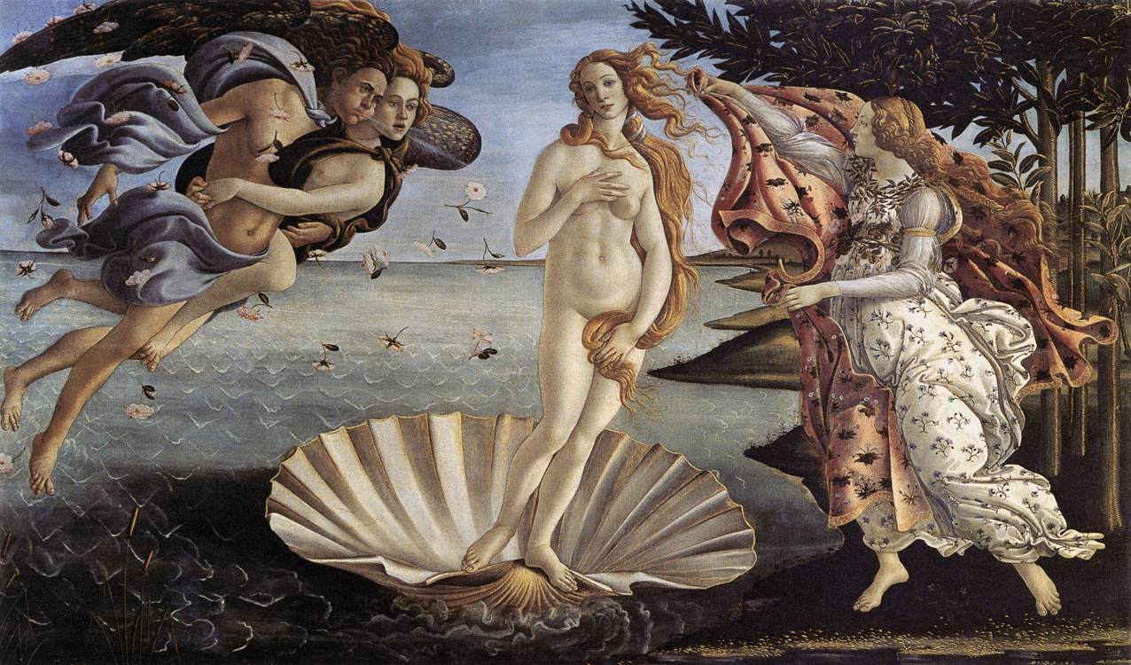
Birth of Venus – Botticelli, 1485
An attempt to depict perfect beauty.

Slide 9
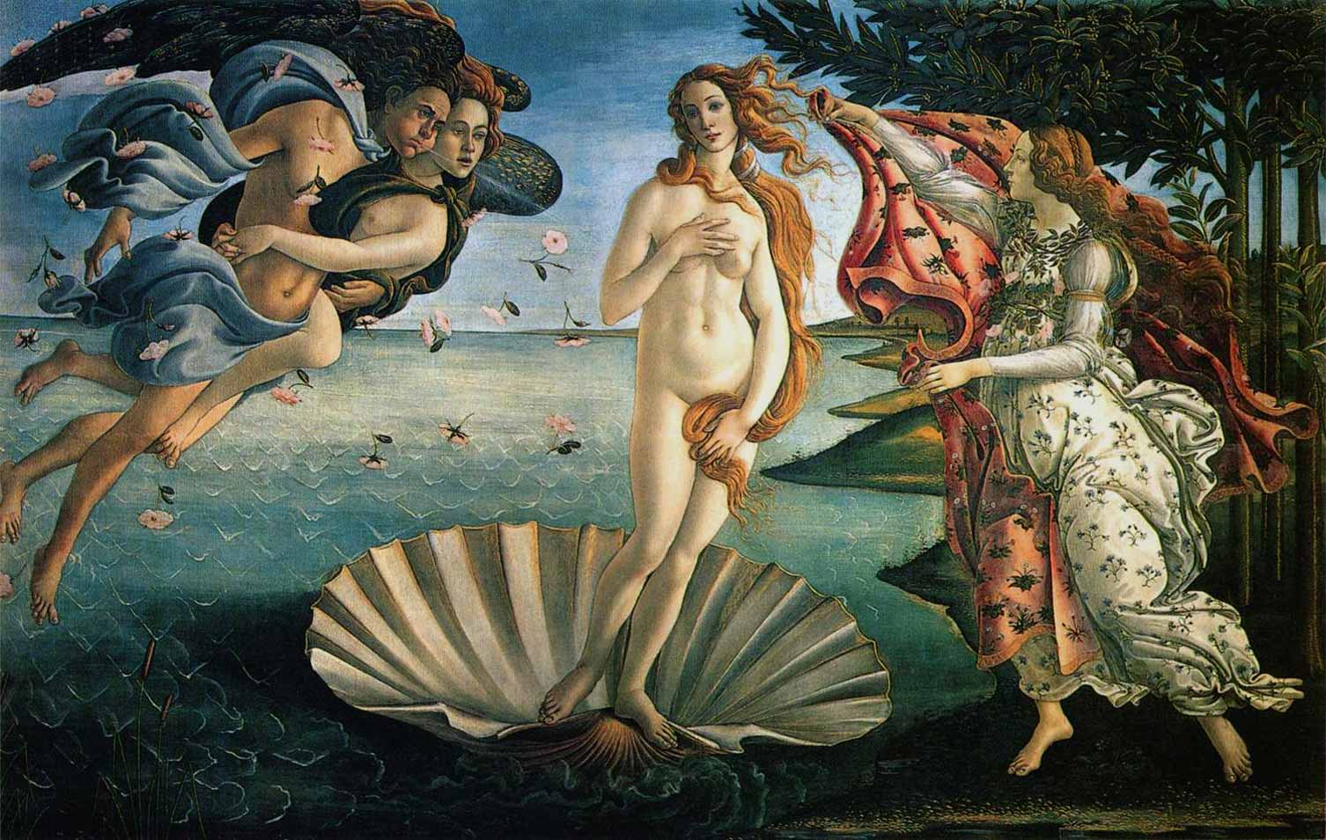
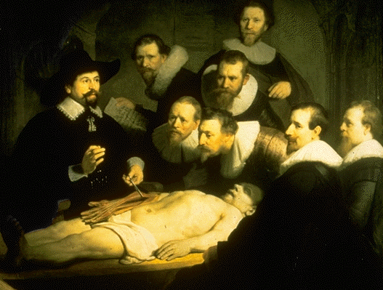
Examples of Humanism and Realism in Renaissance Art
Botticelli's Birth of Venus
Caravaggio’s

Slide 10
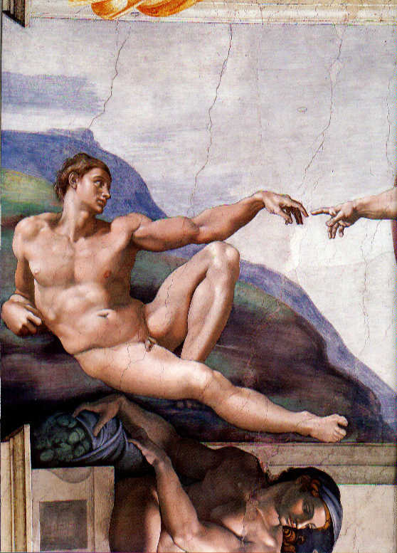
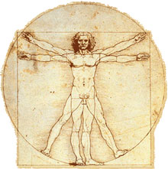
Examples of Humanism and Realism in Renaissance Art
Michelangelo’s
Sistine Chapel
Da Vinci’s
Vitruvian Man

Slide 11
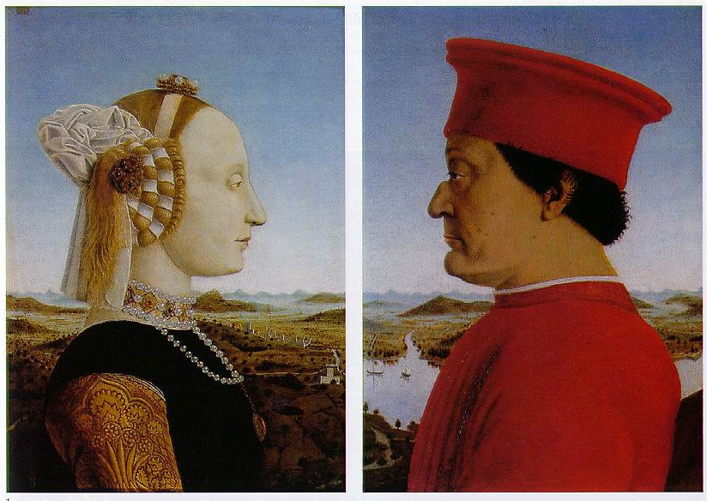
4. Emphasis on Individualism
Batista Sforza & Federico de Montefeltre: The Duke & Dutchess of Urbino
Piero della Francesca, 1465-1466.

Slide 12
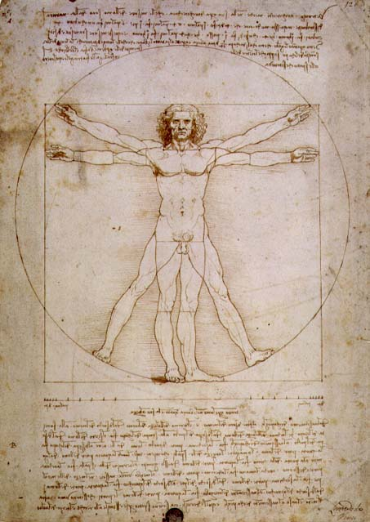
Vitruvian Man
Leonardo da
Vinci
1492
The
L’uomo
universale

Slide 13
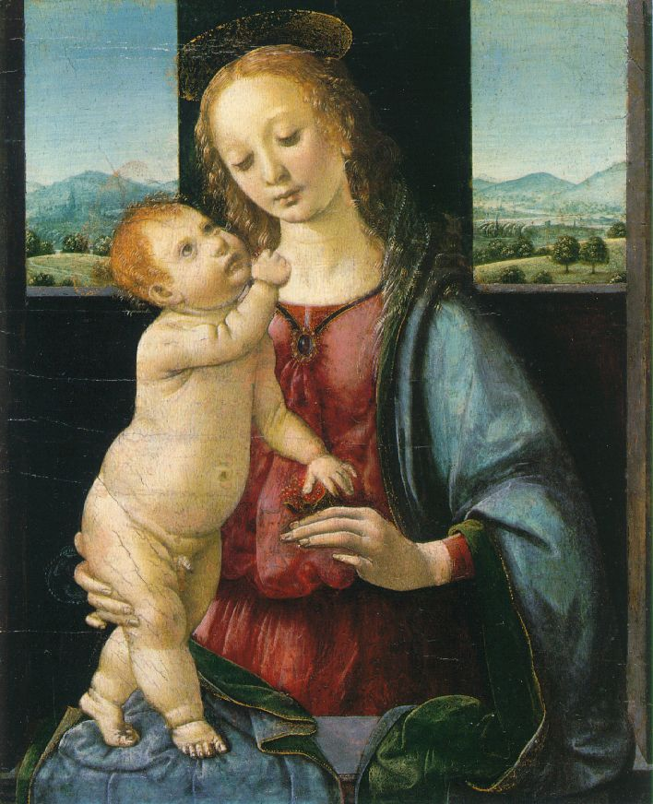
5. Geometrical Arrangement of Figures
The Dreyfus Madonna
with the Pomegranate
Leonardo da Vinci
1469
The figure as architecture!

Slide 14
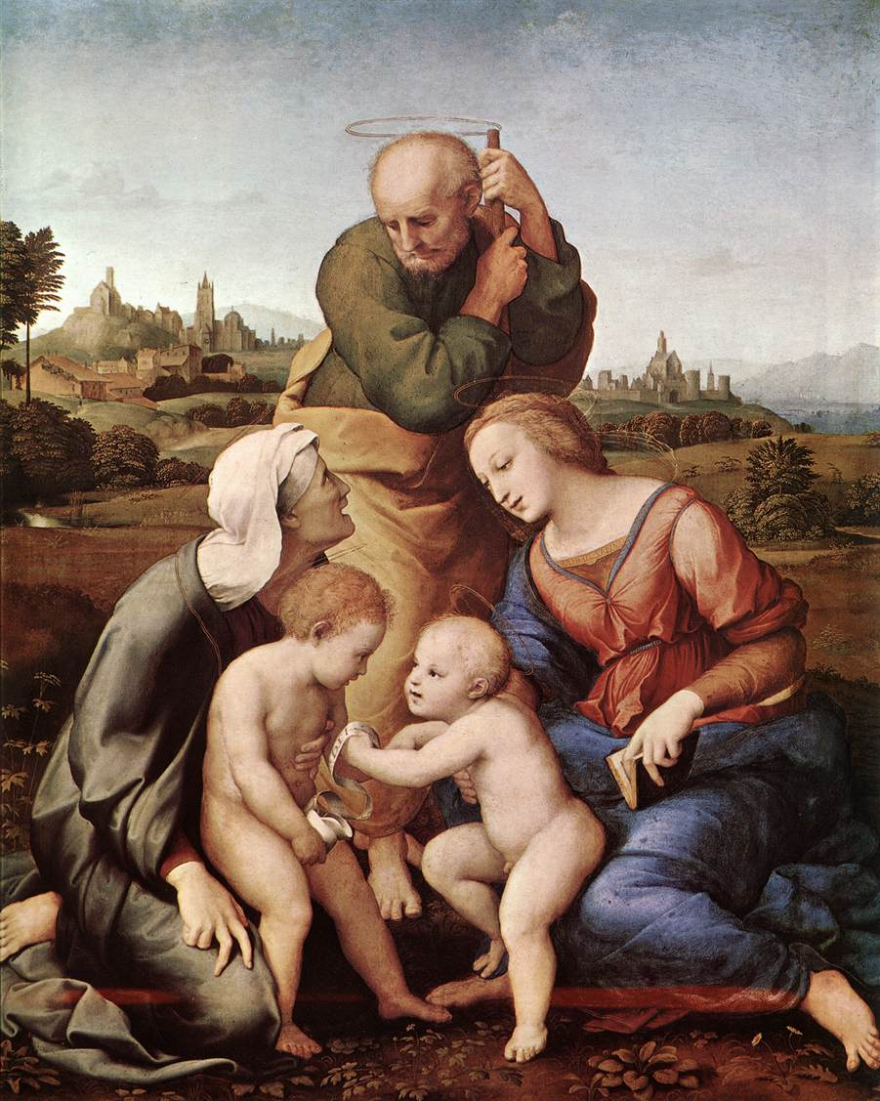
Raphael’s Canagiani Madonna, 1507

Slide 15
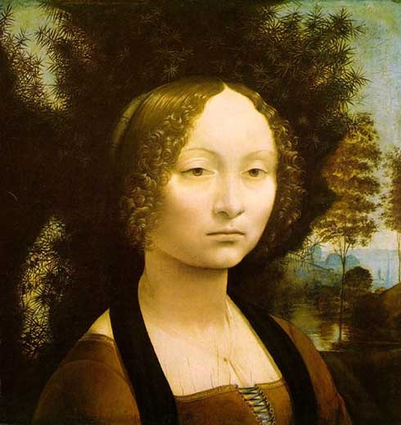
6. Light & Shadowing/Softening Edges
Sfumato
Leonardo da Vinci described sfumato as "without lines or borders, in the manner of smoke or beyond the focus plane."
Chiaroscuro

Slide 16
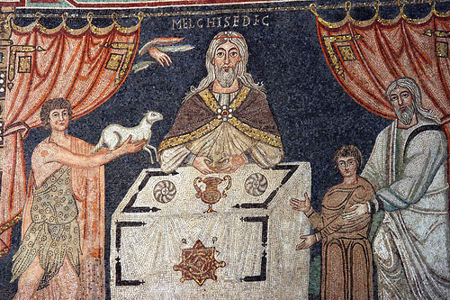
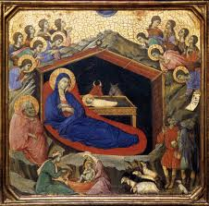

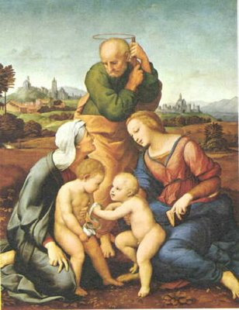

Slide 17

Famous works by Italian
Renaissance Artists
Leonardo
Raphael
Michelangelo
Donatello

Slide 18
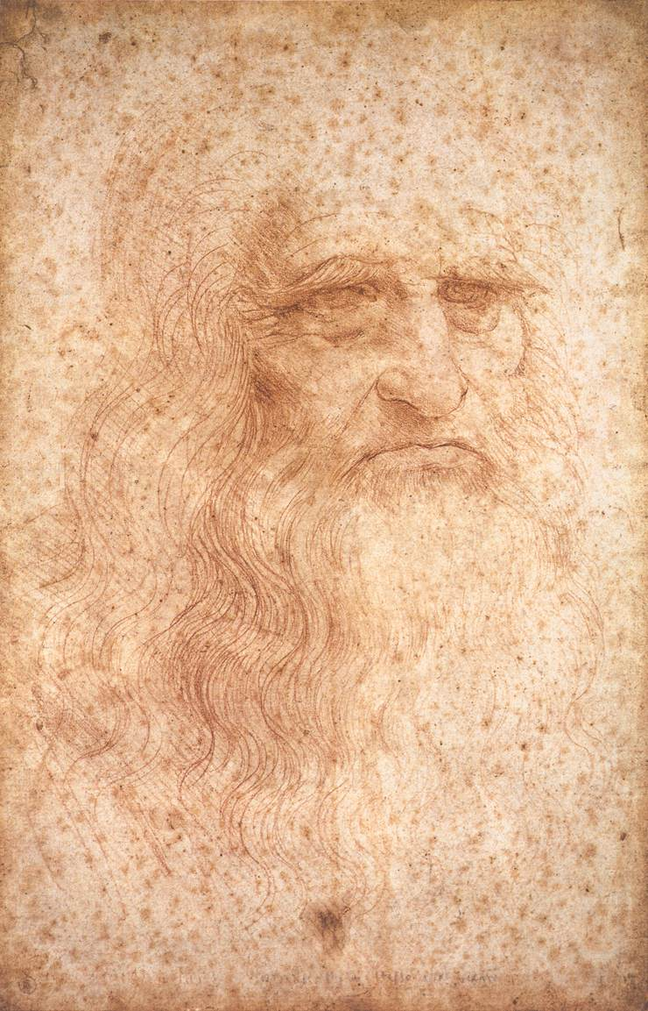
The Renaissance “Man”
Broad knowledge about many things in different fields.
Deep knowledge/skill in one area.
Able to link information from different areas/disciplines and create new knowledge.
The Greek ideal of the “well-rounded man” was at the heart of Renaissance education.
Artist
Sculptor
Architect
Scientist
Engineer
Inventor
1452 - 1519

Slide 19
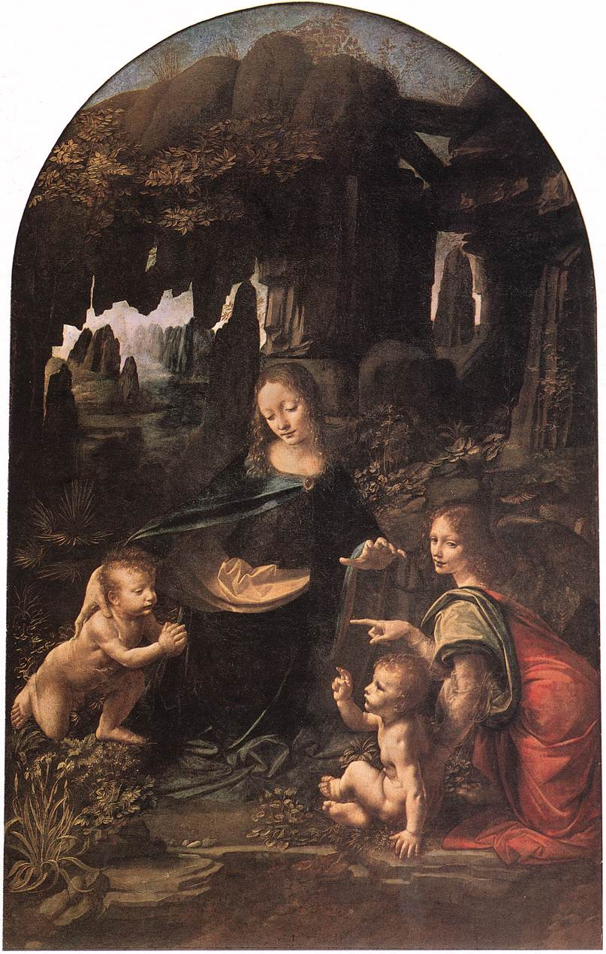
Leonardo da Vinci,
The Virgin of the Rocks
Leonardo da
Vinci
1483-1486

Slide 20
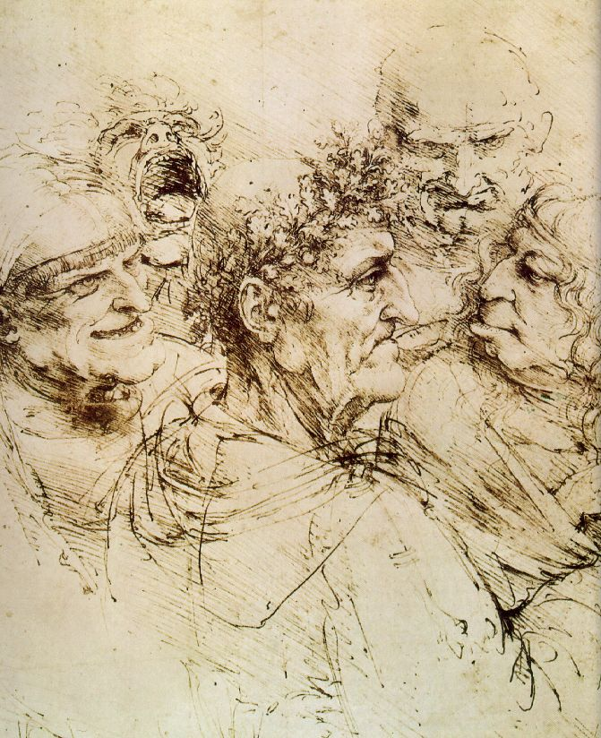
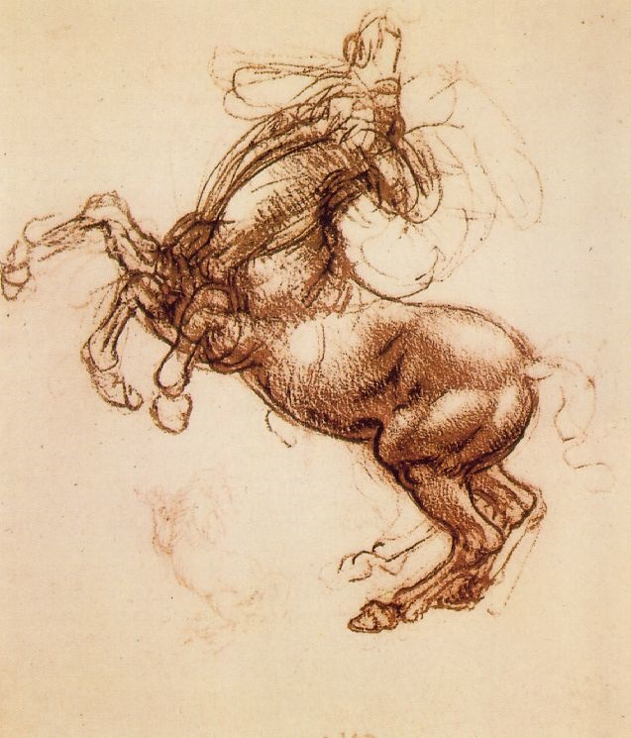
Leonardo, the Artist:
From his Notebook of over 5000 pages (1508-1519)

Slide 21
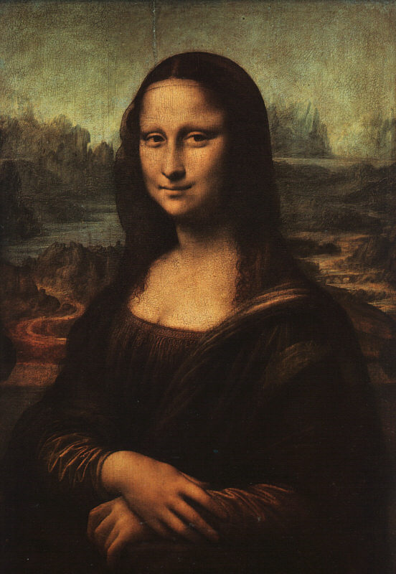
Leonardo Da Vinci
Why is Mona Lisa so famous?
Fun Fact! Notice her lack of eyebrows! Women during this period would shave them off! It was considered fashionable to do so!
Mona Lisa (La Giocande)
Oil on wood panel

Slide 22
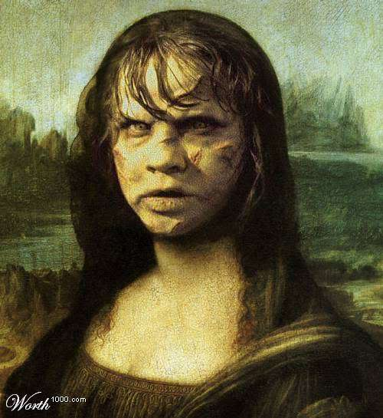
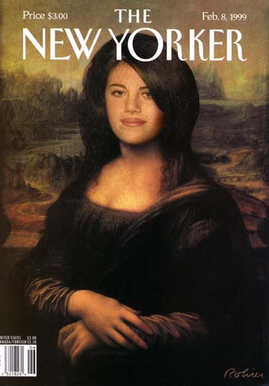
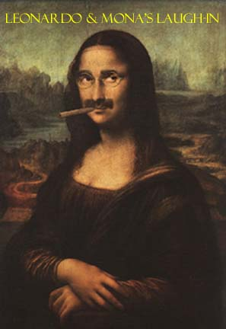
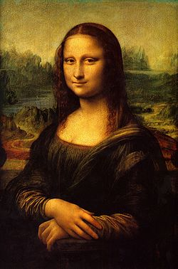
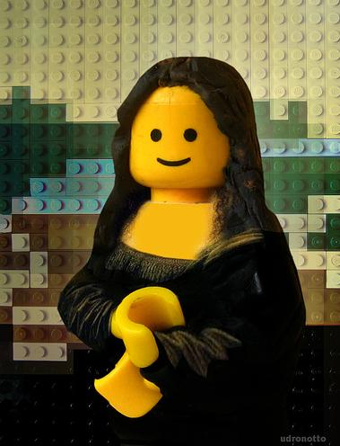
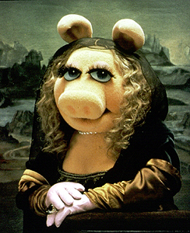
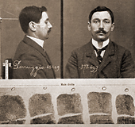
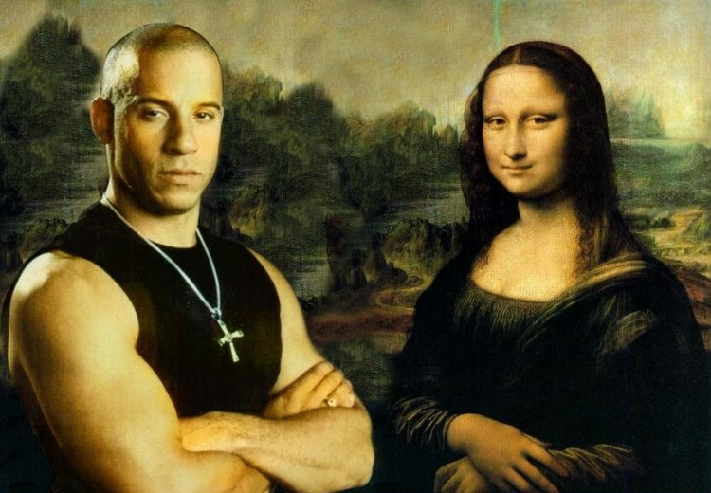
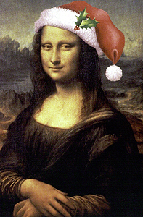

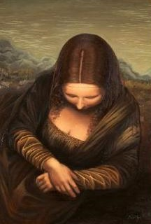

Slide 23
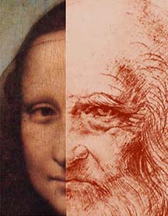

Mona Lisa OR da Vinci??

Slide 24
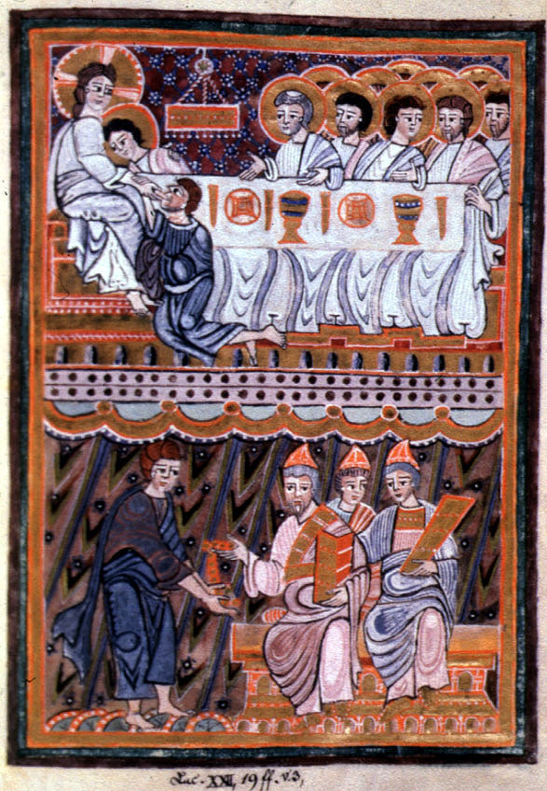
The Last Supper
Gospel Book of Bernward of
Hildesheim, c. 1016
German

Slide 25
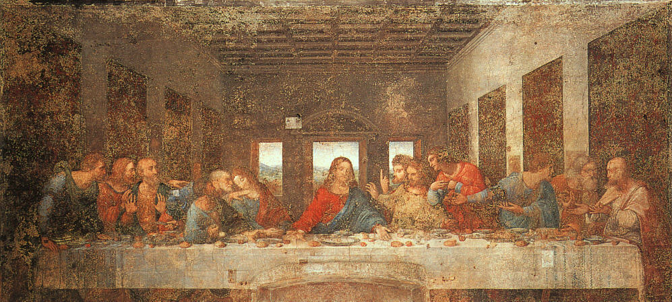
Leonardo da Vinci, “Last Supper”
Convent of Santa Maria delle Grazie, Milan, Italy

Slide 26
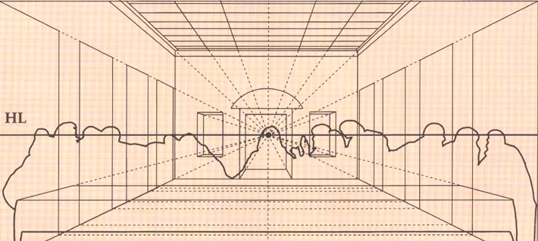
“Last Supper” Perspective

Slide 27
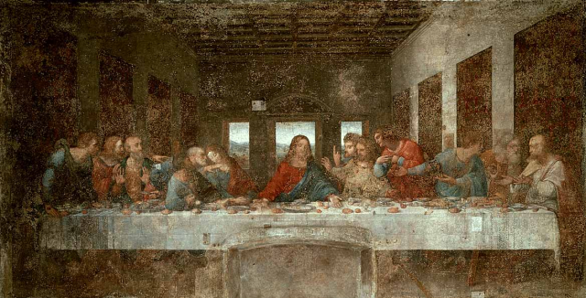
The Last Supper - da Vinci, 1498
vertical
horizontal
Perspective!

Slide 28
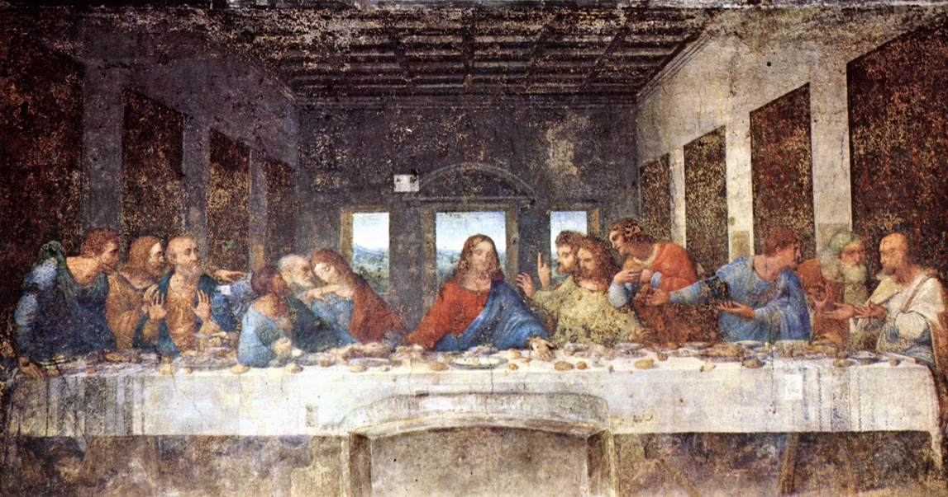
The Last Supper - da Vinci, 1498
& Geometry

Slide 29
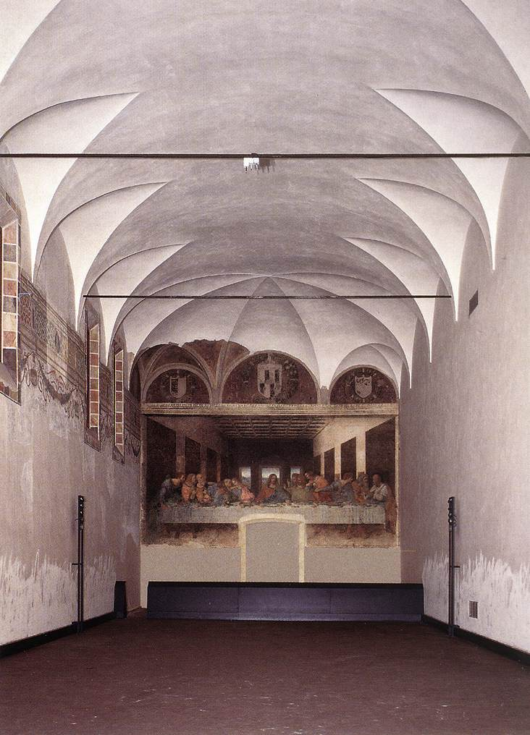
Refractory
Convent of Santa Maria delle Grazie
Milan

Slide 30
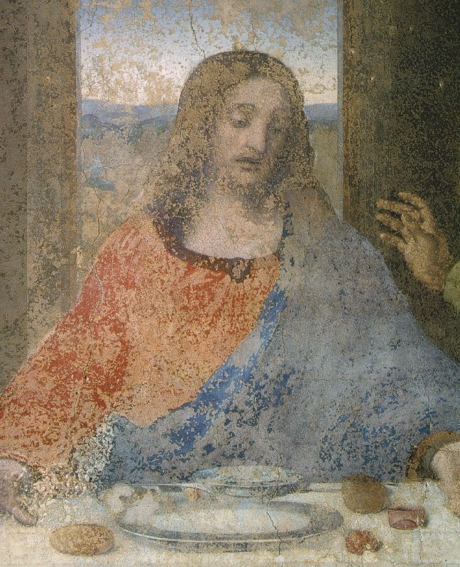
Deterioration
Detail of Jesus
The Last Supper
Leonardo da Vinci
1498

Slide 31
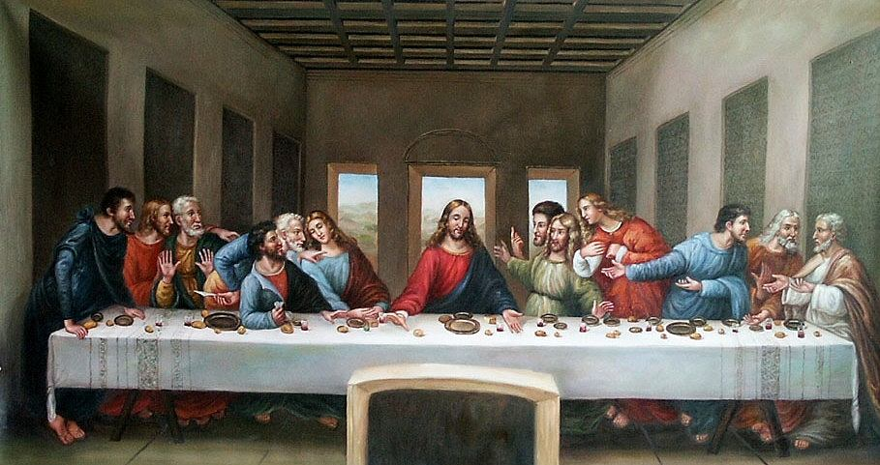
Leonardo Da Vinci
The Last Supper
Tempera and mixed media on Plaster

Slide 32
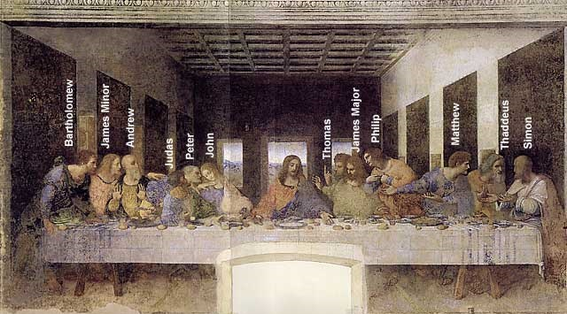
A Da Vinci “Code”:
St. John or Mary Magdalene?

Slide 33

Leonardo, the Sculptor
An Equestrian Statue
1516-1518

Slide 34

Leonardo, the Architect:
Pages from his Notebook
Study of a central church.
1488

Slide 35

Leonardo, the Architect:
Pages from his Notebook
Plan of the city of Imola, 1502.

Slide 36

Leonardo, the Scientist (Biology):
Pages from his Notebook
An example of the humanist desire to unlock the secrets of nature.

Slide 37


Leonardo, the Scientist (Anatomy): Pages from his Notebook

Slide 38



Leonardo, the Inventor: Pages from his Notebook

Slide 39

Man Can Fly?

Slide 40


Leonardo, the Engineer: Pages from his Notebook
Studies of water-lifting devices.
A study of siege defenses.

Slide 41


King David
Above: Gospel Book of Philip the Fair
Right: Vivian Bible

Slide 42


The Liberation of Sculpture
David by Donatello
1430
First free-form bronze since Roman times!

Slide 43

David
Verrocchio
1473 - 1475

Slide 44



David
Michelangelo
Buonarotti
1504
Marble

Slide 45

Michelangelo’s Detail

Slide 46
← 15c
What
a
difference
a
century
makes!
16c →

Slide 47

The Popes as Patrons of the Arts
The Pieta
Michelangelo
Buonarroti
1499
marble

Slide 48


Michelangelo
“The Creating of Adam”
The Sistine Chapel
Fresco

Slide 49
The Sistine Chapel
Michelangelo Buonarroti
1508 - 1512
Film Clip

Slide 50

The Sistine Chapel’s Ceiling
Michelangelo Buonarroti
1508 - 1512

Slide 51

The Sistine Chapel Details
The
Creation
of the Heavens

Slide 52



The Sistine Chapel Details
Creation of Man

Slide 53

A Modern “Adaptation”
Joe Gallo in the New York Daily News, 2004

Slide 54

The Sistine Chapel Details
The Fall from Grace

Slide 55


Creation

Slide 56
Michelangelo, Sistine Chapel

Slide 57
Michelangelo, Sistine Chapel

Slide 58


The Sistine Chapel Details
The Last Judgment

Slide 59


Donatello (Donato di Niccolò di Betto Bardi)
Donatello’s David vs. Michelangelo’s David

Slide 60

Raphel Sanzio
The School of Athens
Fresco (water color on plaster)

Slide 61

Raphael’s “School of Athens”

Slide 62
The School of Athens – Raphael, 1510 -11
One point perspective.
All of the important Greek philosophers and thinkers are included → all of the great personalities of the Seven Liberal Arts!
A great variety of poses.
Located in the papal apartments library.
Raphael worked on this commission simultaneously as Michelangelo was doing the Sistine Chapel.
No Christian themes here.

Slide 63
The School of Athens – Raphael, 1510 -11
Da Vinci
Raphael
Michelangelo

Slide 64

The School of Athens – Raphael, details
Plato:
looks to the
heavens [or
the IDEAL
realm].
Aristotle:
looks to this
earth [the
here and
now].
Film Clip

Slide 65

Averroes
Hypatia
Pythagoras

Slide 66

Zoroaster
Ptolemy
Euclid

Slide 67




Raphael’s “School of Athens”
Clockwise:
Plato (Leonardo), Aristotle,
Raphael,
Michelangelo

Slide 68

Raphel Sanzio
Who’s who in the School?
In the Center: Plato on the Right, Aristotle
On the left!

Slide 69

Italian Renaissance Recap

Slide 70
Aspects of Italian Renaissance Art
More secular than the religious Medieval period
Focus on Humanism: Human achievement and form
Realistic: Emotion
Linear Perspective: Distant objects smaller than those close to the viewer. Making scenes appear 3-Dimensional.
Revival of classical themes

Slide 71


The Renaissance
moves North!
About 100 years after the Renaissance began it Italy,
It moved north to Flanders (Northern Belgium).
Took longer to recover from the economic devastation brought on by the black plague.
100 years war in France/England
Remember me?

Slide 72
Characteristics of Northern Renaissance Art
Contained great detail
More landscape and nature paintings - usually darker and colder
Oil painting on Canvas – allowed for vivid color
Paintings are less secular. More religious questioning.
More scenes of daily life.

Slide 73


Jan Van Eyck - Flanders
The Wedding of
Arnolfini
Oil on canvas

Slide 74

Jan Van Eyck - Flanders
Madonna Del Rolin
Oil on wood

Slide 75

Albrcht Durer
Self Portrait 28
Oil on panel

Slide 76

Albrcht Durer - Germany
Young Hare
Oil on Panel

Slide 77

Hans Holbein

Slide 78

Bruegel

Slide 79

Bruegel

Slide 80

Peasant Wedding
Oil on wood

Slide 81


Medieval vs. Renaissance Architecture
Gothic (Medieval)
Gothic architecture was very large, “pointy”
Flying buttresses supported large walls
Stained glass told stories
Renaissance
Revival of Arch and Dome
Qualities of Greek and Roman architecture
Used columns for support
Intricate design

Slide 82


Renaissance Architecture vs. Medieval Architecture
Notre Dame Cathedral
El Tempieto
Donato Bramante

Slide 83

Il Duomo
Brunelleschi

Slide 84



Filippo Brunelleschi
1377 - 1436
Architect of the Duomo
Cuppolo of St. Maria
del Fiore

Slide 85



Filippo Brunelleschi
Commissioned to build the cathedral dome.
  Used unique architectural concepts.
    He studied the ancient
    Pantheon in Rome.
    Used ribs for support.

Slide 86

Brunelleschi’s Dome

Slide 87

Comparing Domes

Slide 88




Other Famous Domes
Il Duomo St. Peter’s St. Paul’s US capital
(Florence) (Rome) (London) (Washington)

Slide 89



Characteristics of Renaissance Architecture
Influcenced by archectiture of the classical period (Greece, Rome)
Use of Domes, arches, and columns.

Slide 90
The Renaissance brought a new way of thinking and living to Europe
A new worldview was emerging
The medieval Christian worldview was giving way to a more MODERN (secular and humanistic) view of the world and humanity

Slide 91
How did the Renaissance change thought?
Before | After
Focus on Afterlife | Focus on this life
The Individual not important | The Individual is important
Little focus on learning and the arts | Focus on learning the “Classics” (The Iliad, Aristotle) to inspire learning and the arts
“Dark” Ages | “Rebirth”
Age of “Faith” | Age of Reason

