Slide 1
5 THEMES OF GEOGRAPHY
IES SAN JUAN BAUTISTA
MARÍA SANZ

Slide 2
DEFINITION OF GEOGRAPHY
1 : a science that deals with the description, distribution, and interaction of the diverse physical, biological, and cultural features of the earth's surface
Source-Merriam Webster Collegiate Dictionary

Slide 3
IN PLAIN ENGLISH
Geography is the study of the earth and everything on it.

Slide 4




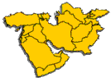
5 THEMES OF GEOGRAPHY
MOVEMENT
PLACE
Human-Environment Interaction
REGION
LOCATION

Slide 5

WHERE DID THE 5 THEMES COME FROM?
The 5 Themes of Geography originated by the National Geographic Society to fulfill a need for geographers

Slide 6
THEME #1
LOCATION
"Where are we?" is the question that the theme Location answers.
Location may be absolute or it may be relative.

Slide 7
THEME #1
ABSOLUTE LOCATION
An absolute location is:
a latitude and longitude (a global location)
a street address (local location).
Examples:
The Oregon Middle School is 42' North latitude and 89' West longitude
Paris, France is 48' North latitude and 2' East longitude
1600 Pennsylvania Avenue, Washington D.C.
601 Pleasant Oak Drive, Oregon, WI

Slide 8

THEME #1
RELATIVE LOCATION
Relative locations compareS a particular place with another.
Examples (All Describing OMS):
Next to Foxboro Golf Course
Five minutes from Subway
South of the police department
Madrid is 626 km far from Barcelona

Slide 9
THEME #1
LOCATION – In YOUR Words
“Location tells where we are and can be absolute or relative. An absolute location is an exact spot that can be found with latitude and longitude or a street address. A relative location is a general area, like when someone says they live by the Oregon Middle School.”

Slide 10
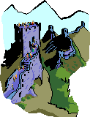
THEME #2
PLACE
What kind of place is it? What do you think of when you imagine China? Japan? Russia? Saudi Arabia?
The image people have of a place is based on their experiences, both intellectual and emotional. People's descriptions of a place reveal their values, attitudes, and perceptions.

Slide 11
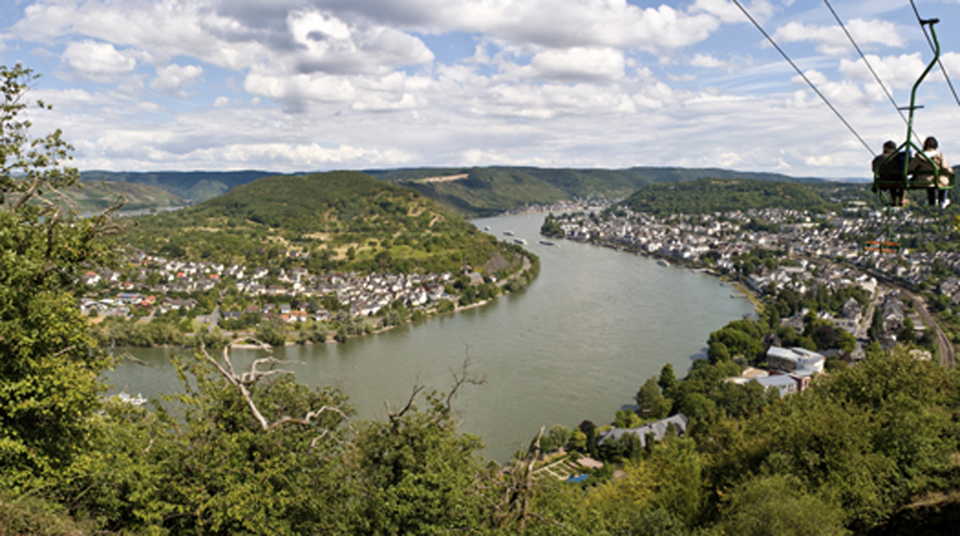
THEME #2
PHYSICAL
CHARACTERISTICS
Physical characteristics are things that occur naturally and would still exist if humans did not wander the earth. They include mountains, rivers, soil, beaches, wildlife, climate and weather.
Examples:
The Pyrenees Mountains
The Nile River
Clearwater Beach (FL)

Slide 12
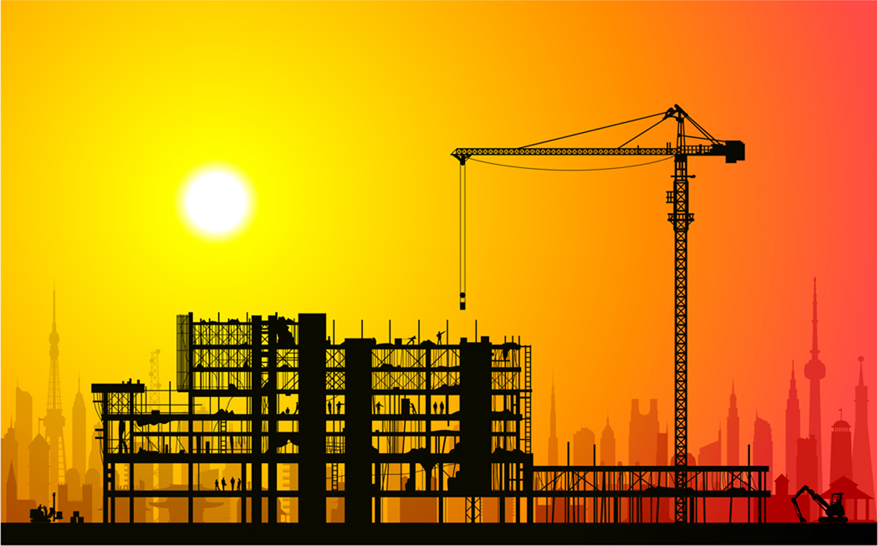
THEME #2
HUMAN
CHARACTERISTICS
Places have human characteristics also.
These characteristics come from the ideas and actions of people that result in changes to the environment, such as buildings, roads, clothing, and food habits. Culture falls in this category.
Examples:
The White House
Rice Fields
The Autobahn

Slide 13
THEME #2
PLACE – In YOUR Words
“There are two different characteristics of place and they describe what a place is like. Places can have physical characteristics like mountains or rivers or they can have human characteristics which are man made, like buildings or towns that are built because land was moved, like New Orleans.”

Slide 14
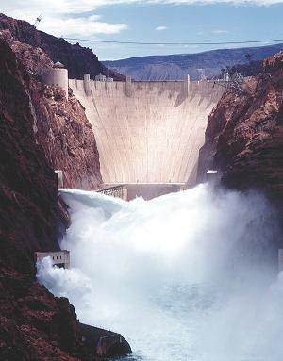
THEME #3
HUMAN ENVIRONMENTAL INTERACTION
How do humans and the environment affect each other?
We change the environment and then sometime Mother Nature changes it back. For example, floods in the mid-West, Hurricane Katrina and earthquakes and mudslides in California.

Slide 15
THEME #3
HUMAN ENVIRONMENTAL INTERACTION
There are three key concepts to human/environmental interaction:
Humans adapt to the environment.
Humans modify the environment.
Humans depend on the environment.

Slide 16
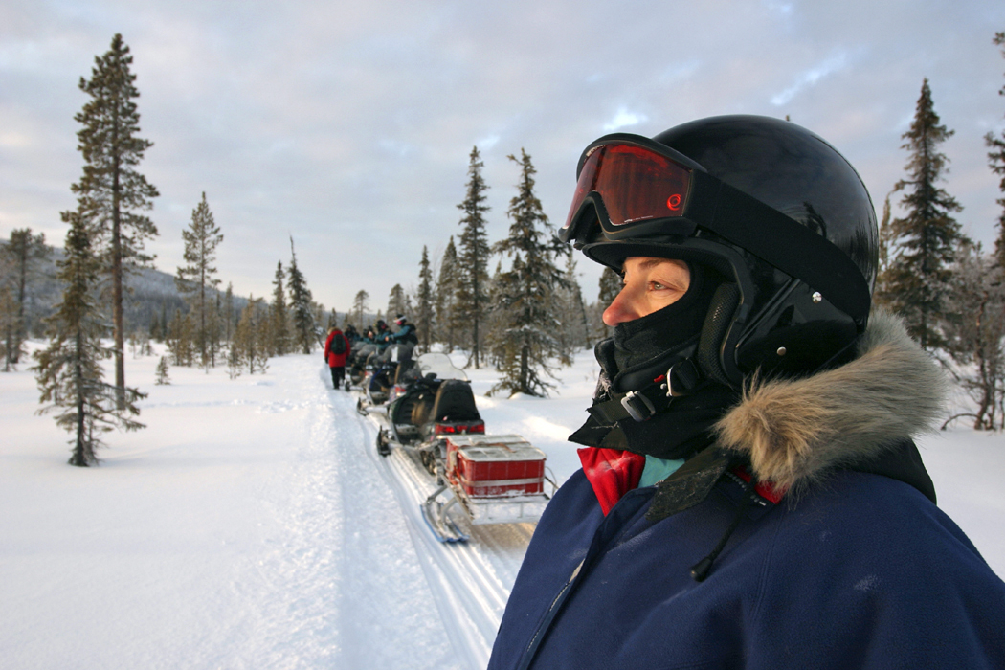
THEME #3
HUMAN ENVIRONMENTAL INTERACTION
Humans Adapt to the Environment
People wear clothing for warm and cold weather.
People wear clothing for rain and sunshine.
People build different houses in different parts of the world.

Slide 17
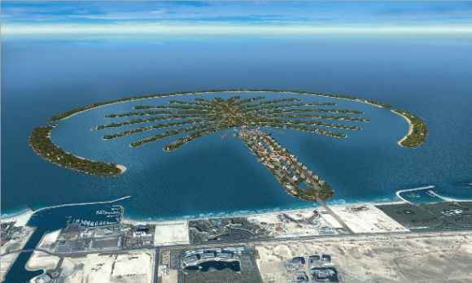
THEME #3
HUMAN ENVIRONMENTAL INTERACTION
Humans Modify the Environment
People heat & cool buildings
People change land formations
People build dams and lakes

Slide 18
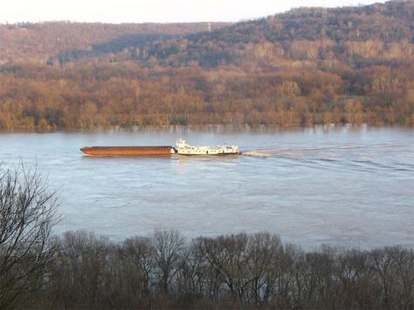
THEME #3
HUMAN ENVIRONMENTAL INTERACTION
Humans Depend on the Environment
People depend on the Mississippi River for transportation.
People depend on Lake Michigan for water.
People depend on the Bering Sea for crab fishing.

Slide 19

THEME #4
MOVEMENT
The movement of people, the import and export of goods, and sharing ideas and information have all played major roles in shaping our world. People everywhere interact. They travel from place to place and they communicate. We live in a global village and global economy.

Slide 20


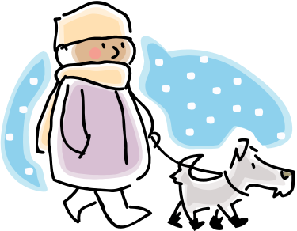
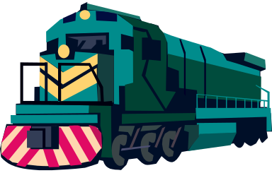
THEME #4
MOVEMENT - PEOPLE
People interact with each other through movement. Humans occupy places unevenly on Earth because of the environment but also because we are social beings.
How do people move?

Slide 21



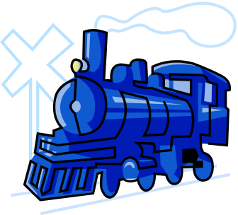
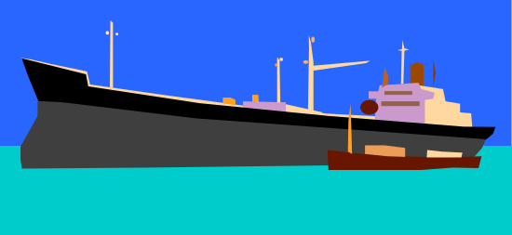
THEME #4
MOVEMENT - GOODS
We interact with each other through trade, including the importing and exporting of goods.
How does that pencil in your
hand get onto your desk?

Slide 22



THEME #4
MOVEMENT
IDEAS/INFORMATION
We interact with each other through methods of mass communication such as e-mail, the internet and telephones.
Have you ever communicated with someone in another country?

Slide 23
THEME #4
MOVEMENT – In YOUR Words
“There are three types of movement. People move by walking and using transportation like cars and planes. Goods like imports and exports are traded and move around the world. Mass communication or ideas travel from one place to another place within seconds. Examples are text messaging and instant messaging.”

Slide 24
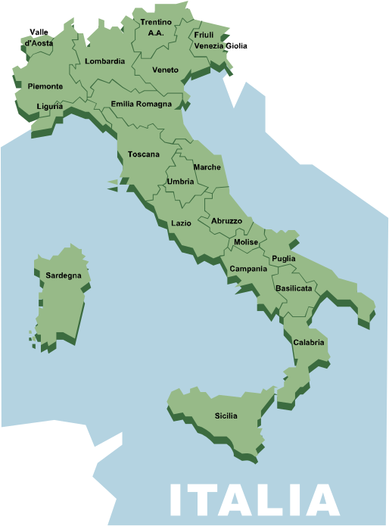
THEME #5
REGION
A region is the basic unit of study in geography. A region is an area that displays a unity in terms of the government, language, or possibly the landform or situation.
Regions are human constructs that can be mapped and analyzed.
There are three basic types of regions.

Slide 25
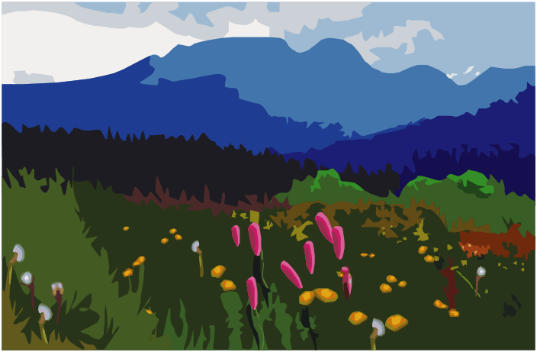
THEME #5
REGION
FORMAL REGIONS
Formal regions are those defined by governmental or administrative boundaries (i. e., United States, Wisconsin, Spain).
These regional boundaries are not open to dispute, therefore physical regions fall under this category (i. e., The Rockies, the Mississippi River).

Slide 26
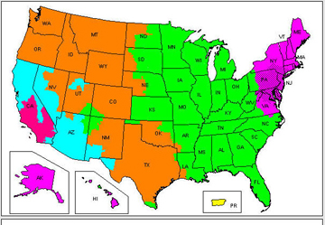
THEME #5
REGION
FUNCTIONAL REGIONS
Functional regions are those defined by a function (i. e., UPS, United Airlines Service area or a newspaper service area).
If the function ceases to exists, the region no longer exists.
UPS Delivery Zones

Slide 27
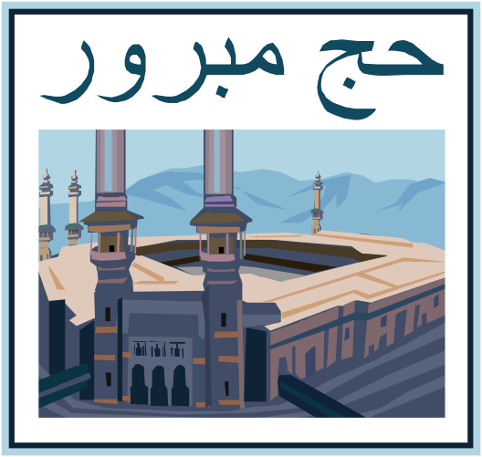
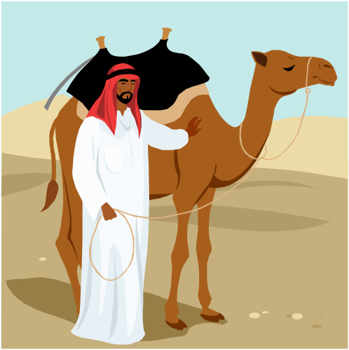
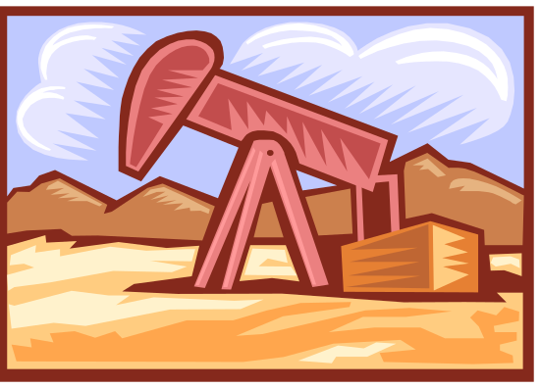
THEME #5
REGION
VERNACULAR REGIONS
Vernacular regions are those loosely defined by people's perception (i. e., The South, The Middle East).

Slide 28
THEME #5
REGION – In YOUR Words
“Regions can be explained in three ways. One region is called formal, where there are boundaries that are made by the government or physical features. Another region is functional, a lot of businesses use these to map out territories for selling or traveling. The last region is perceptual or vernacular, these regions are formed by the way people think about an area, like the middle east. One place can be part of many regions.”

