Slide 1


Types of Economic Systems

Slide 2

Four Types of Economic Systems:
There are four types of economies:
  Pure Market Economy
  Pure Command Economy
  Traditional Economy
  Mixed Economy
  Let’s review each of these types of economies.

Slide 3
Pure Market Economy
NO government involvement in economic decisions. Private firms account for all production.
Consumers decide WHAT should be produced. They do this through the purchases they make.
Businesses determine HOW the products will be produced. They must be competitive.
WHO buys the products? The people with the most money are able to buy more goods and services.

Slide 4

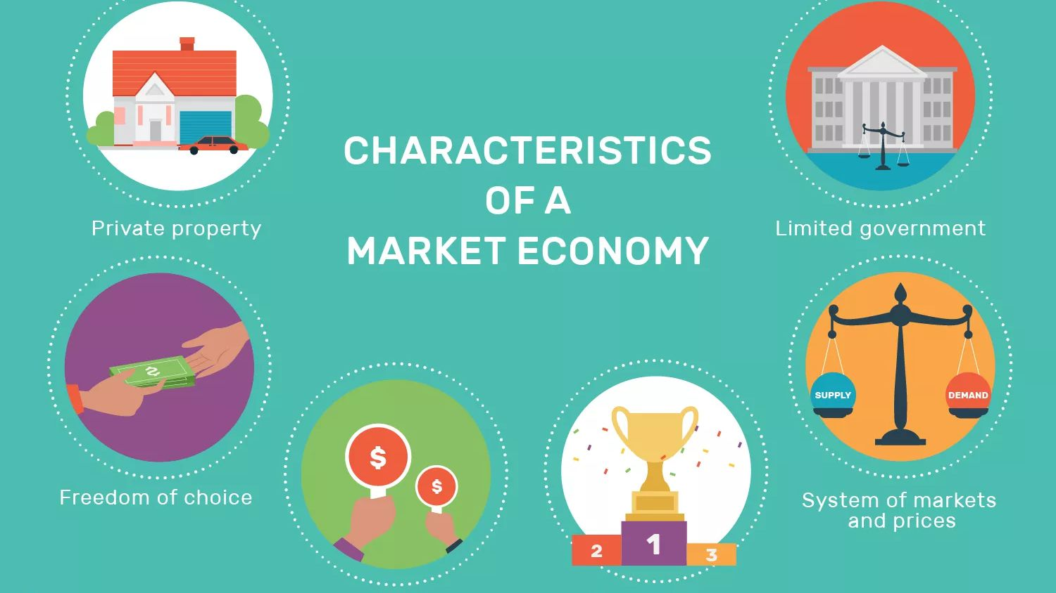

Problems
Some people have few resources to buy, big social differences.
No public goods. - national defense

Slide 5
Pure Command Economy
All resources are government-owned.
One person (dictator) or a group of officials decide WHAT products are needed.
The government runs all businesses, controls all employment, and decides HOW goods and services will be produced.
The government decides WHO receives the products that are produced.

Slide 6
CHARACTERISTICS OF COMMAND ECONOMY
GOVERNMENT CONTROLS WHAT IS PRODUCED
STATE PROPERTY
NO PRIVATE PROPERTY
NO COMPETENCE
GOVERNMENT FIXES PRICES
VERY LIMITED SUPPLY OF GOODS

Slide 7
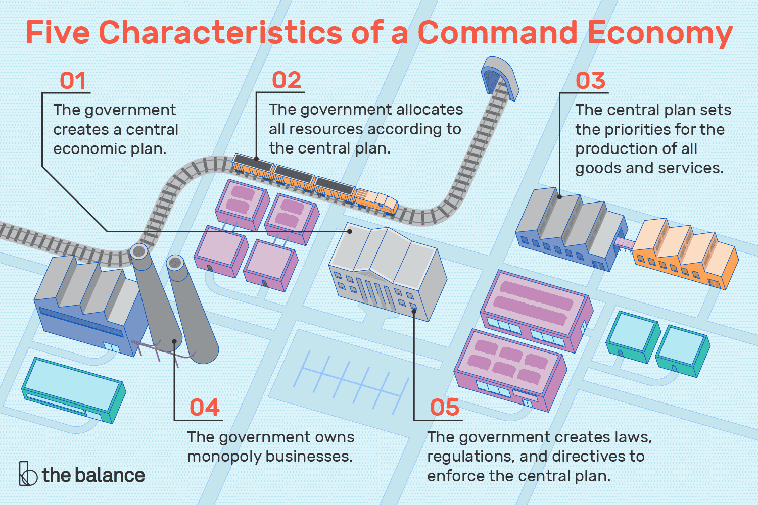
Problems
Consumers get low priority.
Little freedom of choice – few products.
Resources owned by the state are often wasted – individuals don’t care if they don’t own it.

Slide 8
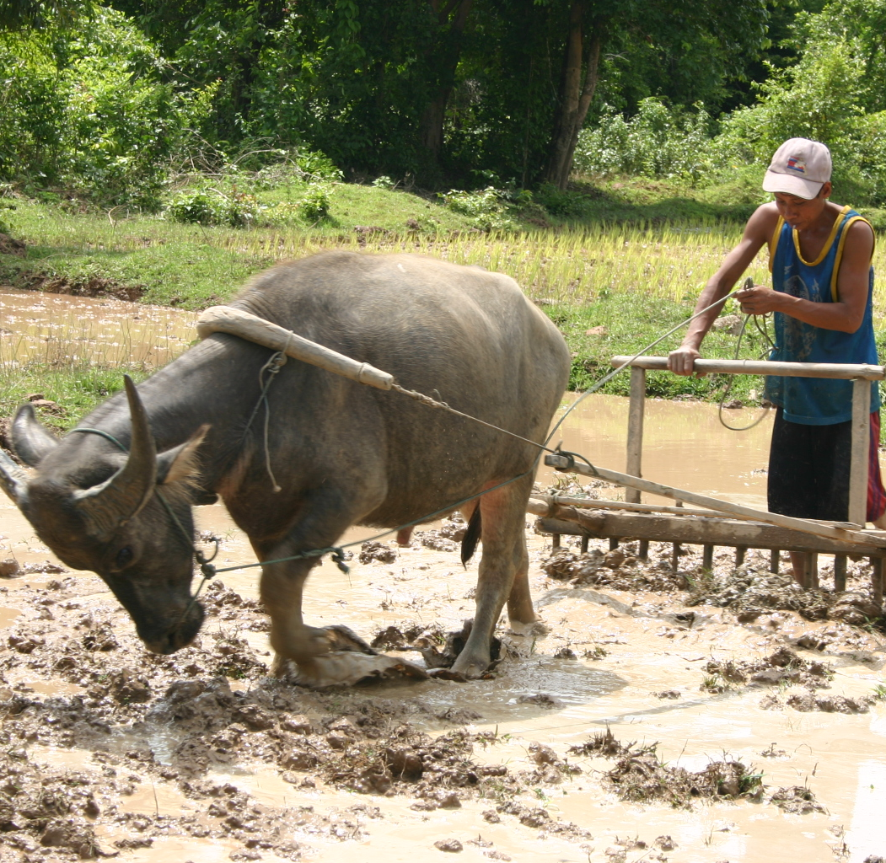
Traditional Economy
Economy is shaped largely by custom or religion.
Customs and religion determine the WHO, WHAT, and HOW.
Example: India has a caste system which restricts occupational choice. (A social class separated from others by distinctions of hereditary rank, profession, or wealth.)

Slide 9
Mixed Economy
Most economies in the world today are mixed.
Classification is based on how much government intervention there is.
In the U.S. the government accounts for about 1/3 of all U.S. economic activity.

Slide 10
Government Philosophies
Countries also have different philosophies of government which reflect not only the laws and rules, but how individuals are treated.
There are three political philosophies:
Capitalism
Socialism
Communism

Slide 11
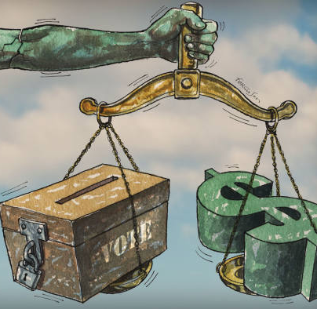
Capitalism
  Capitalism features private ownership of businesses and marketplace competition.
  It is the same as a free enterprise system.
  The political system most frequently associated with capitalism is democracy.

Slide 12
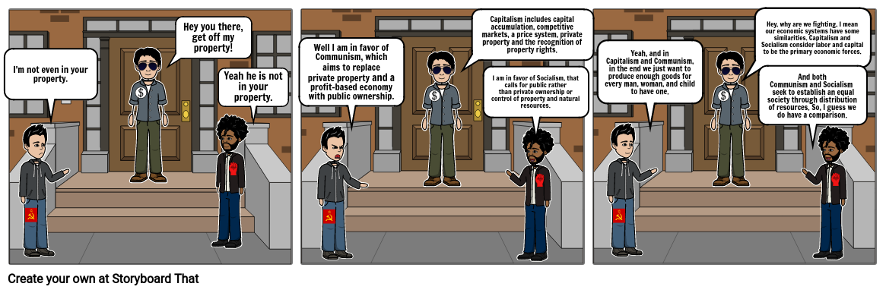
Socialism
  The main goal of socialism is to keep prices low for all people and to provide employment for many.
  The government runs key industries, generally in telecommunications, mining, transportation, and banking.
  Socialist countries tend to have more social services.

Slide 13
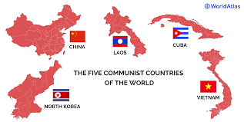
Communism
  Have a totalitarian form of government; this means that the government runs everything and makes all decisions.
  Theoretically, there is no unemployment in communist countries.
  The government decides the type of schooling people will receive and also tells them where to live.

Slide 14
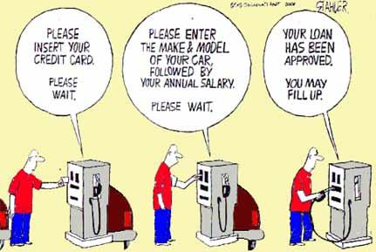
Do you think the oil industry is a monopoly?

