Slide 1
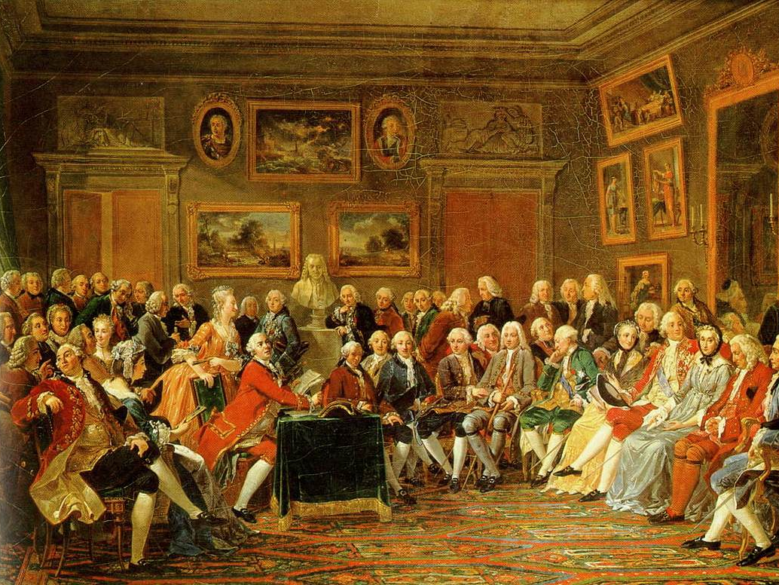
The Enlightenment
Essential Question- How much power should government have?

Slide 2
Review- Renaissance and Scientific Revolution
Before the Enlightenment took hold of Europe, the Renaissance had occurred. The Renaissance led to the Scientific Revolution. All of these time periods are defined by a sense of inquiry, or questioning the established order to find better ways of doing things.
What was the Renaissance?
Golden Age of arts and literature in Western Europe
Rebirth of classical learning
What was the Scientific Revolution?
Scientists begin to question traditional beliefs
Use of logic and reason, observation and experimentation
Renaissance
Scientific
Revolution
The Enlightenment

Slide 3
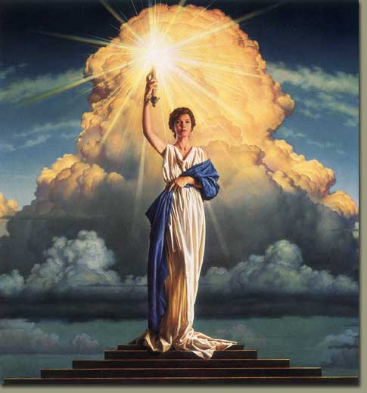
The Enlightenment
Also known as the Age of Reason, the Enlightenment grew out of the Scientific Revolution of the 1500s & 1600s
If scientists could understand the physical world using reason, then reason could also be used to discover natural laws which shape the human experience.
Natural Laws- unchanged principles, discovered through reason, that govern all human conduct

Slide 4

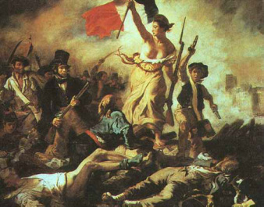
The Enlightenment
Using methods of modern science, reformers set out to study human behavior and solve the political, social and economic problems
of society using reason
Enlightened thinkers, called philosophes,
were concerned with the relationship between government and the people, and their ideas were used by many modern nations in the creation of government
Resulted in the move away from absolutism and divine right (religion) and toward democracy and individual rights (secularism)
→ encouraged revolutionary leaders throughout Europe and the Americas

Slide 5
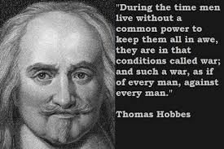
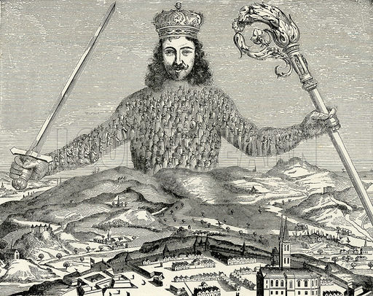
Thomas Hobbes
Argued that people are cruel, greedy, and selfish- as a result government (law) protects people from each other
Without government, people would fight, rob, and oppress one another
Social Contract- an arrangement where people give up their rights to be protected by the government
Supported absolute monarchs
Wrote about his ideas in The Leviathan

Slide 6
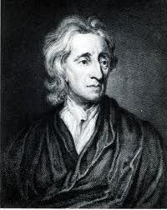
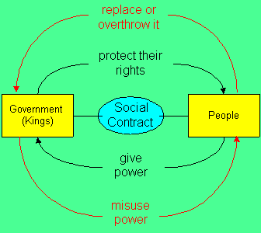
John Locke
Believed that people are basically moral and reasonable. They want to do the right thing.
All people are born free & equal with three natural rights- life, liberty, and property
Government exists at the consent of the governed to protect their rights. If the government fails to protect these rights, the contract is broken and the people may change or replace the government.
Wrote Two Treatises of Government stressing the best governments had limited power—not an absolute monarchy

Slide 7

Montesquieu
Criticized absolute monarchies—admired Britain's limited monarchy and said it protected people’s rights.
Believed having 3 branches in government would prevent tyranny
  Having a separation of powers would prevent any one branch from gaining too much power over the other two
Tyranny: absolute ruler abuses power; unfair and harsh rule
“In order to have…liberty, it is necessary that government be set up so that one man need not be afraid of another.”

Slide 8
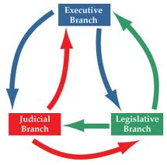
Montesquieu
Believed gov’t should be split into these three branches, and that each branch should be able to serve as a check on the other two:
-Executive (enforces laws)
-Legislative (makes the laws)
-Judicial (applies laws)
Name one country that adopted Montesquieu’s idea of separation of powers

Slide 9



Voltaire
“I do not agree with a word you say, but I will defend to the death your right to say it.”
Believed in the freedom of press and used it to expose the abuses of corrupt political and church leaders.
Fought for civil liberties- rights/freedoms of citizens
  Freedom of Speech
  Freedom of Religion
  Separation of Church and State
Believed that humanity’s worst enemies
were intolerance, prejudice & superstition
His writings angered government and church officials. He was imprisoned and forced into exile. To stop his ideas from spreading his books and writings were outlawed and burned.

Slide 10
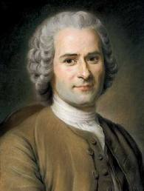
Jean Jacques Rousseau
Believed that people were naturally good, but were corrupted by society
Unequal distribution of property was an especially great evil of society
Stressed the importance of the general will- the will of the people as a whole
Believed the good of the community should be placed above individual interests- common good
Hated all forms of political and economic oppression

Slide 11

Rousseau’s Social Contract
Rousseau wrote The Social Contract
where he lays out his ideas of
government and society
Society places too many limits on
peoples’ behavior- some controls are necessary but should be minimal
Only governments that had been freely elected should impose law
Sovereignty (the power to make laws) should be in the hands of the people, and therefore the only good government is a direct democracy
Remember— a social contract is an arrangement where people give up their rights to be protected by the government

Slide 12

New Economic Ideas
Some enlightened thinkers, called physiocrats, attempted to solve the economic problems of the day in the same manner that others tried to solve political problems.
They argued that there were natural laws of economics, just as there were natural laws for society/gov’t
These thinkers rejected mercantilism and promoted laissez faire economic practices. In a laissez faire economy, the government does not interfere with the operations of business.
Mercantilism required government regulation of the economy to achieve a favorable trade balance.
Laissez Faire = Hands Off

Slide 13

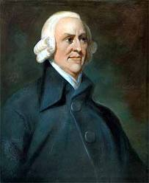
Adam Smith
Adam Smith was a Scottish economist who greatly admired the physiocrats.
Smith wrote The Wealth of Nations, in which he argues for a free market without government interference.
He believed that the forces of supply and demand should run the market—whenever there was a demand for goods or services, suppliers would try to meet that demand in order to gain profits.
Though Smith believed the government should stay out of the economy, he believed that it had a duty to protect society, administer justice, and provide public works.

Slide 14
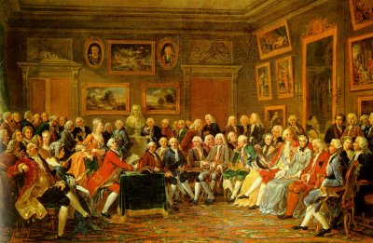
Enlightenment for Women
Natural Rights were for men only.
Though enlightened thinkers said that
women had natural rights, they were
limited to the areas of home and
family.
Some women were exposed to
enlightened philosophy through
salons. Prominent and wealthy women would host informal parties where enlightened thinkers could gather and discuss literature, the arts, science, philosophy and politics.
Salons allowed Enlightenment ideas to spread- because they were hosted by women, guests were forced to speak in vernacular.
Vernacular- common language

Slide 15
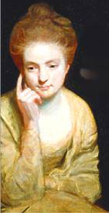
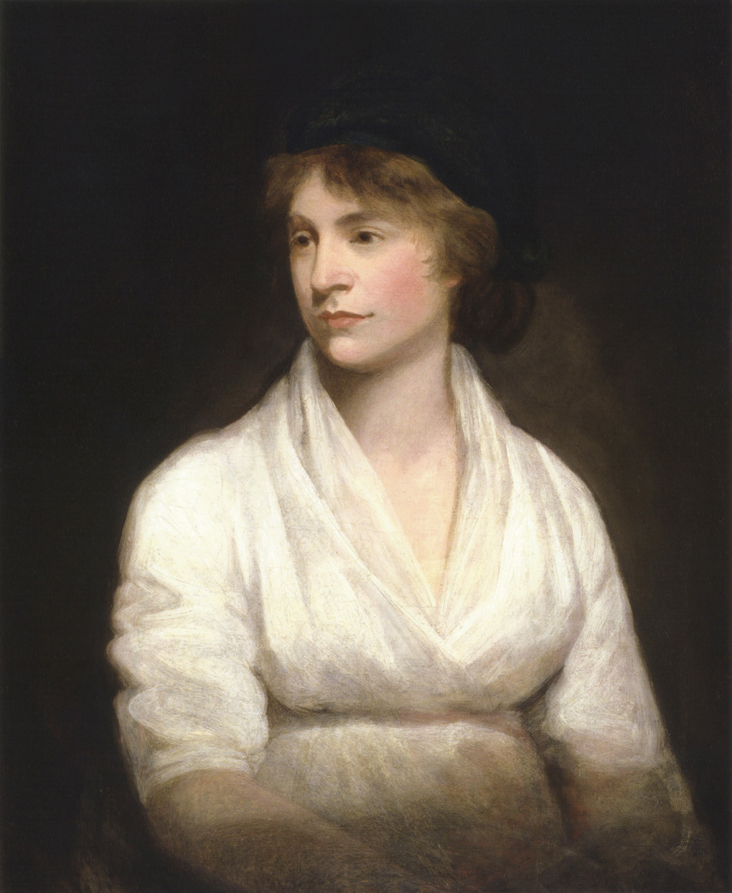
Enlightened Women
Mary Astell
  Wrote A Serious Proposal to the Ladies (1694)
  Questioned the lack of educational opportunities for women
  Criticized the unequal relationship between men & women in a marriage
Mary Wollstonecraft
  Wrote A Vindication of the Rights of
  Women (1792)
  Women need education to participate
  equally in public life

Slide 16
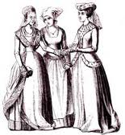
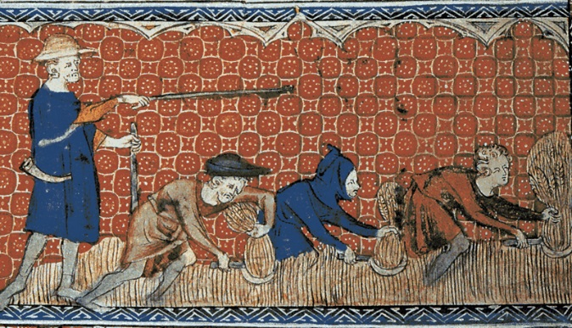
The Spread of Enlightenment
In addition to salons, the theories of enlightened thinkers spread rapidly through the distribution of pamphlets and books. People began to question the “traditional way” of doing things.
Before | After
-Absolute monarchs rule by divine right -Church has authority -Strict separation between nobles and peasants -Suffer in life and be rewarded in heaven | -Government should work to protect the people -Flexible social classes- all people have rights -Happiness on earth

Slide 17
Review
Writers of the Enlightenment were primarily interested in
changing the relationship between people and their government
supporting the divine right theory
debating the role of the church in society
promoting increased power for European monarchs

Slide 18
Review
John Locke and Jean Jacques Rousseau would be most likely to support
a return to feudalism in Europe
a government ruled by a divine right monarchy
a society ruled by the Catholic Church
a society in which the people chose the ruler

Slide 19
Review
Which statement best describes a change that occurred during both the Renaissance and the Enlightenment?
feudalism became the dominant political system
a new questioning spirit and attitude emerged
technology and science were considered unimportant
the use of reason and logic were discouraged

Slide 20
Review
Which statement reflects an argument of Enlightenment philosophers against the belief in the divine right of kings?
god has chosen all government rulers
independence is built by military might
the power of the government is derived from the governed
a capitalist economic system is necessary for democracy

