Slide 1
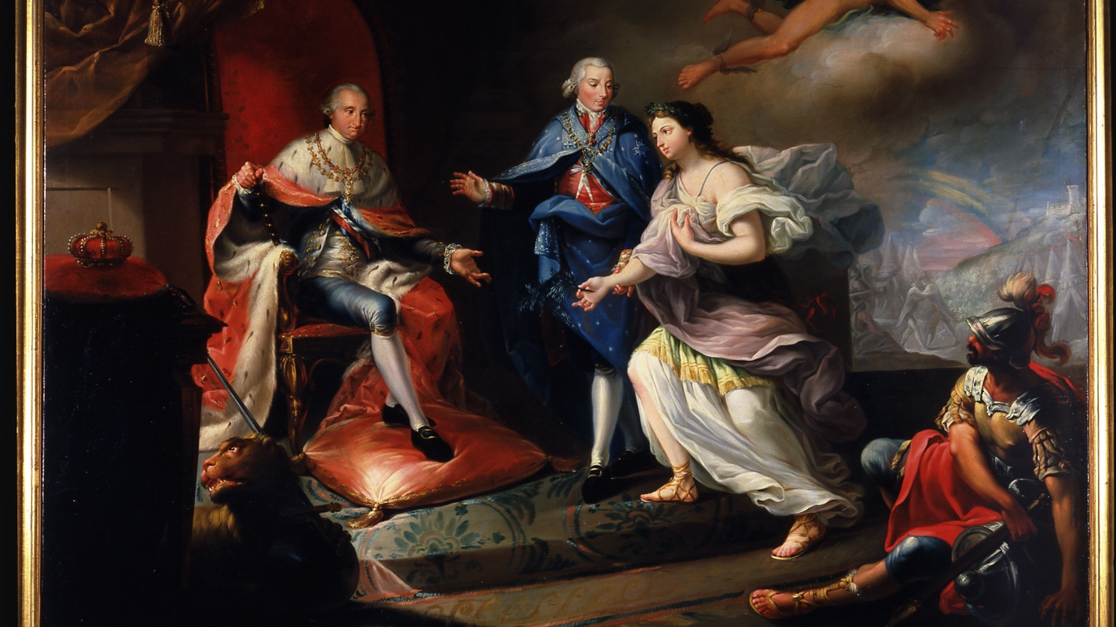
CHARLES IV AND THE FALL OF THE ANCIEN REGIME IN SPAIN

Slide 2
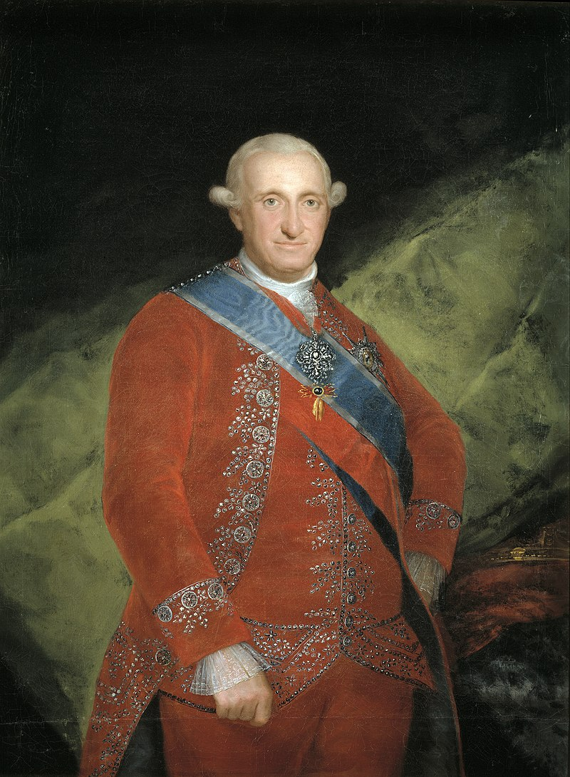
INTRODUCTION
During his reign, Spain entered a series of disadvantageous alliances and his regime constantly sought cash to deal with the exigencies of war. He detested his son and heir Ferdinand, who led the unsuccessful Conspiracy of El Escorial and later forced Charles's abdication after the Tumult of Aranjuez in March 1808, along with the ouster of his widely hated first minister Manuel de Godoy. Summoned to Bayonne by Napoleon Bonaparte, who forced Ferdinand VII to abdicate, Charles IV also abdicated, paving the way for Napoleon to place his older brother Joseph Bonaparte on the throne of Spain. The reign of Charles IV turned out to be a major turning point in Spanish history.[

Slide 3
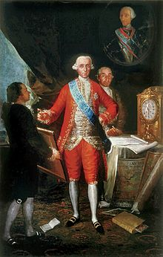
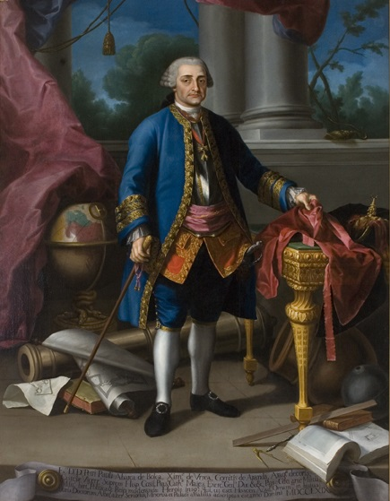
BEGINNING OF THE REIGN
Upon ascending to the throne, Charles IV intended to maintain the policies of his father and, accordingly, retained his prime minister, the Count of Floridablanca.
In 1792, Floridablanca was replaced with the Count of Aranda. However, in the wake of the war against Republican France, Manuel Godoy emerged as Prime Minister replacing Count of Aranda.

Slide 4
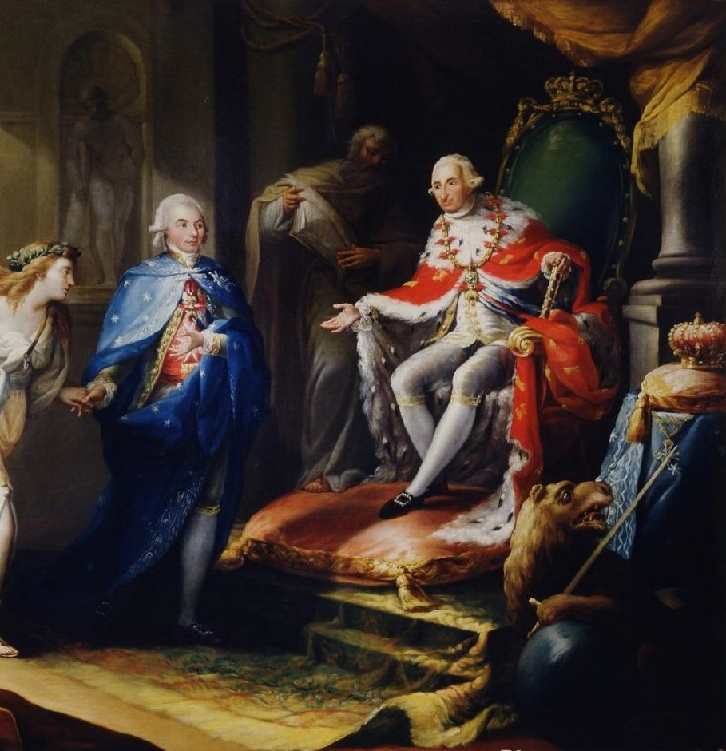
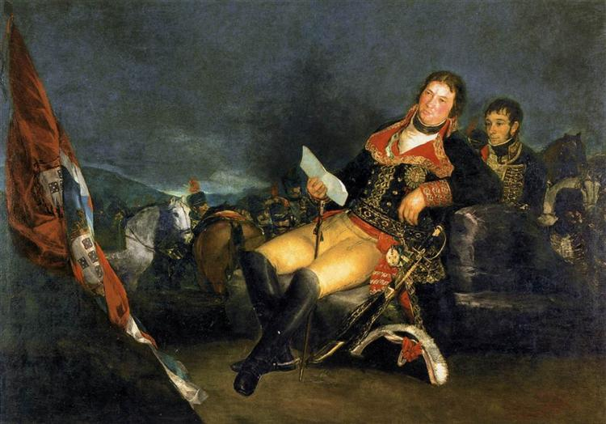
FIRST STAGE OF GODOY AS PRIME MINISTER
The French Revolution conditioned Spanish politics. His first measures were aimed at saving the life of Louis XVI. Despite the efforts of all the European courts, the French monarch was guillotined in 1793.
This generalized a war of the European powers against revolutionary France known as the War of the Convention, in which Spain participated and was defeated by republican France.
Godoy signed the Peace of Basel with France in 1795. The French returned the occupied places to Spain in Exchange of part of the island of Hispaniola. In gratitude, Charles IV granted Godoy the title of Prince of Peace.

Slide 5
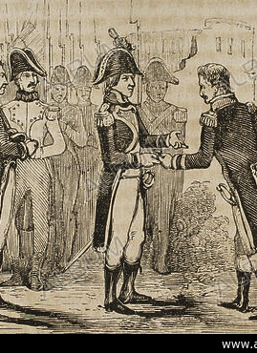
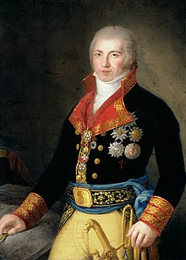
In 1796, after the reign of Terror, Godoy signed the Treaty of San Ildefonso wiht France. Spain became an allí of France and this caused the confrontation with Great Britain. The Spanish navy was defeated and the British occupied Trinidad and Puerto Rico. This caused the fall of Godoy in 1798

Slide 6
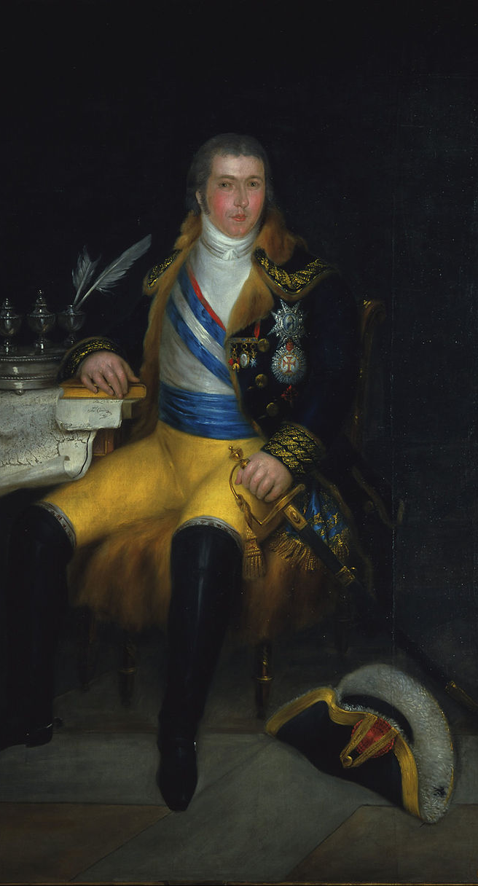
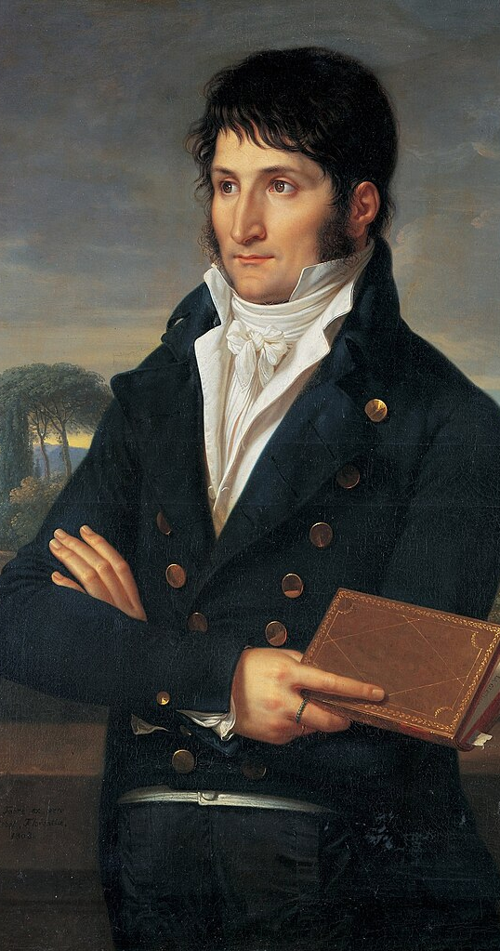
GODOY´S SECOND TURN AS PRIME MINISTER
Napoleon's rise to power altered international relations and renewed the alliance with France.
Napoleon needed, in his fight against the British, to have the collaboration of Spain.
For this reason, he pressured Charles IV to restore his trust in Godoy, who returned to power in 1800 by signing the Aranjuez Convention with Napoleon, which reopened the conflict with Great Britain.

Slide 7
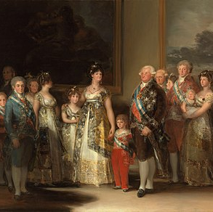
GODOY´S SECOND TURN AS PRIME MINISTER
In 1801, Godoy declared war on Portugal, Britain's main ally on the continent, before France did so.
This conflict, known as the War of the Oranges, meant the occupation of Olivenza by Spain.

Slide 8
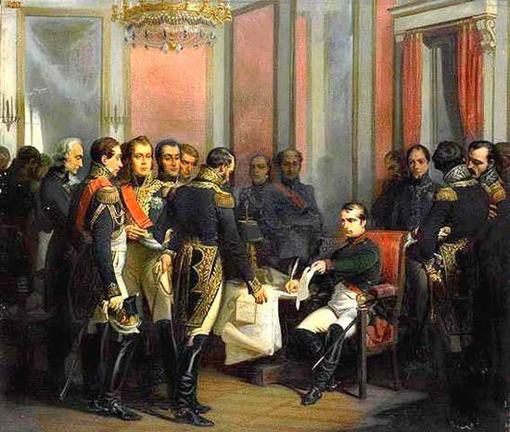
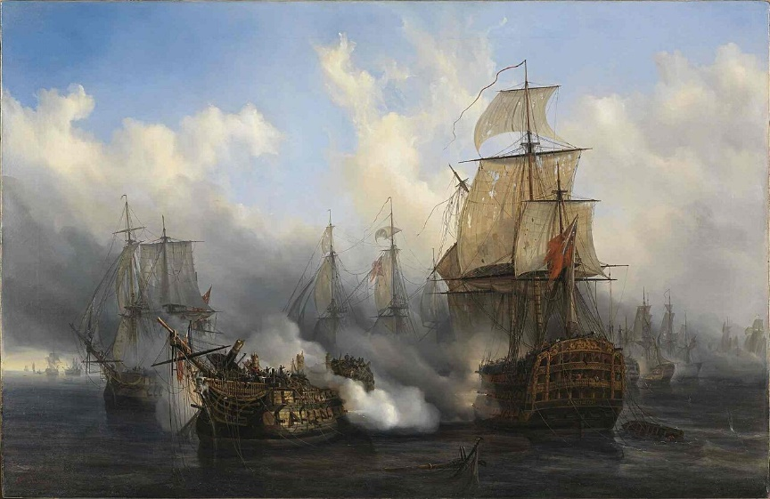
GODOY´S SECOND TURN AS PRIME MINISTER
.
In 1805, the defeat of the Franco-Spanish squadron in the Battle of Trafalgar by the British navy changed the situation. With the naval hegemony of Great Britain, Napoleon resorted to the continental blockade, a measure to which Spain joined. In 1807 the Treaty of Fontainebleau was signed, which established the division of Portugal between France, Spain and Godoy himself, and the right of passage through Spain for the French troops in charge of its occupation.

Slide 9
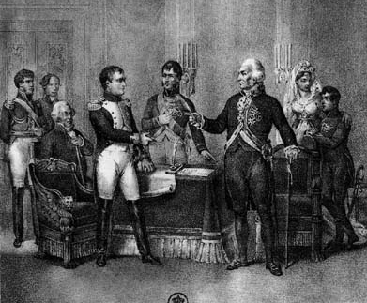
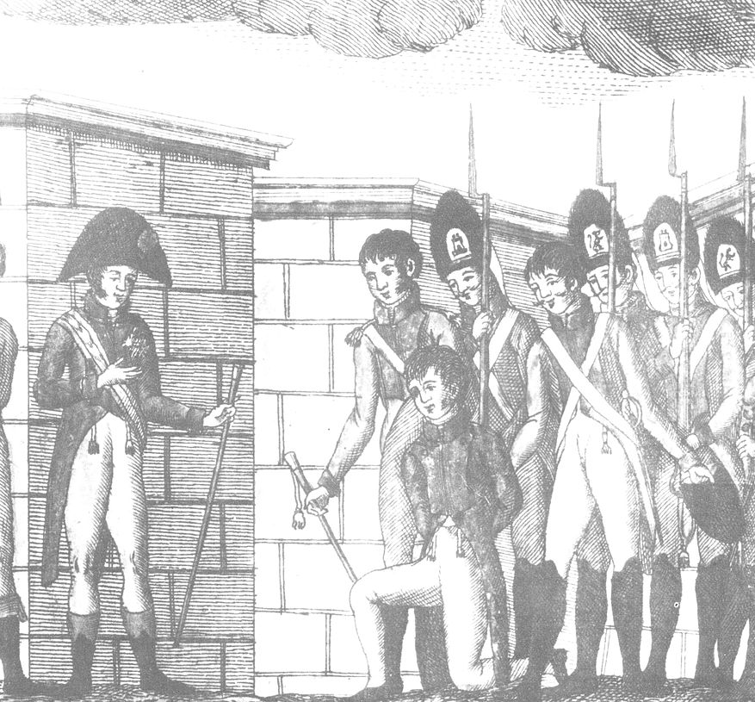
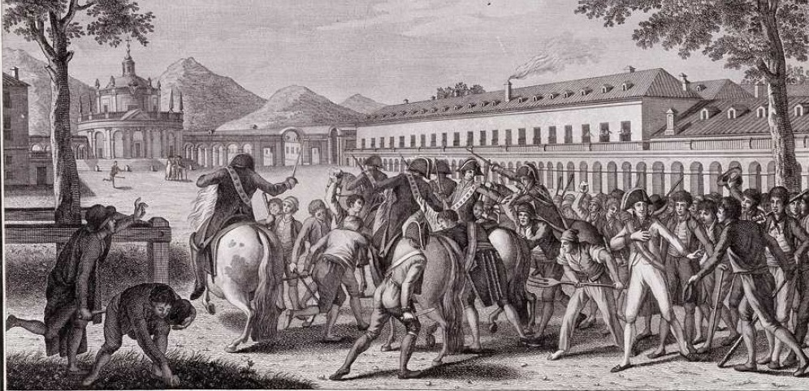
THE FINAL CRISIS
The presence of French soldiers in Spanish territory increased opposition towards Godoy. At the end of 1807 the El Escorial Plot took place, a conspiracy led by Fernando, Prince of Asturias, who sought the replacement of Godoy and the dethronement of his own father.
In 1808, the Aranjuez mutiny occurred, a popular uprising fueled by the nobles opposed to Godoy, against the kings, taking advantage of their presence in the palace of Aranjuez. Godoy was taken prisoner by the mutineers. Charles IV abdicated to his son Ferdinand VII.

Slide 10
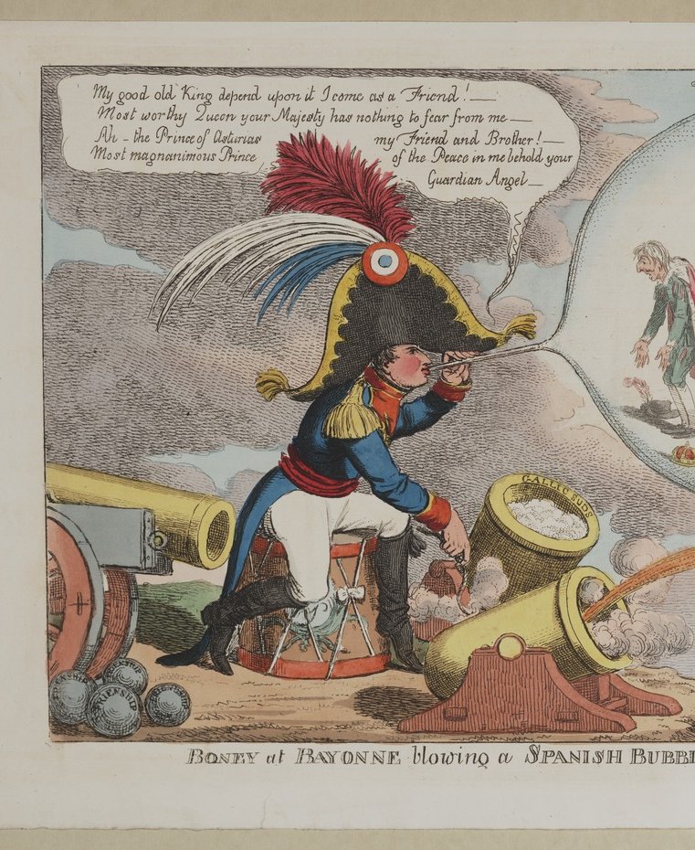
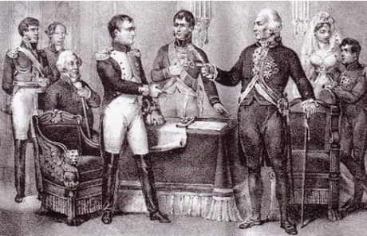
THE END OF CHARLES´ IV REIGN
His reign ended in 1808 when, as a result of the Aranjuez mutiny, he abdicated in favor of his son, Prince Fernando.
In May of the same year, King Ferdinand VII returned the Throne to his father although he, in turn, had ceded his rights to the Crown to Napoleon Bonaparte the day before in what would be known as the Bayonne abdications. This evento marked the end of the reign of Charles IV.

