Slide 1
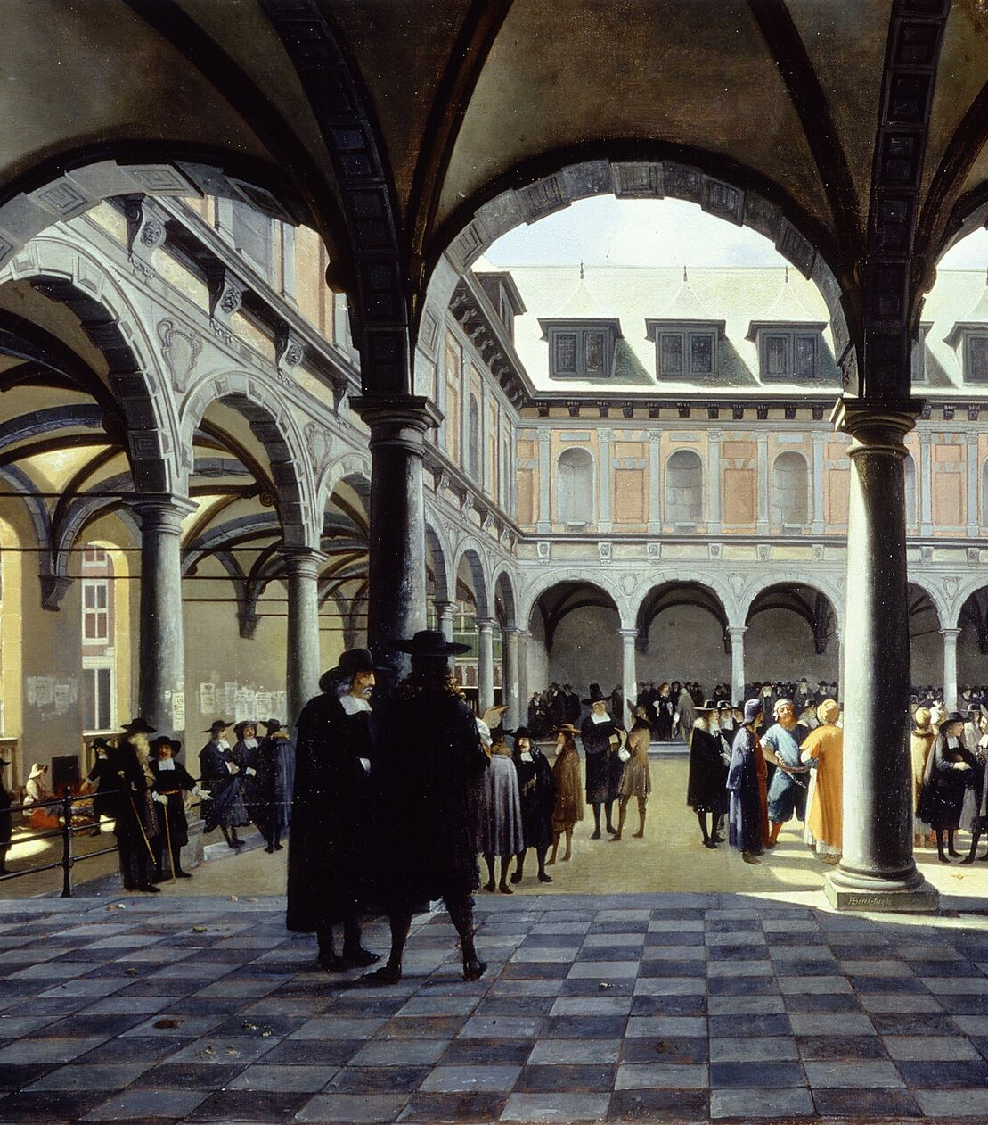
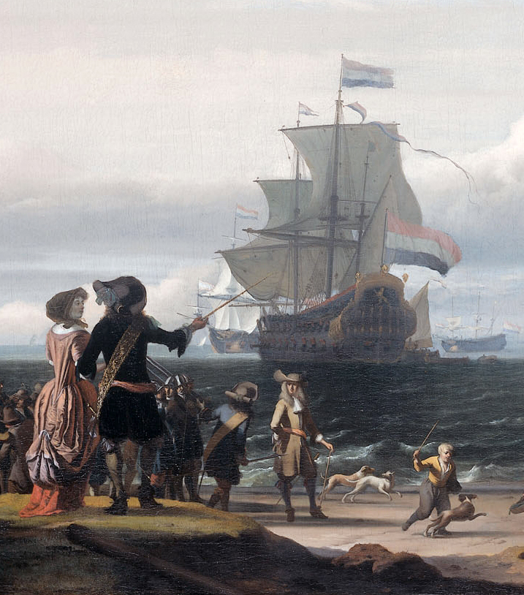
The Dutch Golden Age
1588-1660 AD

Slide 2
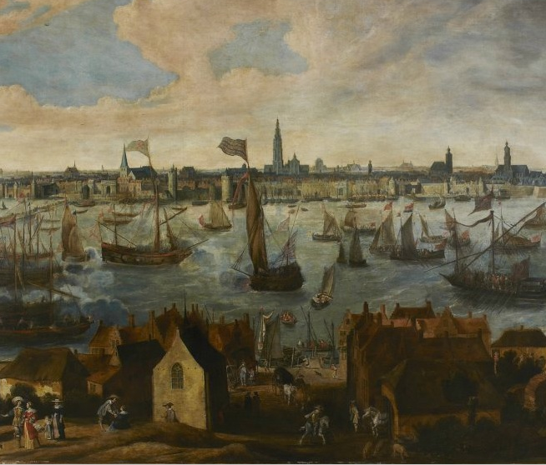
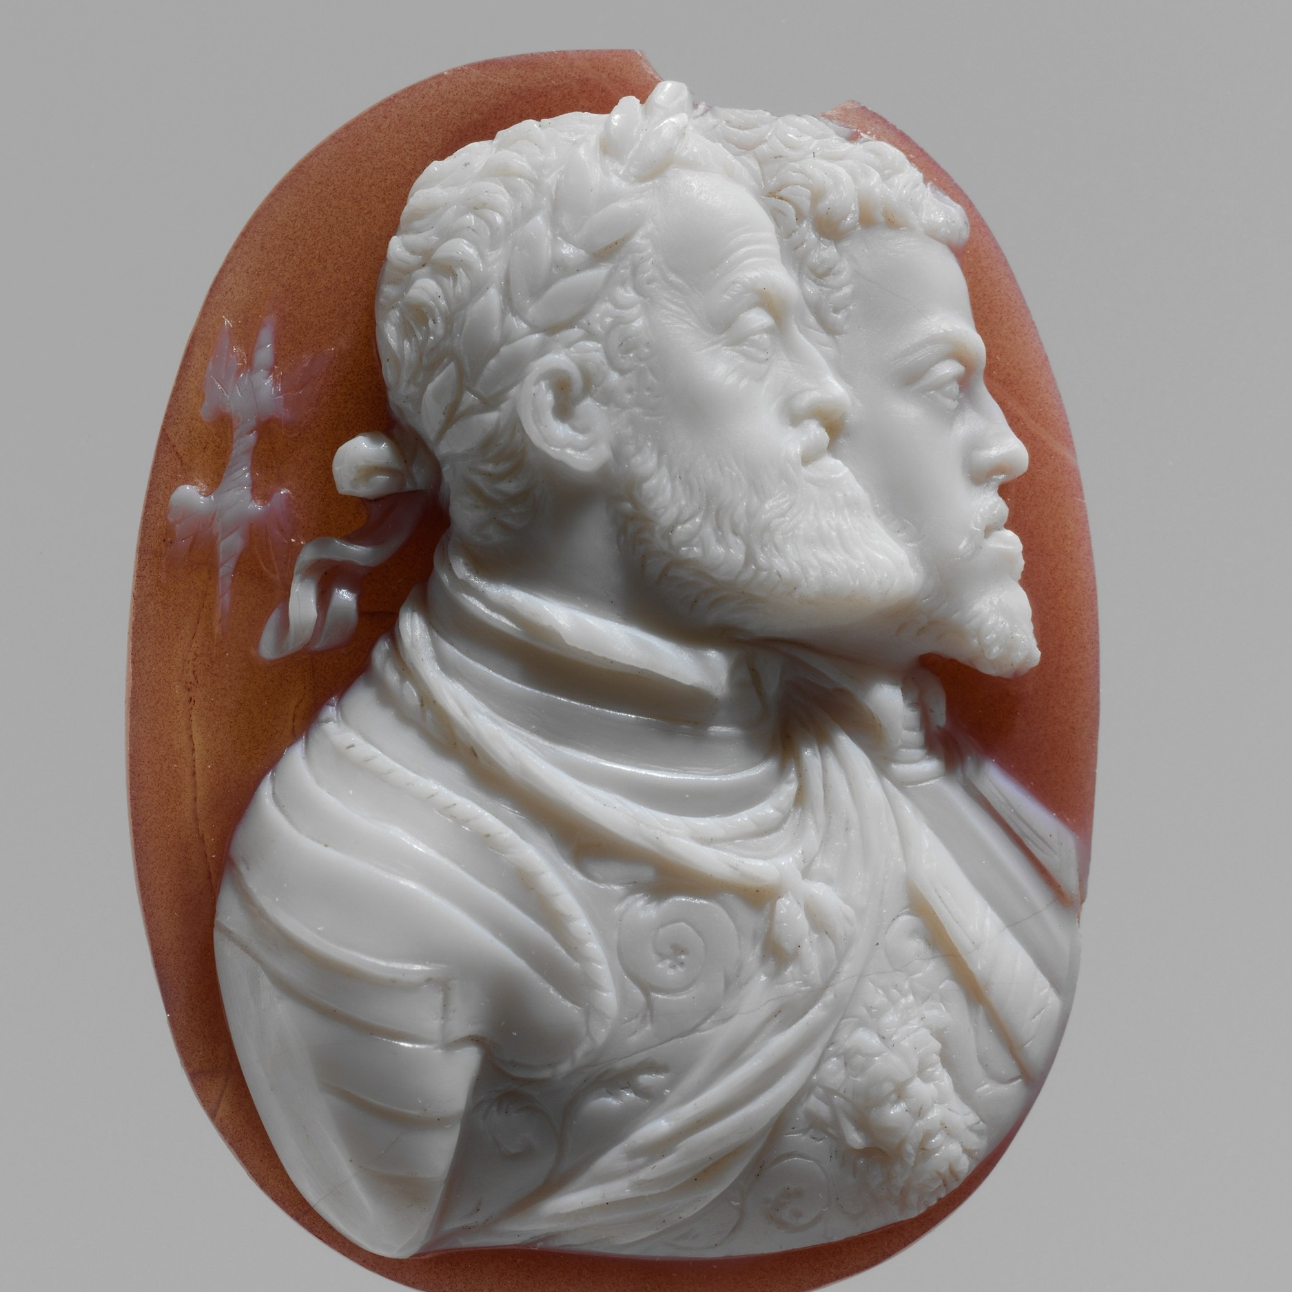
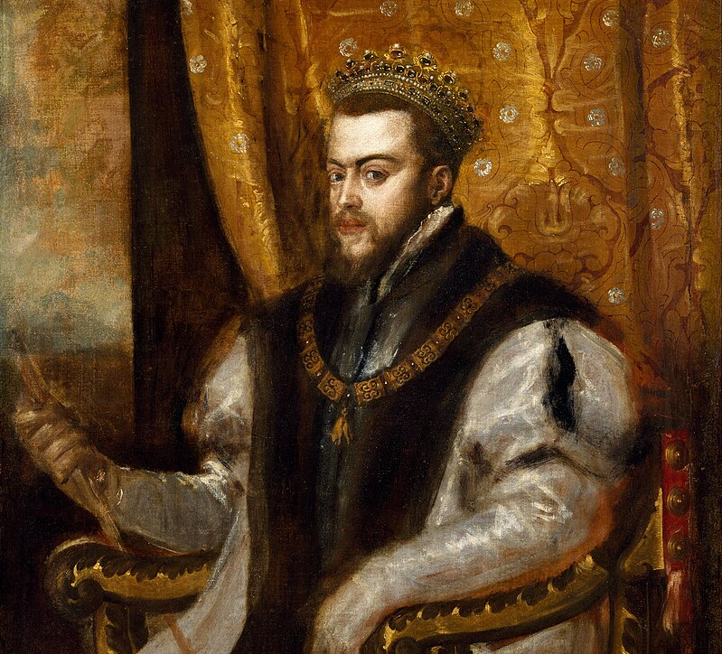
In 1568, the Dutch people of the Netherlands rose up against their overlord the Spanish King Philip II in the Dutch Revolt.
A member of the Habsburg dynasty, which also ruled the Holy Roman Empire, Philip II inherited the region from his father Charles V.
Notes:
Please note that the Netherlands was not ”part of the Spanish Empire,” it was supposed to be a separate domain. Its ruler just happened to also be the King of Spain.

Slide 3
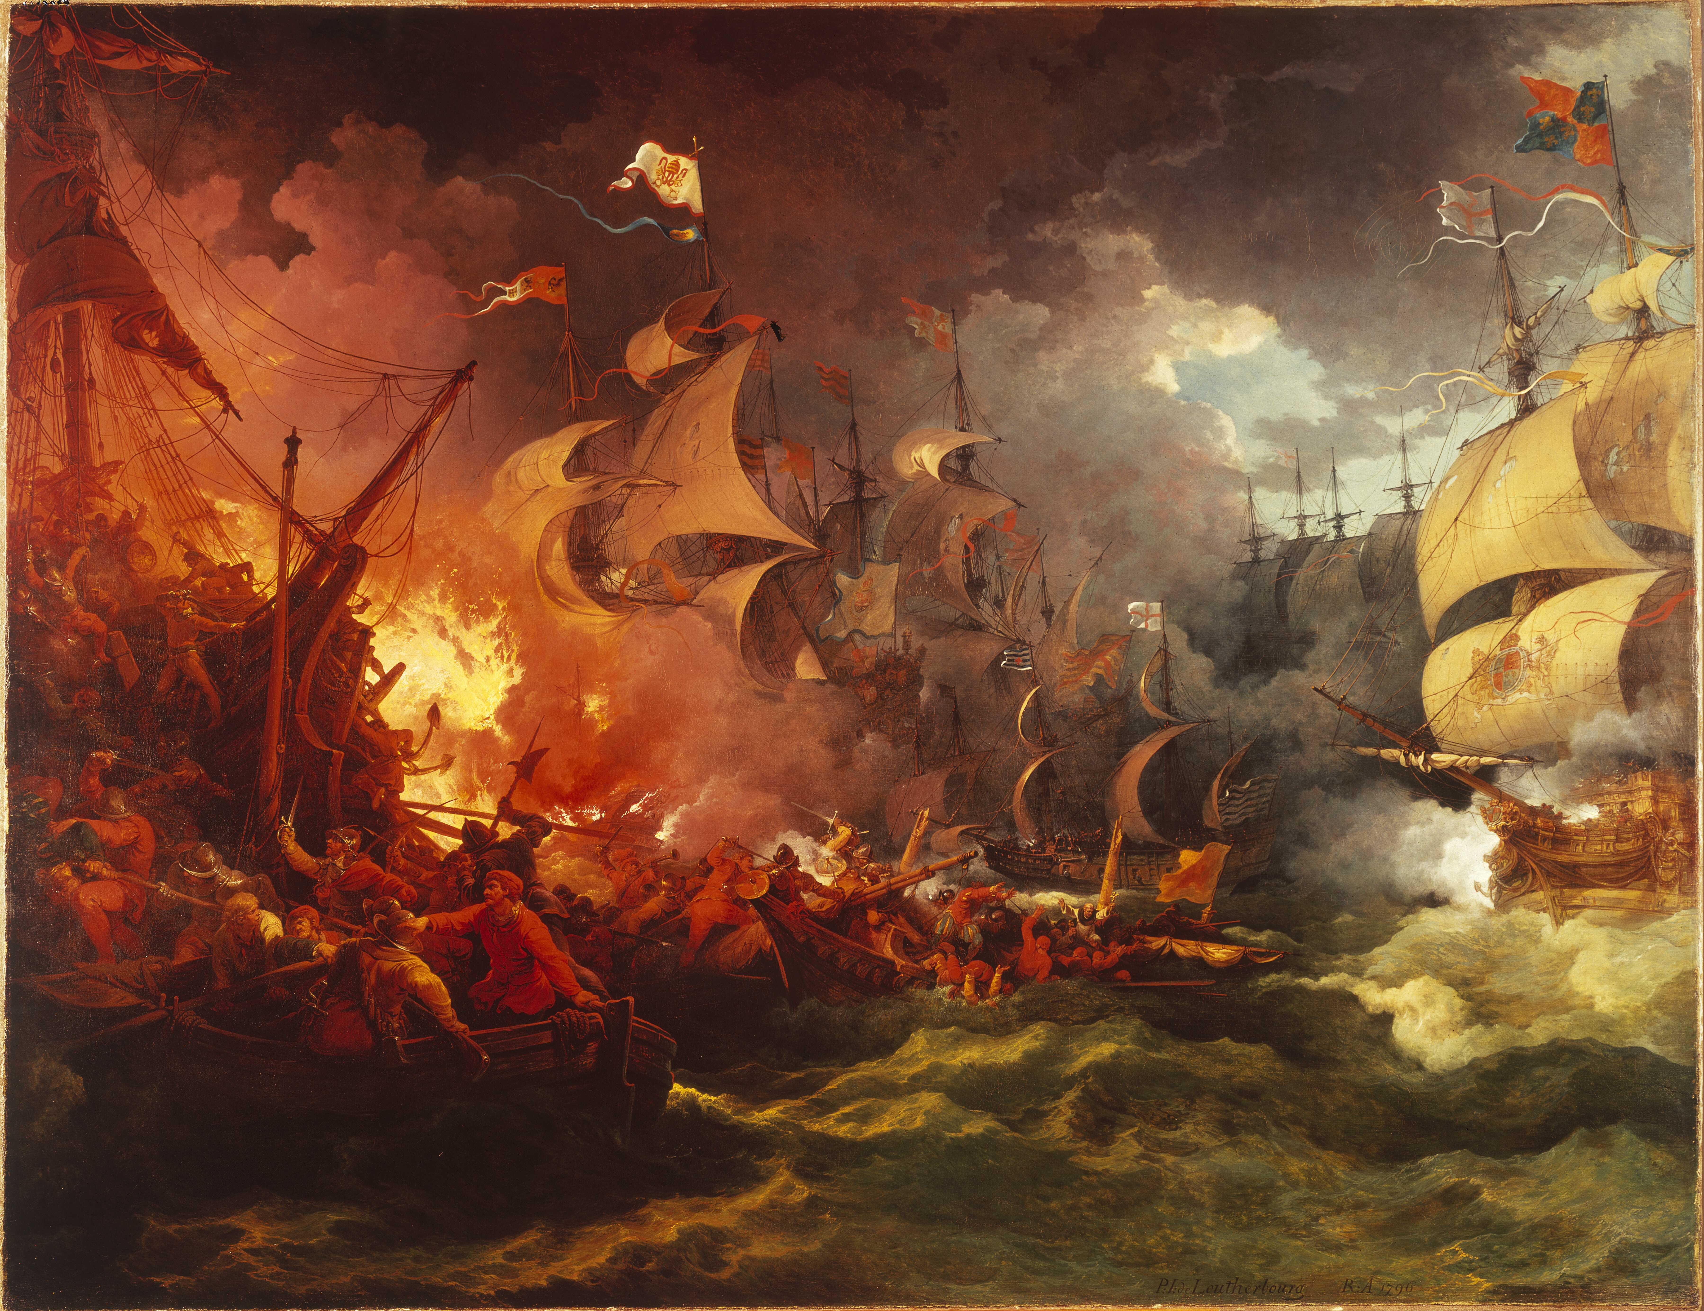
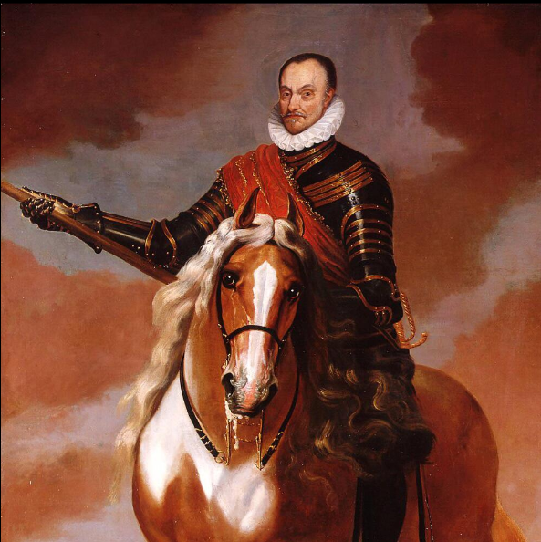
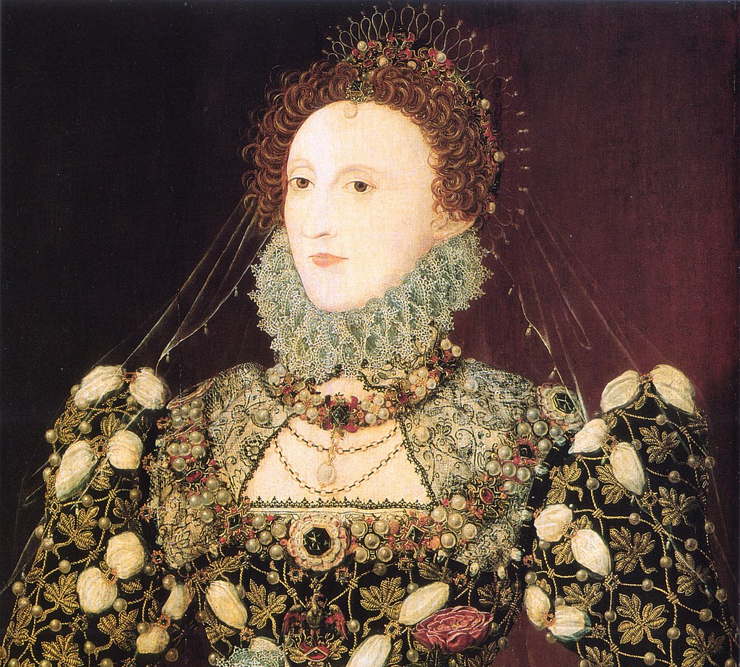
However, Philip II enraged the tolerant Dutch people by treating the Netherlands as a Spanish colony and persecuting its growing Calvinist minority.
The Dutch rebels were led by the Dutch nobleman William of Orange who was a moderate Protestant.
Notes:
The Dutch were aided by the Protestant Queen of England Elizabeth I

Slide 4
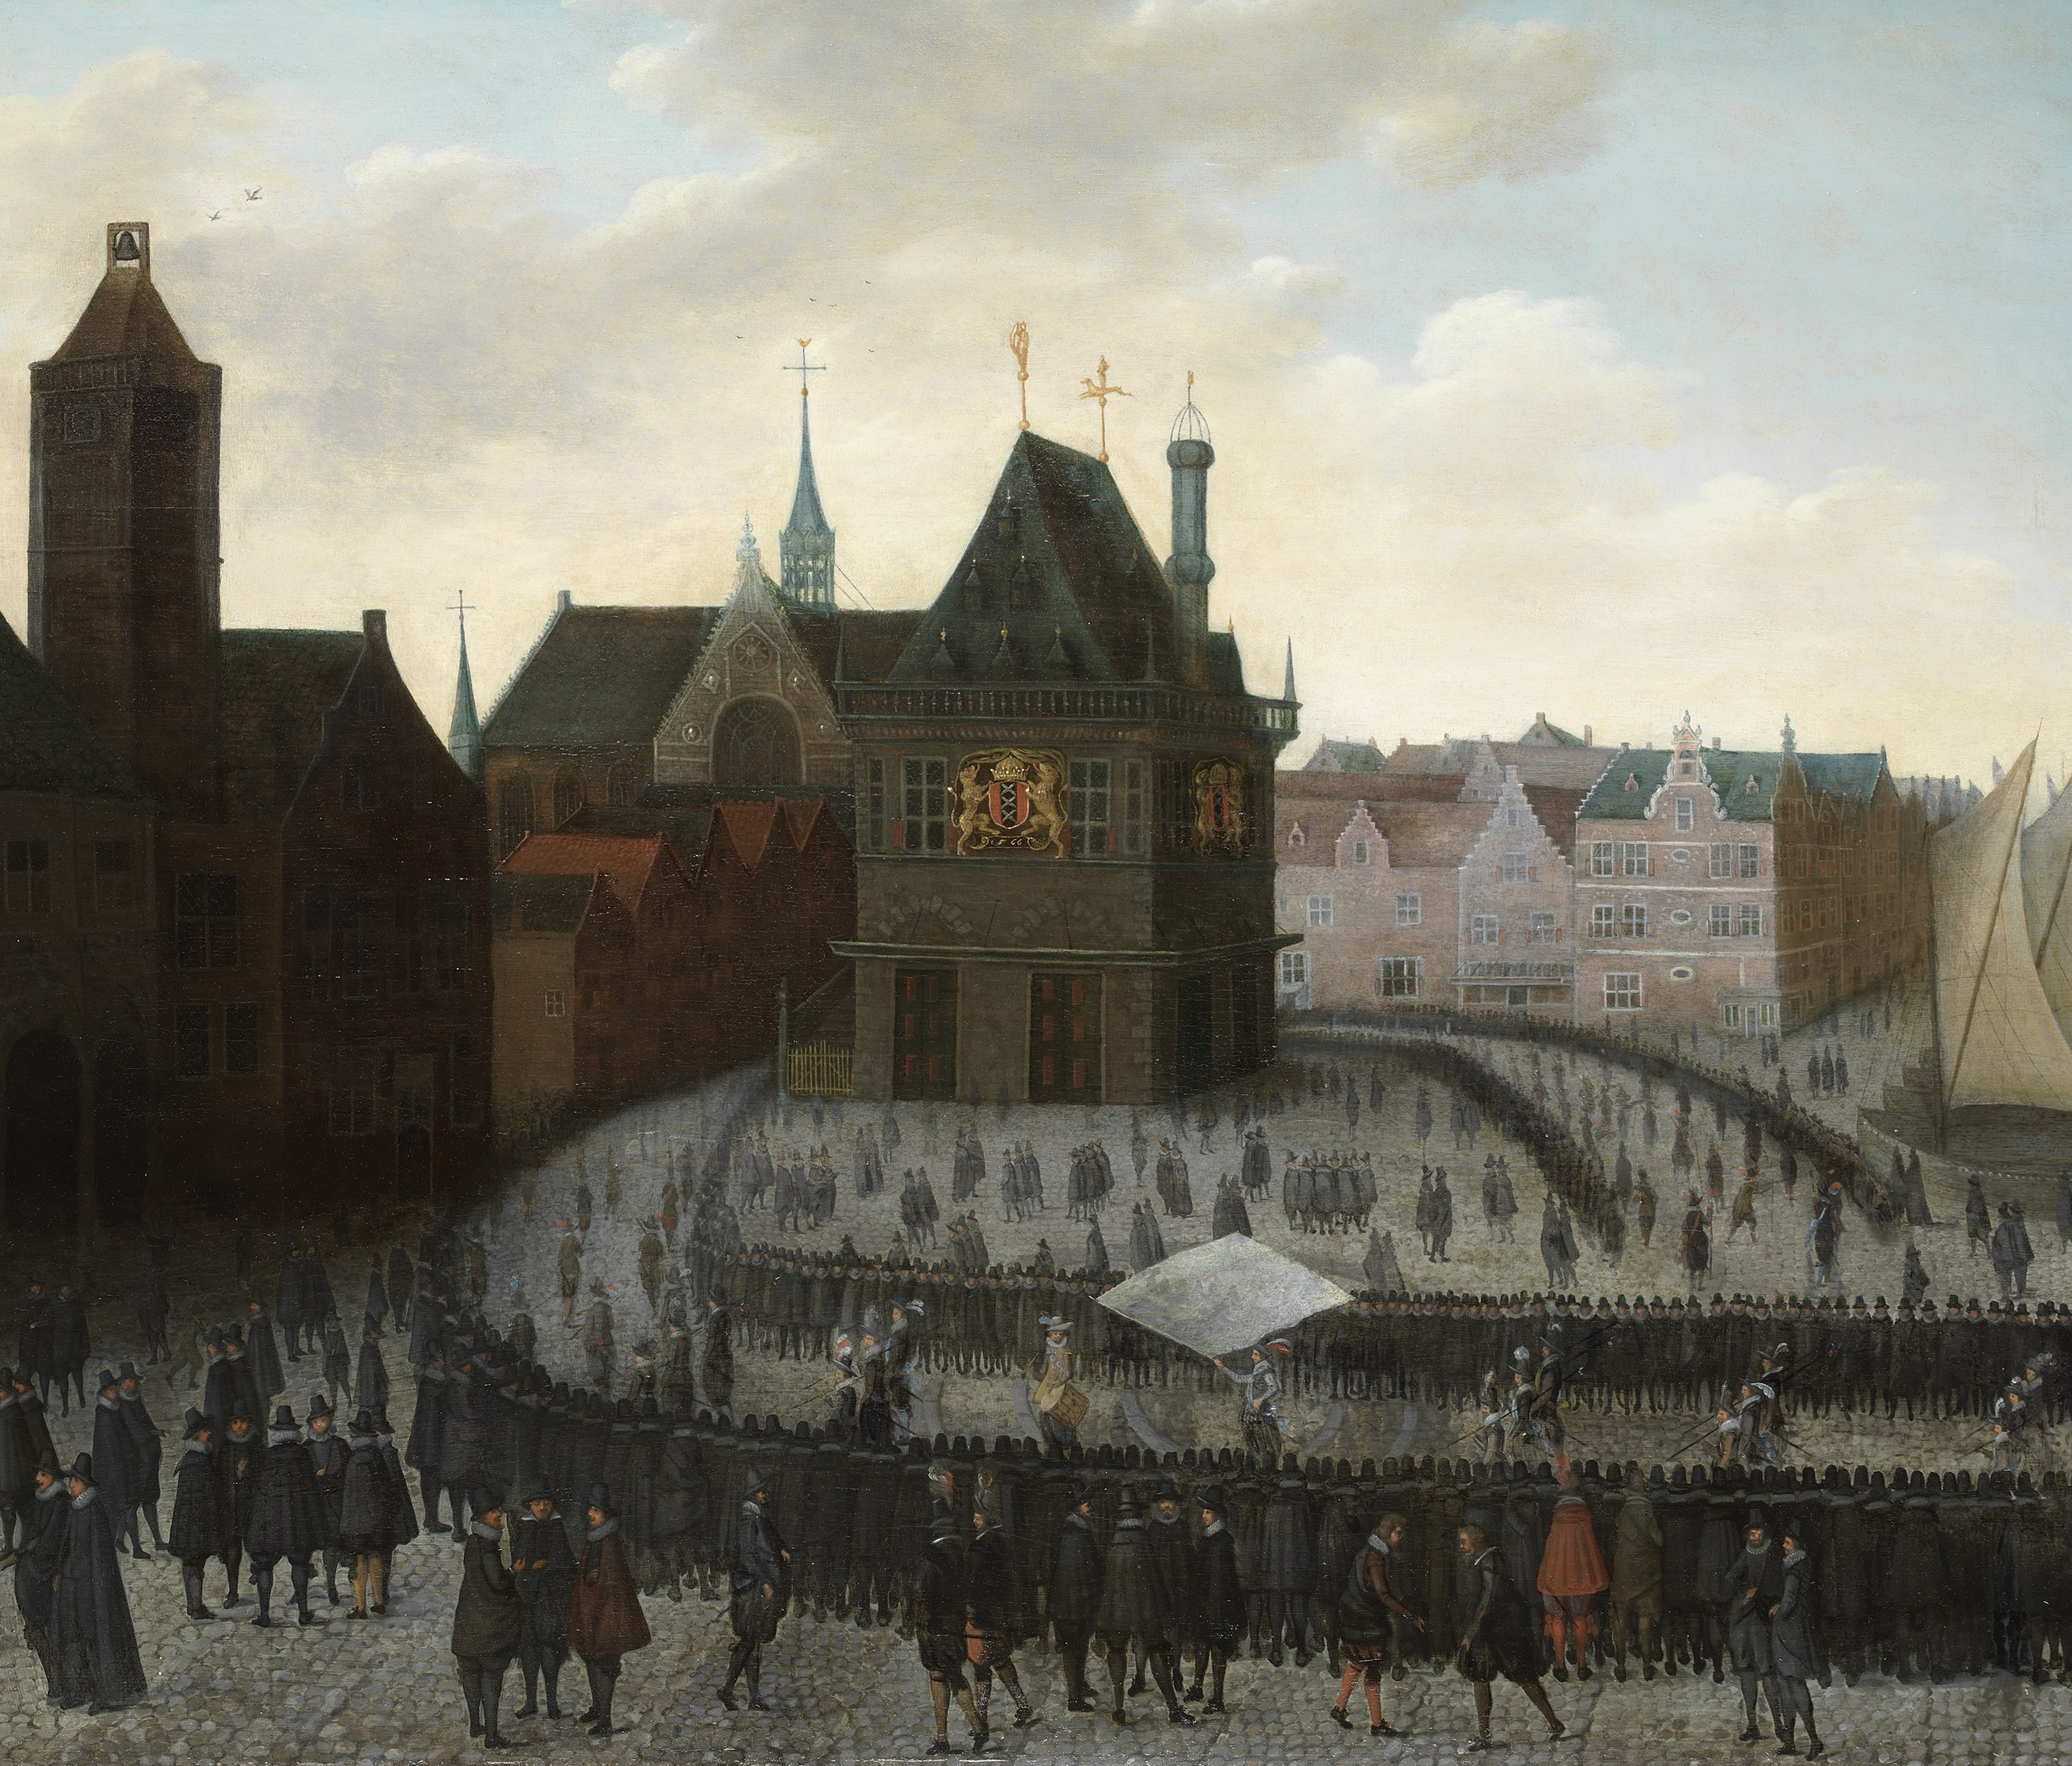
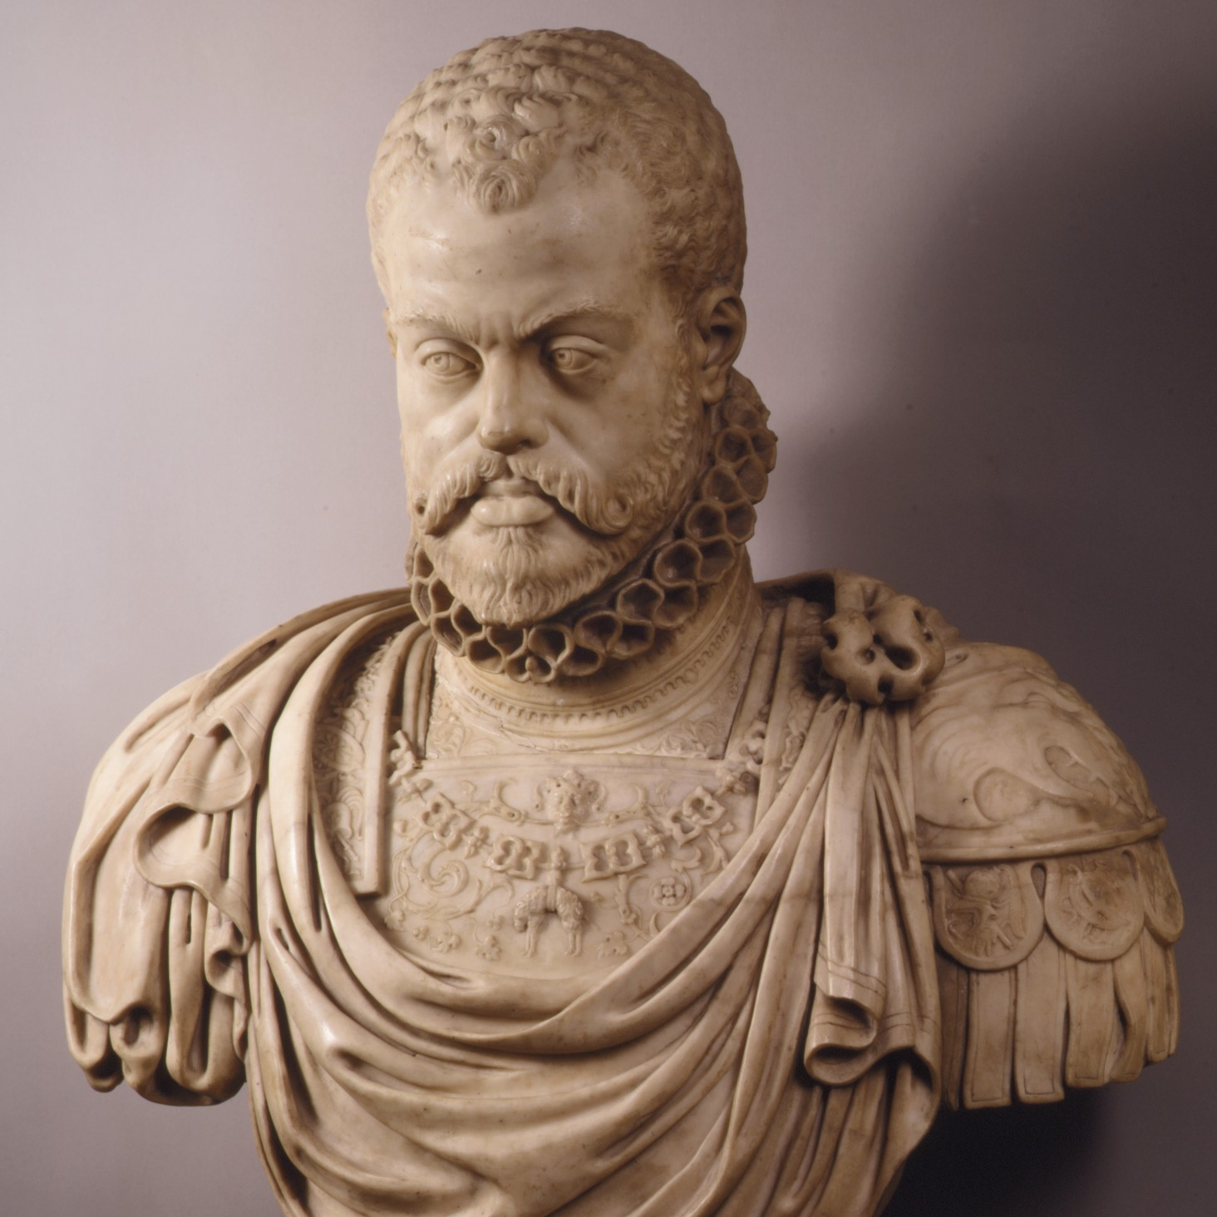
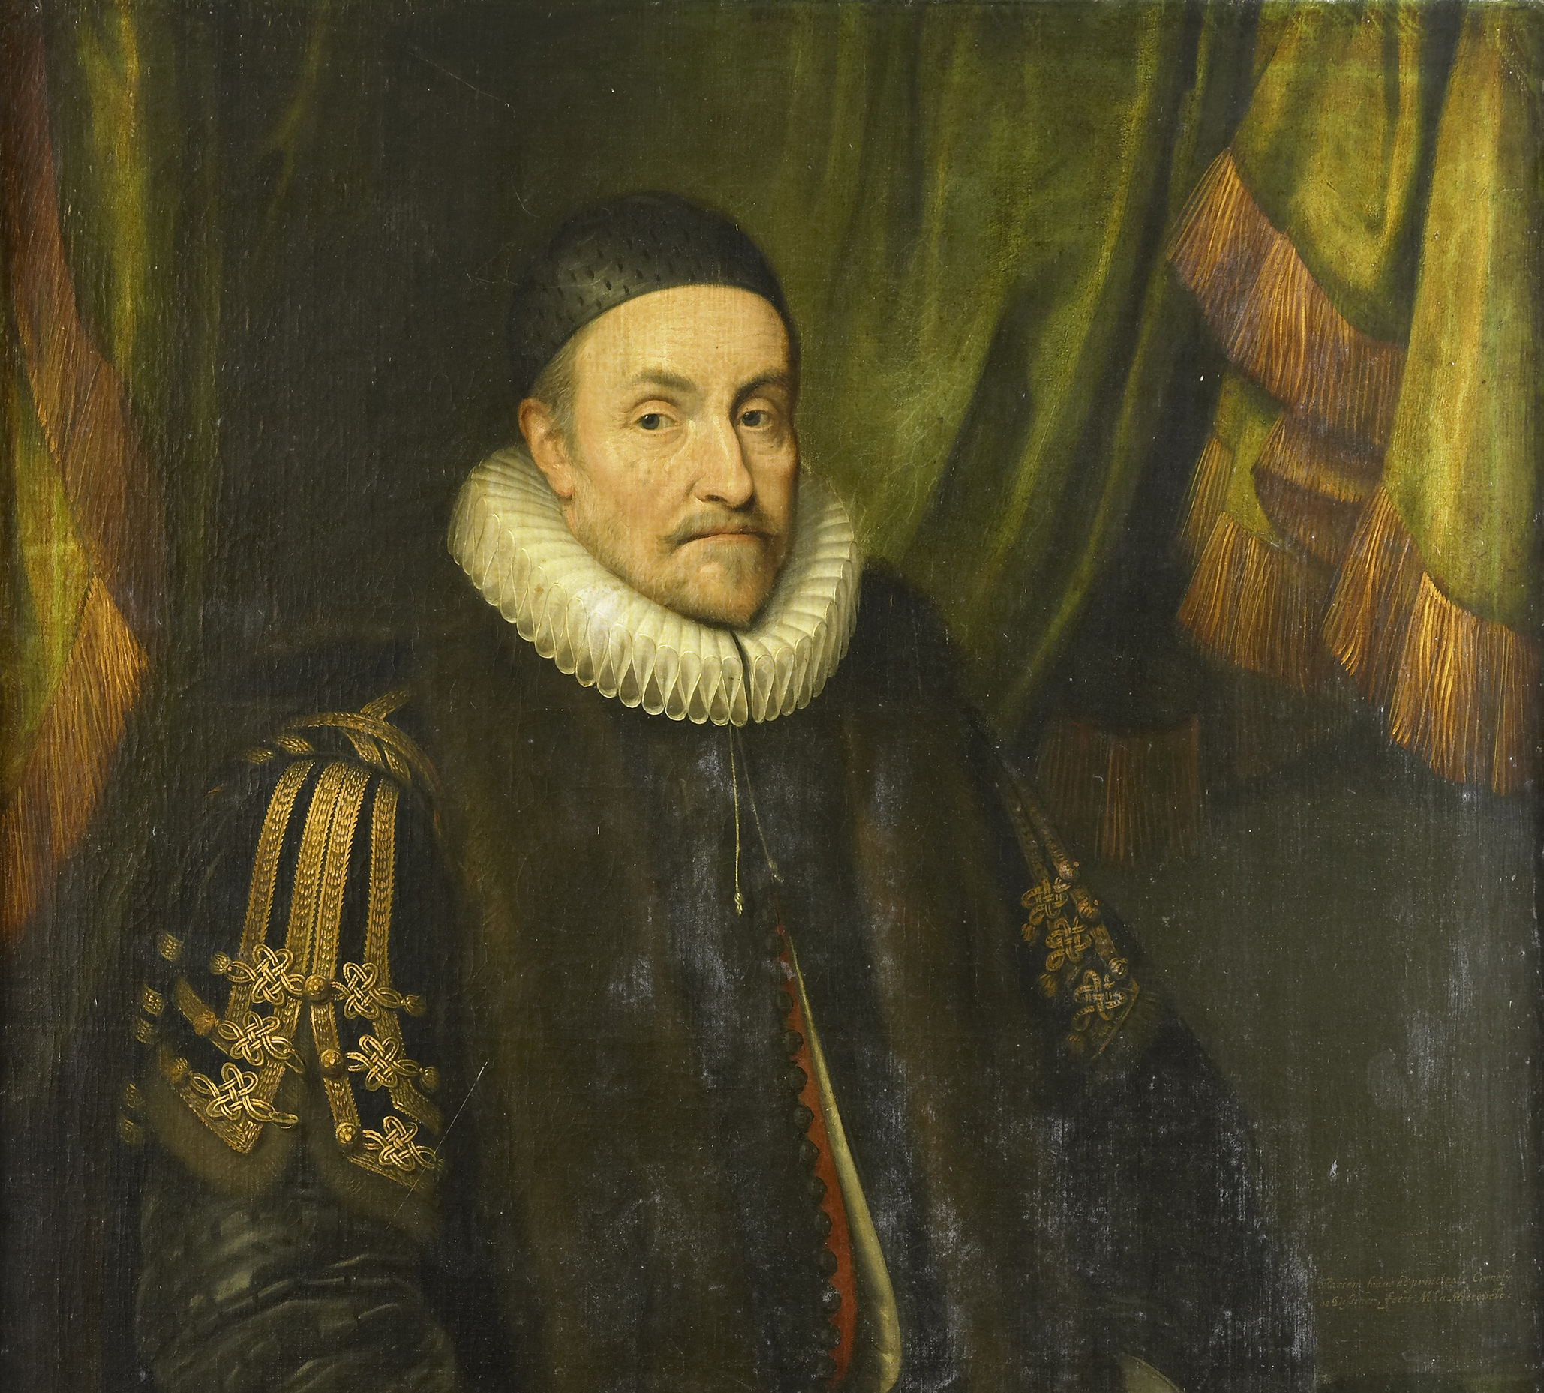
William wished to create a religiously tolerant independent Netherlands.
However, many Dutch Calvinists saw the conflict with the intolerant Catholic Philip II as a religious war.
Calvinists came to dominate the northern provinces of the Netherlands.
Notes:
William of Orange was raised Lutheran before converting to Catholicism (probably only to inherit his lands in the empire of Charles V). He would later in life convert to Calvinism, but always stressed tolerance. His Calvinist son Maurice would be much less tolerant.

Slide 5
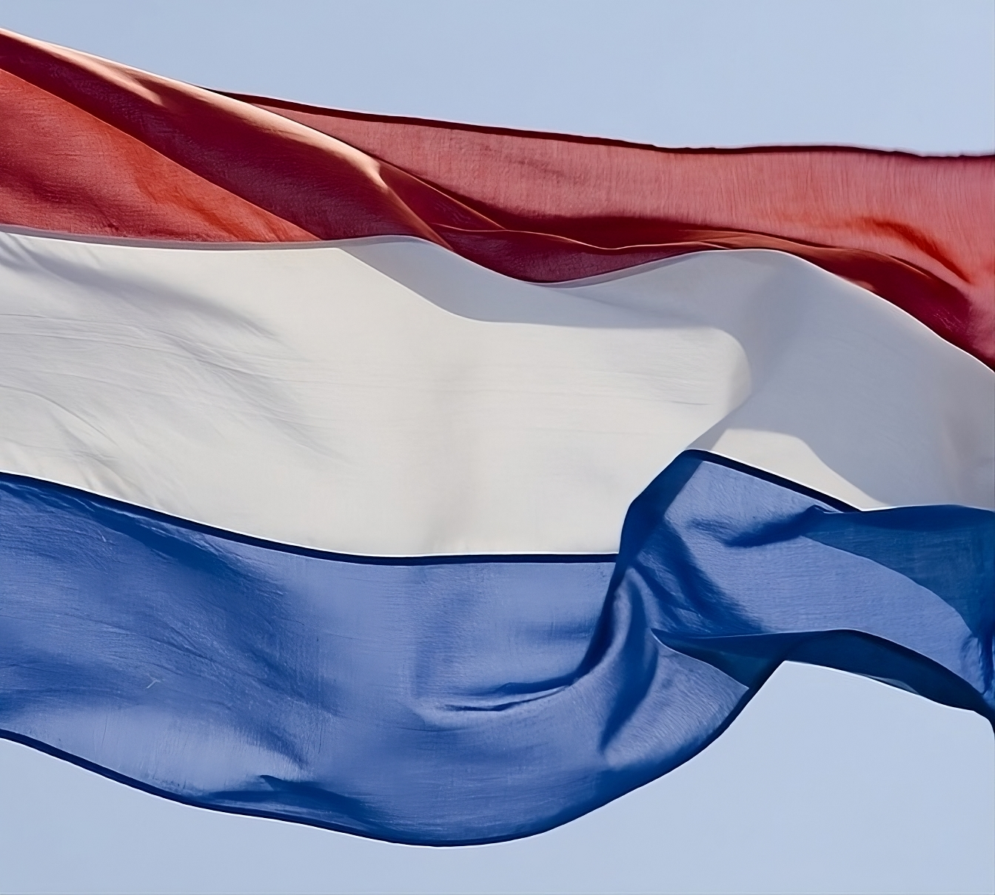
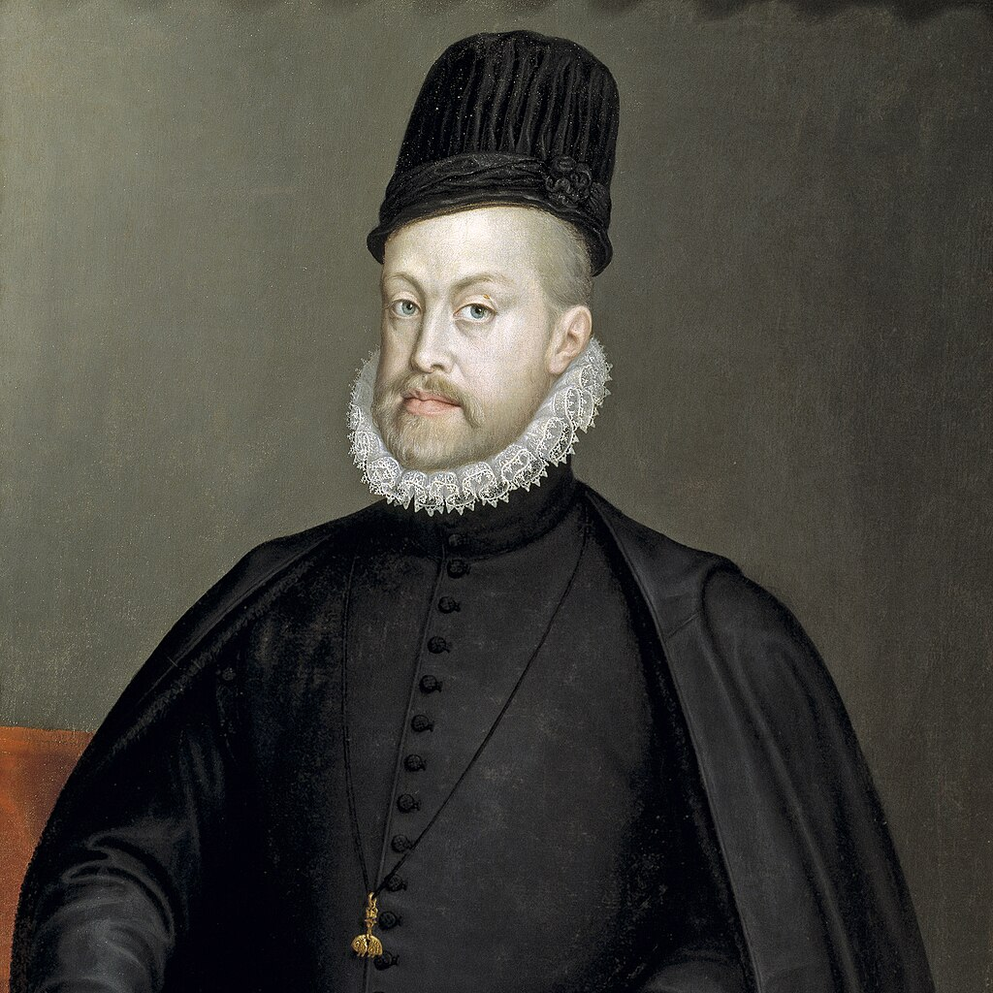
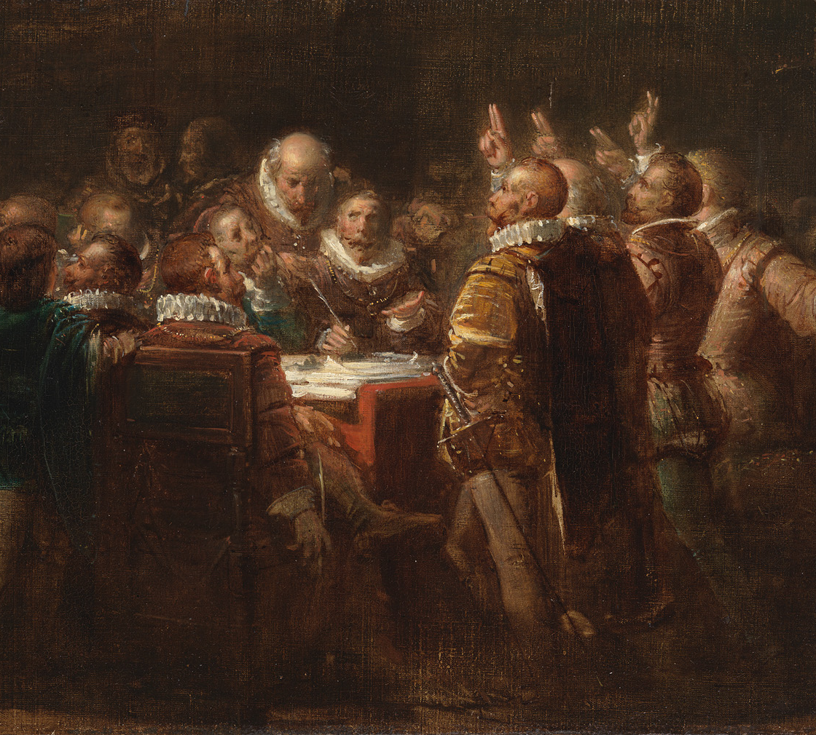
After years of fighting Philip II made peace with the Southern, mostly Catholic Netherlands which became known as Belgium.
The Seven (mostly Calvinist) Northern Provinces of the Netherlands created their own country in 1581 called the Dutch Republic.
Notes:
Northern Belgium (Flanders) spoke a dialect of Dutch called Flemish, while Southern Belgium (Wallonia) spoke French.
William hoped that all of the Netherlands would one day be reunited.

Slide 6
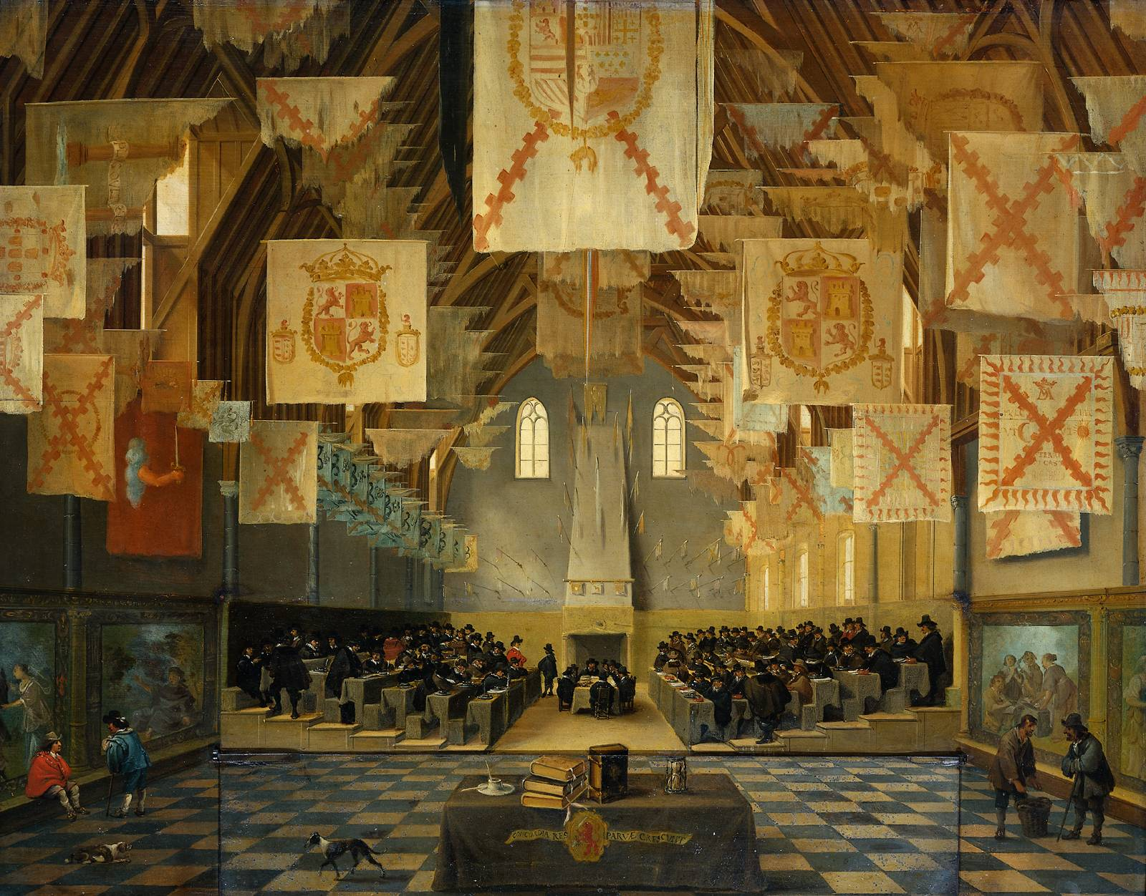
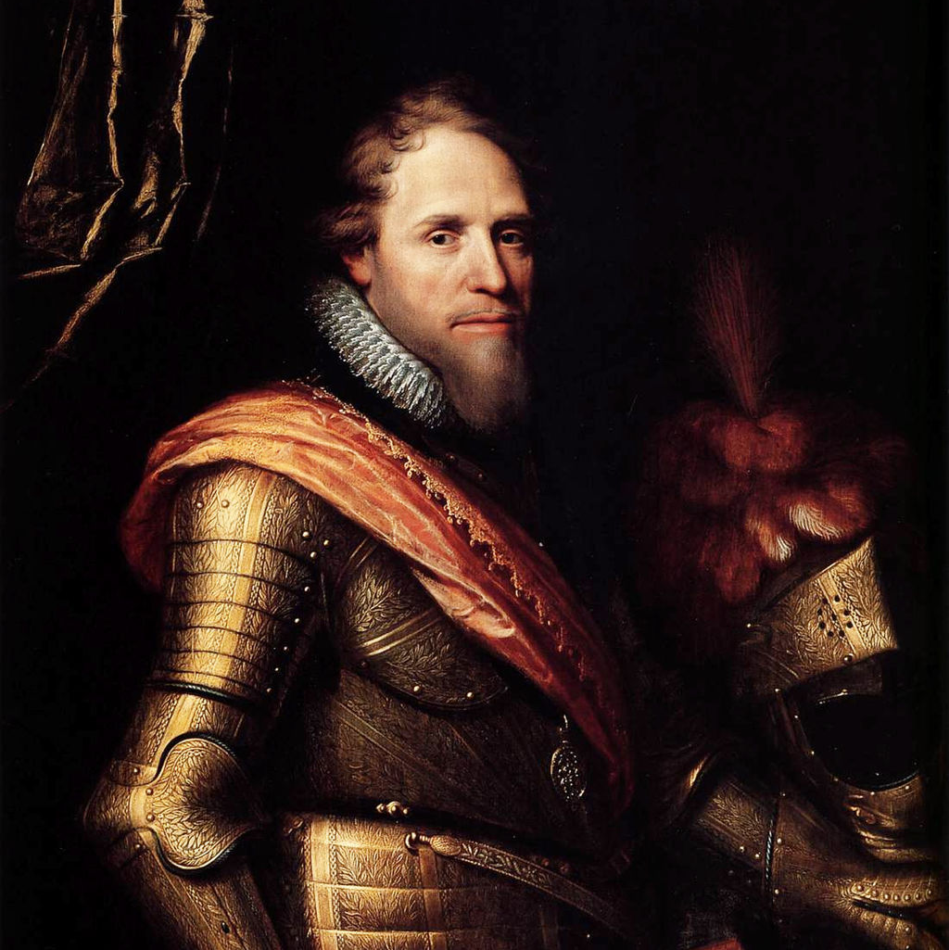
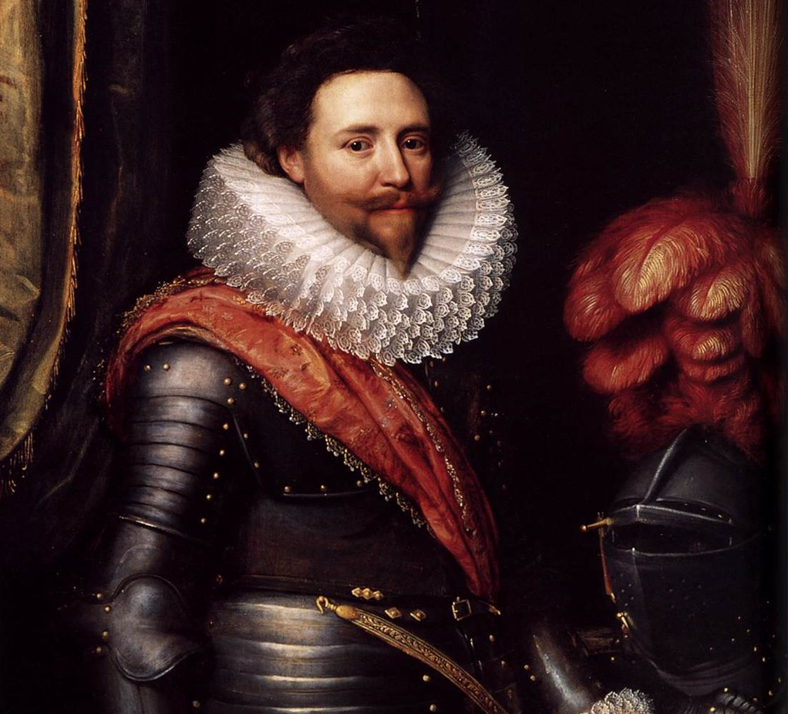
The Dutch Republic was governed by a representative assembly called the States General as well as a powerful elected leader called the Stadtholder.
The Stadtholder was always a member of William’s “Orange dynasty.”
Notes:
Officially each of the seven provinces elected their own stadtholder, but they always elected the same man who was simply referred to as “stadtholder of the Netherlands.”

Slide 7
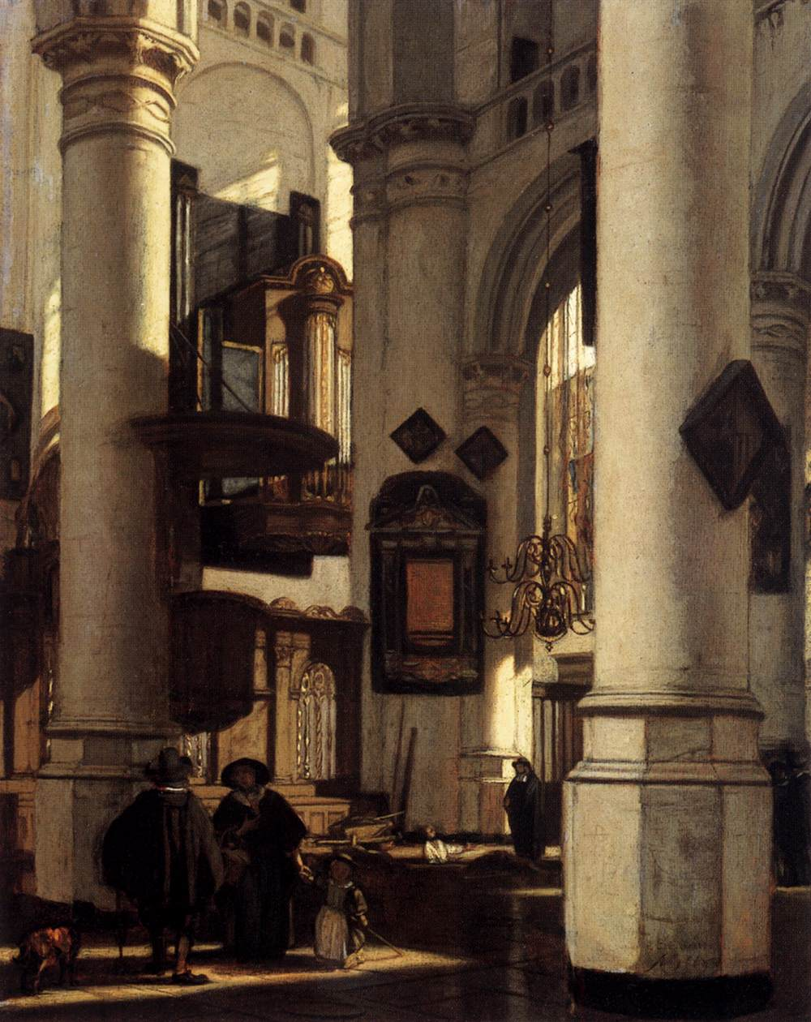
Unlike other European nations, citizens of the Dutch Republic had “personal freedom of religion.”
This meant that they could choose their own religion and practice it in private.
Only Calvinists, however, could practice in public and hold elected offices.
Notes:
William of Orange had ensured that such a right existed to try to attract moderate Catholics to his cause.
The right to freedom of conscience would bring many persecuted peoples to the Netherlands, including Huguenots, Portuguese Jews, and Lutherans from Catholic German states.

