Slide 1
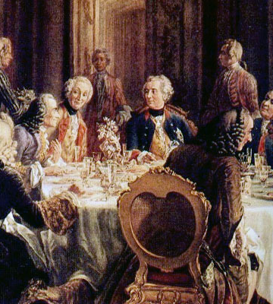
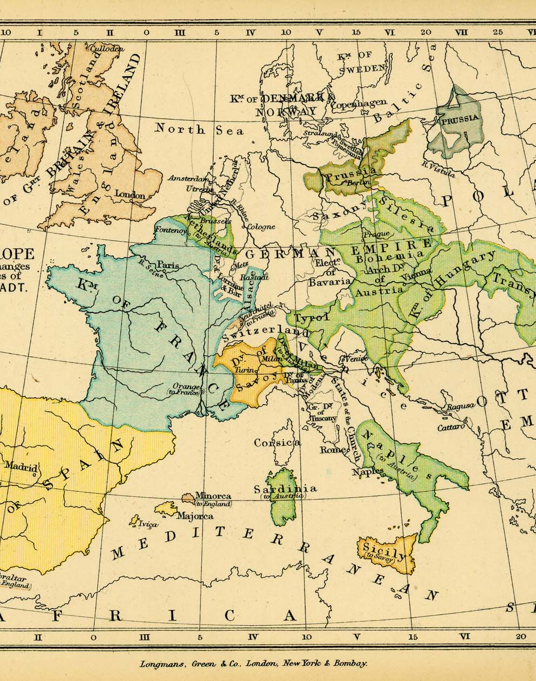
Enlightened Despotism
IES FORTUNY
MARÍA SANZ

Slide 2
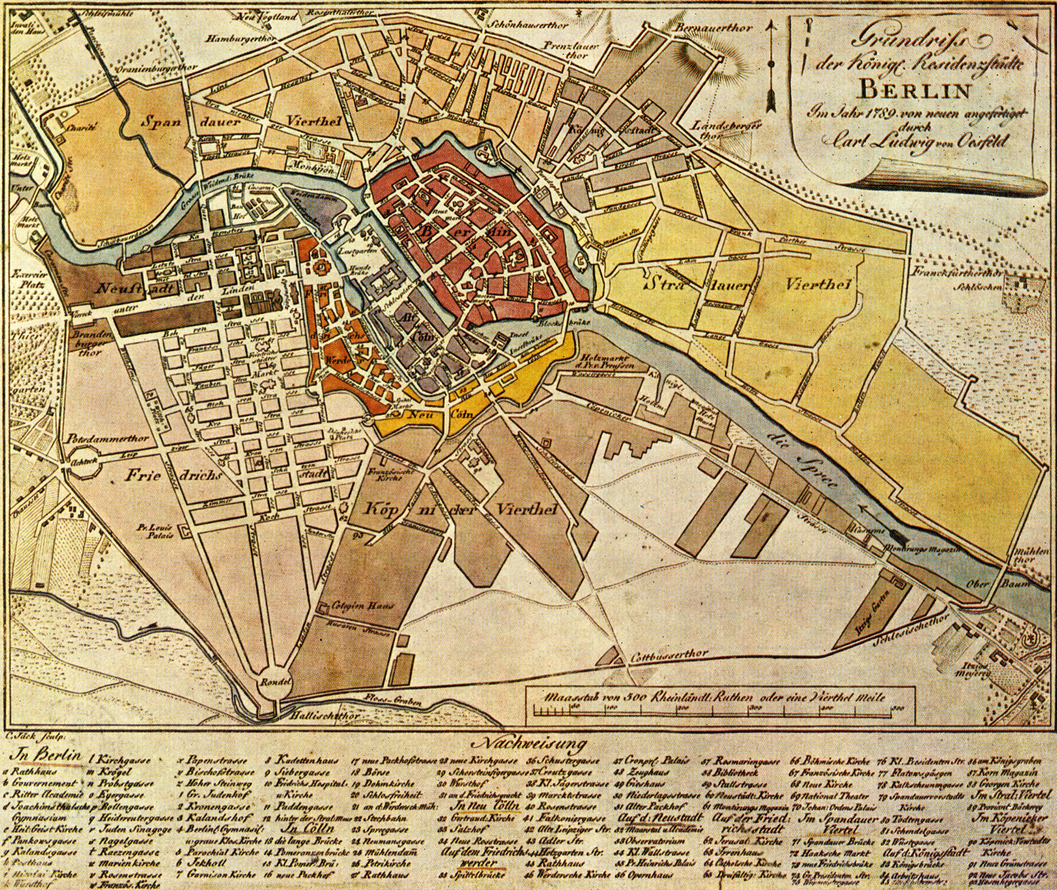
What is Enlightened Despotism?
Enlightened despotism (or enlightened absolutism) is when an absolute monarch is influence by the Enlightenment and uses its principles to govern their people.
Many were patrons of the arts and sciences, allowed freedom of speech and religion, created public primary education, and freed peasants from serfdom. Since they were influenced by the Enlightenment, many were influenced by the writers and philosophers of the time and their ideals, such as Voltaire and Montesquieu.

Slide 3

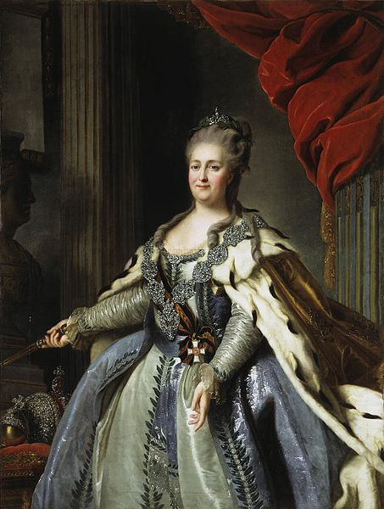
Catherine the Great of Russia
Her Rule and Reforms
Results
Catherine II Empress of Russia ascended the throne after a coup d'état that resulted in her husband, Emperor Peter III, being dethroned and killed.
She wanted Russia to follow the European route to a better economy, education system, and political stability.
Enlarged the Russian empire by expanding out into southern Ukraine, gaining large portions of the partitioned Polish-Lithuanian Commonwealth (Poland), and settling Alaska.
Under Catherine, the Russian economy and conscription didn’t veer from being based serfdom.
Reforms
  Gave the Russian aristocracy more rights and privileges while making them exempt from having to hold government or military positions.
  She established a two-tier education system in all major cities that was free to every free citizen (no serfs).
    Russian Statute of National Education
    Smolny Institute for Noble Maidens
  Freed serfs from the rule of the Russian Orthodox Church.
Under her enlightened rule and encouragement the Russian Enlightenment took root.
Since Catherine extended the rights of the nobility and refused to ease the loads that the serfs bared, such as taxes, they revolted. The most famous of these revolts was the Pugachev’s Rebellion.
The aristocracy gained more influence over the Empress and after her death had much more control over political affairs in Russia.

Slide 4

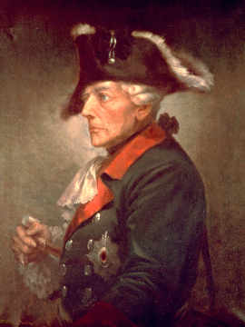
Frederick the Great of Prussia
Rule and Reforms
Results
He created an even more powerful military state than his father Frederick William I Elector of Prussia had. He expanded conscription, creating the largest Prussian army ever, and used unified tactics and training to make the Prussia a European power.
Took power away from the German princes and centralized power under the king.
Reforms
  Reformed the educational system in Prussia, allowing all to have state-funded primary schooling.
      General-Landschulreglement (General Education Regulations)
  Encouraged emigration into Prussia to boost the population and army reserve. About 300,00 in total.
  Created Berlin and made it capital of the Prussia.
  Banned capital punishment and torture, while unifying the law under the General National Law for the Prussian States (Allaemeines Landrecht für die Preusseschen Staaten).
  Financed the mending and creating of infrastructure.
  Allowed freedom of the press and religion.
  Abolished serfdom.
Prussia became a major European superpower due to Frederick’s wide-spread reforms.
The Prussian army became the most coordinated and most powerful in all of Europe.
His reforms bettered the lives of his subjects, though only slightly.
Religious toleration and encouraged emigration substantially increased the Prussian population, creating a more diverse Prussian culture.

Slide 5

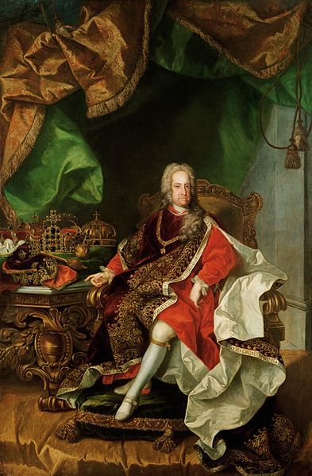
Charles III of Spain
His Life and Rule
Results
Became Duke of Parma as an infant. When he had grown he conquered Naples ands Sicily, reigning as Charles VII of Naples and Charles V of Sicily.
Created a insurance company and made widespread economic reforms to save the kingdom of Sicily from financial ruin.
  Many of the numerous reforms he made in Naples and Sicily transcended into his rule in Spain. He consolidated power under the crown and rearranged the Spanish bureaucracy.
  As in Italy, he made large economic reforms such as eliminating the traditional tax on flour.
  Tried to structure his government so that trade and industry would flourish. Lynch
  Abolished money-wasting ventures and promoted the building of roads, canals, and economic societies (Earlier versions of Chambers of Commerce).
  Promoted trading with foreign sources of commerce such as the United States and many other American colonies.
Under his rule and jurisdiction, the kingdoms of Spain were recognized as an nation, not separate states.
His control over the Catholic Church and election of inquisitors limited the power of the Inquisition.
His alterations to the government created a more industrialized Spain.
Spain had more access to foreign trade and commerce, but still excluded foreigners.
Spain became more economically successful, but not nearly as much as Naples had under Charles’ rule.
The Spanish people had a greater sense of patriotism.

Slide 6
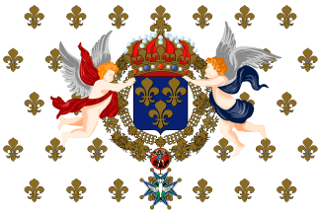
Enlightened Absolutism in France
Louis XVI of France
Napoleon I Emperor of France
While still an absolutist king, Louis attempted to use enlightenment ideals to rule France. The aristocracy acted with hostility towards this, so much of his planned reforms were never put into action.
  Tried to totally abolish serfdom and the taille, a direct land tax all French citizens of non-noble birth.
  The Edict of Toleration (The Edict of Versailles)- a law nullifying the Edict of Fontainebleau which gave many Protestant sects and Jews the rights possessed by all French Catholic citizens.
  Reinstated the parlements in France.
  Attempted to please the public through his legislation, using advisors of the people.
Instituted a constitutional monarchy with the newly created National Assembly. His reforms stop at this point.
While First Consulate for Life and Emperor of France, Napoleon Bonaparte mad long-lasting reforms throughout his reign.
Reforms:
  His main reform was The Napoleonic Code or the Civil Code. This instituted many of the ‘human rights’ that the previous French monarchy had ignored: All people have a fair trail under the law. None are exempt from any laws. Everyone is equal under the law. Etc.
  He reformed the education system to a two-level system. The first level, primary school, was free to all males in France while the second level, the university system, was also free to all males but required tuition. This replaced the previously used lycée.
  Allowed freedom of religion.
  He introduced the metric system of measurement into France.

Slide 7
The Effects of Enlightened Absolutism in Europe
This era of Enlightenment ideals increased the power of the rulers. As a result most of the institutions under them that they had taken power from lost a significant amount of influence in the government. Examples are the Catholic Church, the aristocracy (except in Russia), and the representative bodies such as Riksdag.
The subjects under these enlightened despots benefited too because their rights, freedoms, and protections increased exponentially compared to what they rights they possessed before.

