Slide 1
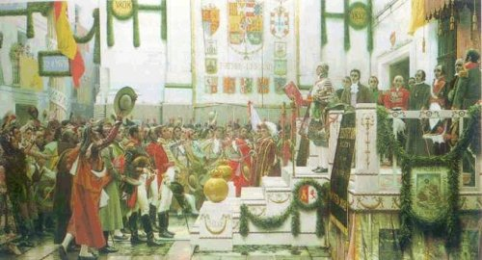
CORTES DE CÁDIZ AND THE CONSTITUTION OF 1812

Slide 2
Cortes de cádiz

Slide 3
THE FORMATION OF THE JUNTAS
The abdications of Bayonne had left the unoccupied Spain with a lack of authority.
To fill that authority void and organise the spontaneous uprisings against the French, the Juntas Provinciales were organized, and they assumed sovereignty.
In September 1808, the Junta Central Suprema assumed all the powers, in absence of the legitimate king (Fernando VII) . They established themselves as the maximum government organism.

Slide 4
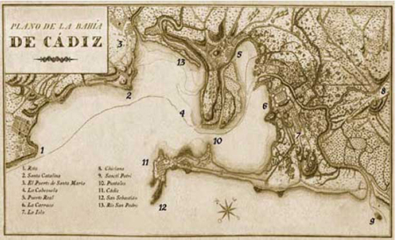
Mapa de Cádiz en época de la Guerra.

Slide 5
The Junta Central convened a meeting of extraordinary Cortes in Cádiz.
Finally, in January 1810, the Junta ceded its power to a Regency, but they didn’t stop the Convene of (Convocatoria) Cortes.

Slide 6
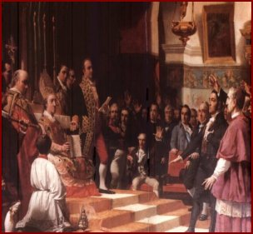
Las Cortes de Cádiz
Juramento de los diputados de las Cortes de Cádiz

Slide 7
LAS CORTES DE CÁDIZ
The meeting of Cortes in a war situation, benefited the burghers, coming from the coast and commercial cities.
The sessions began in September 1810 and there were soon two groups of deputies:
  Liberals: supporting revolutionary reforms, inspired in the French Revolution principles and ideas.
  Absolutists or “serviles”: supporters of maintaining the Ancien Régime (absolute monarchy, unequal and stratified society – estates of the realm, mercantilist and agrarian economy).

Slide 8
LAS CORTES DE CÁDIZ
The liberal majority, taking profit of the king’s absence, began a liberal revolution in Spain, with two objectives:
  To make reforms to end with the Ancien Régime structures.
  To approve a Constitution.
Political reforms of the Cortes de Cádiz:
  Freedom of press (1810).
  Abolition of the feudal system: suppression of the señoríos jurisdiccionales (manor houses). Nevertheless, the nobility maintained the property of almost all their lands.
  Banning of the Inquisition (1813).
  Abolition of the guilds. Freedom in trade and industry (1813).
  Shy desamortización of some Church goods (lands).

Slide 9
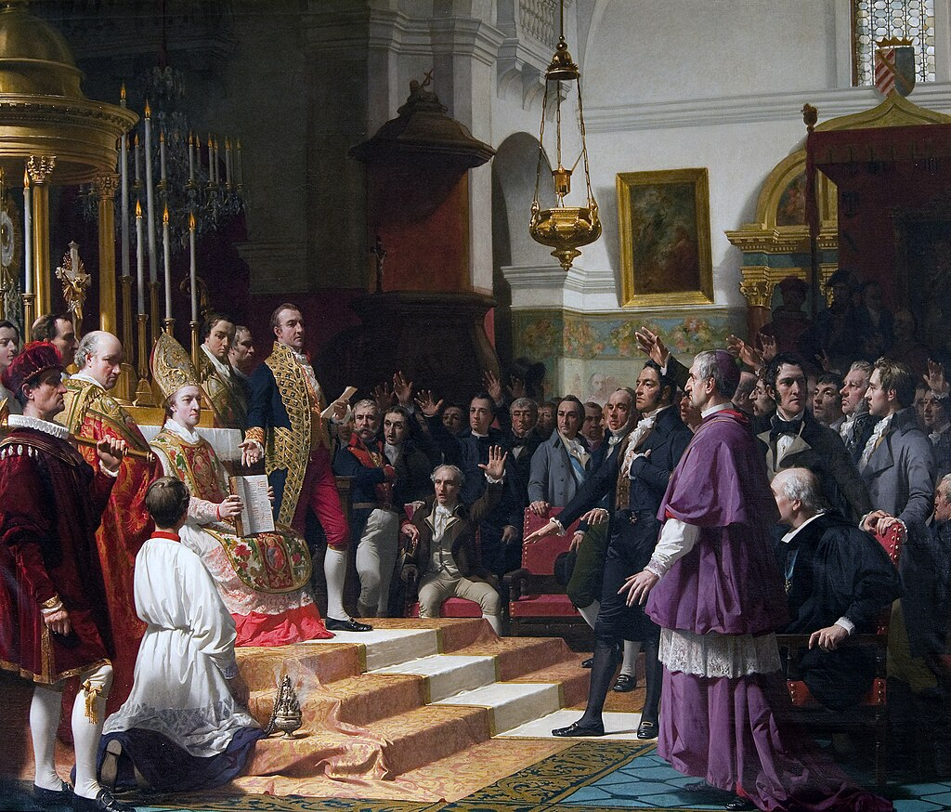

Slide 10
THE CONSTITUTION OF 1812
Approved on 19th March 1812. Known as “La Pepa”, this legal document was the first Constitution in Spain.
The liberal deputies Agustín Argüelles, Diego Muñoz Torrero and Pérez de Castro are the most outstanding people in its preparation.

Slide 11
The Constitution of 1812
National sovereignty. The power is in the nation, not in the king.
Division of Powers:
  Legislative power: Unicameral Cortes.
  Judicial power: Tribunals
  Executive power: the king + Ministers, with limitations:
    He cannot dissolve the Cortes.
    He had a transitive veto during 2 years, after that the decision of the Cortes became law.
    He could name his ministers, but they had to be approved by the Cortes (“doble confianza”).
Male universal suffrage. All man older than 25 years old could vote, indirectely, they chose some representatives (compromisarios ) that could choose their deputies.
Equality of all citizens.
Individual rights: education, freedom of press, inviolability of home, freedom, association and property.
The Catholicism would be the only allowed religion. They had to count with the clergy support to fight against French, this explains that only intolerant feature in such an advance Constitution.

Slide 12
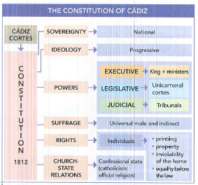

Slide 13
La Constitución de 1812

