Slide 1
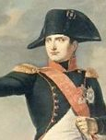
Napoleon Bonaparte (1768-1821)
Savior of the Revolution, Conqueror of Europe

Slide 2
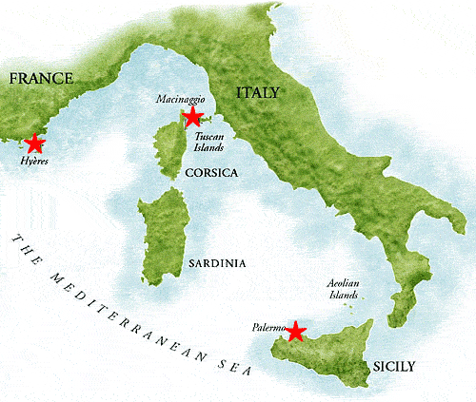
The Early Years
Napoleon Bonaparte was born on the island of Corsica in 1768
His parents were Italian nobles living on the island
At age 9 he enrolled in a French military school

Slide 3
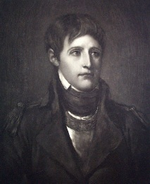
As a Young Soldier
Napoleon was often teased for his Corsican accent and his height (only 5’3”)
He quickly earned respect of his peers by working hard and becoming a brilliant military strategist.

Slide 4
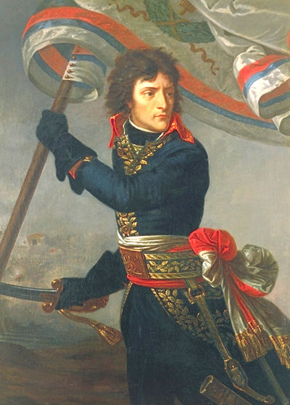
Savior of the Revolution
During the French Revolution, Napoleon won several important battles against the Austrians & Prussians.
He quickly became a general, and saved the Directory (post-revolution government) from royalists (people who wanted to return a king to power)

Slide 5
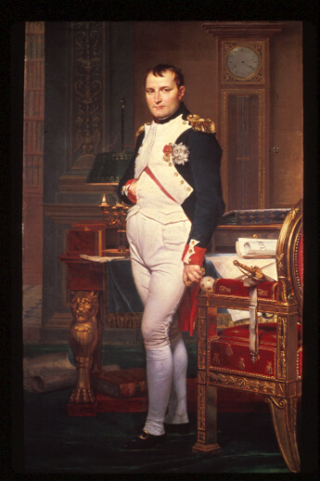
Napoleon Seizes Power
In 1799, a popular Napoleon launches a Coup d’Etat (sudden seizure & overthrow) on the weak and corrupt Directory.
Napoleon is victorious and seizes control of France as a consul (dictator)

Slide 6
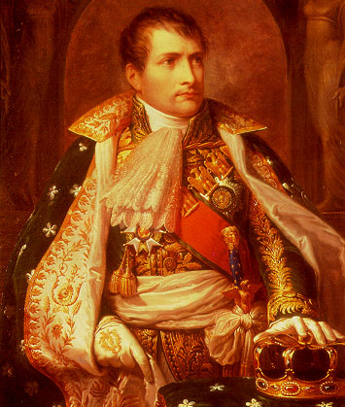
Absolute Rule
Despite overthrowing the absolute King Louis XVI in 1792, the people of France now support Napoleon as an absolute leader. Why?
They would rather have peace and order than bloodshed and uncertainty

Slide 7
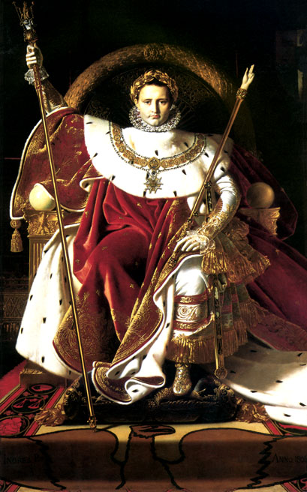
Napoleon as Emperor
In 1804, Napoleon crowns himself Emperor of the French by grabbing the crown out of the Pope’s hands.
This signified his power over the Catholic Church

Slide 8
Napoleon as Emperor
In 1804, Napoleon crowns himself Emperor of the French by grabbing the crown out of the Pope’s hands.
This signified his power over the Catholic Church

Slide 9
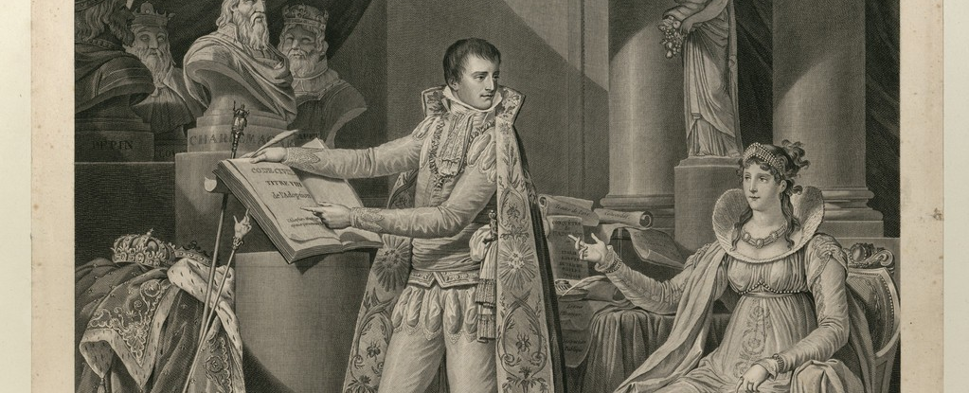
Napoleon’s Accomplishments
Built largest European empire since Rome
Sold Louisiana Territory to U.S. in 1803 for 15 million.
Set up fair tax code
Hires government officials based on merit
Created public schools for all (called Lycees)
Restores Catholicism in France
Creates Napoleonic Code (laws)

Slide 10
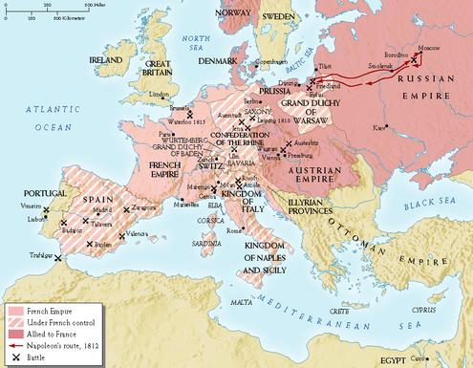
Napoleon’s Empire: 1812

Slide 11
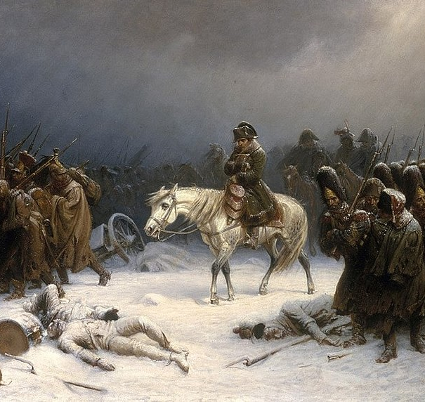
Nationalism: Blessing & Curse
Due to Napoleon’s new policies and conquests, nationalism (intense love & pride in one’s nation) in France was at an all-time high.
But in areas defeated and conquered by France, a strong feeling of hatred towards Napoleon arose. People began to join together as one to fight against France.

Slide 12
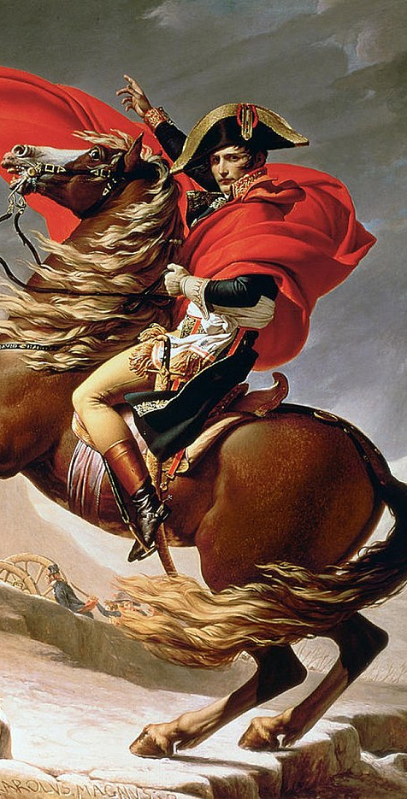
Napoleon’s 3 Big Mistakes
The Continental System
The Peninsular War
3. Invasion of Russia

Slide 13
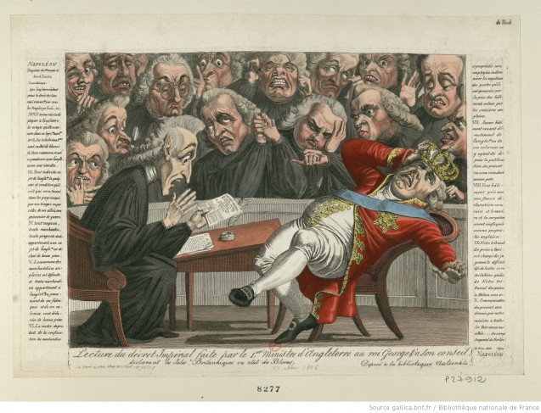
The Continental System
Napoleon attempted to set up a naval blockade preventing Britain from trading with rest of Europe
Many nations ignored it and Britain was able to bust through it (too many holes)
Seeking revenge, Britain launched their own blockade which hurt France’s economy

Slide 14
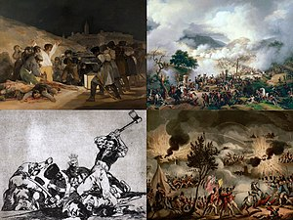
The Peninsular War
France attacks Spain for ignoring the Continental system.
Over 6 years, Spain uses Guerilla warfare techniques to inflict massive casualties on the French military

Slide 15
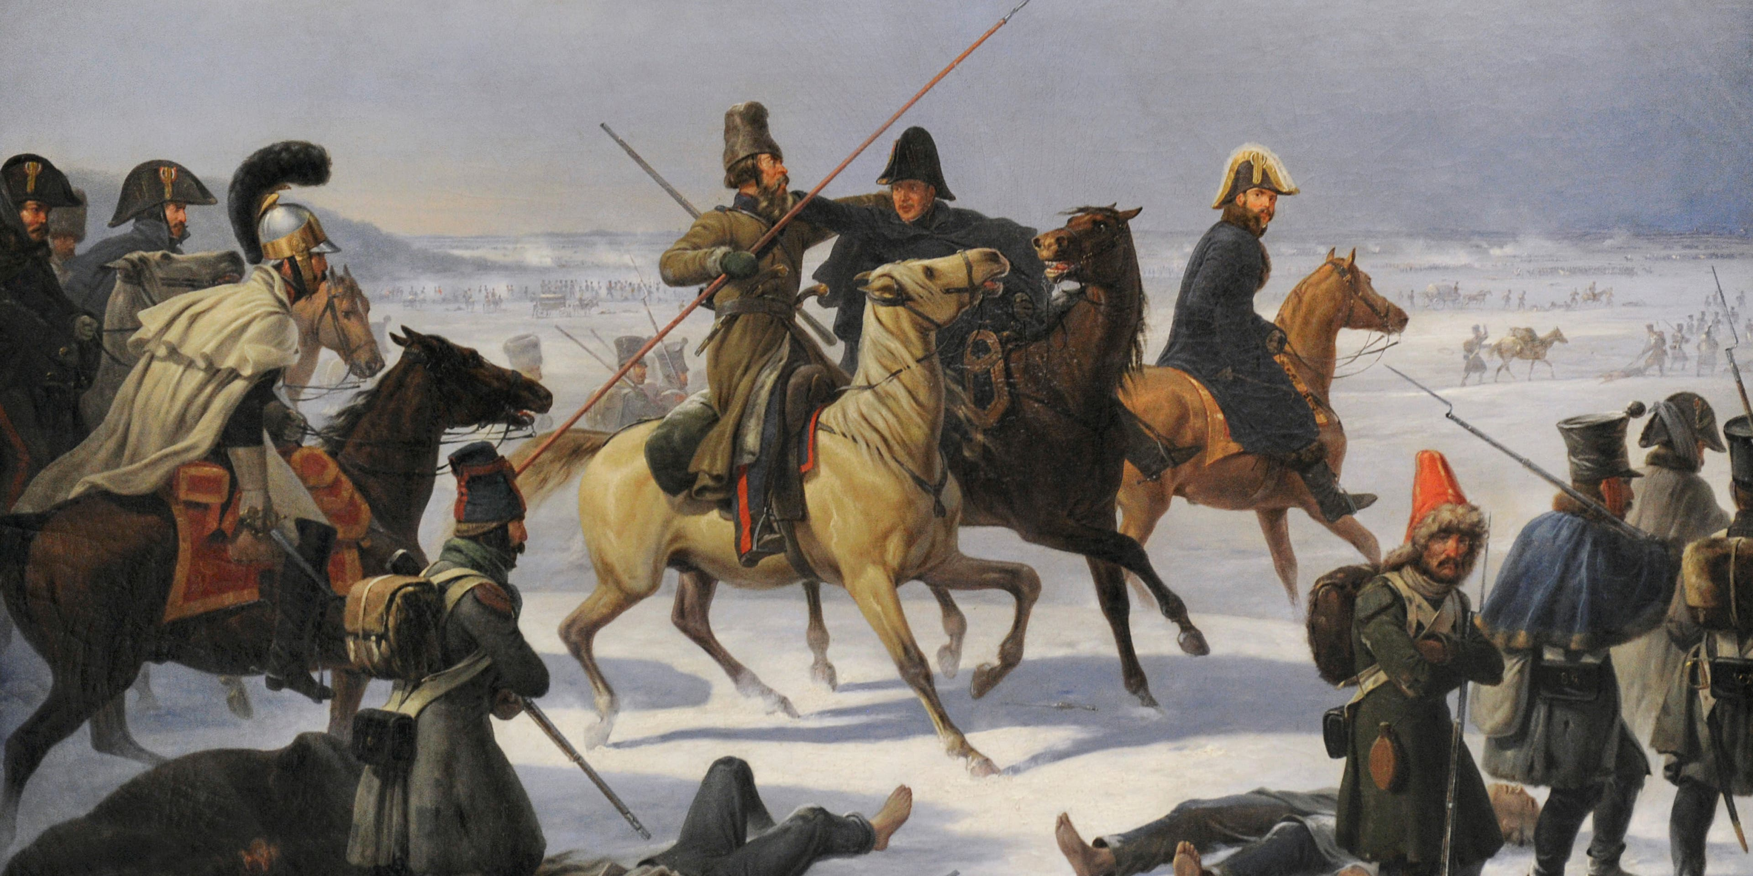
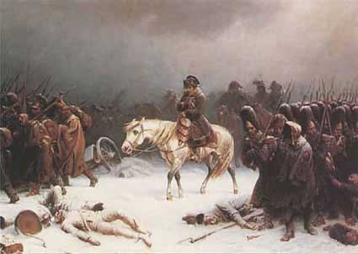
Invasion of Russia-1812
Napoleon invades Russia for trading with Great Britain
As Russian troops retreat to Moscow, they burn everything down (scorched earth policy) leaving nothing for the French
Never receiving a surrender from the Russian czar, Napoleon decides to retreat in Winter.
590,000 of 600,000 French troops starve or freeze to death!

Slide 16
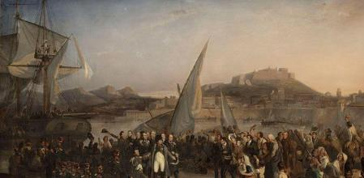
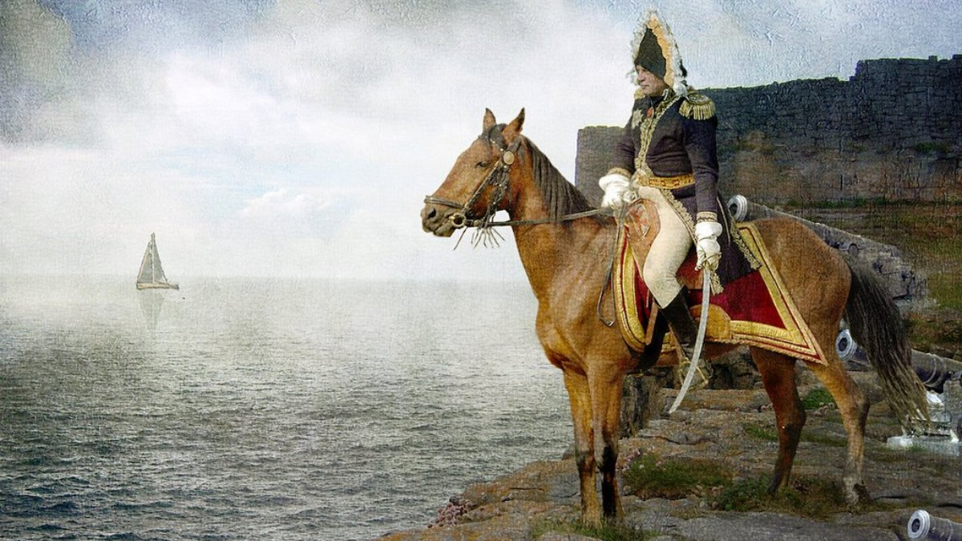
Exile to Elba
With his forces greatly weakened, Napoleon is defeated by a combined British, Russian, and Prussian force.
He is banished to the tiny Island of Elba in the Mediterranean Sea in 1815

Slide 17
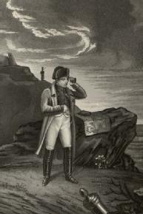
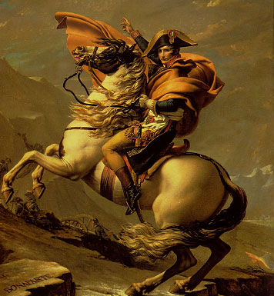
Napoleon’s 100 Days
After a year on Elba, Napoleon raises a small army and escapes back to France
He once again becomes Emperor and attempts to strengthen his army
The French welcome his return

Slide 18
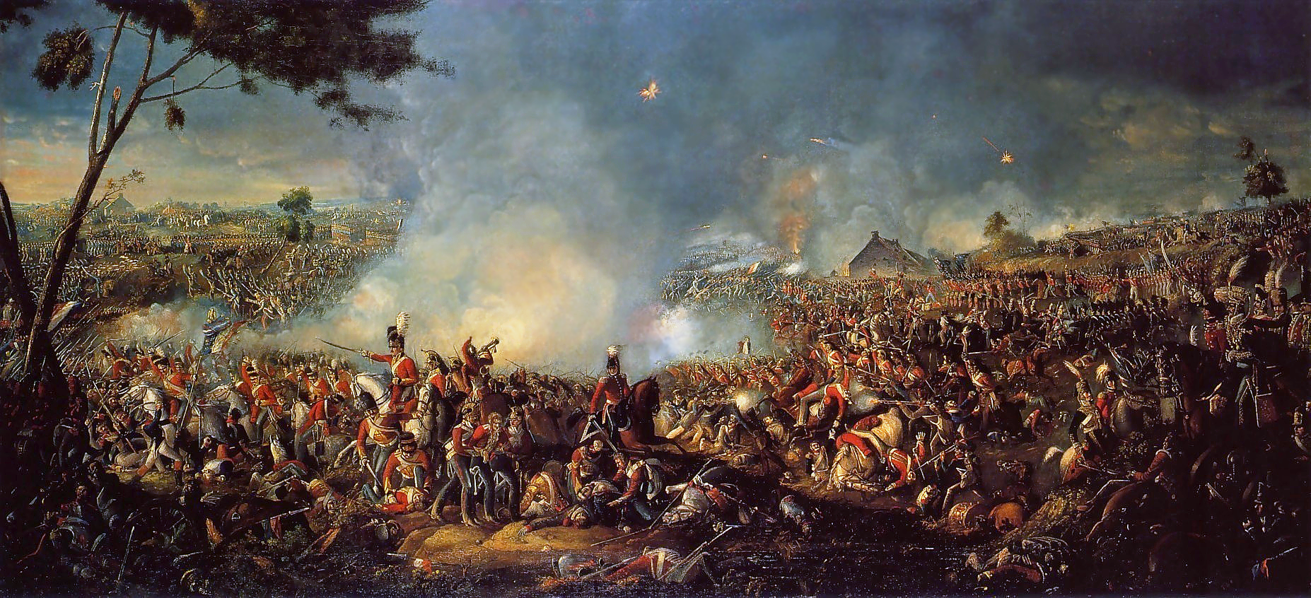
Napoleon’s Last Stand
Seeking to finish him off for good, the British and Prussians meet Napoleon at Waterloo, Belgium.
Napoleon and his inexperienced army is defeated.
He is exiled for good to St. Helena, an island in the South Atlantic

Slide 19
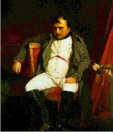
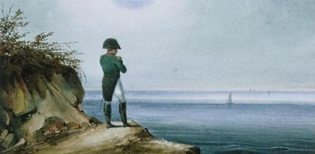
Napoleon’s Death
After 6 years on St. Helena, Napoleon dies of Stomach cancer in 1821.
Much controversy surrounds his death
It is thought by many that the British may have poisoned him

Slide 20
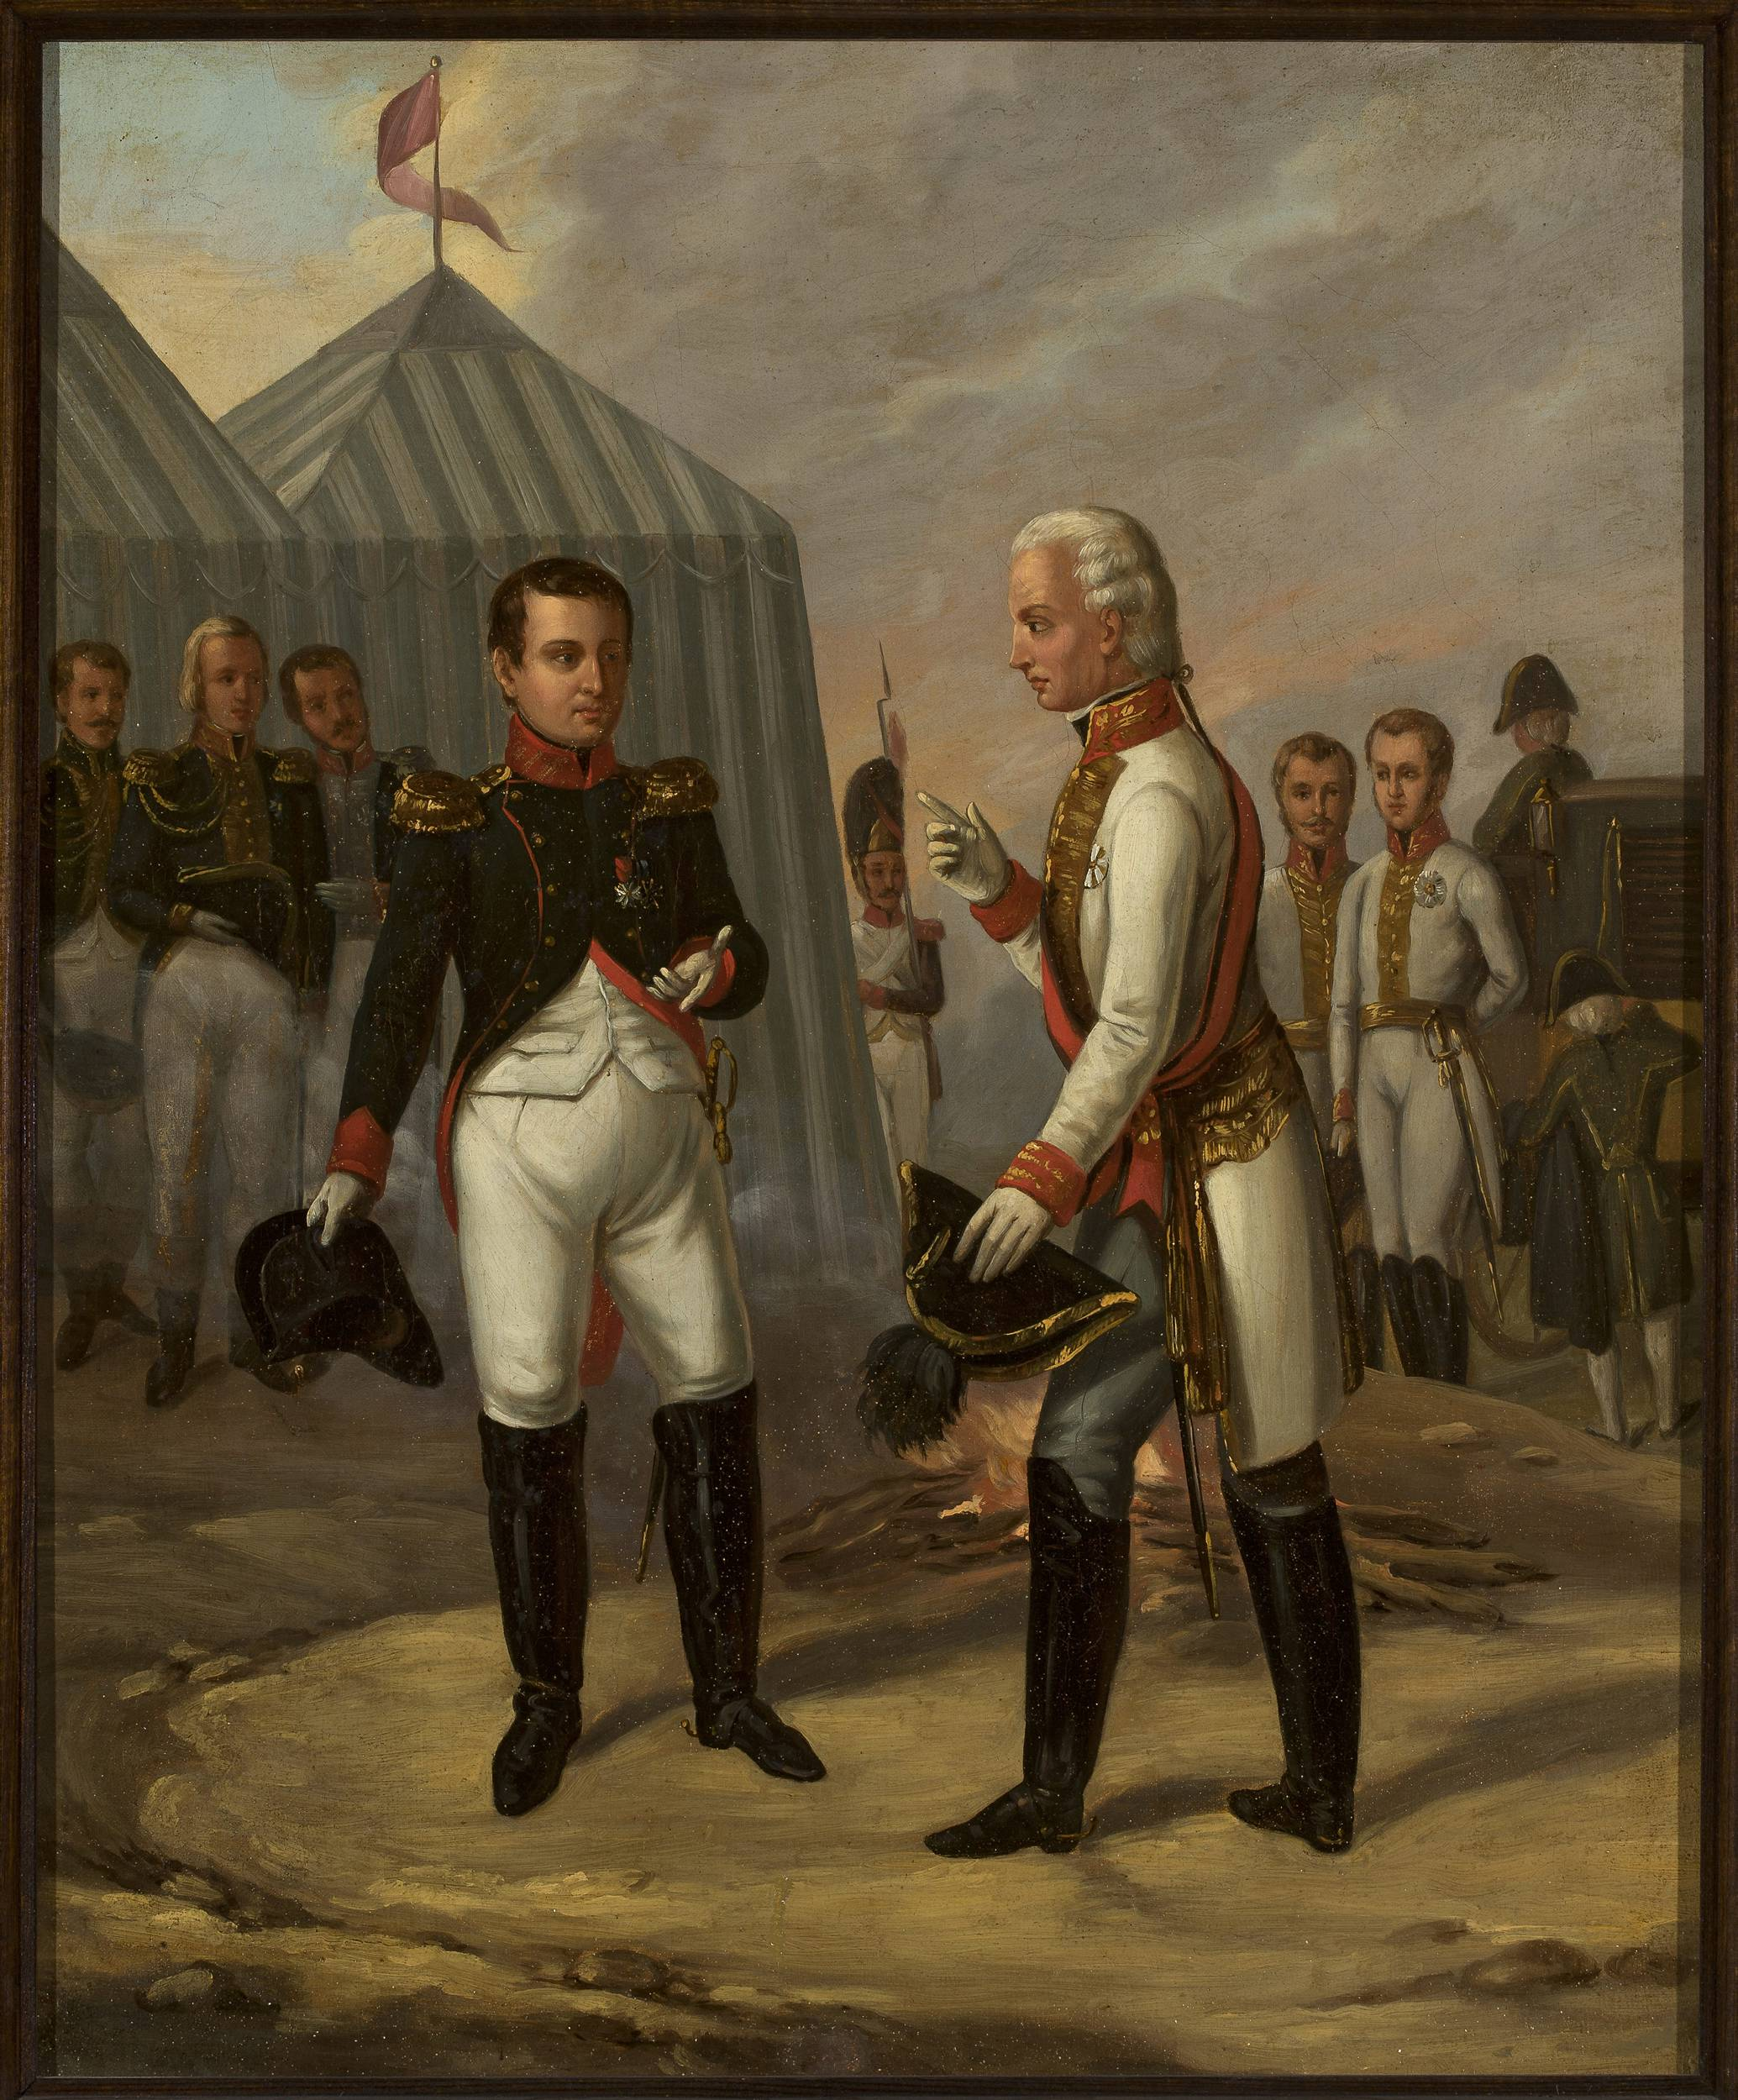
Napoleon’s Legacy
Know as one of the greatest military leaders of all time
Nationalism throughout Europe rose during and after his reign.
The Congress of Vienna (1815)is called to figure out how to create peace between nations.
After his defeat, Europe experiences relative peace between nations for 100 years until WWI.

